Slide 1
Data Communications
Lecture 49

Slide 2
An FHSS system employs a total bandwidth of Ws = 400 MHz and an individual channel bandwidth of 100 Hz. What is the minimum number of PN bits required for each frequency hop?

Slide 3
An FHSS system employs a total bandwidth of Ws = 400 MHz and an individual channel bandwidth of 100 Hz. What is the minimum number of PN bits required for each frequency hop?
Ws = 2^{k}Wd.
Wd= total MFSK bandwidth = channel BW (each channel of Wd width)
Wd = Mfd
The total number of individual channels is: Ws/Wd = (400 MHz)/(100 Hz) = 4 × 10⁶.
The minimum number of PN bits = log2 (4 × 10⁶) = 22

Slide 4
An FHSS system using MFSK with M = 4 employs 1000 different frequencies, frequencies. What is the processing gain?
Ws = 1000 fd;
Wd = 4 fd

Slide 5
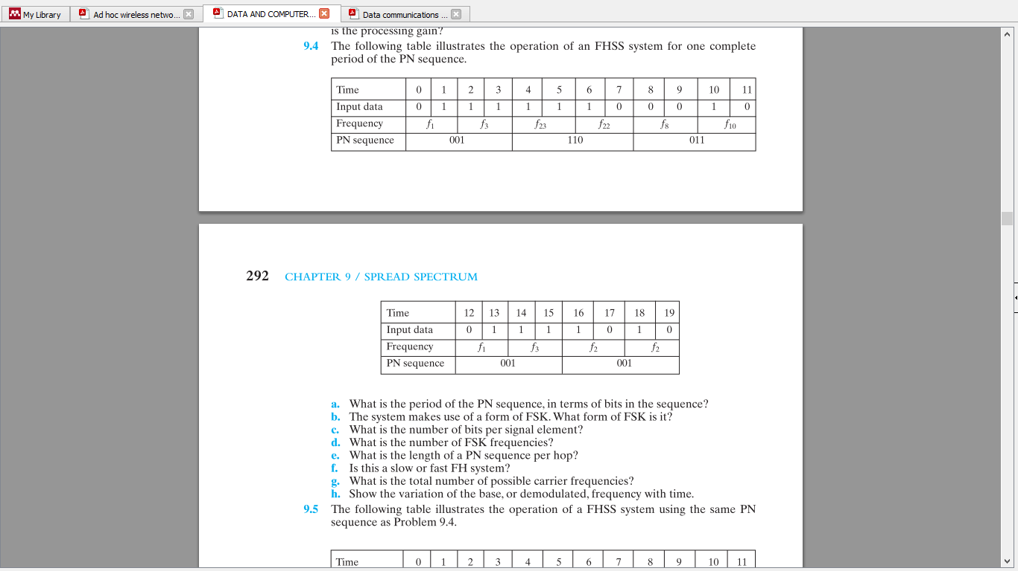

Slide 7
a. Period of the PN sequence is 15
b.MFSK
c. L = 2
d.M = 2^{L} = 4
e. k = 3
f. slow FHSS
g.2^{k} = 8

Slide 8
