Slide 1


Time-compressed speech & the Tempo model Oded Ghitza Boston University
Funded by a research grant
from

Slide 2
time-compressed speech with insertion of silent gaps
introduction
Listening to time-compressed speech provides useful insight into how the brain decodes spoken language. There is a body of work on the effects of time-compression of speech on intelligibility showing, for example, high word error rates (greater than 50%) under a compression factor of 3. We measured word error-rate of time-compressed speech with insertions of silent gaps (Ghitza and Greenberg, 2009) . The experimental corpus comprised semantically unpredictable sentences (e.g., “Where does the cost feel the low night?” and “The vast trade dealt the task”), to eliminate the role of semantic context.

Slide 3
time-compressed speech with insertion of silent gaps
definitions – physical domain
The speech synthesis paradigm is depicted in the next slide. The speech signal was time-compressed and blindly segmented into speech intervals of equal length. Then, silent gaps were inserted, resulting in a waveform as caricatured in the slide. We held the speech interval duration constant (40 ms) while using the gap duration as a parameter. By doing so we dissociated the factors of packaging rate and information per packet.
Because no portion of the acoustic signal was discarded (only time-compressed), and because the speech intervals remained fixed throughout the experiment, the amount of speech information per packet was kept constant. The sole varying parameter was the packaging rate, controlled by the length of the inserted gap.

Slide 4
time-compressed speech with insertion of silent gaps
definitions – physical domain
Information per packet
t
Packaging Rate

Slide 5
time-compressed speech with insertion of silent gaps
definitions – Articulated Speech Information (ASI)
Question: what is the amount of speech information carried by a fragment of a time-compressed speech? For example, what is the amount of speech information within a 40-ms long interval of speech time-compressed by a factor of 4?
we propose to measure this quantity in terms of the speech information that was intended to be conveyed by the speaker when uttered (i.e., before compression).
⇒ we define the Articulated Speech Information (ASI) within a given time-window as the duration, in milliseconds, of the uncompressed speech inside that window. In our example, the ASI in a 40-ms long fragment of speech time-compressed by 4 is 4×40=160 ms, and it comprises about 3 typical 50-ms long uncompressed dyads.
it is worth emphasizing that there is a distinction between the amount of information articulated by the speaker (i.e. intended to be conveyed) and the amount of information perceived by the listener. During the decoding process some of the articulated information may be lost; the amount of the loss depends on the time compression ratio and is measured with respect to the ASI.
the ASI measure will allow a comparative assessment of Tempo’s capability to decode speech material spoken in different speeds.

Slide 6
time-compressed speech with insertion of silent gaps
definitions – perceptual domain
The information per packet available to the listener is defined by the quality of the acoustics, hence termed sensory glimpse (next slide).
The packaging rate (controlled by the length of the inserted gap) determines the duration of decoding time (and memory access) – a cortical factor – hence termed cortical glimpse.

Slide 7
time-compressed speech with insertion of silent gaps
definitions – perceptual domain
Sensory Glimpse
t
Cortical Glimpse

Slide 8
time-compressed speech with insertion of silent gaps
stimuli
The baseline waveform for the insertion of gaps was the time-compressed signal (factor of 3).
The waveforms were blindly segmented into consecutive 40-ms long intervals. This segmentation remained fixed throughout.
The silent gaps were then inserted; the main parameter was the duration of the silent gaps.
The resulting waveforms exhibited a packaging rate, with a rate defined by the length of the silent gaps
ranging from 15 to 5 packets/sec (0-ms to 160-ms of gap duration, respectively).
(Recall that the packaging rate is directly tied to decoding time – a cortical factor – via the duration of the inserted gap.)

Slide 9
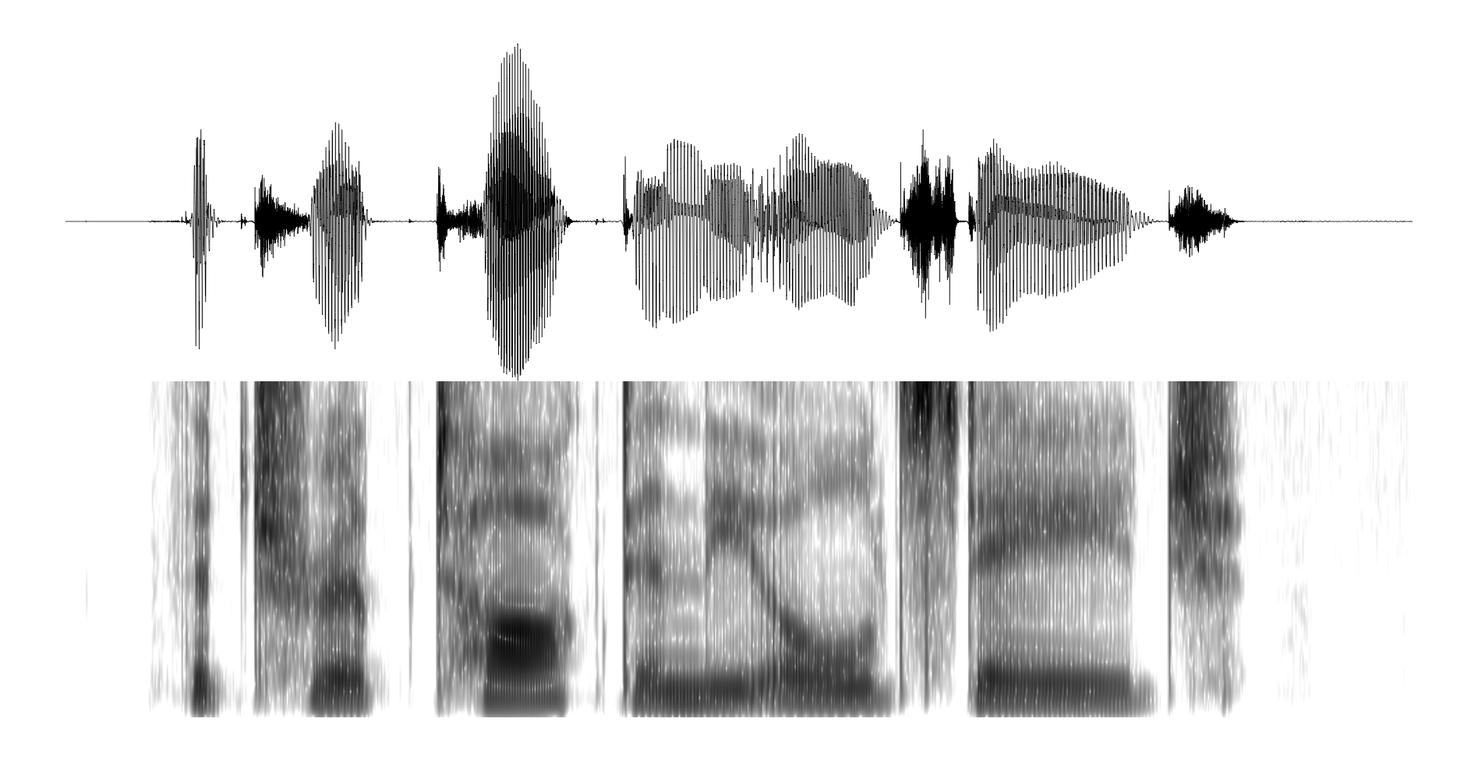

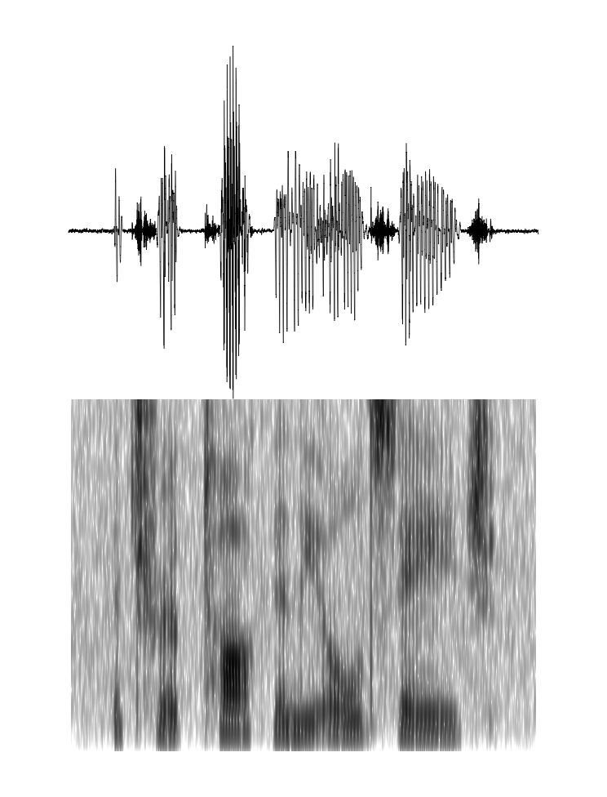
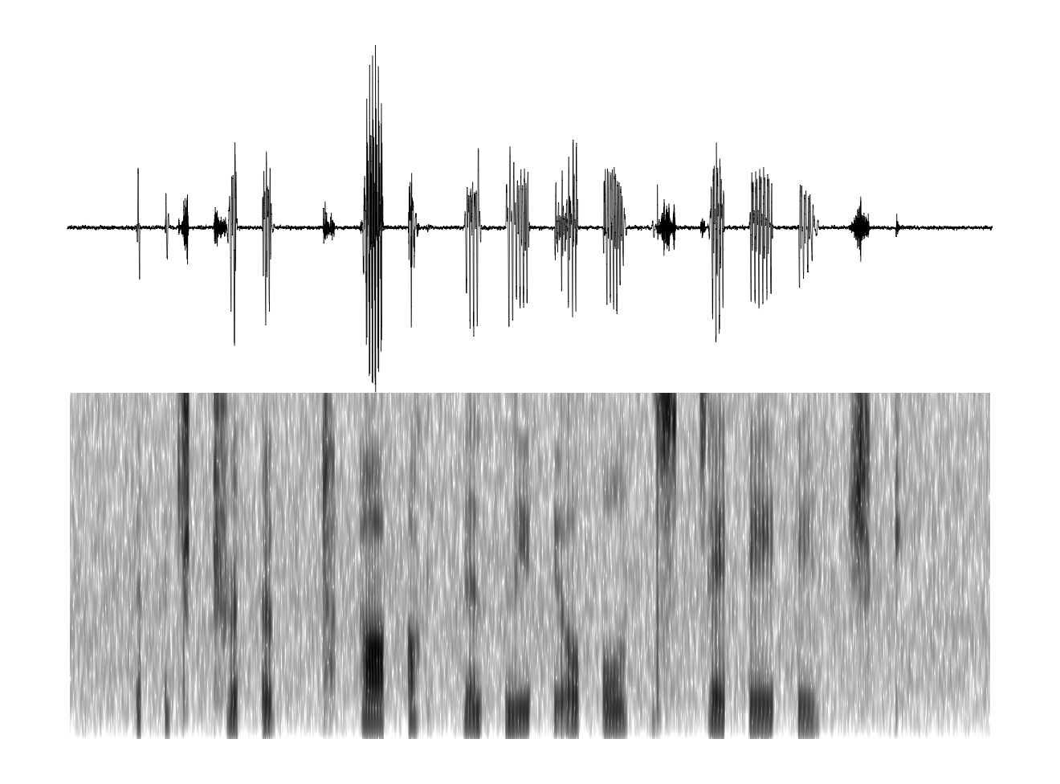
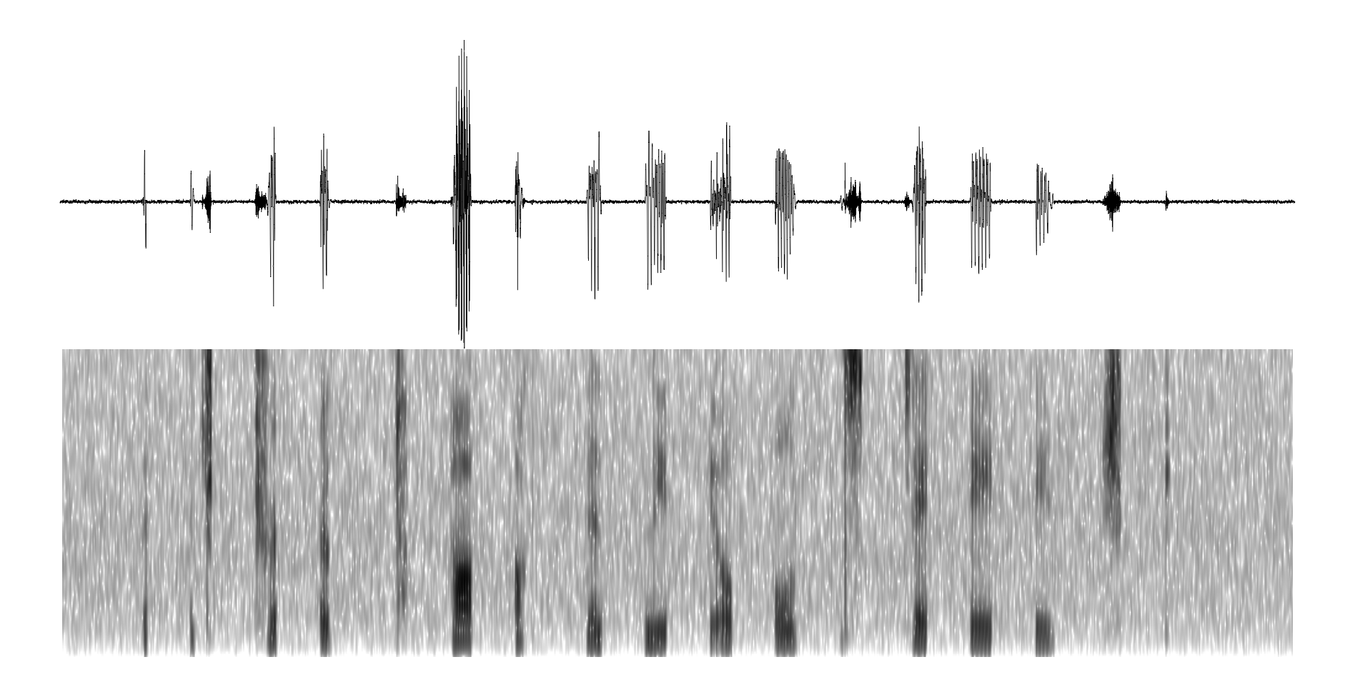
time-compressed speech with insertion of silent gaps
stimuli
Pressure
Waveform
original
(5 syllable/sec)
Spectrogram
time compressed by 3
(15 syllable/sec)
speech packet = 40 ms
silent gaps = 40 ms
(12.5 packets/sec)
speech packet = 40 ms
silent gaps = 80 ms
(8.3 packets/sec)

Slide 10
time-compressed speech with insertion of silent gaps
psychophysics
The next slide shows word error rate as a function of the gap duration or, equivalently, the packaging rate. Without insertions performance is poor (> 50% word error rate). Surprisingly, inserting gaps improve performance, resulting in a U-shaped performance curve; intelligibility was restored considerably as long as the gaps were between 20 and 120 ms. The lowest word error rate (i.e., highest intelligibility) occured when the gap was 80-ms long (or, equivalently, at the rate of 8.3 packets/sec), down to ≈ 20%.

Slide 11
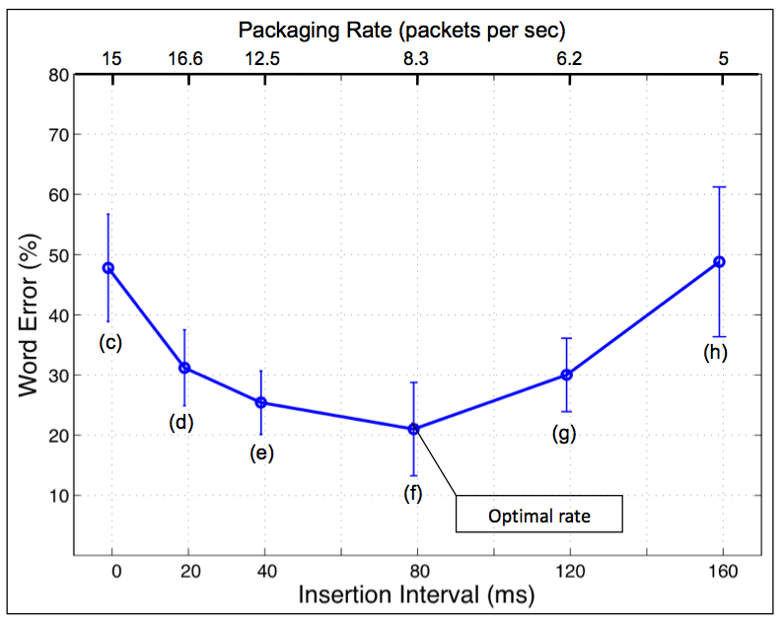
time-compressed speech with insertion of silent gaps
psychophysics

Slide 12
time-compressed speech with insertion of silent gaps
psychophysics
Because the sensory glimpse was kept constant, any change in intelligibility could therefore be attributed to cortical glimpsing (read: decoding time) per se rather than to the sensory glimpse. This observed variation in intelligibility is hard to explain in terms of the standard models of speech perception. It is not just the information in the acoustic signal that is important, but also the length of the silent gap (which provides “needed” decoding time). This is a factor that the standard models do not address.

Slide 13
cascaded oscillators locked to the input rhythm
computational model – Tempo
In our view, decoding time is governed by cortical oscillations. We hypothesize that neural processes, which underline the decoding of speech (up through the syllable level) have oscillations at their core, operating in the theta, beta and gamma range. Such neural circuitry “prefers” incoming sensory information in the form of temporally constrained packets, with a sufficient time for decoding, compatible for pattern matching.
This hypothesis is formulated in terms of a computational model called Tempo.

Slide 14
cascaded oscillators locked to the input rhythm
computational model – Tempo
dyads (≈50ms)
syllables (≈200ms)
Template Matching
Template Matching
Peripheral
Auditory
Model
Time-frequency
Match
(TFM)
dyad
neurons
(coincidence
across
frequency)
Temporal
Sequence
Match
(TSM)
syllable
neurons
(coincidence
across
time)
s(t)
Decoding
Parsing
Cascaded Oscillators
gamma
beta
theta
LPF
×
Acoustic-Edge
Detector
Phase-locked Loop

Slide 15
cascaded oscillators locked to the input rhythm
Tempo – parsing
Tempo comprises lower and upper paths, which process a sensory stream generated by a model of the auditory periphery. The lower path extracts parsing information, which controls the decoding process performed in the upper path. The parsing is expressed in the form of an internal clock-like mechanism, realized as an array of cascaded oscillators locked to the input syllabic rhythm; the frequencies and relative phases of the oscillations determine the processing time-frames required for the decoding process.
the theta oscillator is the master in the cascaded array, providing syllabic parsing . The theta oscillator is viewed as the VCO (voltage controlled oscillator) in a phase-lock loop (PLL) system locked to the input. In accord with neurophysiological data, the frequency of the theta oscillator is restricted to a frequency range between 4 and 10 Hz.
The theta oscillator sets the core frequency of a beta oscillator, to be a multiple of the theta frequency. Here, the multiple was set to 4, hence the frequency of the beta oscillator range between 16 and 40 Hz. The beta oscillator provides finer parsing, on dyad-long information within the syllable (i.e., about 50 ms long). The phase of the beta oscillator is adjusted to best align the beta cycles with the acoustic edges of the dyads within the theta cycle.
A third oscillator is in the gamma range, with a core frequency set to be a multiple (set to 4 here) of the beta frequency. The span of a gamma cycle commensurate with the rapid spectro-temporal transitions associated with dyad elements.

Slide 16
cascaded oscillators locked to the input rhythm
Tempo – decoding
The first component in the decoding path, a time-frequency match component (TFM), maps beta-cycle long dyads to memory neurons, termed dyad neurons, by computing coincidence in firing across auditory (i.e., tonotopic) frequency channels. At this level, time-frequency patterns are matched over relatively short time intervals (about 50 ms) and are often formant transitions associated with such phonetic features as place of articulation, which is important for distinguishing consonants (and hence words). This operation is performed within a beta cycle, and mapping onto a dyad neuron occurs at the end of each beta cycle. One possible realization of the TFM component is an extension of a model suggested by Shamir et al. (2009), described below. It is a model for the representation of time-varying stimuli (e.g. dyads) by a network exhibiting oscillations on a faster time scale (e.g. gamma). An important property of the extended model is the insensitivity to time-scale variations.
The second pattern-matching component, a temporal sequence match (TSM), maps syllabic primitives onto memory neurons, termed syllable neurons, by measuring incidence in firing activity of a sequence of dyad neurons within a theta cycle (about 200 ms). Mapping onto a syllable neuron occurs at the end of each theta cycle.

Slide 17
cochlear envelopes
The next slide shows cochlear envelopes, low-pass filtered to 50 Hz, at four characteristic frequencies. The envelopes are represented in terms of a simulated Inner Hair Cell response. The input is the sentence “The ripe style heard their spades,” naturally spoken by a male speaker. The rate of the envelope fluctuations is about 5 energy-bumps per second. Low-frequency cochlear channels mainly reflect the presence of vowels; high frequency channels mainly reflect the presence of fricatives and stop-consonants.
In Tempo, the theta oscillator is viewed as the VCO (voltage controlled oscillator) in a phase-lock loop (PLL) system locked to the input. The rhythm of naturally spoken speech slowly changes with time, and the sensory representation of this change is manifested in the cochlear envelope spectra. In Tempo, the PLL locks to some integrated form of these signals.

Slide 18
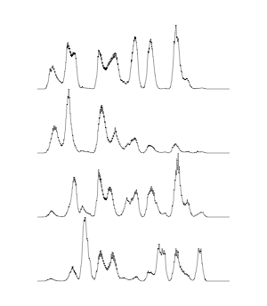
cochlear envelopes
CF=500 Hz
CF=1000 Hz
CF=2000 Hz
CF=3200 Hz
200 ms

Slide 19
cascaded oscillators locked to the input rhythm
TFM module
The next slide shows a model for representing time-varying stimuli by a network exhibiting oscillations on a faster time scale (Shamir et al., 2009). The time varying stimuli considered was a temporally smoothed envelope of a cochlear-channel response to speech dyad (i.e., a consonant-vowel or a vowel-consonant segment, lasting 30–50 ms), and the network oscillations – cortical oscillations in the gamma band.
a cartoon illustration of the model. The abscissa represents time and the ordinate represents neurons ID, each horizontal trace represents cartoon firings of one neuron. The population firings are represented as a vertical thick line. See text for details.
illustration of the coding neurons spiking patterns for five sawtooth-shaped signals with different asymmetries. The coding window coincides with the sawtooth period, and the phase of the gamma oscillations is synchronized with the coding window. The amplitude of the sawtooth at the instant of a gamma firing-burst determines the number of coding neurons spiking at that time (the length of the blue thick line). In Tempo an extended version of Shamir et al. is exploited, where the coding window is the beta cycle; the onset pulse is the acoustic edge, therefore the signal to be coded is a cochlear-channel response to a dyad segment of beta-cycle duration. The extended model is insensitive to time-scale variations: as long as the coding window, and the phase of the gamma oscillations within the window, are synchronized with the time-compressed sawtooth the population code remains unchanged.

Slide 20
cascaded oscillators locked to the input rhythm
TFM module
Neuron ID
Inhibitory
Excitatory
Amplitude
time
Coding
(dyad length)
Onset
Background
(a)
Time, ms
Input
Code
(b)
code window
(beta cycle)

Slide 21
cascaded oscillators locked to the input rhythm
illustration – I
The next slide shows spectrograms of one theta-cycle long time-window of the stimuli used by of Ghitza and Greenberg (2009), in black, and a cartoon illustration of the corresponding oscillations: red, blue and magenta traces represent the theta, beta and gamma oscillations, respectively. Time is plotted along the x-axis of the spectrograms (in milliseconds), frequency is plotted along the y-axis (0–5 kHz, linear scale), and stimulus intensity is denoted by color (light- and dark gray indicate low- and high amplitude, respectively, in dB).
(a) a spectrogram of a 240-ms long segment of uncompressed speech and the corresponding oscillations. Since the input syllabic rate (assumed to be 5 syllables/sec) is within the theta frequency range, theta=5 Hz, beta=20 Hz, and gamma=80 Hz.
(b) the spectrogram of (a) time-compressed by a factor of 2 (hence lasting 120 ms). The syllabic rate is 10 syllables/sec, and since the theta oscillator is still within boundaries the oscillatory array stays locked to the input rhythm (with theta=10 Hz, beta=40 Hz and gamma=160 Hz). No TFM errors compared to (a) because the TFM coding window – i.e. the beta cycle – and the compressed stimulus are locked.
(c’) the spectrogram of (a) time-compressed by a factor of 3 (lasting 80 ms); the syllabic rate is 15 syllables/sec. Shown are oscillations of a hypothetical system, in which the frequency range of the oscillators in the array is unconstrained, hence theta=15 Hz, beta=60 Hz and gamma=240 Hz. No TFM errors compared to (a) because of the same rational as in (b).

Slide 22
cascaded oscillators locked to the input rhythm
illustration – II
(c) same as (c’) but with a constrained oscillatory array. The syllabic rate of the acoustics is 15 syllables/sec – outside the theta range. The theta oscillator is “stuck” at its upper frequency limit (10 Hz). Compared to conditions (a) and (b) a mismatch occurs.
(d) speech compressed by a factor of 3, with insertions of 20-ms long silent gaps; packaging rate (16.6 packets/sec) is outside the theta range, hence the theta frequency is 10 Hz.
(e) with insertions of 40-ms long gaps; packaging rate (12.5 packets/sec) is outside the theta range, hence the theta frequency is 10 Hz.
(f) with insertions of 80-ms long gaps – optimal rate; packaging rate is 8.3 packets/sec – inside the theta range; theta frequency at 8.3 Hz.
(g) with insertions of 120-ms long gaps; packaging rate is 6.2 packets/sec, inside the theta range and the theta frequency is 6.2 Hz.
(h) with insertions of 160-ms long gaps; packaging rate is 5 packets/sec, inside the theta range and the theta frequency is 5 Hz.

Slide 23
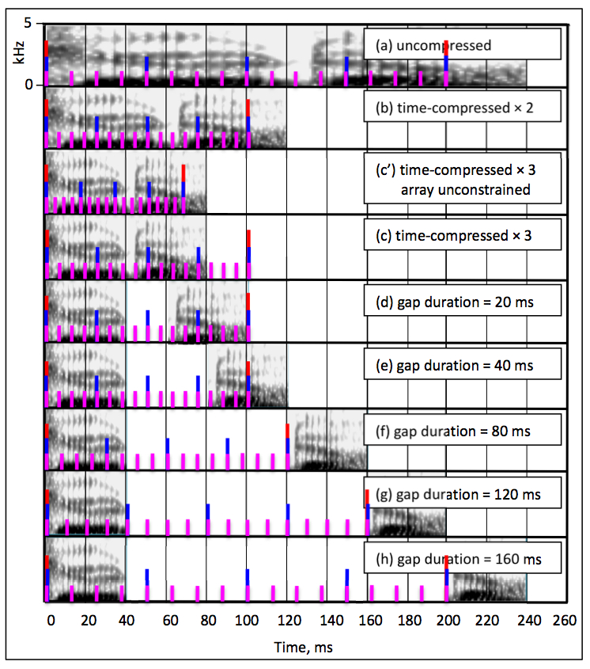
cascaded oscillators locked to the input rhythm
illustration

Slide 24
cascaded oscillators locked to the input rhythm
TSM errors – I
TSM errors reflect the number of dyads unaccounted for due to the limited decoding capacity of the receiver. The dyad loss stems from a mismatch between the number of dyads to be decoded (i.e., the number of dyads intended to be conveyed by the speaker when uttered) and the number of dyad-neuron activations permitted by the receiver.
The time unit over which errors are calculated is the theta cycle:
the number of dyads to be decoded is the number of uncompressed dyads composing the ASI within the theta cycle
the number of dyad-neuron activations is determined by the temporal attributes of the time-compressed stimulus.
In Tempo there are 4 beta cycles per one theta cycle, and a dyad neuron is triggered at the end of a non-zero beta cycle.
⇒ the maximum number of neurons available to decode one theta-cycle long acoustic segment is 4; we term these neurons activated dyad neurons.
For continuous signals the number of activated neurons is 4, and for a signal with silent gaps this number may be less than 4 (because a dyad neuron is triggered only for non-zero input).

Slide 25
cascaded oscillators locked to the input rhythm
TSM errors – II
TSM errors indicate how the temporal aspects of speech – in separation from the spectral aspects – affect intelligibility. This is so because the location and duration of the theta cycle – the time window over which TSM errors are calculated – are determined by the parsing process that takes the temporal aspects of the stimulus as input.
In calculating the number of TSM errors we assume that the dyads are recognized correctly (error in recognition is considered a TFM error). Thus, TSM error count (associated with temporal attributes of speech) is separated from the TFM error count (associated with the spectral attributes).

Slide 26
cascaded oscillators locked to the input rhythm
TSM errors – III
The next slide shows the average number of TSM errors for stimuli representing each of Ghitza and Greenberg’s signal conditions. The Table comprises nine columns, (a) to (h), in correspondence with the rows of the slide shown 2 slides ago.
For calculating the number of errors we consider a generic uncompressed speech waveform 2400-ms long, with a fixed syllabic rate of 5 syllables/sec; assuming that the duration of a typical dyad is 50 ms, the uncompressed stimulus comprises 48 dyads. It is further assumed that the theta oscillator tracks the input without error.
The TSM errors are represented in terms of the total number of dyads, out of 48, that are lost during the decoding process (row ‘total number of dyads lost’). This number, denoted N_{E} (E for Error), is calculated as follows. Let N_{T} (T for Theta) be the number of theta cycles inside the stimulus, N_{U} (U for Uttered) be the number of typical dyads composing the ASI of one theta cycle (see the rows shaded in light blue), and N_{A} (A for Activated) the number of activated dyad neurons per theta cycle (equals the number of beta cycles covering the non-zero portion within the theta cycle – see the rows shaded in light yellow, where ⎡x⎤ is the value of x, rounded up to the nearest integer). Then, N_{E}=N_{T}×(N_{U}-N_{A}).
Note that N_{A} is an integer number, obtained by rounding up to the nearest integer the number of beta cycles covering the non-zero portion of a theta cycle: a “residual” speech fragment, which only spans a portion of a beta cycle, is regarded as one dyad.

Slide 27
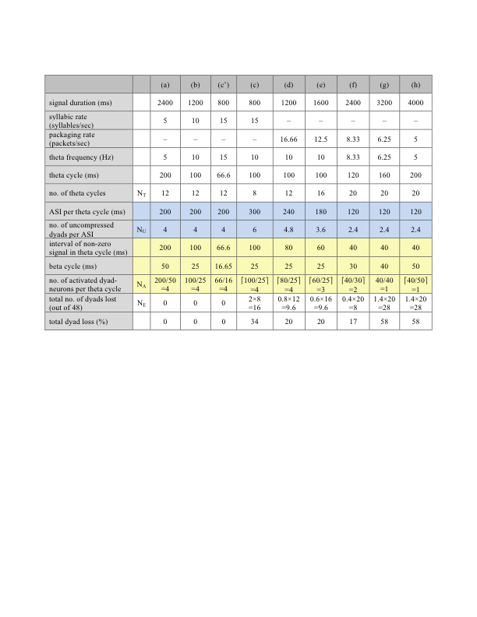
cascaded oscillators locked to the input rhythm
TSM errors

