Slide 1
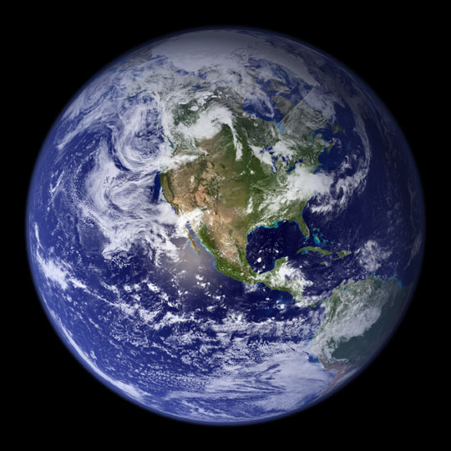
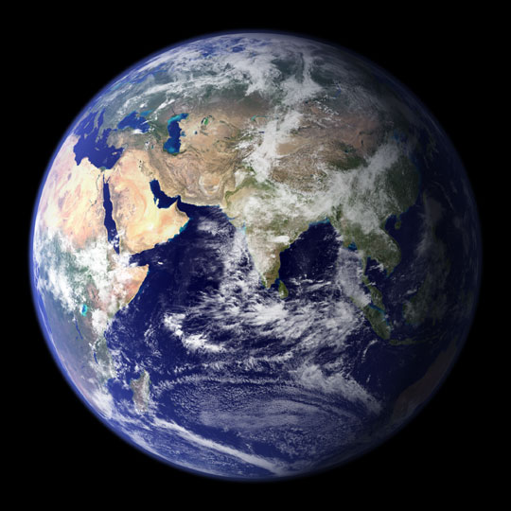

Oh! The beautiful blue!

Slide 2
WHAT A GREAT SPECTACLE
from an orbiting satellite!
Those pictures were taken on a cloudless day.

Slide 3
NIGHT IS FALLING ON EARTH.
Look at Paris and Barcelona, the lights are already lit, meanwhile in London, Lisbon and Madrid the sun is still visible.
Looking south, we can see the islands in the middle of the ocean.
We have a perfect view of the British Islands, Iceland and Canada.

Slide 4
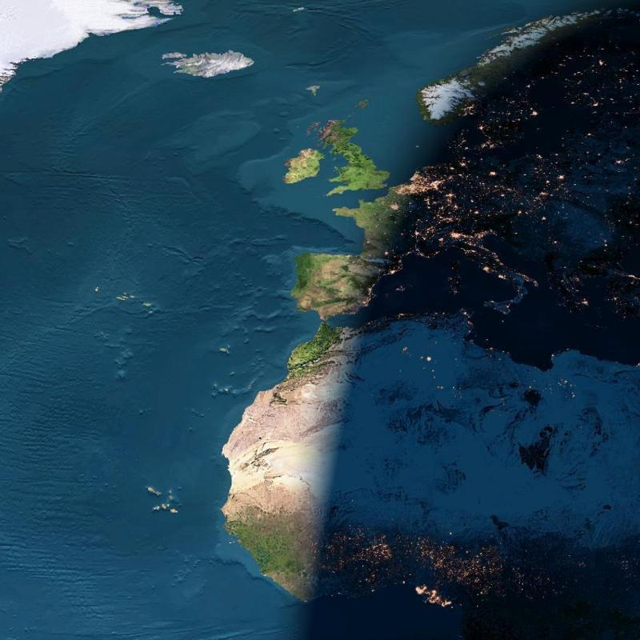
Iceland
England
Atlantic
Ocean
France
Spain
Italy
AFRICA

Slide 5
The next photo, taken by a satellite shows nightime falling on Brazil.
The second is the same with some enhancements of colors to better show the lights.
The next two pictures are showing North America.

Slide 6
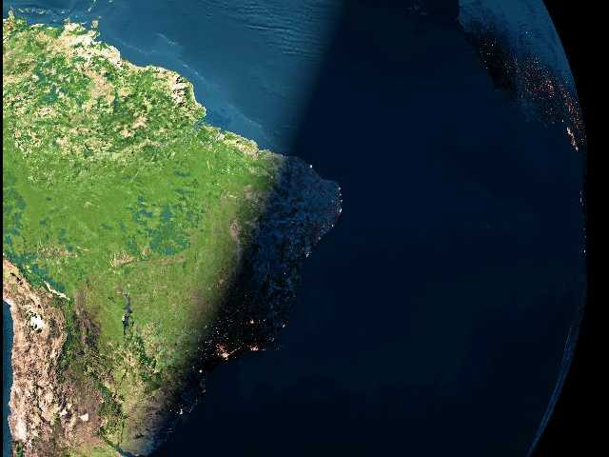
Atlantic
Ocean
Belo Horizonte
Salvador
Rio de Janeiro
Grand São Paulo

Slide 7
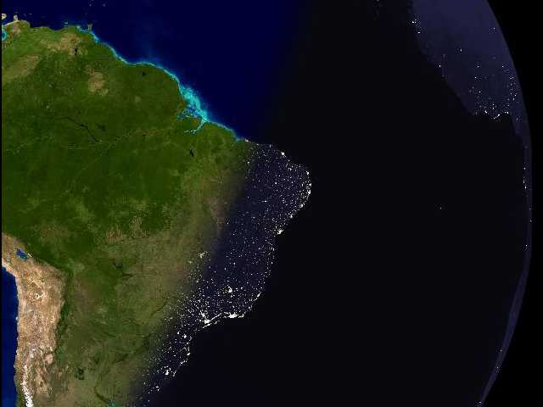
Fortaleza
Brasília
Recife
Goiânia
Salvador
Uberlândia
Belo Horizonte
Rio de Janeiro
Grande São Paulo
Florianópolis

Slide 8
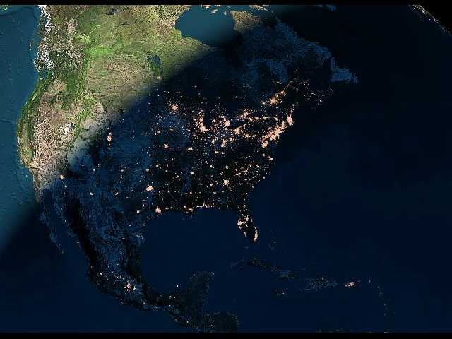
This pictures shows american cities at night.

Slide 9
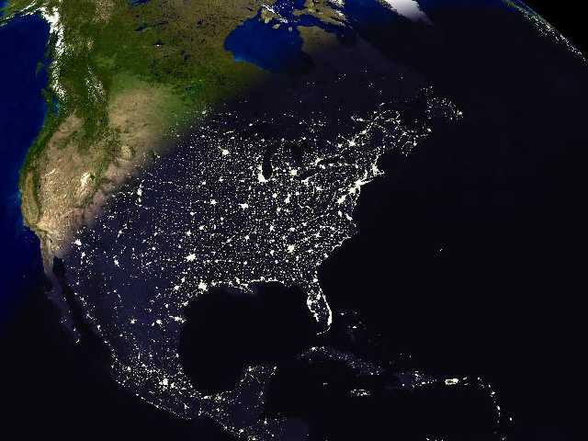
Saguenay
Sept-Iles
Thunder Bay
Toronto
St.John
Ottawa
It’s still daylight in California
Québec
Montréal
Those light are Boston, New York, Philadelphia and Washington.
Detroit
Dallas
Puerto Rico
Houston
Miami
Mexico City
Havana
Port-au-Prince

Slide 10
South of the Ibéric Peninsula,
a sandstorm leaves North Africa.
The Canaries Islands.

Slide 11
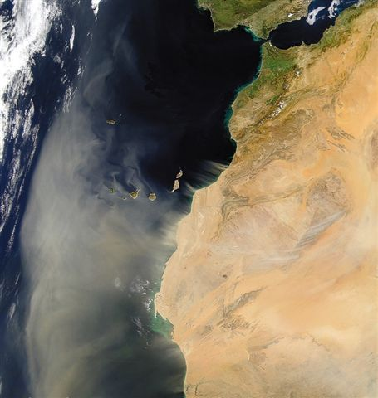
The Canaries
Maroc

Slide 12
Strait of Gibraltar

Slide 13
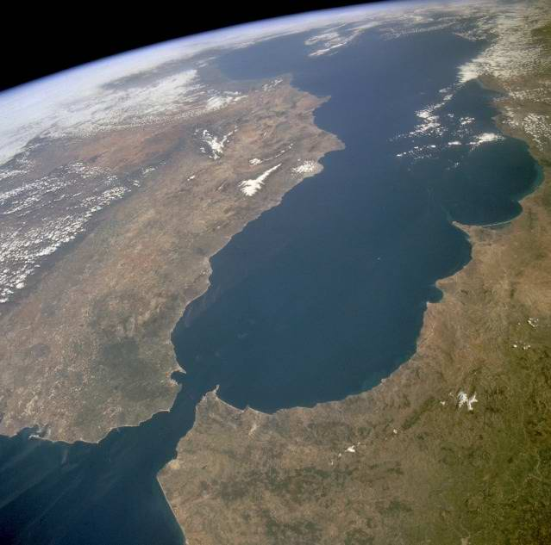
Mediterranean
Sea
Malaga
Spain
Gibraltar
Maroc
Tanger

Slide 14
The Swiss Alps
and
Lake Leman

Slide 15
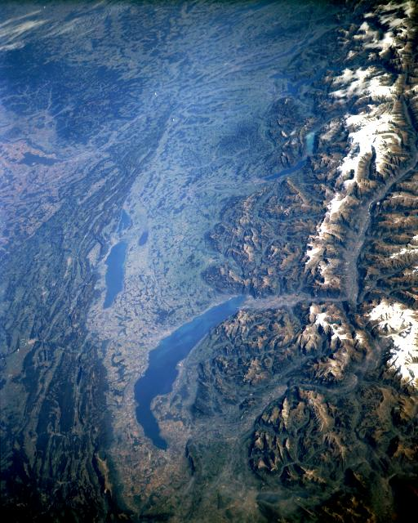
Lake of
Neuchâtel
Lake Leman

Slide 16
Iceland

Slide 17
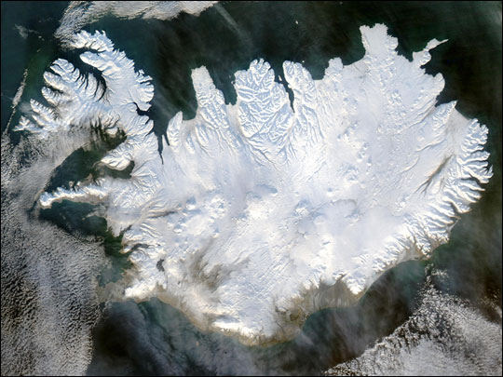
Reykjavik

Slide 18
The Black Sea

Slide 19
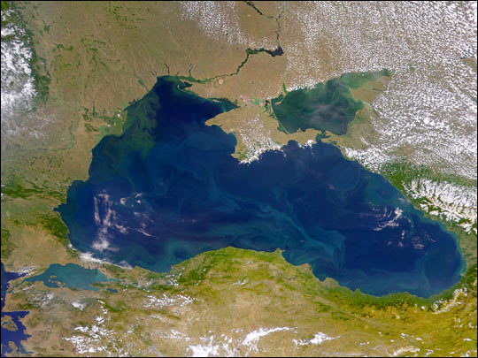
Russia
Azov Sea
Roumania
Black Sea
Bulgaria
Istanbul
Turkey

Slide 20
The Red Sea

Slide 21
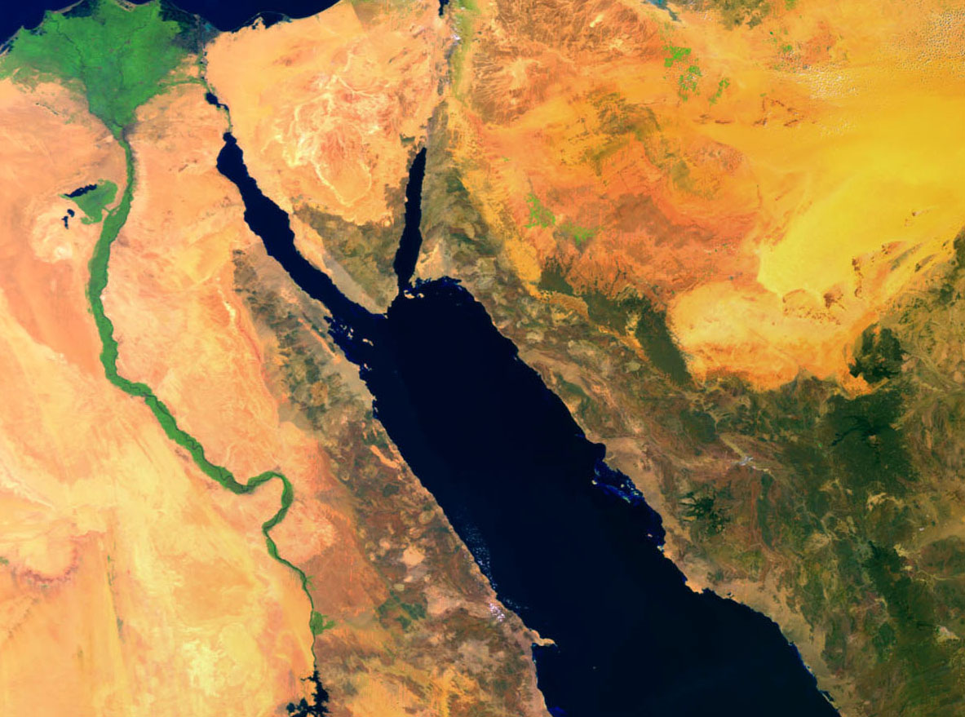
The Nil
Saudi
Arabia
Egypt
Red Rouge

Slide 22
Wonderful, isn’t it??
In order for your kids and grand kids to enjoy this spectacle as well…
Please, pass this message on so everyone can be aware of the treasure we’re all standing on.

