Slide 1

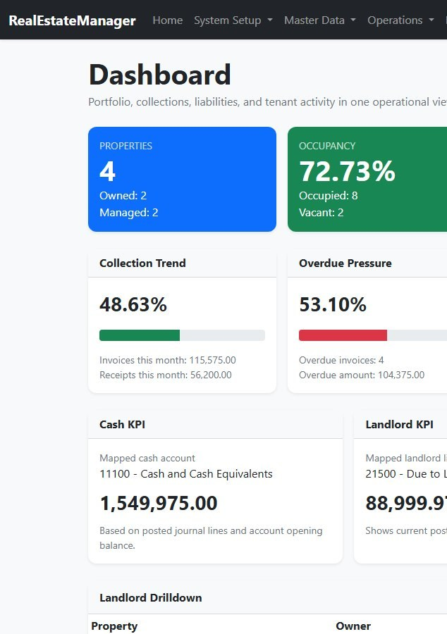
Your property portfolio, leases and accounts — in one system
RealEstateManager
Built for UAE property owners and managers: VAT, e-invoicing and post-dated cheques handled from day one
Prepared for Al Mouj Al Azraq Real Estate
Product presentation · October 2026
Notes:
Welcome and thank them for their time. One sentence on who you are. Promise: in 30 minutes they will see how the whole property cycle - from signing a lease to closing the month - runs in one system, with the accounting done automatically.

Slide 2




Running a portfolio on spreadsheets costs time and control
Scattered records
Cheques tracked by hand
Accounting done twice
Late, uncertain month-end
Leases, tenants and rent schedules live in separate spreadsheets that no one fully trusts.
Dozens of post-dated cheques per building, followed in a register that never matches the bank.
Operations staff record it once; the accountant re-keys it into a separate ledger.
Missed depreciation, unrecognised rent and VAT surprises found only after the figures go out.
Notes:
Ask them which of these four they recognise. Let them talk - their answer tells you which modules to emphasise later. Most UAE landlords name the cheques and the month-end.

Slide 3



One system where every action is also the accounting
Sign a lease, receive a cheque, pay a supplier — RealEstateManager writes the balanced double-entry journal for you.
Your team works in property terms. Your accountant gets a complete, audit-ready ledger.
Operations and finance together
Portfolio, leasing, collections, payables, assets and reporting share one database.
Made for the UAE
VAT and tax invoices, PINT AE e-invoicing, post-dated cheques, owned and managed property.
100%
3
1
Control built in
Permissions, four-eyes approvals, locked closed months and a full audit trail.
of postings created automatically and always balanced
VAT treatments chosen per unit: standard, zero-rated, exempt
screen to close the month, with a traffic light per task
Notes:
This is the one idea to leave them with: operations and accounting are not two systems. Nobody writes a journal by hand for day-to-day work, and the system refuses any journal that does not balance.

Slide 4







From signed lease to closed month, step by step
Property & units
Lease
Invoices
Cheques & receipts
Revenue
Close & report
Owned or managed, with VAT status
Creates every invoice and the revenue plan
UAE tax invoices, e-invoicing
PDCs tracked until they clear
Recognised month by month
Checklist, lock, statements
Every step posts its own journal automatically. Nothing reaches the reports until it is posted, and nothing can be posted into a closed month.
Notes:
Walk the chain left to right. Stress that the lease is the pivot: once it is approved, the full year of invoices and the monthly revenue plan exist. The rest of the deck follows these steps.

Slide 5
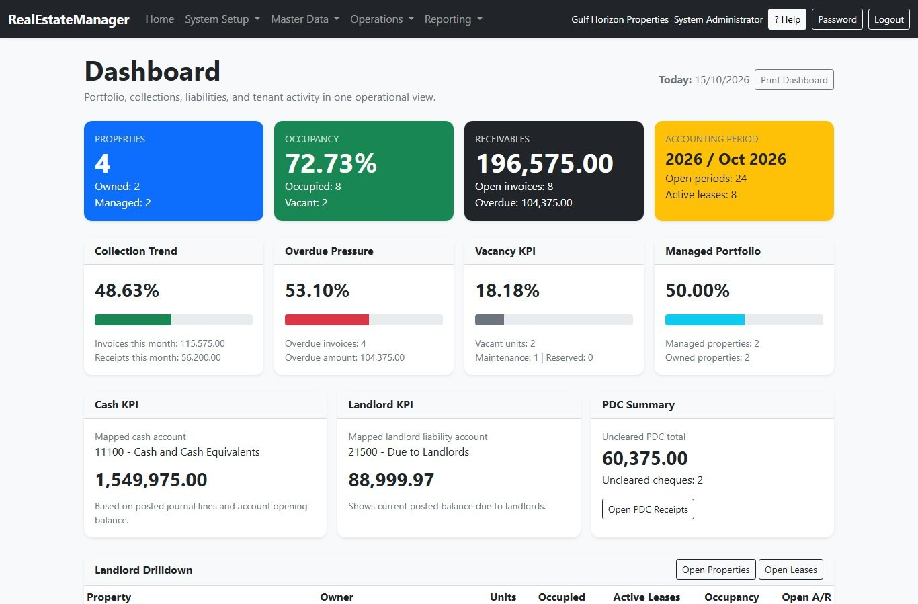



The whole portfolio at a glance
Occupancy and vacancy
Occupied, vacant, under maintenance and reserved units, live.
Collections and overdue
This month's billing against cash in, and what is overdue.
Cheques and cash
Uncleared PDCs, bank balance and what is owed to landlords.
Months not yet closed
Overdue closings and reopen requests waiting.
Notes:
Real screen from the demo company. Point to occupancy, the receivables card and the PDC summary. Mention it can be printed for management meetings.

Slide 6
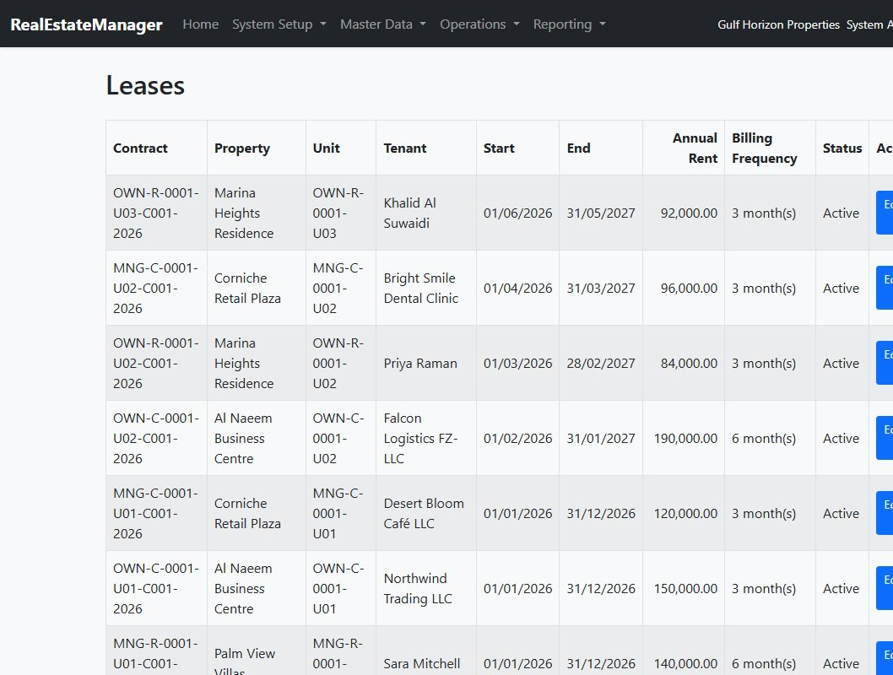



Leasing: one contract creates a year of work
Automatic schedules
Billing monthly to annually: every invoice and the monthly revenue plan are generated on approval.
Two-level approval
A second person approves each contract; nobody approves their own.
Smart contract codes
Codes show building, unit, tenancy and year; print the draft agreement and a QR label.
No double letting
A unit cannot be let twice for overlapping dates.
Notes:
Example from the demo: annual rent 120,000 billed quarterly gives four invoices and twelve monthly revenue entries the moment the contract is approved. Show the draft contract print if they ask about paperwork.

Slide 7
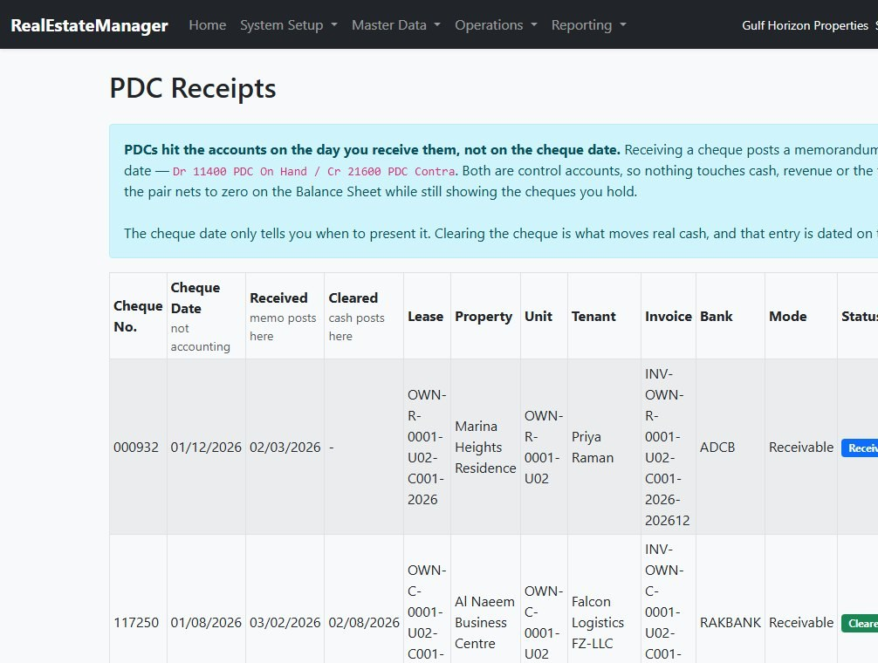



Collections: every cheque followed until it clears
Post-dated cheques
Recorded when received, cleared when the bank honours them; each stage posts itself.
Receipts and part payments
Cash and transfers settle invoices, in full or in part.
Security deposits
Held as a liability, never mistaken for rent.
Tenant statements
Invoices, credits, receipts and the balance, ready to send.
Notes:
This usually lands well with UAE landlords. The register shows every cheque, its date and status; clearing it settles the invoice and moves the money to the bank in one step.

Slide 8
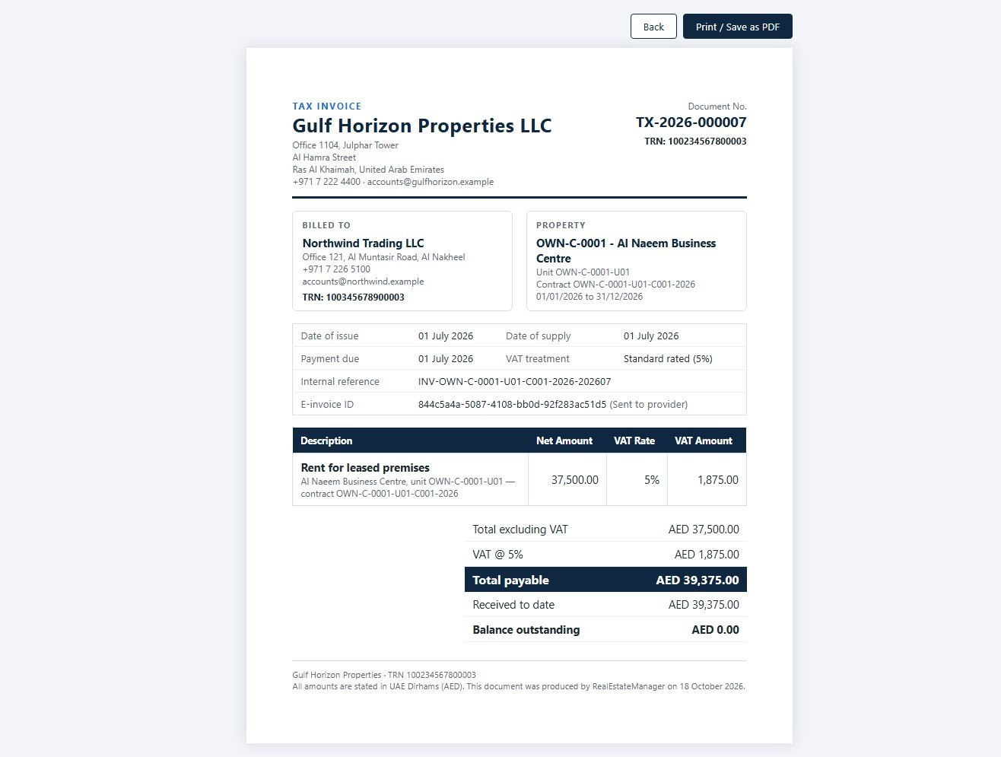



UAE VAT and e-invoicing, handled for you
Right VAT per unit
Commercial 5%, new residential zero-rated, later residential exempt — applied automatically.
Compliant tax invoices
One numbered series, both TRNs, simplified and full invoices, credit notes.
E-invoicing ready
PINT AE invoices queued to your provider; suppliers' e-invoices booked without retyping.
VAT return in one report
Output and input tax, recovery rate and the year-end wash-up.
Notes:
Mention the 2026 e-invoicing mandate if relevant to them. Input VAT on supplier bills is attributed line by line, so a bill covering a commercial and a residential building is reclaimed correctly.

Slide 9

Owned and managed properties, side by side
Owned
Managed for landlords
Rent is your revenue, recognised month by month
Profit and loss by property and by unit
Investment property and depreciation tracked
Development projects and unit sales (off-plan or completed)
Rent is held for the landlord; only your commission is income
Monthly commission tax invoices issued in one click
Owner statement: rent billed, commission, VAT and balance
Pay the landlord with a printed settlement advice
Rent invoiced
Unearned rent
Rental revenue
Rent invoiced
Due to landlord
Your commission
Notes:
Ask whether they own, manage, or both. One flag on the property changes all the accounting, so a mixed portfolio is handled in one company.

Slide 10





Suppliers, petty cash and assets in the same ledger
Supplier bills
Supplier payments
Petty cash
Multi-line bills charged to each property; VAT follows the supplier's registration.
Full or part payments, with a statement per supplier.
One float per site, vouchers, top-ups and a printable cash count.
Prepayments
Fixed assets
Owner withdrawals
Insurance or licences paid once, charged evenly month by month.
Costs collected, capitalised and depreciated automatically.
The owner's personal spending kept out of company expenses.
Notes:
Keep this one quick unless they have a finance person in the room. The point: costs land on the right building, so profit by property is real.

Slide 11




Close every month with confidence: the Closing Cockpit
Red, amber, green per task
Each process is checked against the ledger. Red blocks the close; one click runs it.
October checklist
Rent invoices of the month issued
All 7 posted
Closed means closed
Nothing can be posted, changed or deleted in a closed month.
Revenue recognition run
Ledger agrees: 74,781.66
Depreciation run
Not posted: Run depreciation
Reopen only on approval
A written reason, an approver's decision, and the full history kept.
Prepayment amortisation
Ledger agrees: 4,800.00
Cheques due presented
2 cheques to clear — review
Year-end in one step
Revenue and expenses cleared to retained earnings; balances carried forward.
Ledger in balance
Debits equal credits
Notes:
Real example from the demo company: October showed depreciation in red because it had not run. One click on Run depreciation posted it and the light turned green. Auditors like the reopen approval trail.

Slide 12
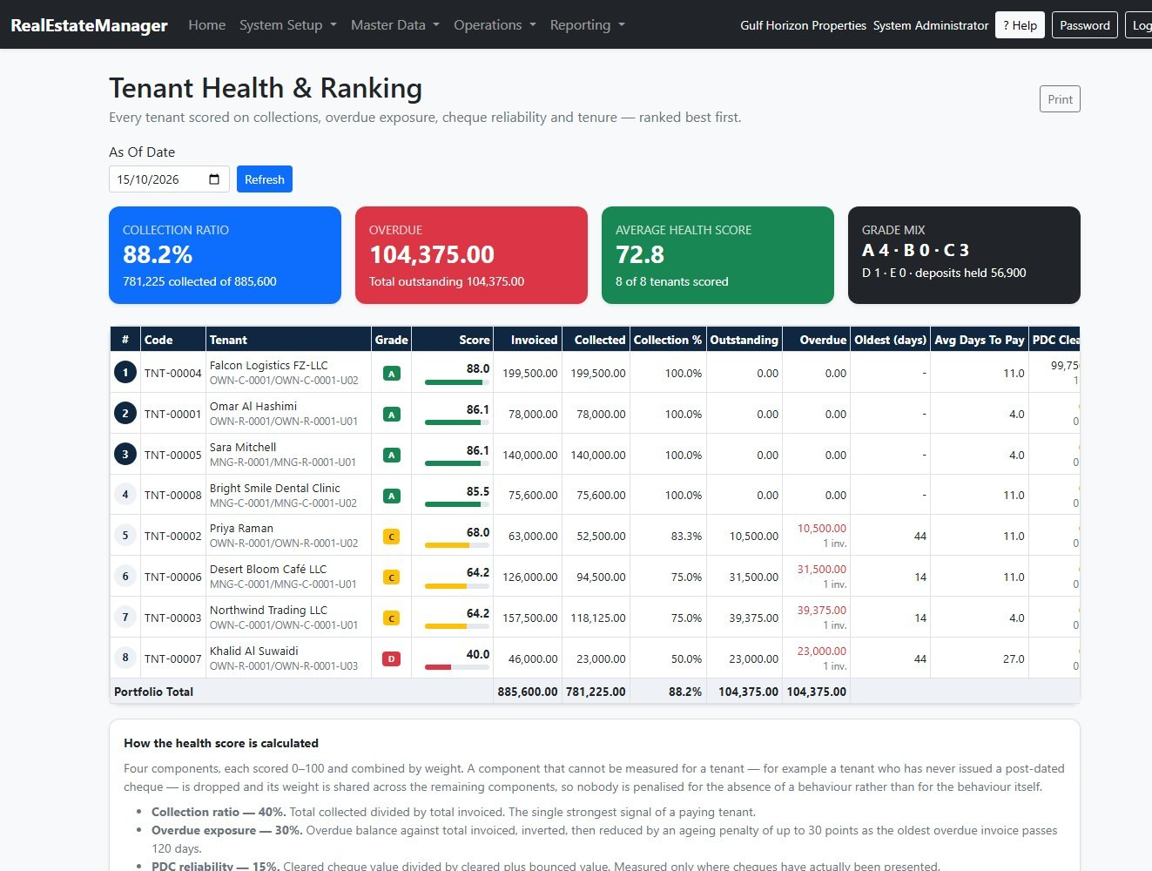
Reports for owners, managers and auditors
Trial Balance
Profit & Loss
Balance Sheet
Cash Flow Statement
General Ledger
VAT Return
P&L by Property
Property Utilization
Tenant Health Ranking
Tenant Statements
Supplier Statements
Owner Tenancy Schedule
Financial statements (blue) and management reports (gold) — every one printable
Notes:
The tenant health ranking scores every tenant on collections, overdue amounts, cheque reliability and tenure - useful before a renewal. P&L by Property answers which building actually makes money.

Slide 13
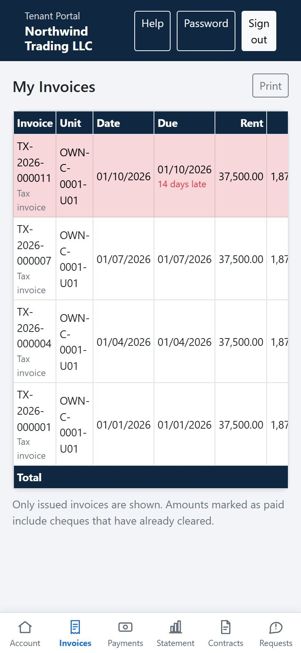
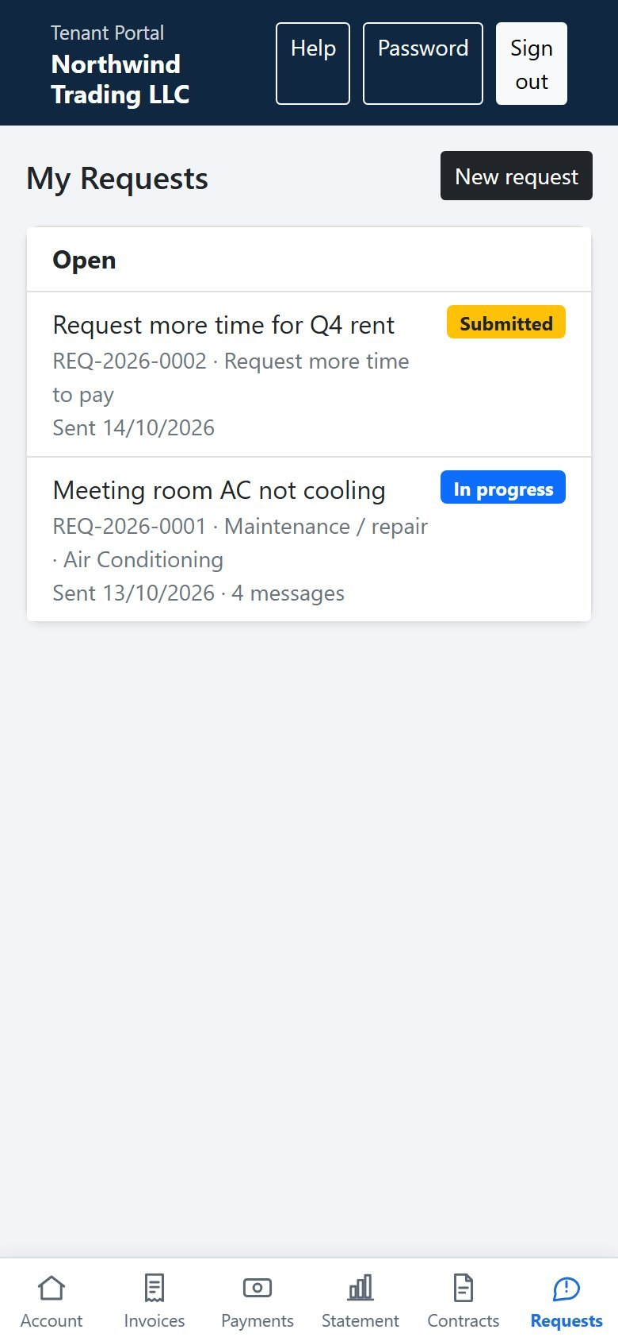




A self-service portal your tenants can use on their phone
Their account, any time
Invoices, payments, statement and contracts, on any phone.
Maintenance requests
Tenants raise and follow requests; your team answers from one queue.
More time to pay
Postponement requests decided and applied without changing the accounts.
Fewer calls
Replies are visible in the portal; internal notes stay internal.
Notes:
These are real phone screens of the tenant portal. Tenants sign in with their own account and see only their own contracts and invoices.

Slide 14




Security and control you can show an auditor
Permissions by role
Four-eyes approvals
Locked periods
Leasing, accounting, approvals and reports granted separately.
Contracts and period reopening need a second person.
Closed months cannot be changed by anyone.
Full audit log
Several companies
Hosted and backed up
Who did what and when, for every screen.
One sign-in, separate books for each company.
Secure web access from office or home; nothing to install.
Notes:
If the customer has an internal audit or an external auditor, this is the slide that matters to them. Emphasise the locked periods and the audit log.

Slide 15

Getting started is simple
1
2
3
4
Set up
Bring your balances
Train your team
Go live
Company, chart of accounts, properties, units and tenants.
Opening balances, open invoices and cheques on hand.
Practice company, training workbook, videos and in-screen help.
Start with the next month; close it in the Closing Cockpit.
Try it free for 15 days
Your own company in the system, ready to explore with sample data, a full user manual and a step-by-step training workbook.
Notes:
Close with a concrete next step: agree the trial start date and who on their side will be the first users. Offer to set up their properties during the trial.

Slide 16





Thank you
Questions, a live demonstration, or your 15-day trial — we are ready when you are.
Anas Odeh
odehanas@gmail.com
realestatemanager.odehanas.com
Phone: 0565022503
Notes:
Thank them, invite questions, and confirm the agreed next step and date before leaving.

