Slide 1
THINK TANKS AND MY OWN YET TO BE NAMED THINK TANK
Thomas wood

Slide 2
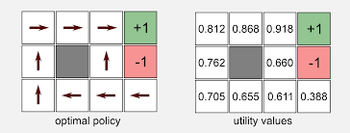



Think Tanks What do they do?
Write policy position papers
Run the world

Slide 3
What DOES MY THINK TANK THINK about?
Economics
Environment
Technology

Slide 4
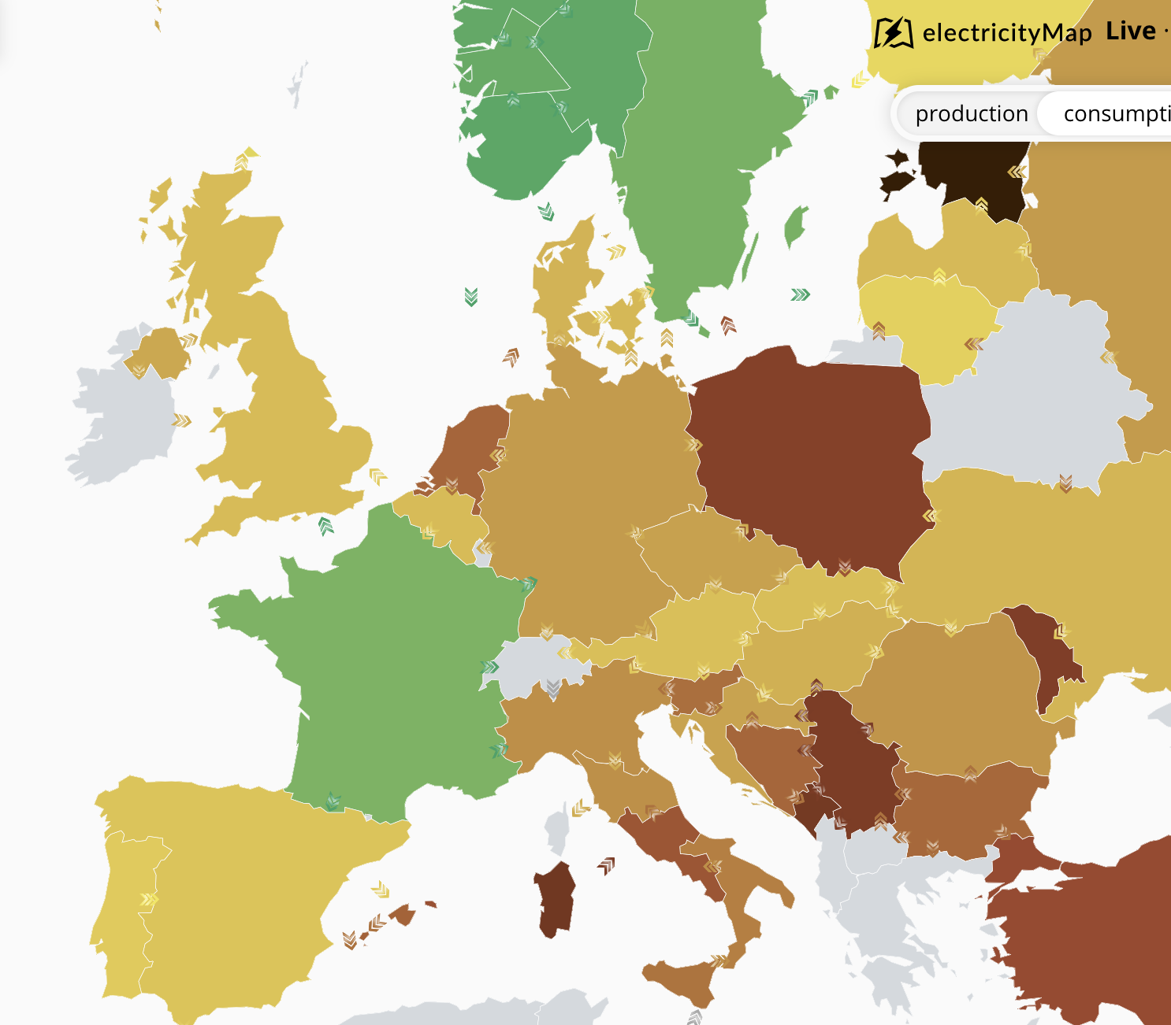
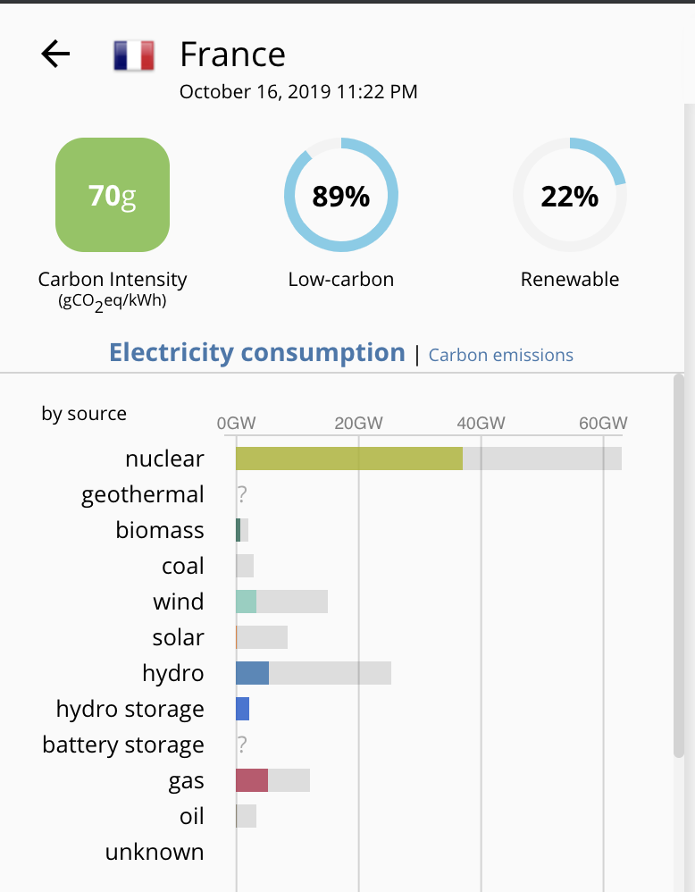
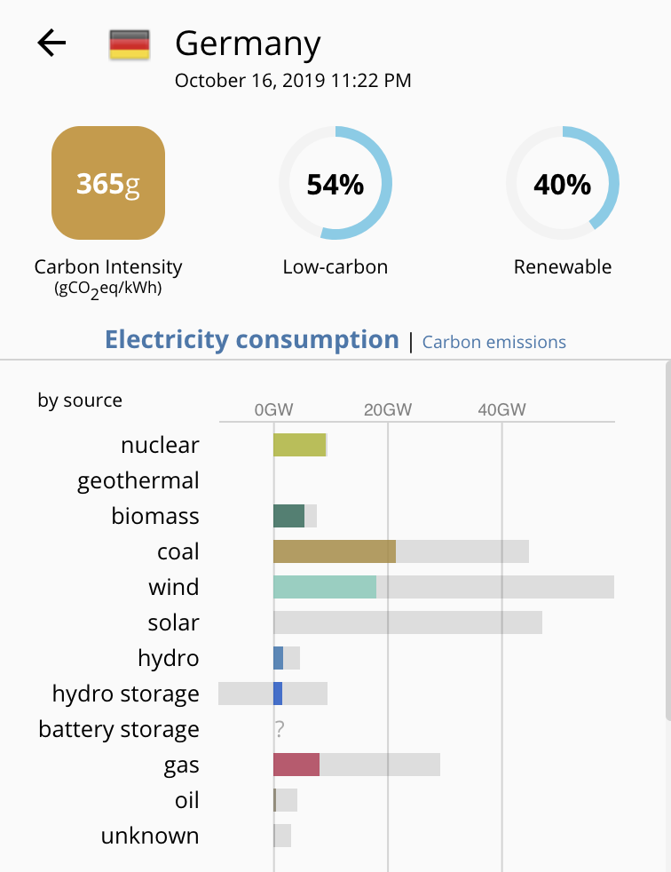
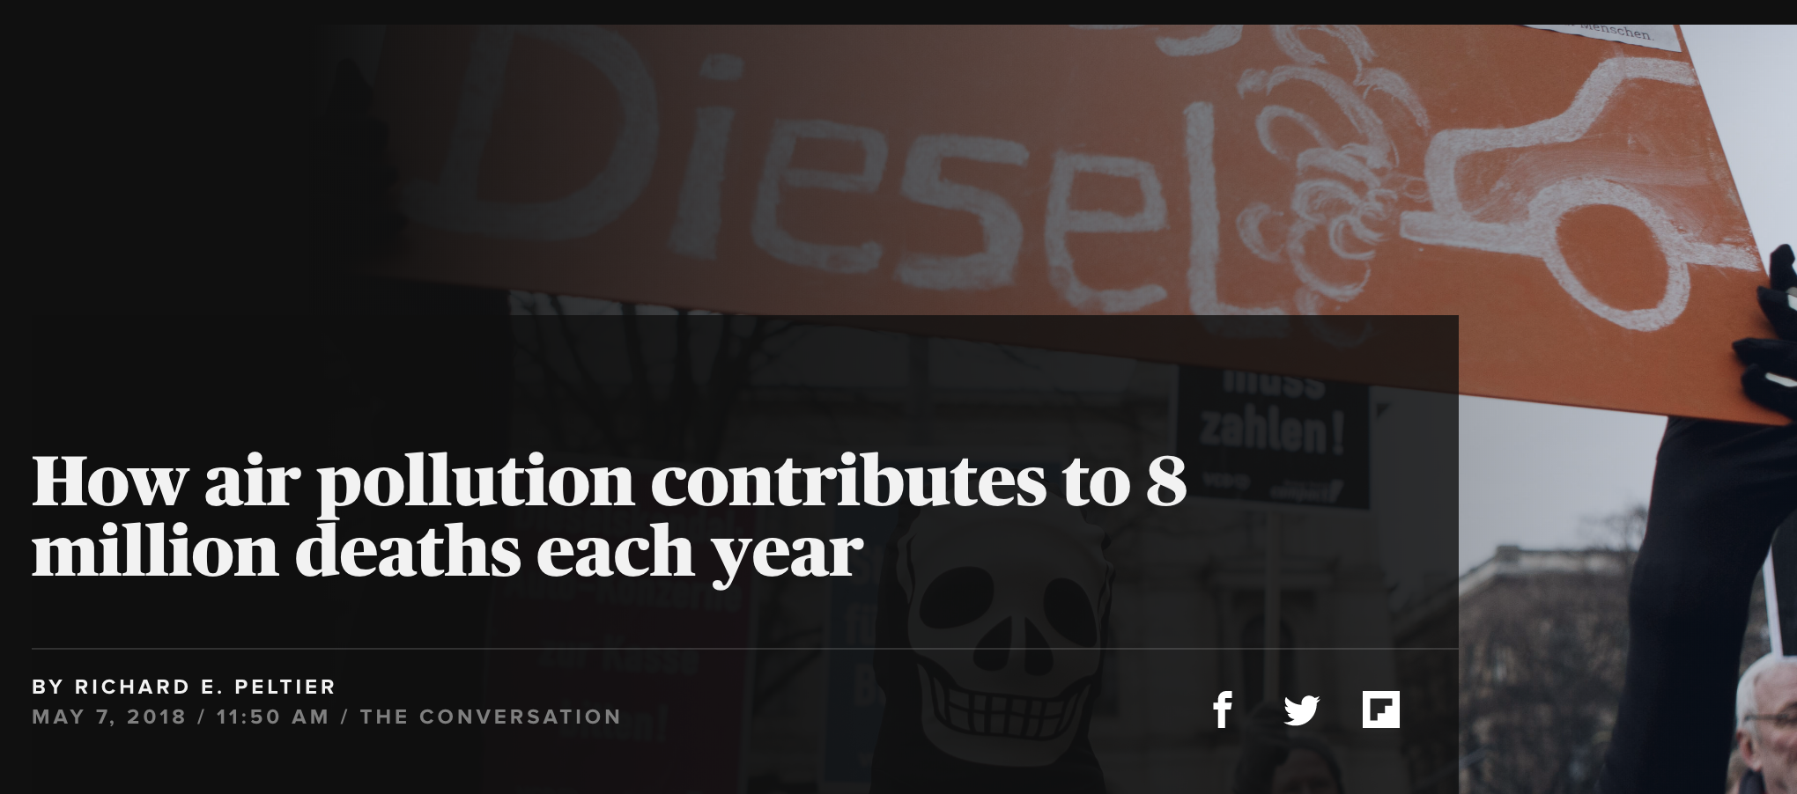
ENVIRONMENT
Public health
Carbon emissions
Nuclear energy

Slide 5
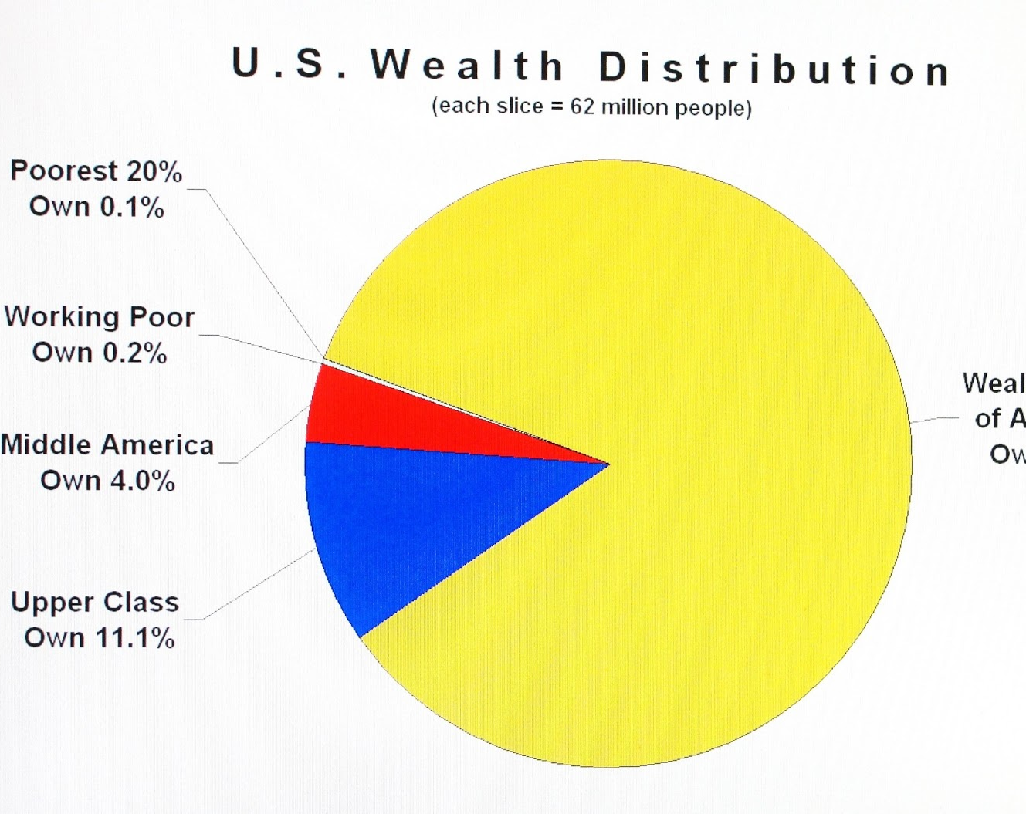
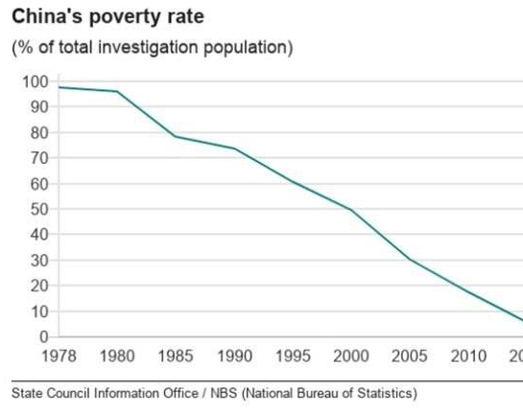
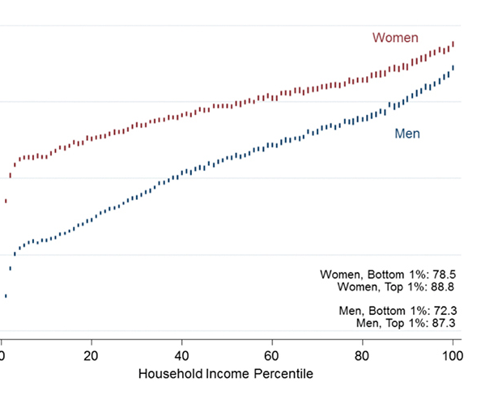
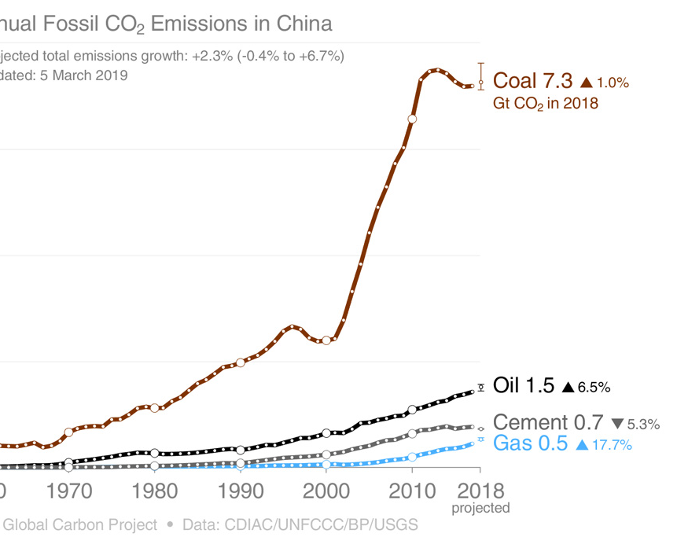
Economics
Social inclusion and open access
Poverty reduction
Public health
Automation and the future of work

Slide 6
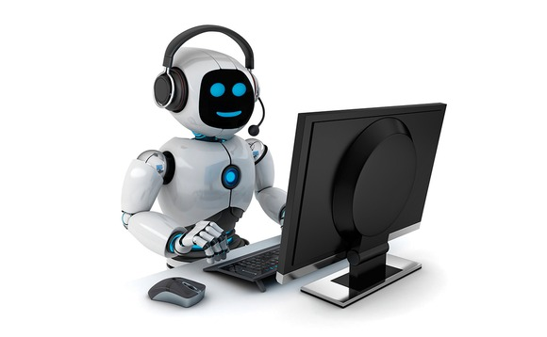

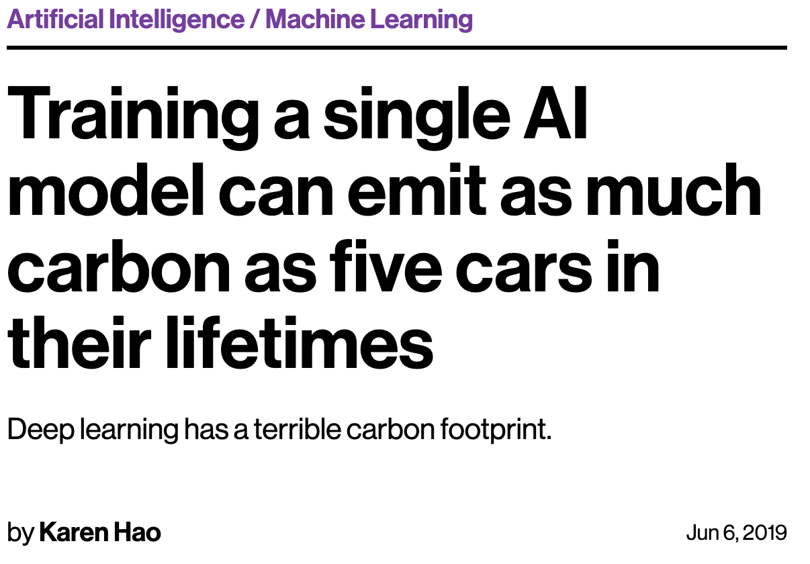
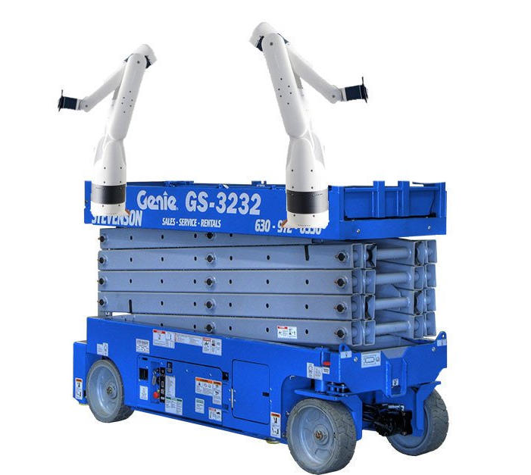
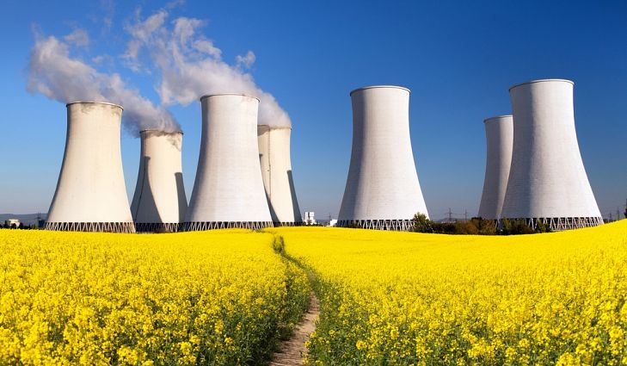
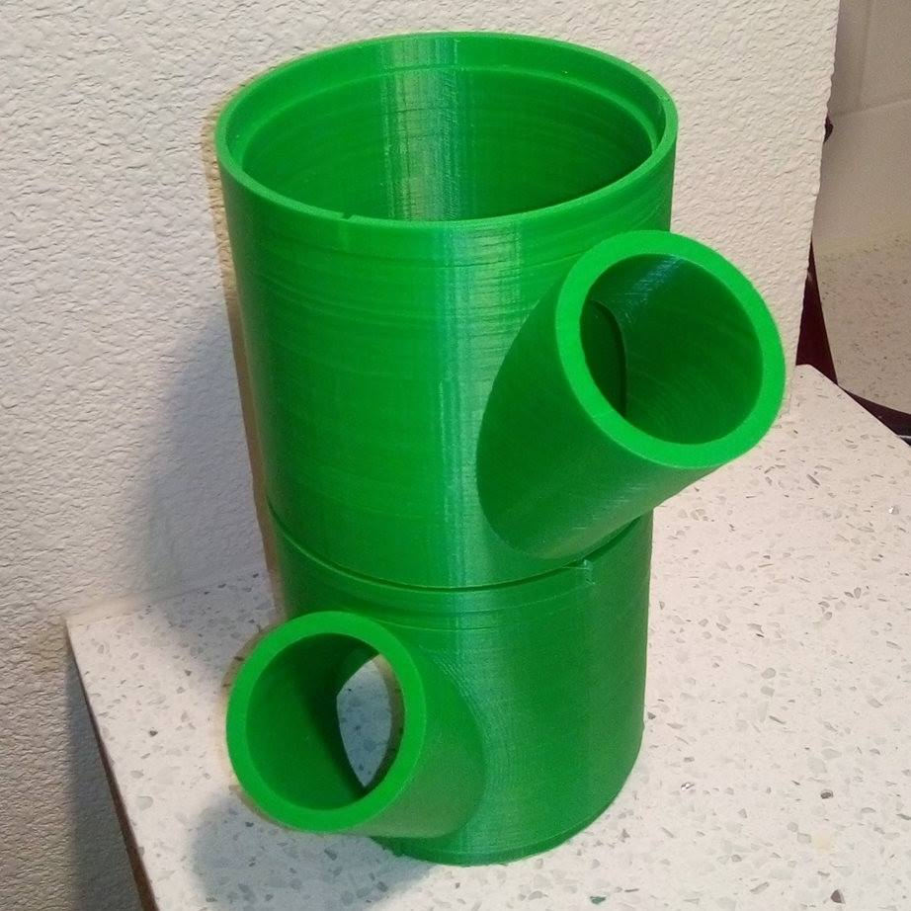
technology
Nuclear energy
Automation and the future of work
Automation and the future of food
Social inclusion and open access
Public health

Slide 7
Economics
Environment
Technology
Poverty reduction
Social inclusion and open access
Automation and the future of work
Public
health
Carbon
emissions
Nuclear
energy

