Slide 1
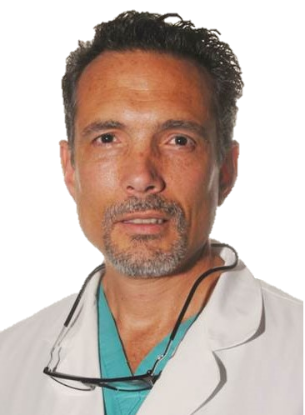
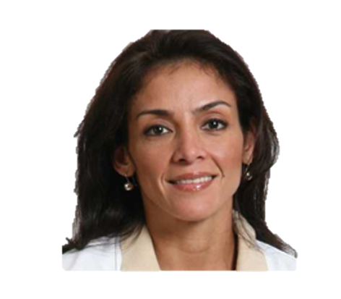

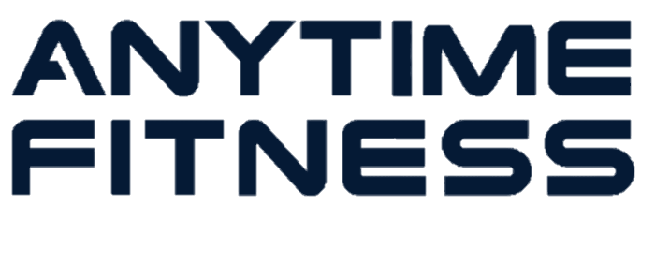
Health Zenith
With time we have come to realize that preserving an acceptable health is not a matter of taking the right medicine at the right time. The best way to secure health is by prevention, and that’s where Nutrition, exercise and good sleep come in handy. At HealthZenith we focus on these 3 pillars to pursuit the healthy life we wish, your healthy life.
Both Carmen Teresa and Eduardo are medical doctors that have also come to realize the benefits of these 3 pillars of life. Not with pharmaceutical drugs, but with alternative medicine, we look to achieve the health we all long for.
ORTHOSPINEACUPUNCTURE.COM
For over 20 years I practiced Orthopaedics and Spine surgery in Venezuela. A fresh start in Canada encourage me to complete a comprehensive program of Traditional Chinese Medicine and Acupuncture. I am now able to fuse two quite different health philosophies but one sole objective, the wellbeing of the patient.
NUTRIFITADVICE.COM
My passion for health began in my youth when I decided to study medicine. I graduated as a physician, specialized in internal medicine. My interest in nutrition motivated me to follow a comprehensive nutrition course becoming a Certified Holistic Nutrition Practitioner. I have been practicing as a nutritionist, or over 15 years offering my patients my knowledge and fascination for health.
Anytime Fitness is an American brand of fitness studios, which has its gyms in more than fifty countries across the globe. Its concept is “open 24 hours 365 days a year”, which is incredibly popular in the contemporary world.

Slide 2

DIMESION SALUD
DISMENSION SALUD
For over 20 years I practiced Orthopaedics and Spine surgery in Venezuela. A fresh start in Canada offered me the opportunity to expand my medical knowledge through a comprehensive program of Traditional Chinese Medicine and Acupuncture. I am now able to fuse and condense two quite different health philosophies but one sole objective, the wellbeing of the patient.

