Slide 1

Diabetes prediction App Using
Machine Learning
Submitted by
AKASH RATHOUR 2000910100013
CHAITAINAYA SHARMA 2000910100051
AYUSH KUMAR 2000910100046
ATISHAY KULSHRESTHA 2000910100043

Slide 2
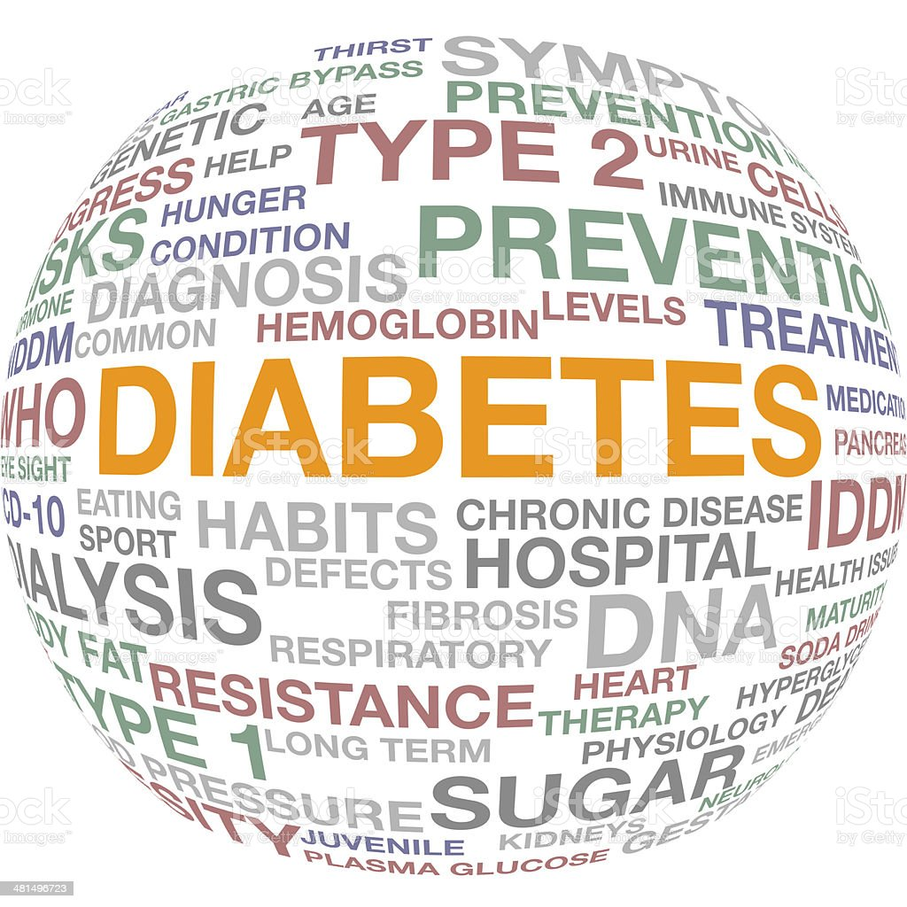
ABSTRACT
Diabetes mellitus is the most common disease worldwide and keeps increasing everyday due to changing lifestyles, unhealthy food habits and over weight problems
There were studies handled in predicting diabetes mellitus through physical and chemical test , are available for diagnosing diabetes
Data science methods have the potential to benefit other scientific fields by shedding new light on common questions

Slide 3
Objective
Dataset collection
Dataset visualization
Splitting dataset into train test split
Applying machine learning algorithm(Svm)
Testing the accuracy of the model

Slide 4
Software and Database
Software
Database
The dataset is used in this model is diabetes.csv. Before creating the model we need to clean the data i.e. removing null values ,dimensional reduction etc and we have to do some data preprocessing such as correlation of independent variables with the target variable
Python 3
Pandas
NumPy
Seaborn
Scikit-learn
Matplotlib
SciPy
Jupyter
Streamlit

Slide 5

SUPPORT VECTOR MACHINE
Support Vector Machine or SVM is one of the most popular Supervised Learning algorithms, which is used for Classification as well as Regression problems. However, primarily, it is used for Classification problems in Machine Learning.The goal of the SVM algorithm is to create the best line or decision boundary that can segregate n-dimensional space into classes so that we can easily put the new data point in the correct category in the future. This best decision boundary is called a hyperplane.SVM chooses the extreme points/vectors that help in creating the hyperplane. These extreme cases are called as support vectors, and hence algorithm is termed as Support Vector Machine. Consider the below diagram in which there are two different categories that are classified using a decision boundary or hyperplane

Slide 6
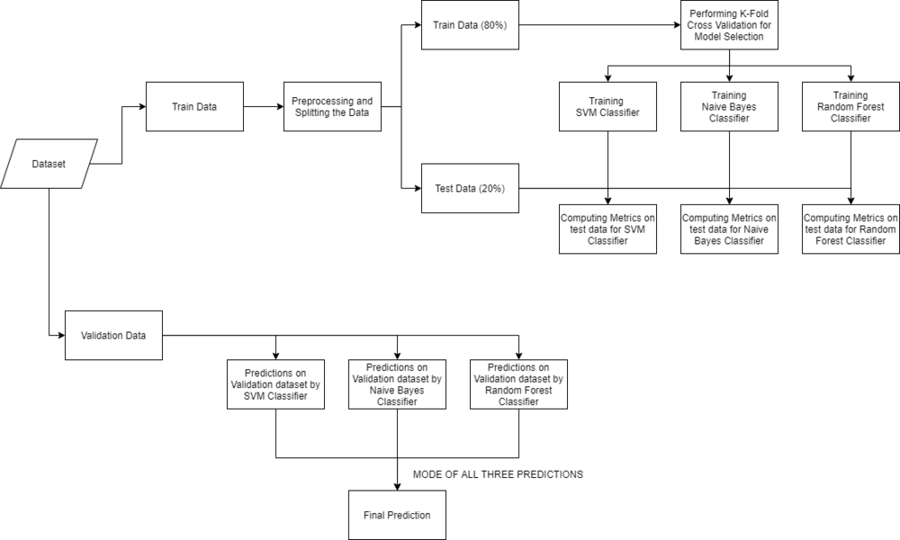
WORKFLOW

Slide 7
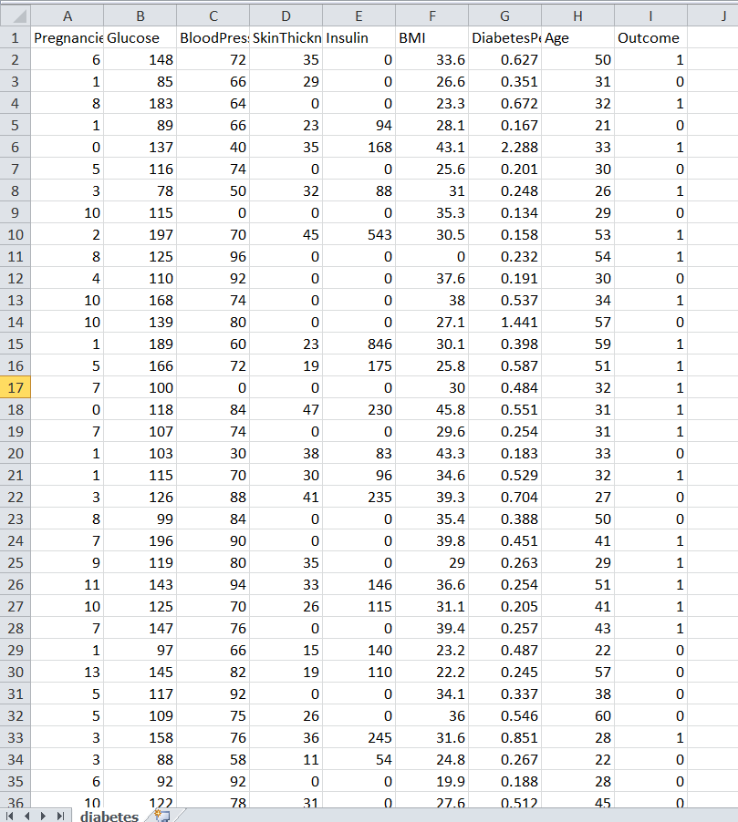
Dataset used in this model
Kbdataset contains 6 feature
Pregnancies
Glucose level
Blood pressure
Skin thickness
Insulin level
BODY mass index
Age
And a target variable
1. Outcome

Slide 8
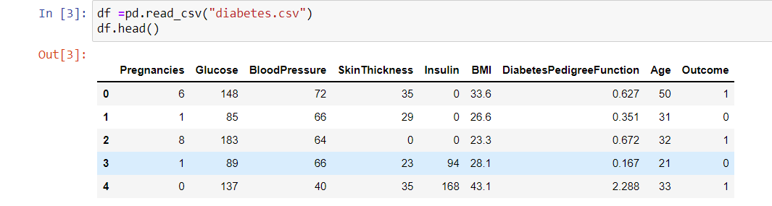

Data cleaning of diabetes.csv
This step involves cleaning of irrelevant data which contain null values from the dataset . Removal of null values is necessary as it leads a model with poor accuracy
We use dropna() command from pandas it will remove null values from the dataset

Slide 9
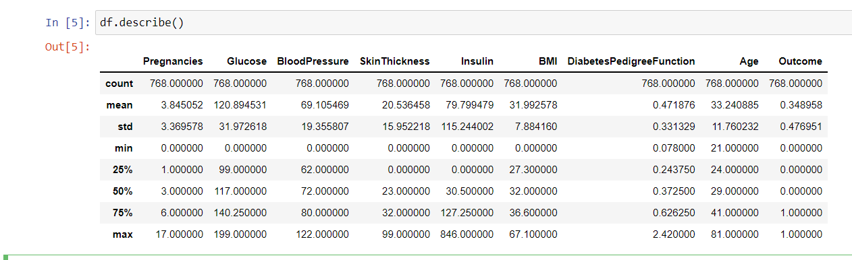
Data preprocessing
In this step we would learn about the relationship among the different features in the dataset such as mean ,variance , quartile range , correlation among features etc
We use df.describe() to know mean, variance of the dataset

Slide 10
Testing of correlation coefficient among features
This comes under data preprocessing step
Correlation coefficient tells that relationship between two feature . If two feature have correlation >0.5 we need to eliminate one of the variable because independent variables having high correlation leads to redundancy and it will ultimately leads to poor result of the model
We use corr() and variance_inflation_factor() from pandas and stats_model library to check the correlation among data variables

Slide 11
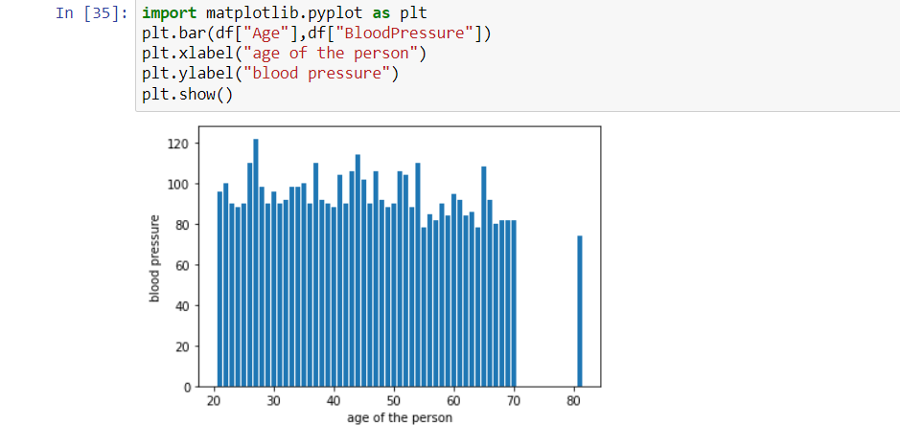
Bar Chart of age of person and blood pressure

Slide 12
Data visualization
Data visualization provides a good, organized pictorial representation of the data which makes it easier to understand, observe, analyze
Data visualization of independent feature is necessary step because this is helpful to visualize the relationship between datapoints and to find the growth rate of one variable with respect to another
Python provide matplotlib and seaborn library for data visualization

Slide 13
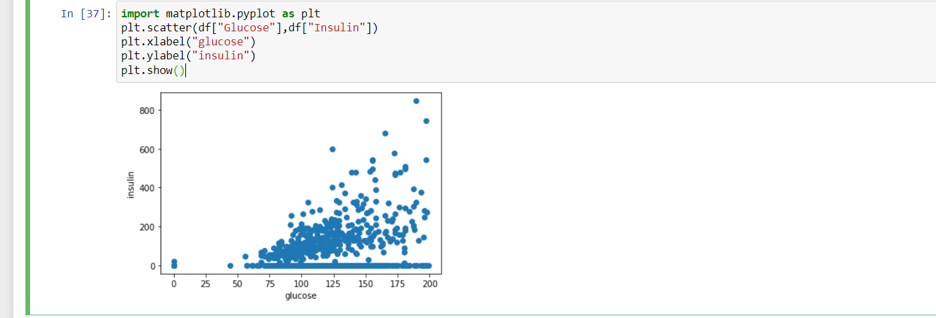
Scatter plot of insulin level and glucose level

Slide 14
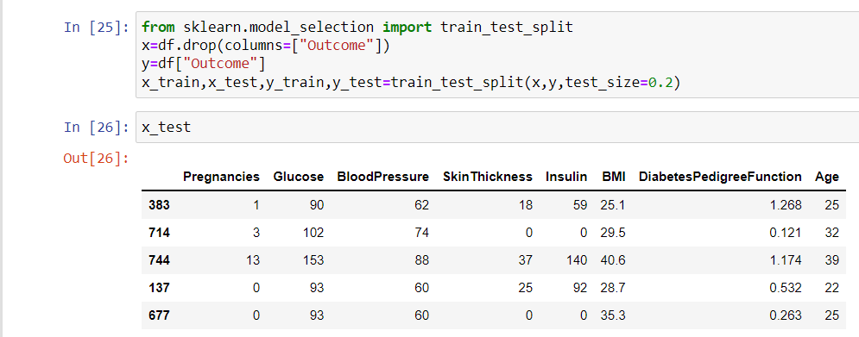
Splitting of dataset
In this step we split our dataset diabetes.csv into train and test data
80% of data is training data which Is used for training the model
And the remaining 20% of data is used for testing the the accuracy of the model
We use train_test_split() function from the sklearn library for dividing the dataset

Slide 15
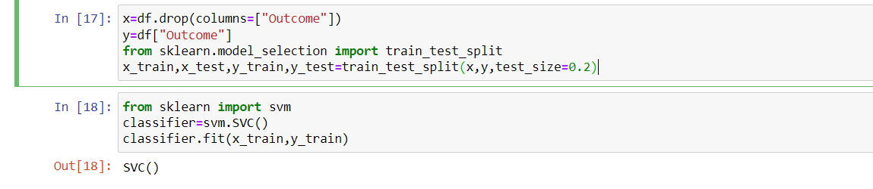
Creation Of Model Using Training Tata
After splitting dataset we need to fit our dataset in SVM algorithm
For this we need to create an object named as classifier which contains SVM.svc() object
After creating the object we need to fit our classifier in the training data of the dataset (i.e., x_train,y_train)

Slide 16
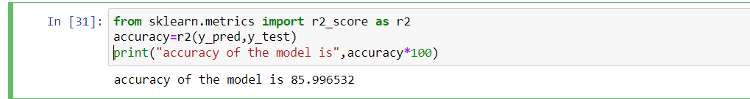
Testing The Accuracy Of The Model
After creating the model we need to test the accuracy of the model , so for this we create another y_pred which stores all the prediction make by the model for x_test
As y_test is the actual data , so we compare y_pred with y_test
Sklearn provide r2_score which takes two parameters y_pred ,y_test and return a value between 0 and 1 .
If value is close to 1 then we can say that our model is best predictor else it is not a good model and we need to train our dataset again

Slide 17
App creation Using Streamlit
Streamlit is an open source app framework in python language. It helps us create beautiful web-apps for data science and machine learning in a little time. It is compatible with major python libraries such as sklearn, numpy, pandas, matplotlib, etc.
It embraces python-scripting.
Less code is needed to create amazing web-apps.
No callbacks are needed since widgets are treated as variables.
Data caching simplifies and speeds up computation pipelines

Slide 18
References
Source: kaggle dataset , Internet
Great Learning Platform
Andriv burkov & Toby segaran Ebook
Link for github repository : https://github.com/odetteswaan/diabetes_prediction
Python libraries Documentation: pandas , numpy ,sklearn ,matplotlib.

Slide 19
Conclusion
The main aim of this disease prediction system is to predict the disease on the basis of the symptoms. This system takes the symptoms of the user from which he or she suffers as input and generates final output as a prediction of disease. Average prediction accuracy probability of 86% is obtained. Disease Predictor was successfully implemented using the grails framework. This system gives a user-friendly environment and easy to use.

Slide 20
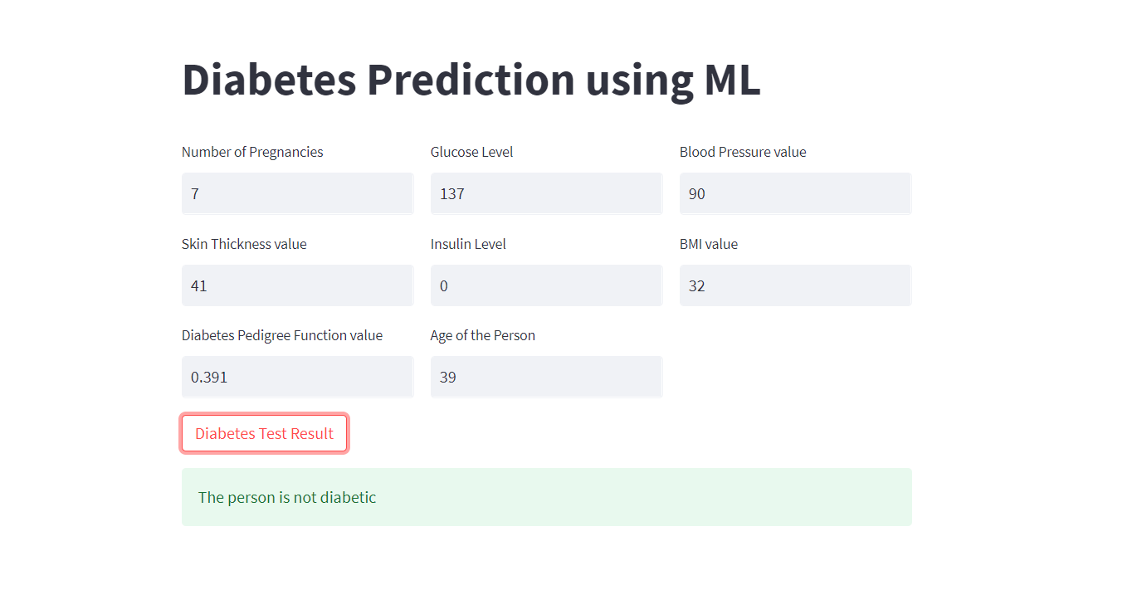
Project Images

Slide 21
THANK YOU

