Slide 1
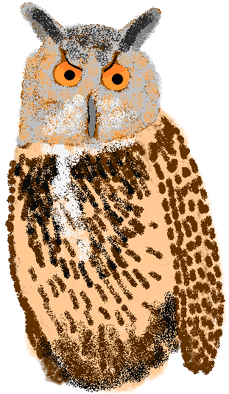
Owlerflow
Otto Järvinen
Roope Vilo
Valtteri Pesu

Slide 2
What is Owlerflow?
A question and answer site
Designed for students
An unregistered user can only view the site
Full use requires a registration

Slide 3
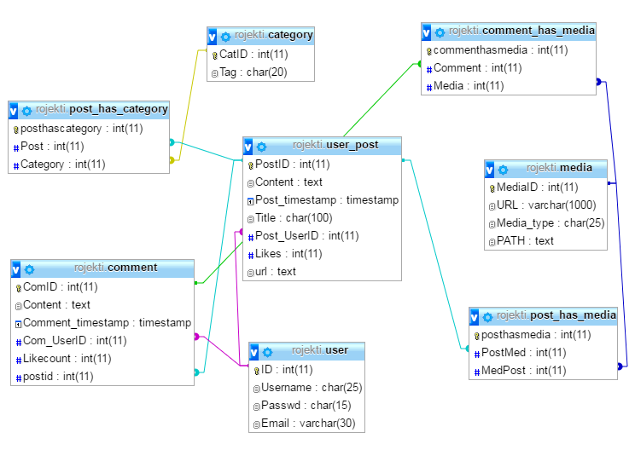
Database Structure

Slide 4
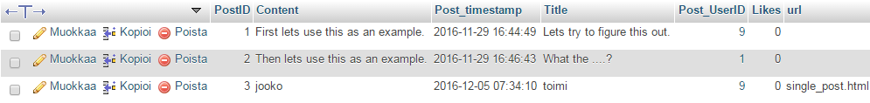
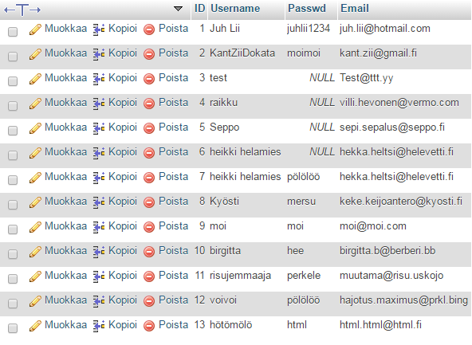

Slide 5
The Process
Roope made the front-end
Otto and Valtteri made the back-end
Google Drive was the main sharing tool

Slide 6
Challenges
Minor troubles with Glassfish
Major problems with Javascript
Lack of skills

Slide 7
Teamwork
We worked well as a team
The whole team was present every day
Groups helped each other
Special thanks to Mikko Jämiä!

