Slide 1

Instructor
Chandra Ayodhya
chandra.ayodhya@smoothstack.com
Python Part 1
learn.smoothstack.com

Slide 2
Learning Objectives :
Introduction to Python
Python Software Installation & Environment Setup
Knowing the Basic Objects and Data Structures of Python

Slide 3
What is Python ?
Python is a general purpose programming language. It’s a programming language for developing both desktop ,web applications . It is also used for developing complex scientific and numeric applications. It facilitates data analysis and visualization.

Slide 4
Why choose Python ?
It is a easy to learn programming language. Mostly scripting. You can emerge fast from a novice developer to a pro.
It can take any shape of regular Functional Language (or) Object Oriented Language.
Python can be used in the development of prototypes, and it can help speed up the concept to creation process because it is so easy to use and read.
Python is ideal for data mining, and big data facilitation.
Developers of all skill levels tend to stay more organized and productive when working with Python when compared to languages like C# and Java.
Since Python is an open source language and is community developed, it has a massive support base. Millions of like-minded developers work with the language on a regular basis. In addition, the community continuously works together to improve upon core functionality.
Python continues to receive official enhancements and updates as time progresses. This is a great way to implement new functionality and meet evolving development standards.

Slide 5



Python Setup
PYTHON INSTALLATION
ENVIRONMENT SETUP
JUPYTER NOTEBOOKS

Slide 6
Python Installation & Environment Setup
To install Python we will use the free Anaconda distribution
The installation will includes Python as well as many other libraries using Jupyter.
Anaconda can be installed on major OS ,Windows OS,Mac OS and Linux.
To go with the installation go to :
www.anaconda.com/downloads
Let’s play...

Slide 7
<<Demo time>>
Demo the installation and configuration
Usage of Jupyter notebook
https://visualstudio.microsoft.com/vs/features/python/ for standalone client

Slide 8
Objects and Basic Data structures
Numbers
Strings
Lists
Dictionary
Tuples
Files
Sets
Booleans

Slide 9
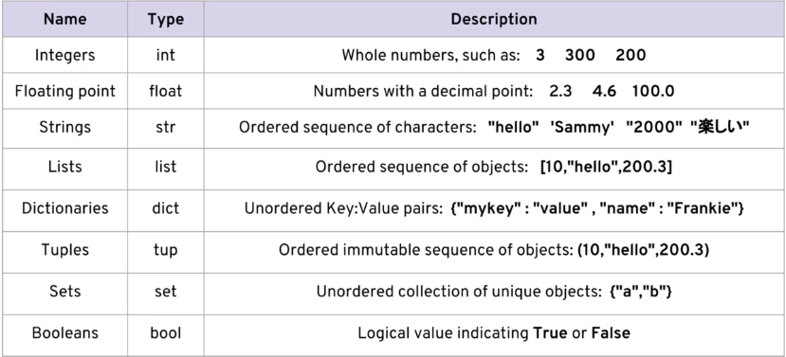
Basic Data Types

Slide 10
Numbers
There are two main number types we will work with:
Integers which are whole numbers.
Floating point numbers which are numbers.
We will also create variables and assign them to the values.
Classwork : 1_Numbers.doc

Slide 11
Variable assignment
Variables are easy and nice assignment of datatype so the reference can be used later in the code.
For example : my_dogs=2
There are couple of rules for variable assignment :
They should not start with a number.
There cannot be any space in the variable name , instead use “_”
Can’t use the symbols : :”’,<>/?|\()!@#$%^&*~-+
Using lower case of variable names is best practice.
Avoid using reserved words like “list” or “str” etc…

Slide 12
Variable assignment
Python uses dynamic typing where variables of one data type can be reassigned to variables of another datatype.
Eg : my_dogs=2
my_dogs = [“Sammy”,”Fankie”]
This is perfectly OK in python
You need to aware of the type() of the variable.
Classwork : 2_Variable Assignment.doc

Slide 13
Thank you!

