Slide 1

Instructor
Chandra Ayodhya
chandra.ayodhya@smoothstack.com
Python Part 2
learn.smoothstack.com

Slide 2
Learning Objectives
Basic Objects and Data Structures
Strings
Lists
Dictionaries
Tuples
Sets and Booleans
Comparison Operators

Slide 3
Strings
Python uses dynamic typing where variables of one data type can be reassigned to variables of another datatype.
Eg : my_dogs=2
my_dogs = [“Sammy”,”Fankie”]
This is perfectly OK in python
You need to aware of the type() of the variable.

Slide 4
Strings ..(contd)
Strings are sequence of characters ,using single and double quotes:
‘hello’ ,“Hello” , “ I don’t do that”
Strings are ordered sequences using indexing and slicing we can grab sub-section.
Indexing notation uses [] notation after the string.
Eg : h e l l o
0 1 2 3 4
Indexing allows a single character from the string.
Slicing allows you to grab a subsection of a string.
[start:stop:step]
Classwork : 3_firstpart_Strings.doc , 3_secondpart_String Formatting

Slide 5
Lists
Lists are ordered sequences that hold a variety of object types.
They use []brackets and commas to separate objects in the list.
Eg : [1,2,3,4,5]
Lists support indexing and slicing.Lists can be nested and support a variety of useful methods.
Classwork : 4_Lists.doc

Slide 6
Dictionaries
Dictionaries are unordered mappings for storing objects. Previously we saw how lists store the objects in an ordered sequence, dictionaries will have key ,value pairs.
Key-value pair will allow users to quickly grab an objects without needing to know an index location.
Dictionaries use curly braces and colons to signify the keys and their associated values.
{‘key1’: ’value1’ , ‘key2’:’value2’}
Question when to choose a dictionary vs list ?

Slide 7
Dictionaries ..contd
Dictionaries objects are retrieved by key name.
Unordered and cannot be retrieved.
Whereas List are ordered sequence of values and can be indexed and sliced.
Classwork : 5_Dictionaries.doc

Slide 8
Tuples
Tuples are very much similar to list. But only key difference is they have – immutability.
Once element is in a tuple it cannot be re assigned.
Tuples uses parenthesis: (1,3,5)
Classwork :6_Tuples.doc

Slide 9
Sets and Booleans
These are unordered collections of unique objects.
Meaning they have one representative of objects.
Booleans are operators that allow to convey true or false statements.
They are very important as they have control logic.
Classwork : 7_Set and Booleans.doc

Slide 10
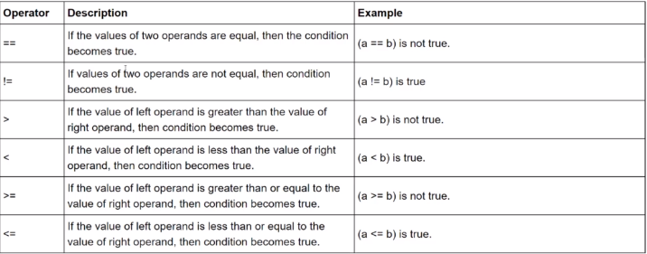
Comparison operators
Classwork : 8_Files.doc

Slide 11
Thank you!

