Slide 1
DIAMONDS EXPLORATORY ANALYSIS AND PRICE PREDICTION MODEL
Presented by:
Emmanuel Otieno
r_cds_005

Slide 2
Why Diamonds?
The topic of this project is diamonds exploratory analysis and price prediction model. It seeks to explore the diamonds dataset and ultimately create a price prediction model.
I am interested to know what the attributes of a diamond are and ultimately what variables are used to determine the price of a diamond. I chose this topic as mining is an upcoming industry in the country, and it is interesting to see what kind of data exists for this industry.
Kenya is underexplored for minerals as the focus is on agricultural produce, the mining sector is currently dominated by the production of non-metallic commodities. As a percentage of GDP mining contributes roughly 1% to GDP as of 2016 but has the potential to contribute more.
In Kenya, the ministry of mining was established as a single institution in 2013. 5 years ago, on 27th May 2016, the government established a new Mining Act

Slide 3
Why Diamonds contd.
The new mining act legalizes artisanal miners who are small scale independent miners
Also important is that new discoveries are being made for example LSE listed firm Acacia mining discovered gold at its mines in Kakamega in 2017.
Ultimately for natural resources the compensation for laborious work of mining must be the value derived from these resources
Therefore, this leads us to look at what information determines the price of such a resource. A dataset is readily available in R that has the prices of approximately 54,000 diamonds together with other attributes.

Slide 4
Summary Process
Exploratory analysis seeks to explore the dataset in the following way,
First, we look at the dataset structure and go through each variable describing its meaning.
We then do an in-depth analysis of the variables calculating statistics such as counts, mean, median etc.
After the statistical analysis we use various visualizations to see the calculations we had done.
This process enables us to understand our dataset and draw meaningful conclusions.
Finally, we create a model that enables us to predict the price of a diamond given it has certain attributes.

Slide 5
DATASET
The diamonds dataset is a dataset containing the prices and other attributes of almost 54,000 diamonds. It is an inbuilt R dataset from the package ggplot2.
It has 10 variables with 53,940 observations.
3 of these variables are categorical and the rest numerical

Slide 6
10 variables
Cut
This is an ordered factor variable measuring quality of the diamond cut.
5 levels- Fair < Good < Very Good < Premium < Ideal
Color
Color is an ordered factor variable measuring diamond color.
7 levels- D < E < F < G < H < I < J
Clarity
Clarity is an ordered factor variable measuring how clear the diamond is.
8 levels- I1 < SI2 < SI1 < VS2 < VS1 < VVS2 < VVS1 < IF
Carat
Carat is a numerical variable measuring weight of the diamond.
Depth
This is a numerical variable measuring total depth percentage.
It is calculated as: z / mean (x, y) = 2 * z / (x + y) (43–79)
Table
This is a numerical variable measuring width of top of diamond relative to widest point.
It has a range of values from 43 to 95 mm.
Price
Price is a numerical variable measuring price in USD.
It has a range of values from $326 to $18,823.
X
X is a numerical variable measuring length in mm.
It has a range of values from 0 to 10.74 mm.
Y
Y is a numerical variable measuring width in mm.
It has a range of values from 0 to 58.9mm.
Z
Z is a numerical variable measuring depth in mm.
It has a range of values from 0 to 31.8 mm.

Slide 7
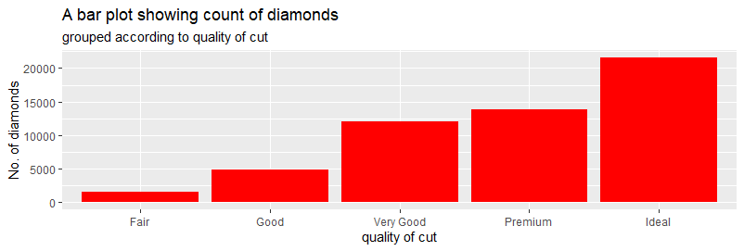
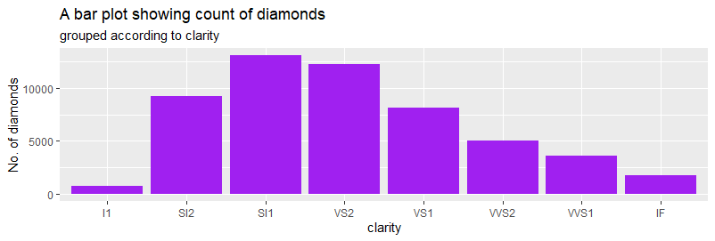
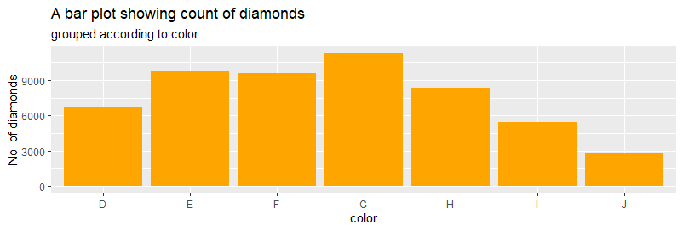
3 categorical variables

Slide 8
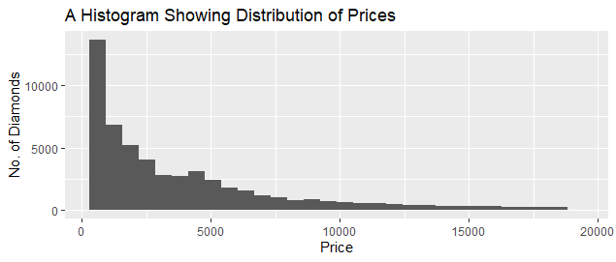
Factors affecting price
Price of diamonds is measured in USD. The minimum price is 326, maximum price is 18823, median price is 2401 and mean price of diamonds in USD is 3933 . We look at how these statistics vary for different categorical data
From the histogram we can see majority of diamonds cost less than 2500 USD

Slide 9
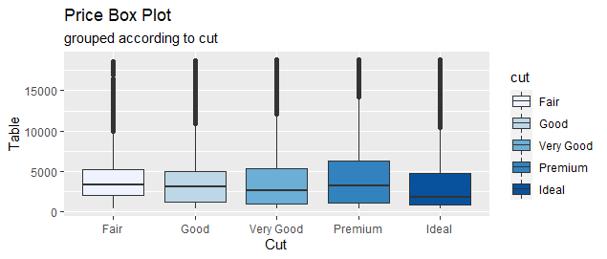
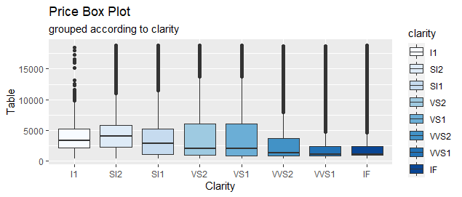
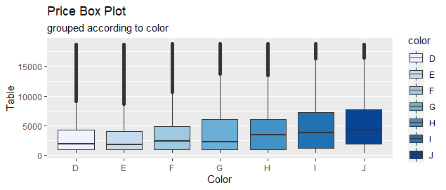
Price With regards to categorical variables

Slide 10
Price WITH REGARDS TO NUMERICAL VARIABLES
When looking at the relationship between price and a numerical variable such as weight we plot a scatterplot after calculating the correlation coefficient.
The correlation coefficient tells us what linear relationship exists between two variables
Between price and weight(carat) there is a very high positive correlation of 0.9215.
Between price and depth there is a low negative correlation of -0.01
Between price and table there is a low positive correlation between the two of 0.1271
We visualize these below.

Slide 11
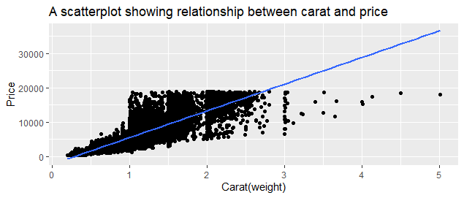
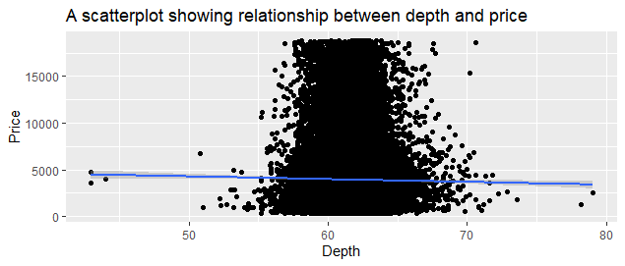
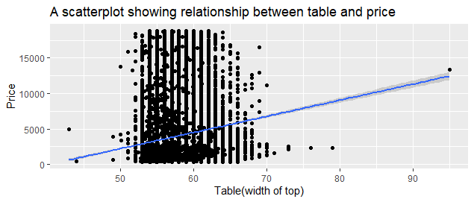
Price WITH REGARDS TO NUMERICAL VARIABLES contd.

Slide 12
PRICE Prediction model
We begin with a simple linear regression model
We use the formula price=B0+B1carat. Using the formula, we create a model that predicts the price of a diamond given its weight.
When we predict the price of a diamond weighing 1 carat using our model, we get a predicted price of 5500 which is close to the average price of diamonds weighing one carat of 5241.
We then create a new column with predicted values of price and calculate the correlation coefficient between predicted and actual prices to be 0.9215.
This is visualized below.

Slide 13
Multiple linear regression model
Our variables of interest are carat, cut, color, clarity, depth, table, x, y and z
Using the formula price=B0+B1carat+B2cut+B3color+B4clarity+B5depth+B6table+B7x+B8y+B9z we create a price prediction model.
A hypothetical diamond b with the following attributes is predicted to have a price of 2775. Diamond b-carat=0.5, cut=Premium, color=E, clarity=SI1, depth=60, table=50, x=4, y=3,z=2.
We then create a new column with predicted values of price and calculate the correlation coefficient between predicted and actual prices to be 0.959.
This is visualized below.

Slide 14
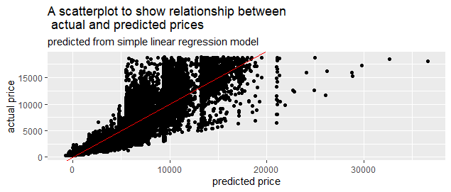
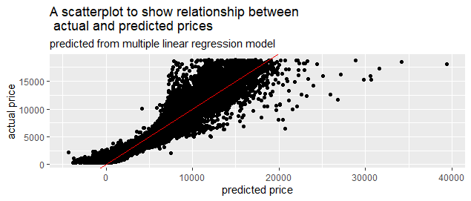
Prediction visualization

Slide 15
Conclusion
Both models are good, but we prefer the second model as it has a higher correlation coefficient and r squared meaning the second model explains better the variation in prices.

Slide 16
Limitations
Access to such a database of prices of diamonds or any natural resource and the factors influencing it may be difficult to access.
Also, Kenya’s mining sector is still in its young stages meaning the data most needed and relevant at this stage is geological data that enables miners be able to make new discoveries.

Slide 17
references
Kenya Mining Investment Handbook
file.html (tralac.org)

