Slide 1
Predicting Customer Churn From SyriaTel
By Anthony Odhiambo
Senior Analyst

Slide 2

Problem Statement
Customer Retention remains a critical KPI For SyriaTel
Acquiring new customers is often more expensive than keeping existing ones.
SyriaTel is experiencing customer churn where users discontinue their service.
This project seeks to build a classifier to predict churn
Identifying the patterns and factors that drive churn can help the company take proactive measures to reduce customer loss, enhance loyalty, and increase revenue.

Slide 3
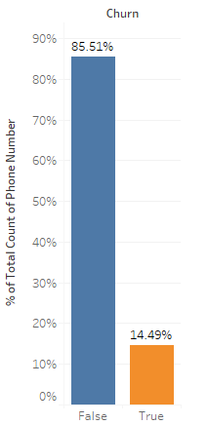
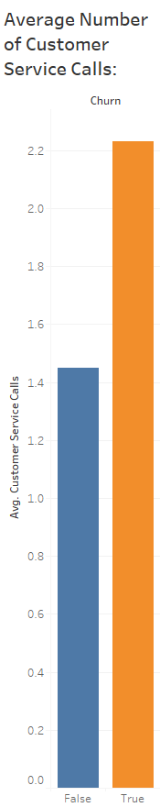
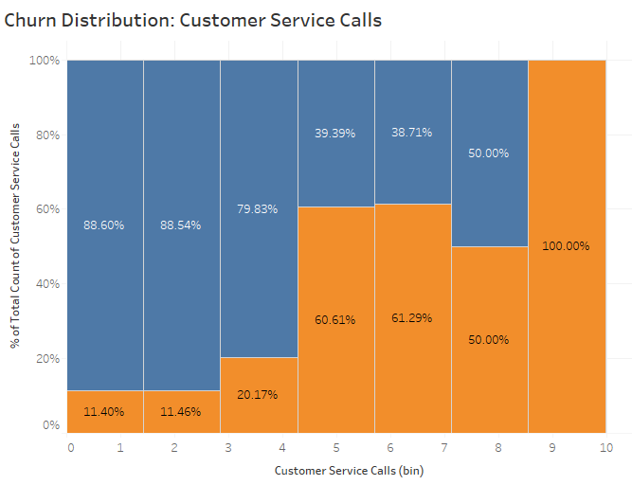
EDA Sample - Customer Service Calls
14.49% Churn Rate at SyriaTel
On average, churned customers made more than 2 customer service calls
For customers who made more than 4 Customer service calls, the churn probability is very high
There could be underlying problems not being solved leading to high churn rate

Slide 4
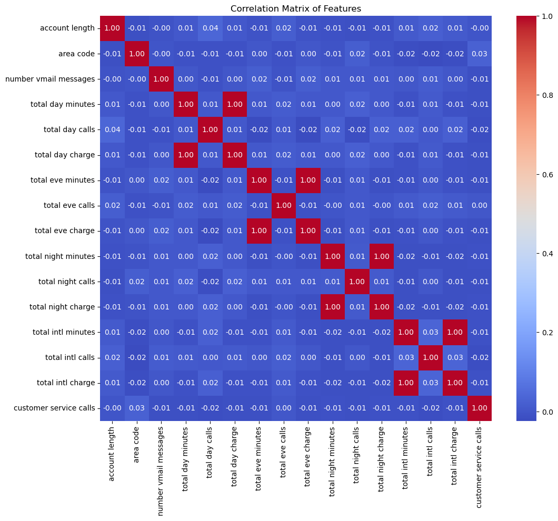
EDA Sample – Correlation
The relationship between the original features appears non-linear
Except for charges vs call-time
Logistic Regression does not handle non-linear relationships well

Slide 5
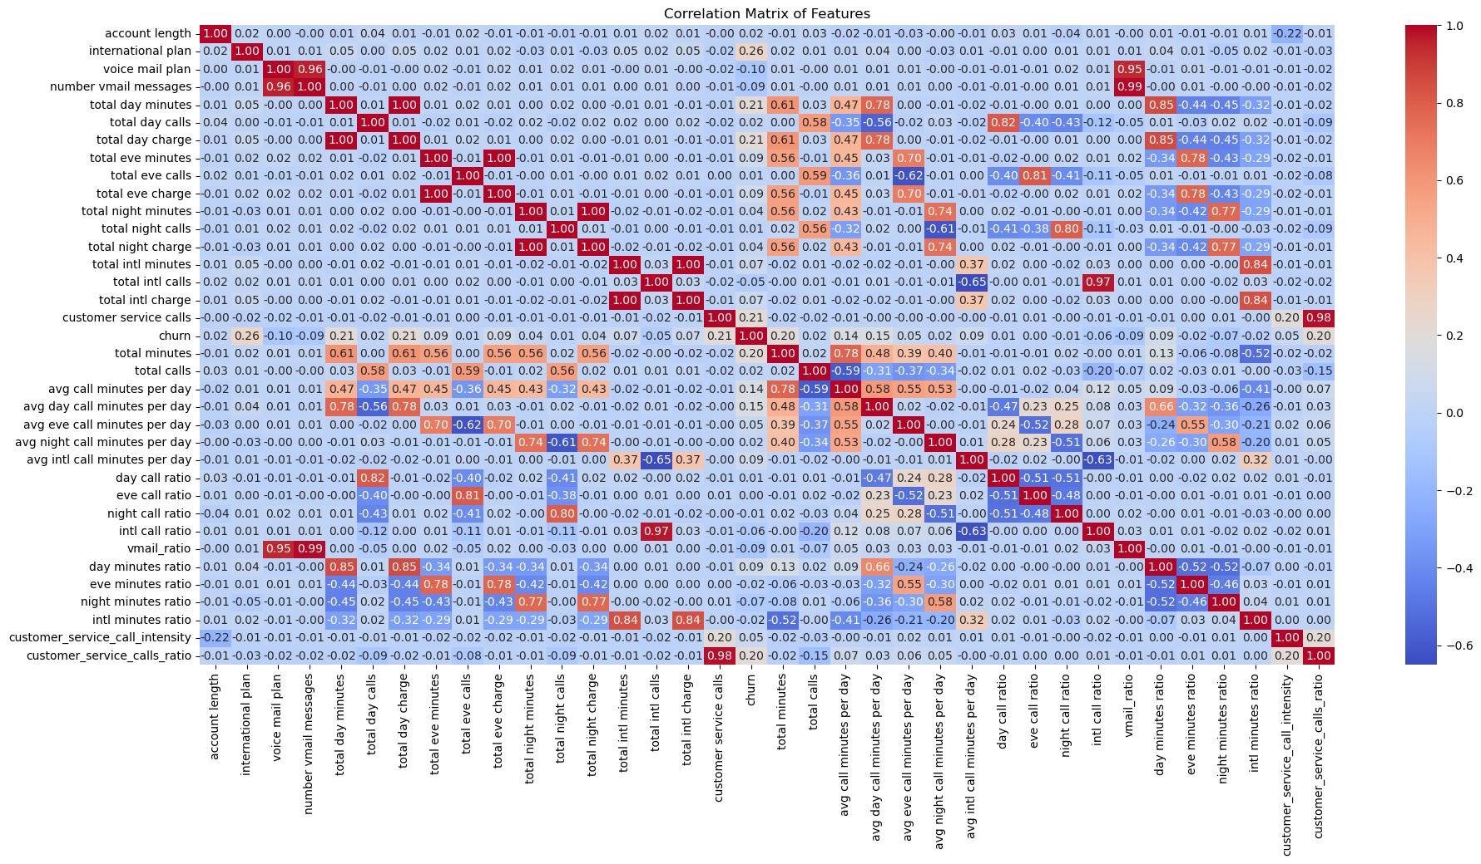
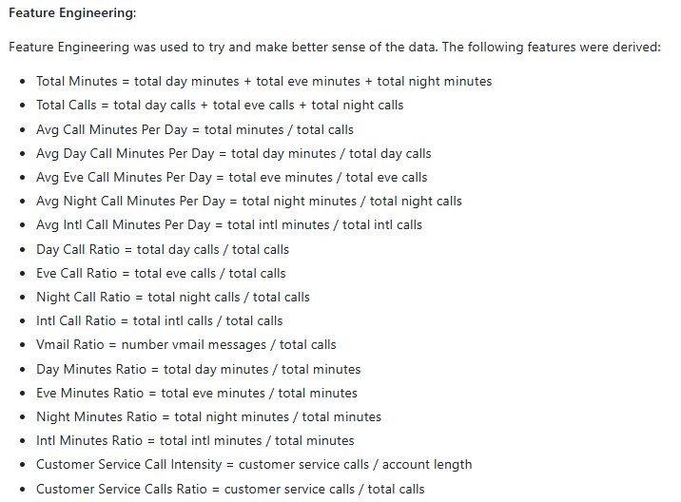
EDA Sample – Correlation
Feature Engineering attempted to explore potentially higher correlations

Slide 6
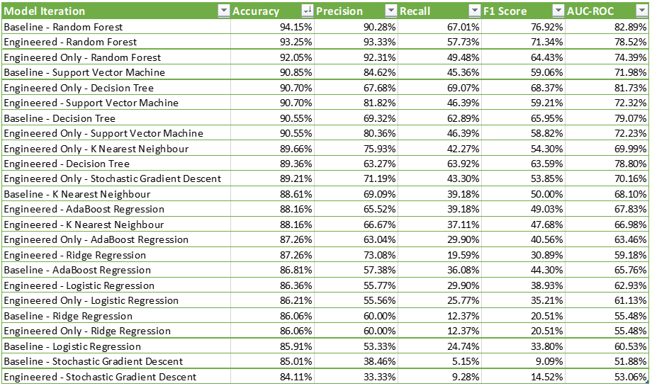
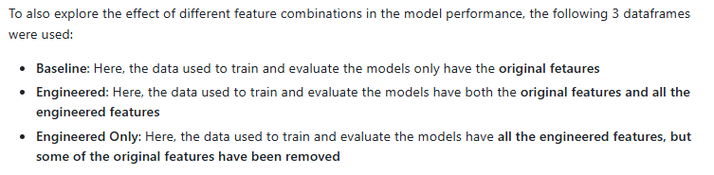
Modeling – Finding the Best Model
Random Forest Model with the baseline data yielded the highest Accuracy, Recall, F1 and AUC-ROC scores

Slide 7
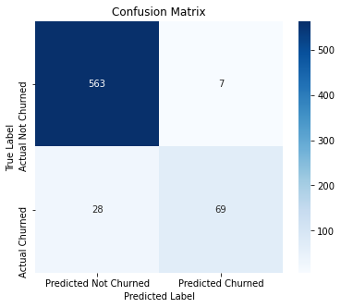
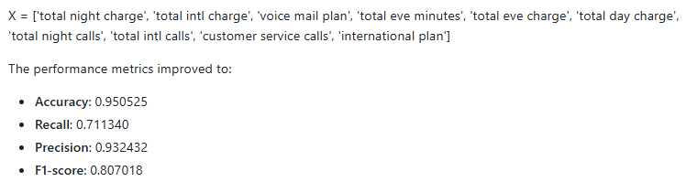
Modeling – Feature Selection
Refining feature selection improved the model performance slightly
This was done through a function that randomly selected 10 features 10000 times and evaluated the best performing one

Slide 8
Conclusions and Recommendations
The recall is still a bit low. Other classification techniques e.g. XGBoost Classification could be attempted to yield better model performance.
Other ML techniques like SMOTE can be used to handle the data imbalance and subsequently enhance recall
More descriptive features could improve model performance e.g. Customer Service Calls Reasons – Addressing the core challenges that necessitate Customer Complaints will reduce churn
Improving the customer experience of customers with international call plan will reduce the rate of churn

Slide 9
Thank you
Anthony Odhiambo
0710 – 001 - 001
moringa@consultant.com

