Slide 1
MULTIBIOMETRIC SYSTEM-BASED TECHNIQUE AS A FACTOR TO ENSURING NATIONAL SECURITY STRATEGY; A CASE STUDY OF NATIONAL IDENTITY MANAGEMENT COMMSSION (NIMC) - KADUNA STATE.
BY
ODIDO GODWIN
NDA/PGS/FMIS/MCS/M/1003/18

Slide 2
PRESENTATION OUTLINE
INTRODUCTION
LITERATURE REVIEW
MATERIAL AND METHODS
RESULTS AND INTERPRETATIONS
CONCLUSION AND RECOMMENDATION

Slide 3
INTRODUCTION
The term biometric is characterized from two Greek words 'bio' signifies life and 'metric' signifies estimation
Biometrics is defined as the unique (personal) physiological or behavioral characteristics or traits of human body.
The different biometric perspectives used for individual identification are: fingerprints, face, hand geometry, palm print, finger veins, gait signature, DNA acknowledgment, Iris, facial appearance, voice and so forth.
NIMC Act of 2007 was created to handle citizens and legally authorized individuals identity enrolment and verification using the Fingerprint and Face biometric data and converting it into the present day NIN

Slide 4
STATEMENT OF PROBLEM
A number of different types of cyber-attacks and conventional crimes are possible and hardly traceable
In a quest to meet up with the National Security Strategy, especially with respect to the nation citizen’s identification and verification, biometrics has a great role to play.
In order to achieve this, the research aim to assess the NIMC biometric system and propose the need to adopt a unique Iris biometric technology to complement the pre-existing facial and fingerprint enrollment and verification process which pose to have lots of vulnerabilities associated example identity theft.
This consequently will differ in a way of biometric data collections from different agencies (private and government) thereby solving the problem of Centralized database

Slide 5
AIM AND OBJECTIVES
The aim of this work is to evaluate NIMC biometric system and propose an Iris recognition technique that will enhance their biometric systems.
The objectives of this research work include:
To evaluate fingerprint and facial biometric technology as used by NIMC
To evaluate Iris biometric technology.
To evaluate a multi-biometric system based technique.
To suggest recommendations in ensuring National security strategy is achieved by NIMC through the adoption of Multi-biometric system based technique.

Slide 6
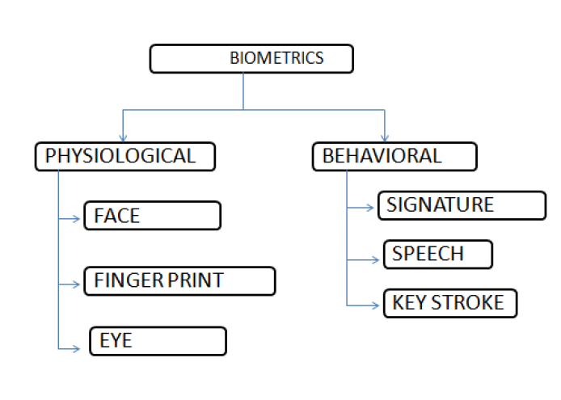
SCOPE OF THE STUDY

Slide 7
SCOPE OF THE STUDY cont…
This research tends to evaluate the basic biometric technologies used by the NIMC namely the fingerprint and facial recognition technique. This work will subsequently cover the biometric devices, operations and vulnerability associated.

Slide 8
NATIONAL CYBER SECURITY STRATEGY.
" Loader and Thomas (2000) had clarified, "Cybercrime will be believed to be computer mediated exercises which are unlawful or considered illegal by specific gatherings and which might be conducted through worldwide electronic networks".
Define minimum standard and technical requirements to safeguarding personal information from been compromised by NIMC or other government and private agencies.
To find out and keep up a dependable information communication and transaction condition by giving digital certificate management administrations with global acknowledgment. Improve security of electronic communications and transactions.

Slide 9
NATIONAL IDENTITY MANAGEMENT COMMISSION (NIMC)
The NIMC Act 2007 provides for the establishment of the NIMC, its was created to replace the Department of National Civic Registration (DNCR) to do the following among other functions:
Primarily to create legal institution for identification.
Perform enrolment of citizens
Create National Identity database
Issue National Identification Number (NIN) to citizen and legal residents.

Slide 10
MATERIAL AND METHODS
Web Questionnaire
Observation
Research and Reading (Literature Review)

Slide 11
SAMPLING AND SAMPLING TECHNIQUES
Nigeria , the latest population of Nigeria as at December 2020 is over 200 million people although the UN has placed the population at 206,867,836 million people with Kaduna having over 1,133,503 persons(United Nations world population prospect, 2020)
Kaduna has 23 Local government area, chikun inclusive with 12 wards which include Kuriga, Kujama, Gwagwada, Narayi, Sabon Tasha, Nasarawa, Sabon garin Nasarawa, Kakau, Rido, Kunai, and Ungwan Yelwa
According to Wikipedia sources, Chikun has an area of 4466km² and a population of about 372,272 persons.

Slide 12
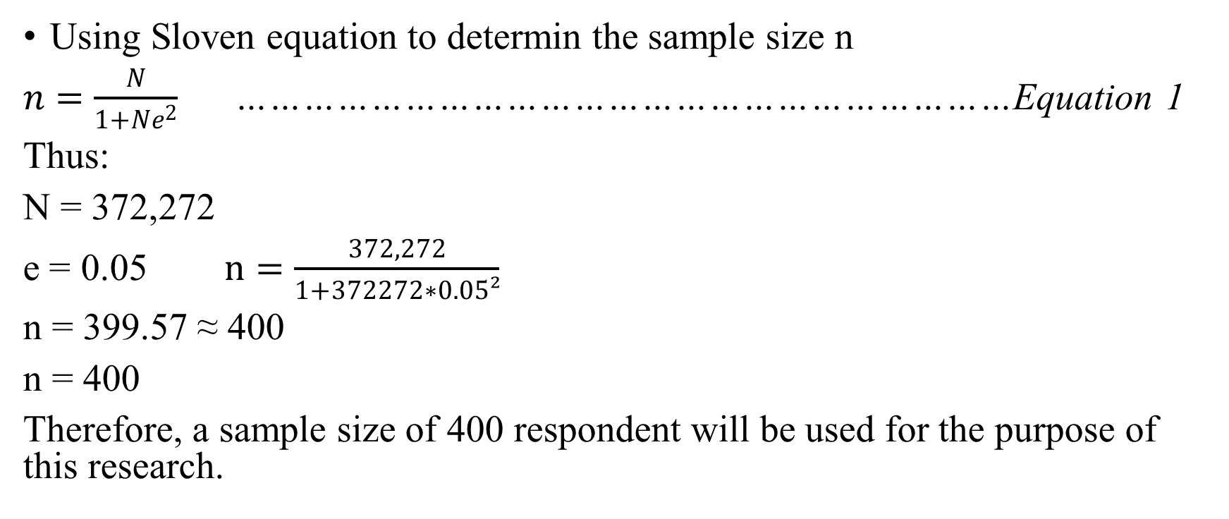
Sampling Techniques
Using Sloven equation to determin the sample size n
$n=\frac{N}{1+Ne^{2}}$ ……………………………………………………………Equation 1
Thus:
N = 372,272
e = 0.05 $n=\frac{372,272}{1+372272∗0.05²}$
n = 399.57 ≈ 400
n = 400
Therefore, a sample size of 400 respondent will be used for the purpose of this research.

Slide 13
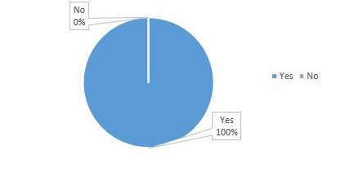
RESULT AND INTERPRETATIONS
Have you been registered on the NIMC platform?
Out of a total number of 400 target respondent, 350 (100%) responded to have been registered on the NIMC platform as shown in figure 4.1

Slide 14
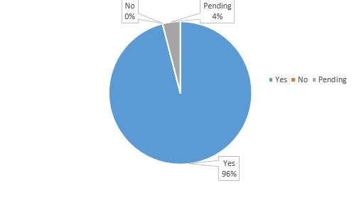
Result And Interpretations Cont.
Was your Biometric data captured during registration?
336 (96%) respondent, acknowledged that their biometric (fingerprint and face) data was captured during the registration process.
14 (4%) respondent gave a pending response

Slide 15
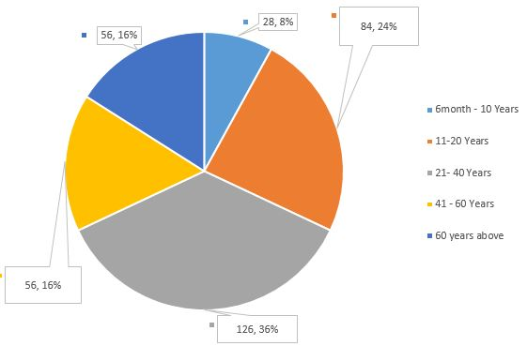
Result And Interpretations Cont.
Enrollment age of Respondent.

Slide 16
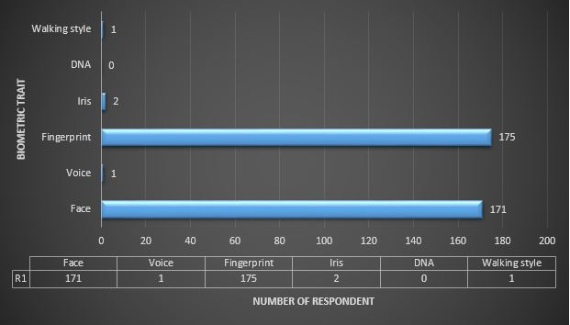
Result And Interpretations Cont.
Respondent Biometric Data Captured upon Enrollment.

Slide 17
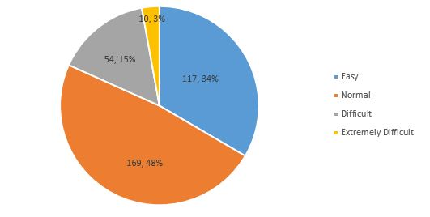
Result And Interpretations Cont.
Respondent View on Fingerprint Biometric Data Capture Process.

Slide 18
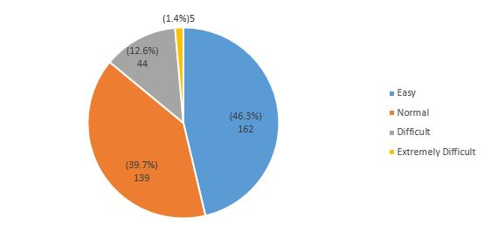
Result And Interpretations Cont.
Respondent View on Face Biometric Data Capture Process.

Slide 19
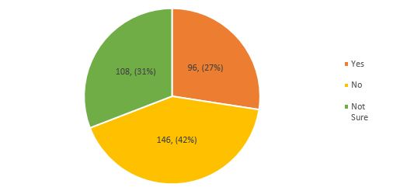
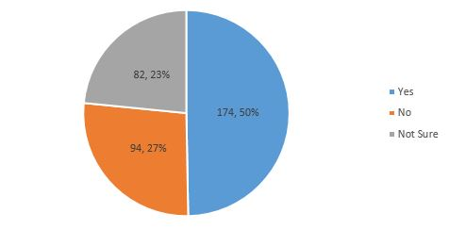
Respondent View on Possible Factors that Affects Face and Fingerprint Enrollment and Verification.
Biological factors like facial marks, age, distorted fingers, face structure, facial skin and facial expression changes
Environmental factors like temperature, humidity, light intensity

Slide 20
Result And Interpretations Cont.
Basis for Iris Based Biometric Technique
Step 1: Image Acquisition means capturing the iris image using a high resolution camera.
Step 2: Image Preprocessing includes converting the image to a gray scale image and removing noise disturbances.
Step 3: Template matching compares the user templates with templates of database using a matching metric.
Step 4: Authentication uses the matching metric and declares a person either an authentic person or an imposter.

Slide 21
Why Use Iris Based Technique?
Although it is Very intrusive and costly ; It has the stigma of people thinking it is potentially harmful to the eye; Comparisons of template records can take as much as 10 seconds, depending on the size of the database.
The advantages of the Iris base technique includes:
Very high accuracy.
The eye from a dead person would deteriorate too fast to be useful, so no additional precautions needs to be taken with retinal scans to be certain the user is a living person.
Highly protected, internal organ of the eye.
Externally visible; patterns imaged from a distance.
Uniqueness: set by combinatorial complexity
Limited hereditary penetrance of iris patterns
Patterns obviously stable all through life

Slide 22
Why Multi-Biometric Systems?
The physiological features like palm prints, hand geometry, finger veins, and pulses have extremely high false acceptance rate (FAR). Thus, a single biometric feature based approach is not reliable and secure.
A single biometric system base is susceptible to sensitivity to noise, intra-class variability, data quality, non-universality (due to incorrect data), intra-class variations (due to incorrect interaction with sensor), inter-class similarities (due to overlap), and identity theft.

Slide 23
CONCLUSION
Biometrics technology has proven to be an emerging and reemerging technology that has helped in providing seamless and easy human identification across the world. The abduction of biometric technology has played a vital role in ensuring national security.
Biometrics, when properly implemented, not only increase security but also often are easier to use and less costly to administer than the less secure alternatives.
The ultimate form of electronic verification of a person’s identity is biometrics.

Slide 24
RECOMMENDATIONS
It is recommended for the implementation of the iris scan in conjunction with the fingerprint and face recognition by the National Identity Management Commission (NIMC). This is of utmost importance as it helps to establish a more secure biometric design and database.
Government should invest massively in Biometric technology and forensic studies, this will help to easily apprehend perpetrators of crime and threat agents.
Further research should be carried out on multi-biometric design algorithm and operations.

Slide 25
THANK YOU FOR LISTENING

