Slide 1
CS 4843 Cloud Computing MapReduce Algorithm Design
Palden Lama, PhD
Department of Computer Science
University of Texas at San Antonio

Slide 2
MapReduce Algorithm Design
Aggregation
Pairs and Stripes (Complex key-value pairs)
Order Inversion
Value to Key Conversion

Slide 3
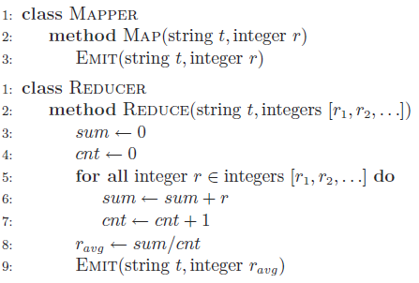
Aggregation (cont’d)
Compute the mean of values associated with the same key
e.g web log analysis (calculate average session time per user)
User1, 5
User2, 10
User1, 3
User3, 5
MAP 1
User1, 4
User2, 6.33
User3, 3
User4, 10
REDUCE
User2, 4
User4, 10
User3, 1
User2, 5
MAP 2
Notes:
A real-world example might be a large user log from a popular website, where keys represent user ids and values represent
some measure of activity such as elapsed time for a particular session
the mean session length on a per-user basis
Userid is key, session time is value

Slide 4
Aggregation (cont’d)
Compute the mean of values associated with the same key
As many intermediate pairs as there were input key-value pairs
How to reduce too many network transfers and disk writes ?
User1, 5
User2, 10
User1, 3
User3, 5
MAP 1
User1, 4
User2, 6.33
User3, 3
User4, 10
REDUCE
User2, 4
User4, 10
User3, 1
User2, 5
MAP 2
Notes:
A real-world example might be a large user log from a popular website, where keys represent user ids and values represent
some measure of activity such as elapsed time for a particular session
the mean session length on a per-user basis
Combiner can be used to reduce xfer and writes. But can it be used in reduce func?

Slide 5
Aggregation
Compute the mean of values associated with the same key
As many intermediate pairs as there were input key-value pairs
How to reduce too many network transfers and disk writes ?
Can we use Reduce function as the combiner ?
Reduce function can be used as combiner only if it is both commutative, and associative.
Notes:
A real-world example might be a large user log from a popular website, where keys represent user ids and values represent
some measure of activity such as elapsed time for a particular session
the mean session length on a per-user basis
No we cant use reduce func as combiner cuz the avg is not commutative or associative. Only if func is commutatic/associative can we use reduce func as combiner. F(a,b) = F(b, a) commutitive f(a, b, c) = f( f(a,b), f(c ) ) associative

Slide 6
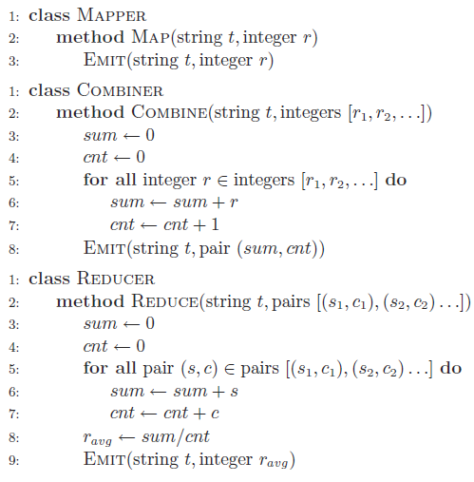
Local Aggregation : 1st Attempt with Combiner
LOGICALLY CORRECT BUT INCOMPATIBLE WITH MAPREDUCE
Combiner’s input key-value type must be the same as the mapper’s output type
Combiner’s output key-value type must be the same as the reducer’s input type
Combiners must have the same input and output key-value type
Why the restriction on input-output format ?

Slide 7
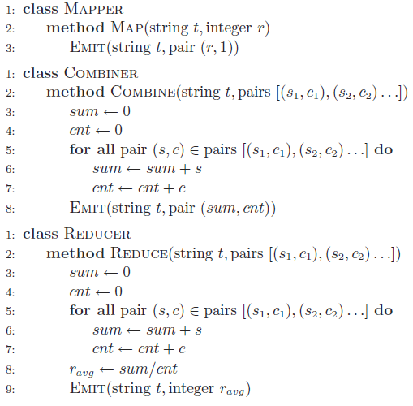
Local Aggregation : Combiner
Mapper EMITS
String as key
A pair consisting of the integer and one as value (integer represents sum, and one represents the count)
Will it work if no combiner was run ?

Slide 8
Local Aggregation (cont’d)
COMBINER
User1, (5,1)
User2, (10,1)
User1, (3,1)
User3, (5,1)
User1, (8,2)
User2, (10,1)
User3, (5,1)
MAP 1
User1, 4
User2, 6.33
User3, 3
User4, 10
REDUCE
User2, (4,1)
User4, (10,1)
User3, (1,1)
User2, (5,1)
User2, (9,2)
User4, (10,1)
User3, (1,1)
MAP 2
Notes:
A real-world example might be a large user log from a popular website, where keys represent user ids and values represent
some measure of activity such as elapsed time for a particular session
the mean session length on a per-user basis

Slide 9
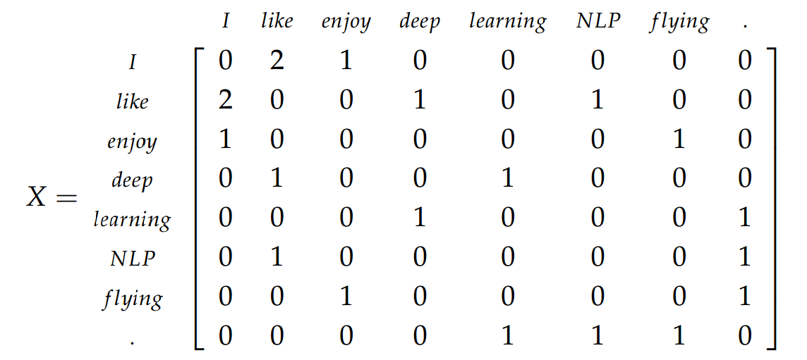
PAIRS
Building word co-occurrence matrix
Examples:
finding correlated product purchase in retail (online) shop
Statistical natural language processing
Text mining
Notes:
Natural language processing…
Finding out correlated product purchase in a retail shop or website

Slide 10
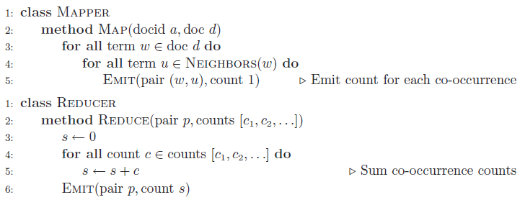
PAIRS
Building word co-occurrence matrix
Co-occurring word pair emitted as key
PAIRS : use of complex keys

Slide 11
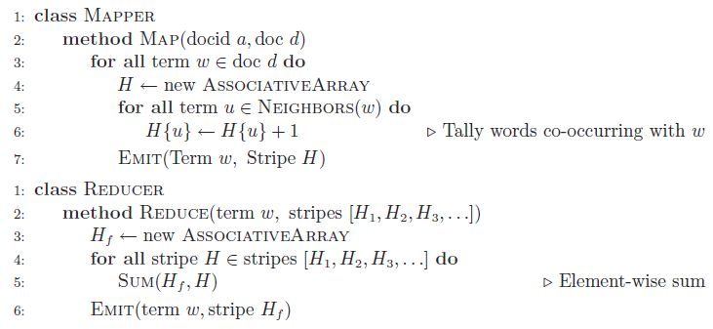
STRIPES
Building word co-occurrence matrix
Co-occurrence counts of the neighbors of a particular word is stored in an associative array
each final key-value pair encodes a row in the co-occurrence matrix.

Slide 12
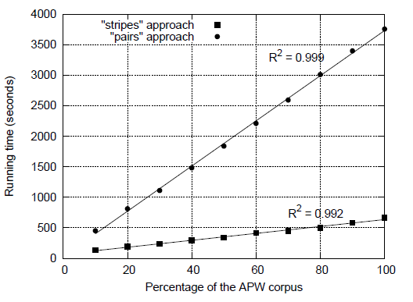
Pairs Vs Stripes
Total corpus: 2.27 million documents
5.7 GB total
Hadoop cluster : 19 slave nodes
with 2 CPU each
Pairs Approach:
- Intermediate data = 2.6 billion key-pairs
- After combiner, 1.1 billion key-pairs
- Reducer data = 142 million key-pairs
Stripes Approach:
- Intermediate data = 142 million key-pairs
- After combiner, 653 million key-pairs
- Reducer output = 1.69 million key-pairs
Notes:
2.27 million documents from the Associated Press Worldstream (APW) totaling 5.7 GB
19 nodes
two single-core processors and two disks

Slide 13
Word co-occurrence with Pairs approach (assume neighborhood/context of up to 2 words)
((I, enjoy), 1)
(enjoy, flying), 1)
(flying, .),1)
((I, like), 1)
(like, NLP), 1)
((NLP, .), 1)
I enjoy flying.
I like NLP.
MAP 1
REDUCE
((I, like), 1)
(like, deep), 1)
(deep, learning),1)
((learning, .), 1)
I like deep
learning.
MAP 2

Slide 14
Word co-occurrence with Pairs approach (assume neighborhood/context of up to 3 words)
((I, enjoy), 1)
((I, flying), 1)
(enjoy, flying), 1)
((enjoy, .), 1)
(flying, .),1)
((I, like), 1)
((I, NLP), 1)
(like, NLP), 1)
((like, .), 1)
((NLP, .), 1)
 | I | like | enjoy | deep | learning | NLP | flying | .
I | 0 | 2 | 1 | 1 | 0 | 1 | 1 | 0
like | 2 | 0 | 0 | 1 | 1 | 1 | 0 | 1
enjoy | 1 | 0 | 0 | 0 | 0 | 0 | 1 | 1
deep | 1 | 1 | 0 | 0 | 1 | 0 | 0 | 1
learning | 0 | 1 | 0 | 1 | 0 | 0 | 0 | 1
NLP | 1 | 1 | 0 | 0 | 0 | 0 | 0 | 1
flying | 1 | 0 | 1 | 0 | 0 | 0 | 0 | 1
. | 0 | 1 | 1 | 1 | 1 | 1 | 1 | 0
I enjoy flying.
I like NLP.
MAP 1
REDUCE
((I, like), 1)
((I, deep), 1)
(like, deep), 1)
((like, learning), 1)
(deep, learning),1)
((deep, .), 1)
((learning, .), 1)
I like deep
learning.
MAP 2

Slide 15
Word co-occurrence with Stripes approach (assume neighborhood/context of up to 3 words)
(I, {‘enjoy’:1, ‘flying’:1}) (enjoy, {‘flying’:1, ‘.’:1}), 1)
(flying, {‘.’:1})
(I, {‘like’:, 1, ‘NLP’:1})
(like, {‘NLP’:1, ‘.’:1})
(NLP, {‘.’:1))
 | I | like | enjoy | deep | learning | NLP | flying | .
I | 0 | 2 | 1 | 1 | 0 | 1 | 1 | 0
like | 2 | 0 | 0 | 1 | 1 | 1 | 0 | 1
enjoy | 1 | 0 | 0 | 0 | 0 | 0 | 1 | 1
deep | 1 | 1 | 0 | 0 | 1 | 0 | 0 | 1
learning | 0 | 1 | 0 | 1 | 0 | 0 | 0 | 1
NLP | 1 | 1 | 0 | 0 | 0 | 0 | 0 | 1
flying | 1 | 0 | 1 | 0 | 0 | 0 | 0 | 1
. | 0 | 1 | 1 | 1 | 1 | 1 | 1 | 0
I enjoy flying.
I like NLP.
MAP 1
REDUCE
I like deep
learning.
(I, {‘like’:1, ‘deep’:1})
(like, {‘deep’:1, ‘learning’:1})
(deep, {‘learning’:1, ‘.’:1})
(learning, {‘.’:1})
MAP 2

Slide 16

Order Inversion Example: Computing Relative frequencies of word co-occurrence
Some words may occur more frequently than others (more common)
What proportion of the time does w_{j} appear in the context of w_{i}.
e.g flowers and chocolates are frequently bought together in Amazon.com. However, absolute frequency count may show that Amazon Fire TV sticks are also bought together with flowers.
dog, zebra ….
dog, cat ….
mouse, cat …
….dog, cat….
…mouse, cat.
Notes:
Show the matrix,
Compare stripe and pairs approach

Slide 17
Order Inversion Example: Computing Relative frequencies of word co-occurrence
Joint Event
= ----------------
Marginal
Relative frequency computation is straightforward in Stripes approach.
In Pairs approach, marginal may not be computable by the reduce task, if we have more than one reduce tasks.
Possible Solution:
By controlling how keys are sorted and how the key space is partitioned, we can present data to the reducer in the order necessary to perform the proper computations
dog, zebra ….
dog, cat ….
dog, cat
mouse, cat …
mouse, cat.
This works ! But, it requires the reducer to maintain an associative array for all the neighbors of w_{i}.

Slide 18
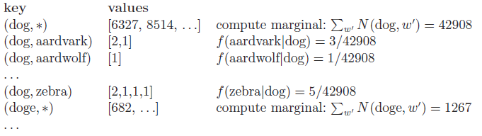
Order Inversion (cont’d)
Modify mapper to emit a special key-value pair (w, *) for each co-occurring word pair in the mapper to capture its contribution to the marginal.
Make sure that key-value pairs representing the marginal contributions are processed by the reducer before any of the pairs representing the joint word co-occurrence counts.
Special symbol of the form (w, *) must be ordered before any other key-value pairs where the left word is w.
Ensure that all pairs with the same left word are shuffled to the same reducer. (Using Custom partitioner)
Notes:
(wi, *)

Slide 19
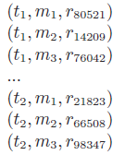


Value-to-Key Conversion
Secondary Sorting Example (sorting by value)
Sensor data collected over time for m sensors
How to reconstruct the activity at each individual sensor over time ?
Intermediate Key
OR
Move part of the value into the intermediate key to form a composite key
Sort intermediate key by sensor id first, and then by timestamp
Custom portioning based on sensor id
Notes:
This would bring all readings from the same sensor together in the reducer.
BUT sensor readings will not likely be in temporal order.

Slide 20
Working with Composite keys and/or values
In-built keyfield based partitioning and sorting
Keys are seen as combination of fields (e.g 10.242.144.20)
Fields are recognized based on key field separator
KeyFieldBasedPartitioner
KeyFiledBasedComparator
Through customization
Custom Writable
Custom Partitioner
Custom Comparator

Slide 21
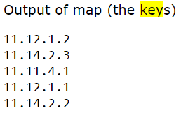
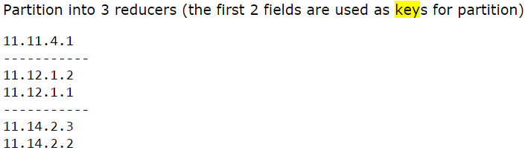
Partitioning with Key Fields
map.output.key.field.separator = “.”
mapred.partitioner.class = org.apache.hadoop.mapred.lib.KeyFieldBasedPartitioner
mapred.text.key.partitioner.options = -k1,2
Notes:
-k1, 1
-k1, 2

Slide 22
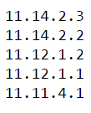
Sorting with Key Fields
map.output.key.field.separator = “.”
mapred.output.key.comparator.class = org.apache.hadoop.mapred.lib.KeyFieldBasedComparator
mapred.text.key.comparator.options = -k2nr
Notes:
map.output.key.field.separator = “,”
-k1 –k2

Slide 23
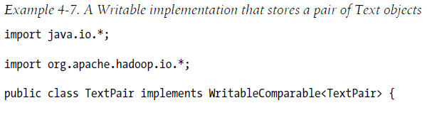
Customization-based Approach for Composite keys
Implement custom writable, which
can be used as composite key
Implement custom comparator
to redefine sort ordering
Implement custom partitioner
to have more control over
composite key partitioning.
Notes:
Writable is a serialization format used by Hadoop. (turning structured objects to byte streams for network transmission or storage)

Slide 24
More Complex Algorithms
Relational Joins
Data warehousing
Graph Algorithms
Page-rank
Minimum spanning tree
Bipartite graph matching
Maximum flow
Machine Learning
Expected Maximization
Hidden Markov Models
Linear Regression

Slide 25
Reference
Data-Intensive Text Processing with MapReduce
Jimmy Lin and Chris Dyer
University of Maryland, College Park
Hadoop: The Definitive Guide
Tom White

Slide 26
EXTRAS

Slide 27
((I, enjoy), 1)
(enjoy, flying), 1)
(flying, .),1)
((I, like), 1)
(like, NLP), 1)
((NLP, .), 1)
I enjoy flying.
I like NLP.
MAP 1
REDUCE
((I, like), 1)
(like, deep), 1)
(deep, learning),1)
((learning, .), 1)
I like deep
learning.
MAP 2
REDUCE

