Slide 1
CS 4843 Cloud Computing Hadoop and MapReduce
Palden Lama, Ph.D Department of Computer Science University of Texas at San Antonio

Slide 2
Agenda
Big Data Challenges
Hadoop Overview
MapReduce
Job Execution
Fault Tolerance
Data Locality
Speculative Execution
Hadoop Distributed File System (HDFS)
HDFS Architecture
HDFS Operations
Replica Placement

Slide 3

Data Deluge
The New York Stock Exchange generates about one terabyte of new trade data per day.
Facebook hosts approximately 10 billion photos, taking up one petabyte of storage.
Ancestry.com, the genealogy site, stores around 2.5 petabytes of data.
The Internet Archive stores around 2 petabytes of data, and is growing at a rate of 20 terabytes per month.
The Large Hadron Collider near Geneva, Switzerland, will produce about 15 petabytes of data per year.
application

Slide 4
Big Data Characteristics (3 Vs)
Volume
Large data size (TBs, and PBs)
Conventional relational database are not scalable enough
Velocity
High rate of data generation
To keep storage requirements practical, analysis is required to streaming data
Analyze streaming data for immediate response
Variety
Diverse data source (social network, image data, sensor data, etc.)
Unstructured and semi-structured data (web logs, XML, JSON, etc.)
Notes:
Velocity - > proliferation of mobile devices, sensor networks, and new sources of data such as social media
Streaming -> large hadron collider at CERN

Slide 5

Distributed Data Processing
Large data centers (x1000 machines): storage and computation
application
Traditional approach:
highly complex programs
expensive and powerful machines
data was moved from storage to compute clusters for processing
Parallelize computation and data access
Handle failures
Inter-machine communication
How to handle such complexity ?

Slide 6
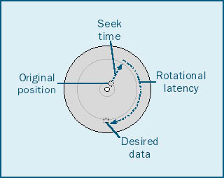
Handing Big Data with Hadoop and MapReduce
Scale out instead of scale up
(large number of cheap commodity servers)
Assume failures are common
(failures are handled automatically through software)
Move process to data
(faster than moving data to process)
Process data sequentially and avoid random access
(large block size)
Seamless scalability

Slide 7

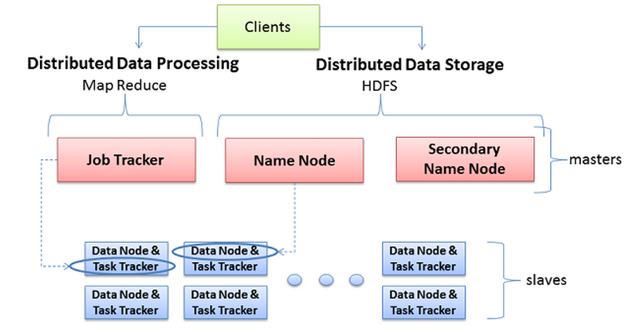
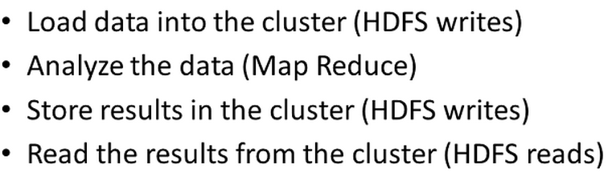
A framework that allows for the distributed processing of large data sets across clusters of computers using simple programming models. It is designed to scale up from single servers to thousands of machines, each offering local computation and storage.

Slide 8
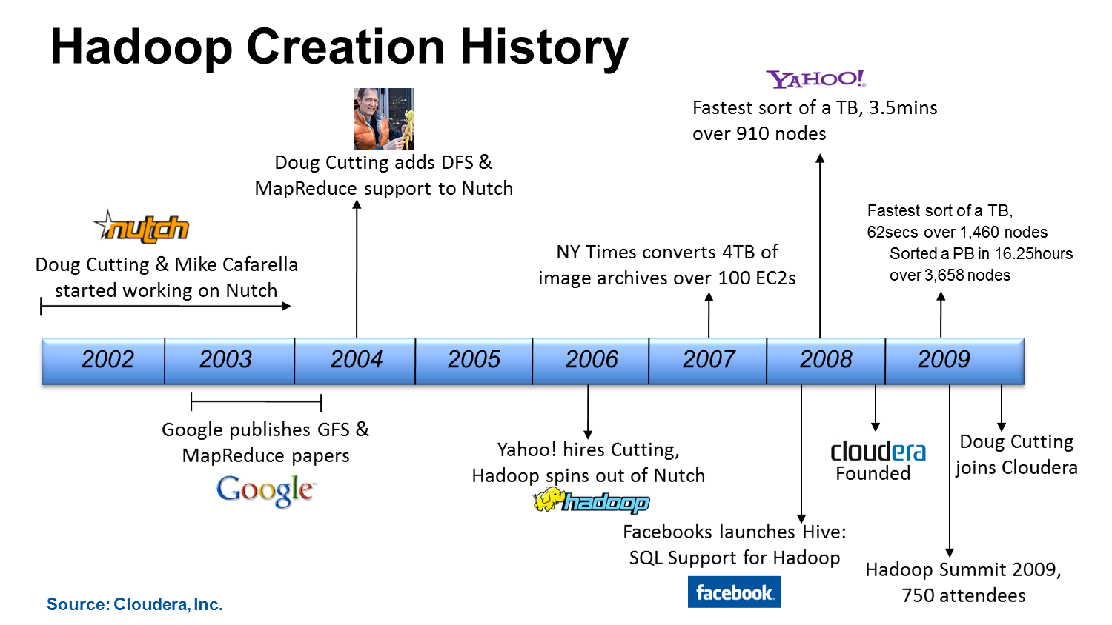
A Brief History of Hadoop

Slide 9
MapReduce [Google, OSDI 04]
A programming model for distributed data processing.
A MapReduce job usually splits the input data-set into independent chunks which are processed by the map tasks in a completely parallel manner. The framework sorts the outputs of the maps, which are then input to the reduce tasks.
The MapReduce framework takes care of scheduling tasks, monitoring them and re-executes the failed tasks.
Typically the compute nodes and the storage nodes are the same, that is, the MapReduce framework and the Distributed File System are running on the same set of nodes.

Slide 10
MapReduce [Google, OSDI 04] : Major Contributions
This programming model is easy to use, even for programmers without experience with parallel and distributed systems.
hides the messy details of parallelization, fault tolerance, data distribution and load balancing
Good fit for problems that need to analyze the whole dataset (unstructured data)
web indexing, data mining, log file analysis, data warehousing, etc
Originally Implemented on Google’s cluster using GFS (Google File System)
Google’s MapReduce library was implemented in C++.
a typical MapReduce computation processes many terabytes of data on thousands of commodity machines

Slide 11
MapReduce [Google, OSDI 04] cont’d
User Program
- Map, Reduce functions
Master : JobTracker
Worker : TaskTracker
Master
assign map
assign reduce
Input Data
Worker
Worker
Output File 0
Split 0
Split 1
Split 2
Worker
Worker
Output File 1
Worker
(intermediate result)
local write, and partitioning

Slide 12
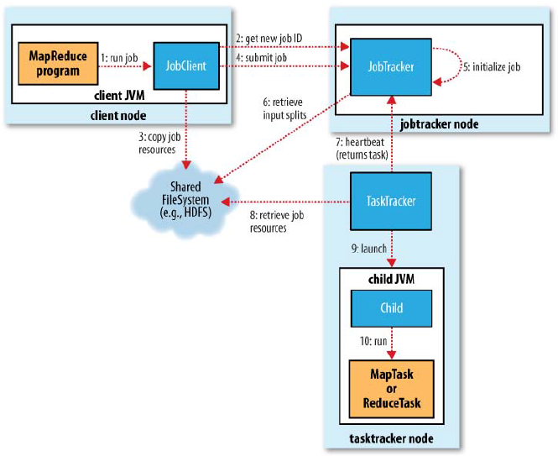
How Hadoop runs a MapReduce job
Job Client
Primary interface for user job to interact with the Hadoop cluster
Used for submitting job and tracking job progress
Job Submission
2: Get new job id
3: Copies job resources to HDFS
4: Calls jobsubmit() on jobtracker
Job Initialization
Puts job in an internal queue
5: Job scheduler picks up job according to its scheduling algorithm
6: Job scheduler retrieves input splits for the selected job
Creates a list of map and reduce tasks (task are given IDs). Each map task is created for a particular input split.
Notes:
Jobclient’s submitJob( )
- get new job id( ) from jobtracker
- calls the getsplits() method to computes the input splits based on job configuration - input path, and split size,
- copies JOB resources to HDFS – JAR file (high replication mapred.submit.replication =10) , config file, computed input splits
- calls jobtracker’s submitjob() method

Slide 13
How Hadoop runs a MapReduce job (cont’d)
Task Assignment
7: Each tasktracker periodically calls heartbeat method (indicating whether it is ready to run task every 5 seconds)
Jobtracker assigns a map/reduce task to the tasktracker
The default scheduler fills up the empty map slots before reduce slots
Tasktracker has a fixed number of map and reduce slots
Notes:
Heartbeat every 5 seconds minimum.
For larger cluster, heatbeat is sent less frequently

Slide 14
How Hadoop runs a MapReduce job (cont’d)
Task Execution
8: Tasktracker retrieves job resources
9: Launches a new JVM for running each task
Child process informs the parent about task progress every few seconds until completion.
Notes:
Child JVM : isolates failure of tasks from tasktracker

Slide 15
MapReduce [Google, OSDI 04]: Fault Tolerance
User Program
- Map, Reduce functions
How is fault detected ?
What happens to failed tasks ?
What happens to completed tasks ?
Master
assign map
assign reduce
Input Data
Worker
Worker
Output File 0
Split 0
Split 1
Split 2
Worker
Worker
Output File 1
Worker
(intermediate result)
local write, and partitioning

Slide 16
Handling Task Failures
JobTracker
reschedule task
notify
TaskTracker
[Kill child JVM], free up slot
mapred.task.timeout
Child JVM
Child JVM
Runtime Exception
Hangs

Slide 17
Handling Task Failures
When user code throws runtime exception
Child JVM reports error to tasktracker, before it exits.
Tasktracker marks task attempt as failed, and frees up a slot to run another task.
Tasktracker notifies task failure to Jobtracker through heartbeat call.
When a task hangs (does not report progress for a period – mapred.task.timeout)
Tasktracker marks task as failed, kills child JVM, and frees up a slot.
Tasktracker notifies task failure to Jobtracker through heartbeat call.
When the Jobtracker receives task failure notification
Reschedules execution of the task.
Avoids rescheduling task to the tasktracker that had previously failed.
mapred.map.max.attempts and mapred.reduce.max.attempts
Notes:
Timeout -> 10 min – mapred.task.timeout
If failures exceeds max.attempts, whole job is failed.

Slide 18
Tasktracker and Jobtracker Failures
Jobtracker Actions on Tasktracker failure
Jobtracker assumes tasktracker failure if heatbeat is not received for 10 minutes or as specified by mapred.task.tracker.expiry.interval
Removes the failed tasktracker from its list for scheduling purpose.
Reschedules tasks that were in progress.
Reschedules map tasks that completed on the tasktracker but are part of incomplete jobs.
Jobtracker failure
No mechanism to handle this.

Slide 19
MapReduce [Google, OSDI 04]: Data Locality
User Program
- Map, Reduce functions
What is data locality ?
Why data locality ?
How is data locality achieved ?
What if data-local tasks are not available ?
Master
assign map
assign reduce
Input Data
Worker
Worker
Output File 0
Split 0
Split 1
Split 2
Worker
Worker
Output File 1
Worker
(intermediate result)
local write, and partitioning

Slide 20
Data Locality-Aware Task Assignment
Task Assignment
7: Each tasktracker periodically calls heartbeat method (indicating whether it is ready to run task every 5 seconds)
Jobtracker assigns a map/reduce task to the tasktracker
Assign a map task whose input split is as close to the tasktracker as possible.
Preference for task assignment:
data-local > rack-local > non-local
Tasktracker has a fixed number of map and reduce slots
Notes:
Look for data-local tasks in a job.
If not found, skip the job and fetch next one
If a job has been skipped for a certain time, allow rack-local tasks from that job to run. If not found, skip the job.
If a job has been skipped for a certain time at rack-level, allow non-local tasks from that job.
Prevents starvation

Slide 21
MapReduce [Google, OSDI 04]: Slow Nodes
User Program
- Map, Reduce functions
What if some nodes are much slower than others ?
Master
assign map
assign reduce
Input Data
Worker
Worker
Output File 0
Split 0
Split 1
Split 2
Worker
Worker
Output File 1
Worker
(intermediate result)
local write, and partitioning

Slide 22
Problem: Impact of slow nodes on MapReduce Job
Some tasks may be slower than others due to faulty hardware, or software misconfiguration - stragglers
A few stragglers can slowdown the entire job.
8 Map tasks
2 Reduce tasks
node1
node2
node3
node4
MapReduce Job execution time

Slide 23
Solution: Speculative Execution
Avoid straggler tasks from slowing down the whole job
Hadoop detects when a task is running slower than expected and launches a duplicate copy of the task as a backup.
Hadoop's scheduler starts speculative tasks based on a simple heuristic comparing each task's progress to the average progress.
Whichever copy finishes first is accepted, and the duplicate task is killed
Notes:
Only the last wave of tasks is affected by it.

Slide 24
8 Map tasks
2 Reduce tasks
node1
node2
node3
node4
MapReduce Job execution time
node1
1
2
node2
3
4
node3
5
7
6
8
node4
7
killed
8
killed
MapReduce Job execution time with Speculative Execution

Slide 25
Selection of Speculative tasks
Hadoop monitors tasks progress score between 0 and 1
Progress score of Map task is the fraction of input data read.
Progress score of Reduce task is divided into three phases
copy phase when task fetches map output
sort phase when map outputs are sorted/merged
reduce phase when the reduce function is applied
For each phase progress is calculated as fraction of data processed
If a task’s progress score is less than average progress score minus 0.2, and the task has run for at least a minute, it is marked as a straggler
In case of multiple stragglers, data local tasks are preferred for execution.

Slide 26
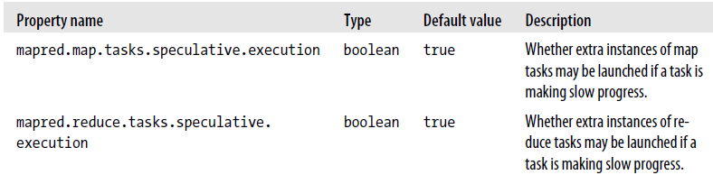
Speculative Execution (cont’d)

Slide 27
Hadoop Distributed File System (HDFS)
Distributed filesystems
Filesystems that manage the storage across a network of machines.
Designed to hold data and provide access to many clients across the network.
E.g. NFS (Network File System), GFS (Google File System), HDFS, etc.
HDFS
Holds and provides high throughput access to very large amount of data (Petabytes)
– By spreading data across a large number of machines
Fault Tolerant
– By data replication
Scalable: possible to server larger number of clients by adding more machines
- Distributed data nodes
Allows data to be read and computed upon locally when possible.
- Integration with MapReduce

Slide 28
HDFS Limitations
Not suitable for random realtime (low latency) data access
Optimized for long sequential read performance
Alternative: HBase (a no-sql datastore built on top of HDFS)
Not suitable for lots of small files
Increases overhead for Namenode
Limited by the memory capacity of Namenode
Does not support multiple writers, or modification at arbitrary offsets in a file

Slide 29
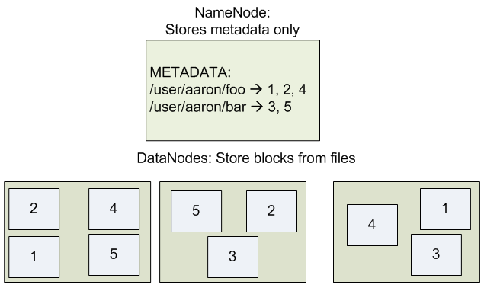
HDFS Blocks and Files
Files are broken into blocks of fixed size (block: smallest unit of data stored in a filesystem)
Blocks are replicated and stored across cluster of machines (datanodes)
Namenode stores metadata information
Filesystem namespace
File Permissions
File to Block Mapping
Block location
Default Replication factor = 3
Default Block Size = 64 MB
A file too large to fit in one machine, can be easily stored in HDFS
Simplifies management (fixed size blocks)
Fault tolerant
Notes:
Benefit : file can be larger than any single disk
the target machines which hold each block are chosen randomly on a block-by-block basis

Slide 30
Why Is a Block in HDFS So Large?
Disk blocks are normally 512 bytes, Hadoop default block size is 64 MB
Large block size
Amortizes the time to locate each block
Decreases the amount of meta data storage required per file
However too large block may be counter productive since it reduces parallelism.
Notes:
Disk block = minimum amount of data that can be read or written

Slide 31
NameNode: FileSystem MetaData
Persistent MetaData
fsimage file
File system metadata - file’s replication level, access permissions, modification and access times, block size, and block ids associated with the file
edit log
updated for a write operation such as creating, or moving a file.
operations on edit log is applied to in-memory filesystem metadata
direct operation on fsimage would be too slow
when namenode restarts, fsimage is loaded to memory and then edit log operations are applied
In memory MetaData
In memory representation of filesystem image
Block locations on datanodes
Constructed intitially in Safemode, when datanodes give their block list when they join the cluster
Updated periodically to ensure correct mapping
Notes:
Inode : data structure representing a filesystem object – stores attributes and disk block locations of the object

Slide 32
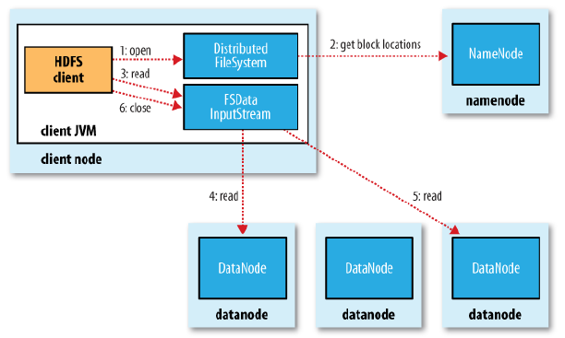
Reading data from HDFS
Open() on a filesystem object/ instance of DistributedFileSystem class
Gets a batch of block locations from the Namenode using RPC call
Returns an FSDataInputStream
Read() on FSDataInputStream
For each block
Connects to first (closest) datanode
Reads the data from that datanode
Gets next batch of block locations
from the Namenode
Close() on FSDataInputStream
Notes:
Hdfs interfaces : command line interface, or FileSystem APIs in Java program
MapReduce task can be a client

Slide 33
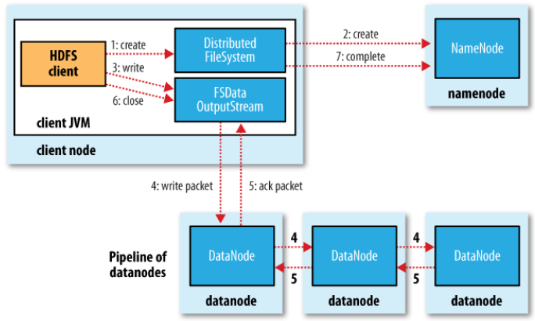
Write data to HDFS
Create() on DistributedFileSystem
RPC call to namenode to create a
new file (with no blocks associated)
Returns FSDataOutputStream
Write() on FSDataOutputStream
Data is buffered in internal queue
Namenode is contacted to allocate blocks
and find a list of Datanodes for storing data
Data is streamed to the datanodes in a
pipeline
Close() on FSDataOutputStream
Flushes the remaining data to pipeline
Waits for acknowledgement
Contacts Namenode for completion
Notes:
List of data nodes forms a pipeline for replicated data storage

Slide 34
Replica Placement
Tradeoff between Reliability, Write Bandwidth and Read Bandwidth
Placing all replicas on single node
Lowest write bandwidth penalty (low replication overhead)
Poor reliability
High read bandwidth penalty (multiple jobs/users reading from same node)
Placing all replicas on different racks
High reliability
High write bandwidth penalty
Low read bandwidth penalty

Slide 35
Replica Placement
Hadoop’s Default Policy
Place the first replica on the same node as the client (for clients running outside the cluster, a node is chosen at random, although the system tries not to pick nodes that are too full or too busy).
The second replica is placed on a different rack from the first (off-rack), chosen at random.
The third replica is placed on the same rack as the second, but on a different node chosen at random.
Further replicas are placed on random nodes on the cluster, although the system tries to avoid placing too many replicas on the same rack.

Slide 36
Network Topology: Rack Awareness
The namenode uses the network location (rack awareness) when determining where to place block replicas.
The jobtracker uses network location (rack awareness) to determine where the closest replica of an input split is for a map task.
(data-local vs rack-local)
Hadoop can be made rack-aware by providing a script which allows the master node to map the network topology of the cluster.
Network topology script
/switch1/rack1
/switch1/rack2
IP address (node1)
IP address (node4)

Slide 37
Network Distance in Hadoop
1
1
Network is represented as a tree and the distance between two nodes is the sum of their distances to their closest common ancestor
1
1
1
1
1
1
d=2
d=4
Notes:
Dist measured in hops.

Slide 38

Network Distance (cont’d)
What is the network distance between a) Node1 and Node 7 ?
b) Node7 and Node 10 ?
CORE SWITCH
AGGREGATE SWITCH
Switch1
Switch2
TOR
SWITCH
Node 1
Node 2
Node 3
Node 4
Node 5
Node 6
Node 7
Node 8
Node 9
Node 10
Node 11
Node 12

Slide 39
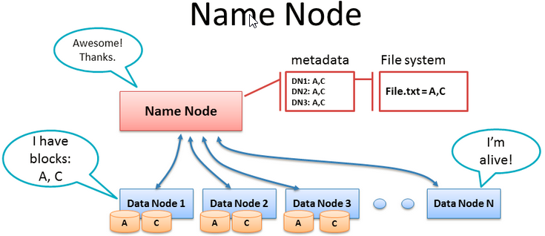


Failure handling in HDFS
1. Data Node 3 fails
2. Name Node consults metadata
3. Name Node consults rack awareness script
4. Name Node tells a datanode to re-replicate to maintain the default replication factor of 3.
8
Replication factor = 3
Notes:
What happens with data node failure. File.txt has 2 blks, each is 64mb. Name node knows where the blks are stored. Replication factor is 3 so 3 copies of each blk. Each datanode has alive func that sends notice ot name node to tell it its alive. If no signal from data node then there is a timeout in Name node. So now there are only 2 copies of a,c cuz data node 3 is dead. So where does name node make the 3rd copy. Rack awareness script is consulted. Rack has DN2 and its crap so it goes to another rack, rack 9. DN8 is used to store 3rd copy of a,c.

Slide 40
HDFS Cluster Size
You are building a Hadoop cluster where each datanode has 128 GB of free disk space. How many datanodes are needed to store a file of size 1 TB in the Hadoop cluster ? Replication factor is 3.
Notes:
Total file size / size of node = 3*1024GB/128GB = 24 data nodes needed.

Slide 41
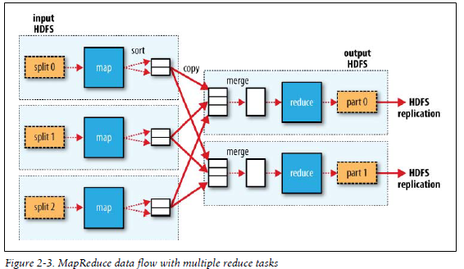
MapReduce job execution in Hadoop Cluster
Record Reader: read input split from HDFS, and provide key-value pairs to the map task.
(e.g key=byte_offset of a line of text, value=line of text)
p1
map task: executes a user-provided Mapper program (Java) and produces intermediate records in key-value pairs. The number of map tasks = number of input splits.
p2
Record Reader
Partitioner
p1
p1
p2
Partitioner: divides intermediate records (key-value pairs) into multiple partitions
group of keys are assigned to a partition
same key can’t be assigned to multiple partitions
Keys are sorted within each partition
each partition is sent to a unique reduce task
number of partitions = number of reduce tasks
Default partitioner = Hash Partitioner
partitionID = Hash(Key)%number_of_reducers
Record Reader
Partitioner
p2
p1
p2
Record Reader
Partitioner
Notes:
Each lite blue box is a node. Split is a piece of data we working on. Many splits can be worked on by one copy of func. User defines reduce task number.

Slide 42
MapReduce job execution in Hadoop Cluster
Copy/Shuffle: partitions of intermediate key-value pairs are sent to nodes running the reduce tasks.
p1
p2
Record Reader
Partitioner
p1
Merge: partitions are merged (merge sort) and fed to a reduce task.
p1
p2
Record Reader
Reduce: executes a user-provided Reducer program (Java) and writes the final output to HDFS. The number of reduce tasks has to be specified by the user.
Partitioner
p2
p1
p2
Record Reader
Partitioner

Slide 43
Launching a MapReduce job in Hadoop Cluster
Packaging the JAR file
Run the application
$ bin/hadoop jar /usr/joe/wordcount.jar org.mypackage.WordCount /usr/joe/wordcount/input /usr/joe/wordcount/output
What if our Mapper and Reducer programs are not written in Java ?

Slide 44
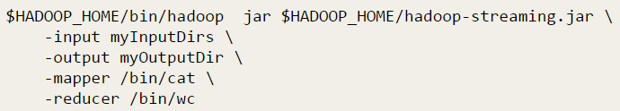
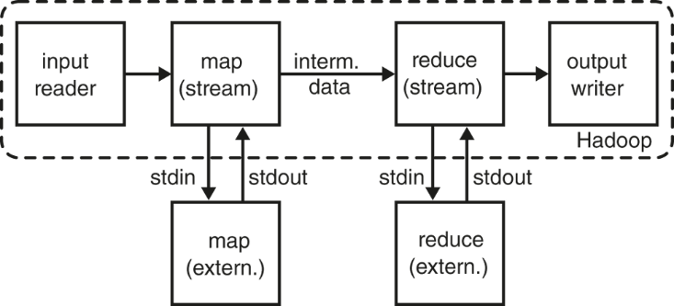
Hadoop Streaming
The utility allows you to create and run Map/Reduce jobs with any executable or script as the mapper and/or the reducer.

Slide 45
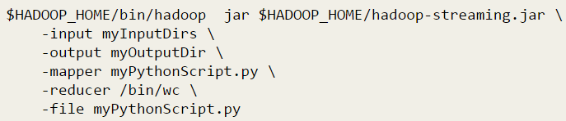
Hadoop Streaming: Packaging file with job submission

Slide 46
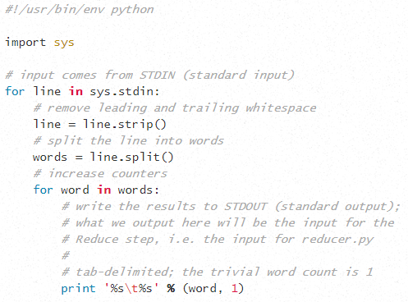
Wordcount Mapper in Python
Deer 1
Bear 1
River 1
Bear 1
Deer Bear River
Bear
Mapper.py
Deer Car River
Car
Mapper.py
Deer 1
Car 1
River 1
Car 1
Notes:
Important need the sh-bang for code to work

Slide 47
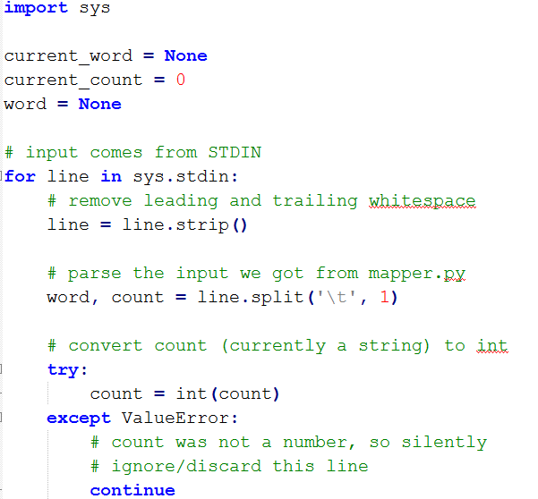
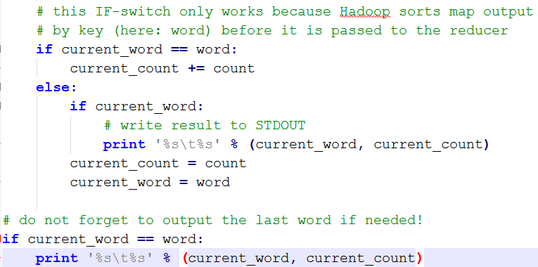
Wordcount Reducer in Python
Bear 1
Beer 1
Car 1
Car 1
Deer 1
Deer 1
River 1
River 1
Bear 2
Car 2
Deer 2
River 2
Reducer.py
Notes:
Same keys are kept in same partition.

Slide 48
Optimizing MapReduce with Combiner : Wordcount Example
Deer 1
Bear 1
River 1
Bear 1
Bear 2
Deer 1
River 1
Deer Bear River
Bear
Mapper.py
Combiner
Reducer
Deer Car River
Car
Mapper.py
Deer 1
Car 1
River 1
Car 1
Combiner
Car 2
Deer 1
River 1
Problem:
redundant intermediate pairs causes too many network transfers and disk write operations.
Solution:
use (user-provided) Combiner to reduce intermediate data
Reducer.py can be used as combiner in the wordcount example
Notes:
Redundant data such as bear 1 in first node causes too much data xfers and writes. So use a user created combiner to combine same key values and reduce xfers and writes.

Slide 49
Hadoop Streaming: Launching Python based MapReduce program
$HADOOP-HOME/bin/hadoop jar $HADOOP_HOME/hadoop-streaming.jar \
-input myInputDirs \
-output myOutputDir \
-file mymapper.py \
-mapper mymapper.py \
-file myreducer.py \
-reducer myreducer.py \
-combiner myreducer.py

