Slide 1

CS4843: Cloud Computing The Art of Virtualization
Palden Lama, Ph.D.
Department of Computer Science
University of Texas at San Antonio
http://cs.utsa.edu/~plama

Slide 2
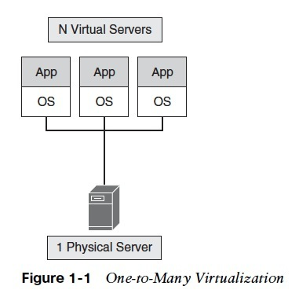
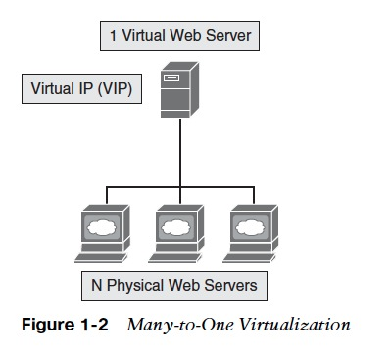
Virtualization Basics
Abstraction of physical resources into logical units, such that:
a single physical resource can appear as many logical units (one-to-many)
multiple physical resources can appear as a single logical unit (many-to-one)
e.g LVS (Linux Virtual Server)
http://www.linuxvirtualserver.org/
e.g Xen, KVM, Vmware, etc.
Hypervisor / VMM
Notes:
Different types of one-to-many virtualization, based on the degree to which virtual machines implement the functionality of targeted real machine.
Each VM emulates a physical computer by creating a separate operating system environment
Each OS gets the illusion that it is the only one running on the host server

Slide 3
A Brief History of Virtualization
Need for Virtualization
1960s,
Time sharing in IBM mainframe
1980s, 1990s
Inexpensive x86 machines,
Distributed Computing
Late 1990s onwards
Powerful x86 servers, multi-core technology, Cloud Computing Era

Slide 4
Implementation Levels of Virtualization
Heavyweight
More Functionality
Hardware Abstraction Level
Instruction Set Architecture
Operating System Level
Library Level
User-Application Level
Different levels of one-to-many virtualization, based on the degree to which virtual machines/logical units implement the functionality of targeted real machine.
Lightweight
Limited Functionality

Slide 5
Implementation Levels of Virtualization User Application Level
Application program acts as a virtual machine
High level language (HLL) VMs
Runs programs written and compiled to a particular abstract virtual machine.
e.g Java Virtual Machine (JVM) , .NET Common Language Runtime (CLR)
Application Sandboxing
Isolate application from host OS and other applications.
Execute applications without them being installed in the traditional sense by virtualizing resources such as environment variables, files, etc.
E.g Vmware Thinapp, XenApp, Virtualenv etc.
Benefits ?
Portability
Portability, Avoid software conflict (DLL hell)
Benefits ?
Most suitable for standalone Desktop applications

Slide 6
Implementation Levels of Virtualization Library Support Level
Virtualize APIs
Intercept API calls to redirect to different implementations
Control communication between application and system through API hooks.
Example,
WINE (Wine Is Not an Emulator) allows Windows application to run on UNIX hosts by translating Windows system calls into POSIX-compliant system calls

Slide 7
Implementation Levels of Virtualization Operating System Level
Abstraction layer between OS and applications to create isolated containers on a single physical server.
Containers provides namespace isolation and resource isolation.
Namespace isolation: isolate applications' view of the operating environment, including process trees, network, user ids and mounted file systems.
Resource isolation: isolate the usage of CPU, memory, I/O, network, etc. using Linux kernel’s cgroup feature.
Pros/Cons:
low virtualization overhead, low resource requirements, minimal startup/shutdown costs
can not support multiple OS on same physical server
Examples: LXC, Docker, Jail, FVM, etc.
Notes:
Containers look like real servers to the user
LXC uses cgroups for resource isolation (CPU, memory, block I/O, network, etc.),
FVM (feather weight VM) WINDOWS PLATFORM

Slide 8
Implementation Levels of Virtualization Instruction Set Architecture Level
Emulating target ISA by the ISA of the host machine
e.g MIPS binary code on x86-based host machine
Improves portability of legacy binary code
Methods:
Code interpretation: decode and interpret source instruction to target instruction and execute one by one. (slow)
Binary translation (Static and Dynamic): binary code of the source is directly translated to binary code of target processor
Examples: QEMU, BOCHS, Transmeta, etc.
Notes:
e.g MIPS binary code on x86-based host machine
Code interpretation: decode and interpret source instruction to target instruction and execute one by one. (slow)
Binary Translation / Recompilation : binary code of the source is directly translated to binary code of target processor

Slide 9
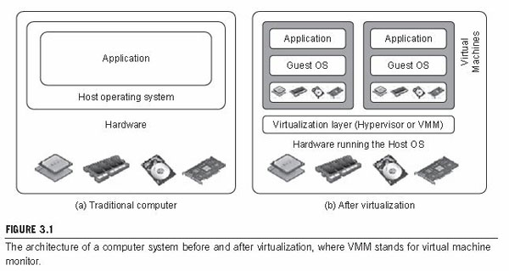
Implementation Levels of Virtualization Hardware Abstraction Level
Generates an isolated virtual hardware environment for a VM
Virtualizes CPU, memory, I/O devices, etc.
Provides the illusion that each VM’s OS is controlling the hardware of the entire host.
Improves server utilization, eases application deployment, increases availability, etc.
Example: Xen, Vmware ESX, KVM, VirtualBox, etc.
Notes:
Multiplex multiple virtual machines on the same hardware by trapping priviledged instructions and re-routing to VMM

Slide 10
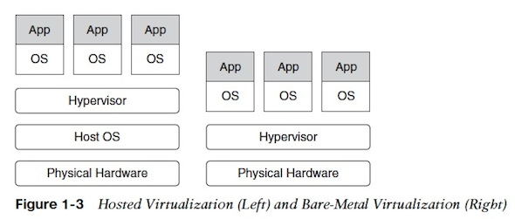
Types of Hardware Virtualization
Type 2 Virtualization
Type 1 Virtualization
- more efficient
(system calls go through fewer layers)
platform/hardware specific
E.g Xen, Vmware ESX
Less efficient
Supports wider range of platforms
E.g virtualbox, Vmware workstation
Notes:
Type 1 hypervisors are typically more efficient because they have direct access to the underlying hardware and can deliver superior performance any system call made by the guest operating system has to go through fewer software layers
Type 2 hypervisors support a wider range of platforms and I/O devices, because they run on top of a standard operating system.
(popular among PC, laptops) e.g Vmware WorkStation, VirtualBox etc.

Slide 11
Hardware Virtualization
Common hypervisors used in the cloud
KVM (used by Google cloud)
Xen (used by Amazon cloud)
HyperV (used by Azure)
VMWare (used in many commercial clouds)

Slide 12
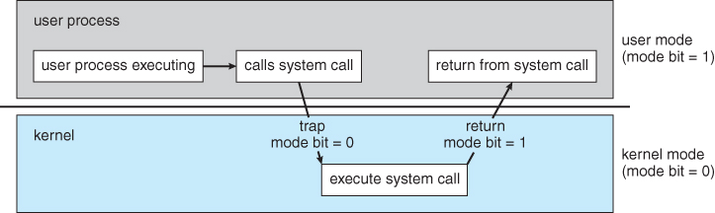
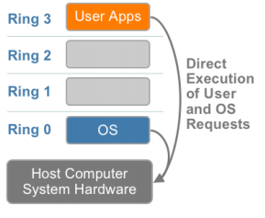
Virtualizing the CPU: CPU modes
User mode
System call
Kernel mode
Privileged vs. Non-privileged instructions
X86 architecture offers 4 levels of privilege
to OS and applications

Slide 13
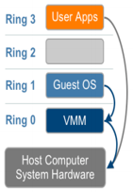
Virtualizing the CPU: Trap and Emulate
User mode
System call
System call
virtualize
De-privilege the OS
(system calls will trap to VMM
instead of OS)
Kernel mode

Slide 14
x86 Hardware Virtualization Challenge
Challenges:
Virtualization requires placing the virtualization
layer in Ring 0.
X86 has some sensitive instructions that need VMM
intervention, but difficult to trap since they were
non-privileged instructions.

Slide 15
Popek and Goldberg Virtualization Theorem
A computer architecture is virtualizable if its sensitive instructions are a subset of its privileged instructions.
Instruction classification:
Privileged Instructions: instructions that if executed in user mode trap to kernel mode.
Control Sensitive Instructions: instructions that modify the system registers.
Behavior Sensitive Instructions: instructions whose behavior depends on the mode or configuration of the hardware. E.g PUSH, POP, JMP, INT, MOV, etc
Critical Instructions : sensitive but non-privileged instructions in the kernel code
X86 architecture was difficult to virtualize
Notes:
1974 ..
System registers : stack register, control registers, memory management registers, etc. e.g PUSHF, POPF, SGDT, etc
Behavior sensitive : PUSH, POP, JMP, INT, MOV, etc.
Binary Translation: dynamically rewrites portions of the hosted machine code to insert traps wherever VMM intervention might be required

Slide 16
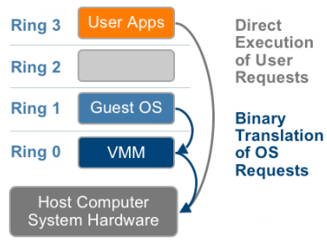
Full Virtualization
In 1998, VMware developed a technique (binary translation) that made x86 virtualization
possible.
Combination of direct execution and binary translation
User-level code executed directly
Kernel code is translated on the fly to replace nonvirtualizable instructions with new instructions that have the intended effect on the virtual hardware.
VMM provides all the services of the physical system
to the VMs.
Pros:
Guest OS is completely decoupled from the hardware
no need to modify the OS
provides portability and isolation
Cons:
Performance hit due to binary translation
Notes:
In 1998, VMware developed a technique (binary translation) that made x86 virtualization possible.
E.G Vmware products

Slide 17
Para Virtualization/ OS Assisted Virtualization
Modified OS replaces non-virtualizable instructions
with hypercalls that communicate directly
with the hypervisor.
Hypervisor provides interfaces of hypercalls
for critical kernel operations.
Advantage:
Lower virtualization overhead since binary
translation is not required.
Disadvantage:
Poor portability and compatibility
Support and maintanance issues due to OS modification
Notes:
Critical kernel operations : memory management, interrupt handling, time keeping, etc.

Slide 18
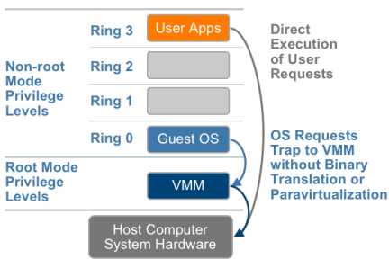
Hardware Assisted Virtualization
Virtualization support from hardware vendors
Intel VT-X, AMD-V
Privileged instructions execute in a new
CPU execution mode. (VMM in root mode)
Sensitive instructions are automatically
trapped to hypervisor.
Notes:
Processors with INTEL VT-X and AMD-V available from 2006 onwards.
Different generations of hardware support exist today.

Slide 19
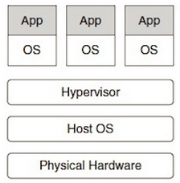
Host-Based Virtualization (Type 2)
Virtualization layer on top of host OS
Host OS still manages the hardware
Applications can run
directly on host OS
On top of guest OS
Examples: VMware workstation, VirtualBox, etc.
Notes:
Binary translation required with host OS has different ISA than guest OS.

Slide 20
Virtualizing Memory
OSes assume they have full control over memory
OS assumes it owns it all
OS assumes it can map any virtual page to any physical page
But VMM partitions memory among VMs
VMM needs to assign hardware pages to VMs
VMM needs to control mappings for isolation
Cannot allow an OS to map a virtual page to any hardware page
OS can only map to a hardware page given to it by the VMM

Slide 21
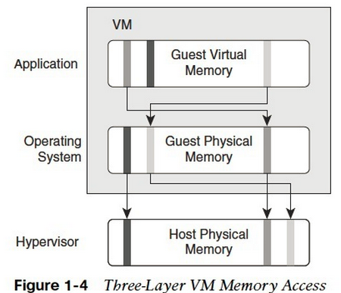
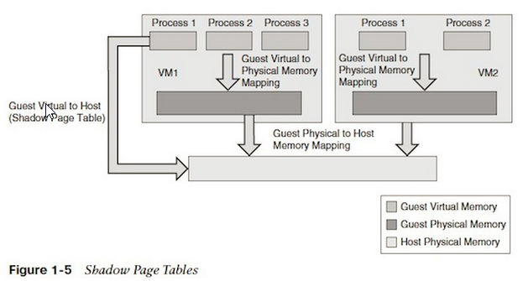
Virtualizing Memory
avoids performance hit due to double translation
updated by the hypervisor whenever the guest OS changes the mapping..
Notes:
Shadow page table: to avoid performance hit due to double translation,
updated by the hypervisor whenever the guest OS changes the mapping..

Slide 22
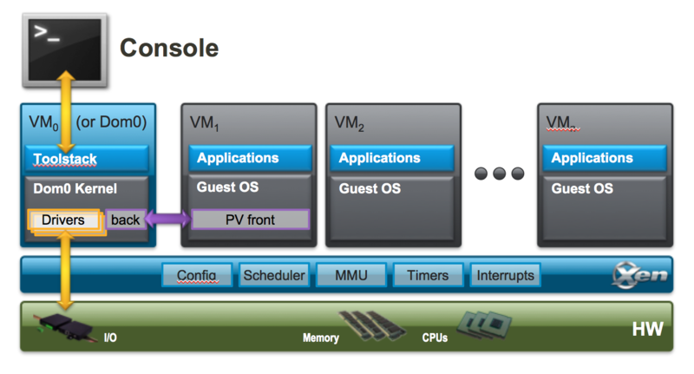
Hypervisor Architectures
Micro-Kernel Architecture
Includes basic and unchanging functions (memory management, processor scheduling, etc.)
Device drivers and other components are outside hypervisor.
e.g Xen, Microsoft Hyper-V, etc.
Monolithic Architecture
Includes all functions including those of device drivers.
Much larger is size than micro-kernel hypervisors.
e.g VMware ESX.
Xen hypervisor is lean (<150,000 lines of code)

Slide 23
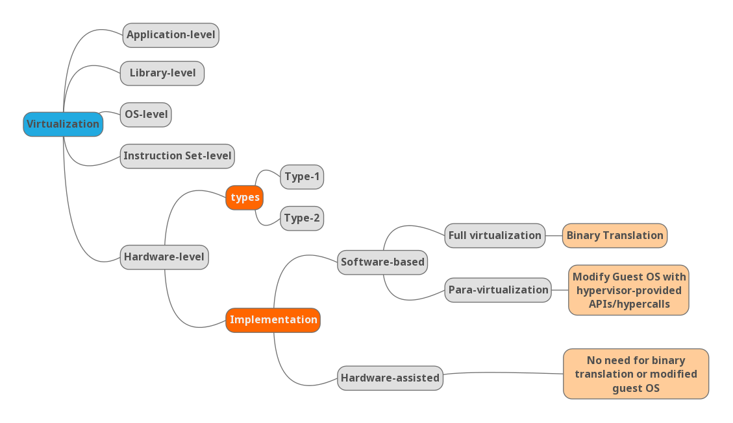
Taxonomy of Virtualization

