Slide 1
CS4843: Cloud Computing Cloud-based MPI Cluster Setup & Benchmarking
Palden Lama, Ph.D Department of Computer Science University of Texas at San Antonio

Slide 2
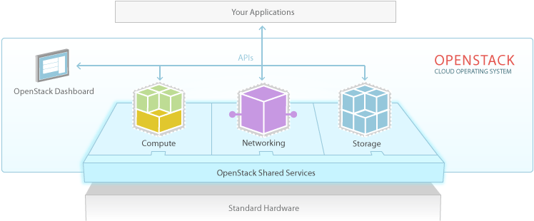
OpenStack

Slide 3
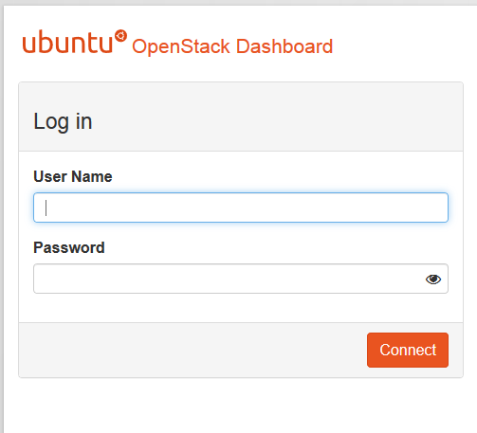
OpenStack Dashboard
Login to the horizon dashboard, with your username and password
http://10.100.11.11/horizon
Note: This is only accessible from on campus network.
UserName: groupX
Default Password: Fa2018
Please change your group password by logging in and navigating to Identity > Users > Change Password

Slide 4
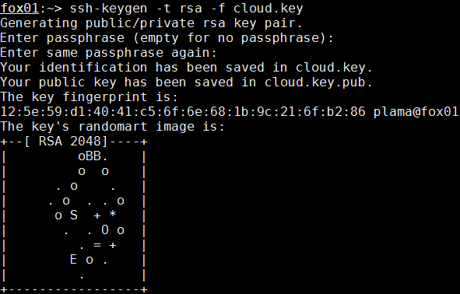
Create SSH Keypair
In order to log into the VMs that you will create, you need to create an SSH keypair for secure access to the VMs.
Login to a fox server (fox01.cs.utsa.edu)
Create a SSH key pair
This generates a pair of keys: a key you keep private (cloud.key) and a public key (cloud.key.pub)
ssh-keygen -t rsa -f cloud.key

Slide 5
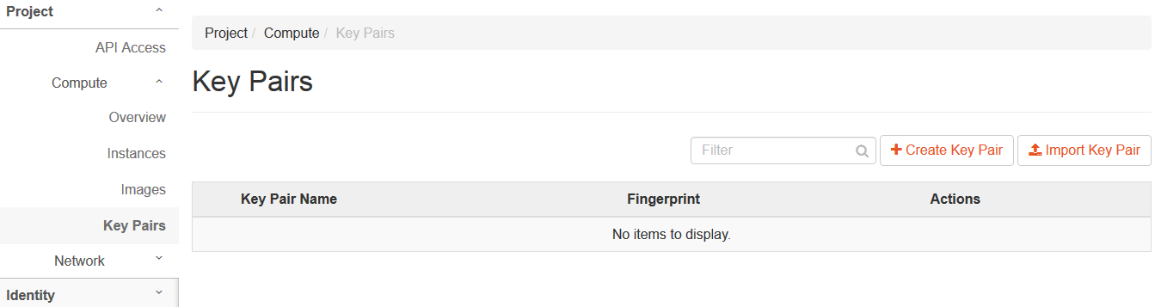
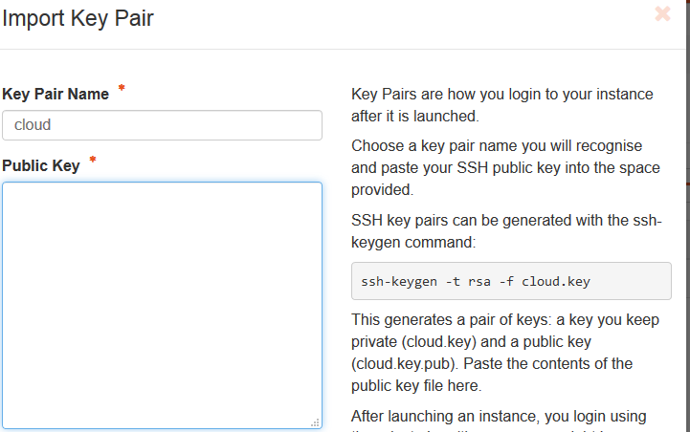
Create SSH Keypair
Login to the OpenStack Dashboard
Navigate to Project > Compute > Key Pairs
Click Import Key Pair
Copy & paste the content of cloud.key.pub file into the Public Key box.

Slide 6
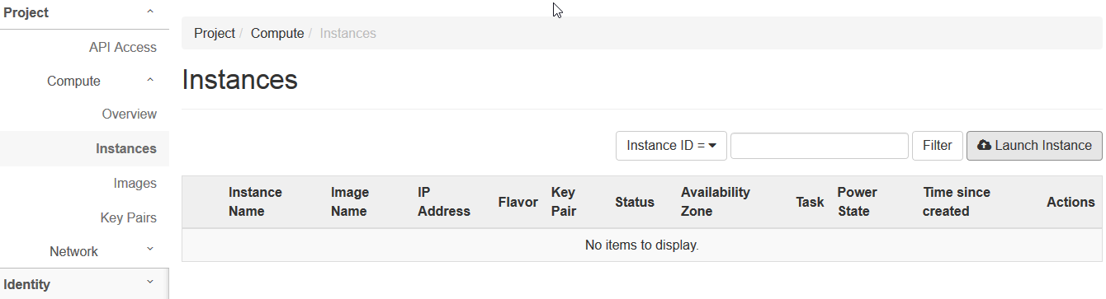
Build the OpenStack VM
In Horizon’s left-hand menu, navigate to Project>Compute>Instances and click Launch Instance.

Slide 7
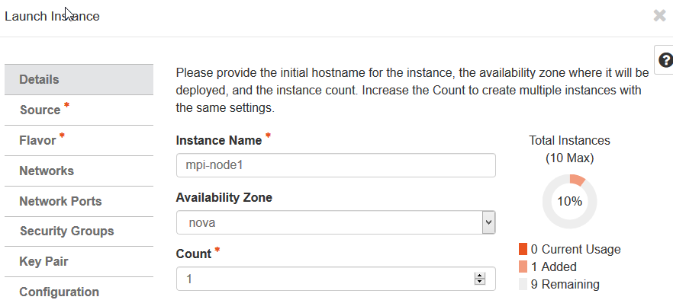
Build the OpenStack VM: Details
Give your VM a name

Slide 8
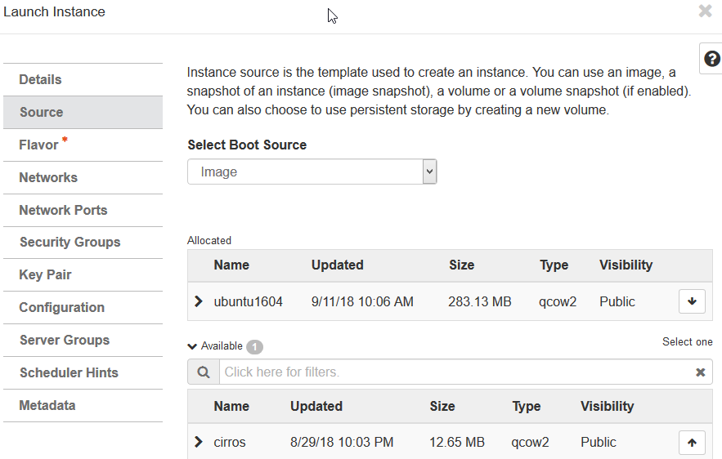
Build the OpenStack VM: Source
Select ubuntu1604 Source.

Slide 9
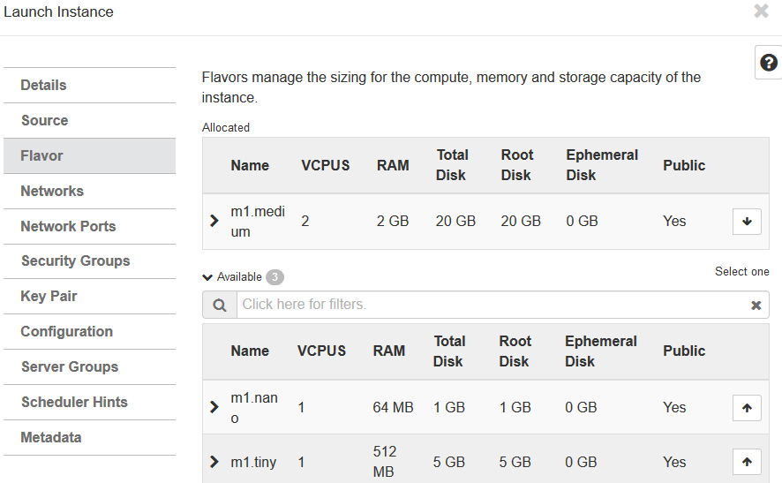
Build the OpenStack VM: Source
Select m1.medium Flavor

Slide 10
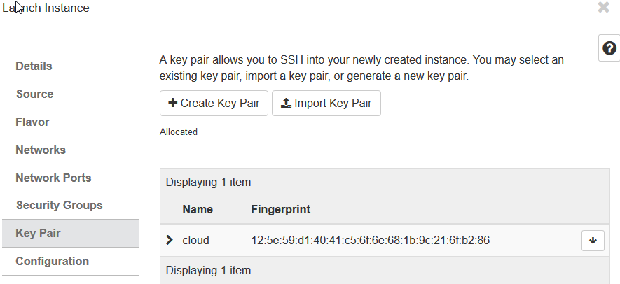
Build the OpenStack VM: Key Pair and Launch Instance
Select cloud
Key Pair
(selected automatically if
only one key pair exists)
Click Launch Instance

Slide 11
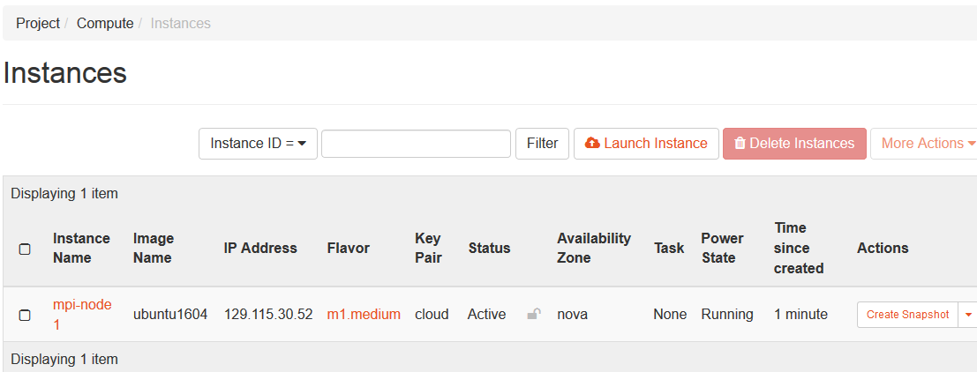
VM Created

Slide 12
Creating and Benchmarking MPI cluster in the Cloud
Option1
Launch all VMs
Install OpenMPI on each VM
Option2
Launch 1 VM
Install MPI benchmark
enable password-less ssh authentication
Install MPI benchmarks on each VM
Install OpenMPI
Create ssh key
Create a Snapshot
Launch VMs using the Snapshot

Slide 13
Creating and Benchmarking MPI cluster
Step 1: ssh login to your virtual machine, and install Open MPI
fox01:~> ssh -i cloud.key ubuntu@129.115.30.52
ubuntu@mpi-node1:~$ sudo apt-get update
ubuntu@mpi-node1:~$ sudo apt-get install build-essential
ubuntu@mpi-node1:~$ sudo apt-get install openmpi-bin openmpi-common openmpi-doc libopenmpi-dev -y
Install mpi4py
sudo apt-get install python-dev
sudo apt-get install python-pip
sudo pip install mpi4py

Slide 14
Creating and Benchmarking MPI cluster
Step 2: enable password-less ssh authentication among VMs
ubuntu@mpi-node1:~$ ssh-keygen -t rsa
ubuntu@mpi-node1:~$ cat ~/.ssh/id_rsa.pub >> ~/.ssh/authorized_keys

Slide 15
Creating and Benchmarking MPI cluster
Step 3: install MPI benchmarks on the VM
Step 4: Create a snapshot of the VM
Step 5: Launch more VMs using the snapshot
Step 6: on the master node, create a file named mpihosts
Step 7: update mpihosts file with the ip addresses of worker nodes. You may include the master node to have a dual role (master/worker).

Slide 16
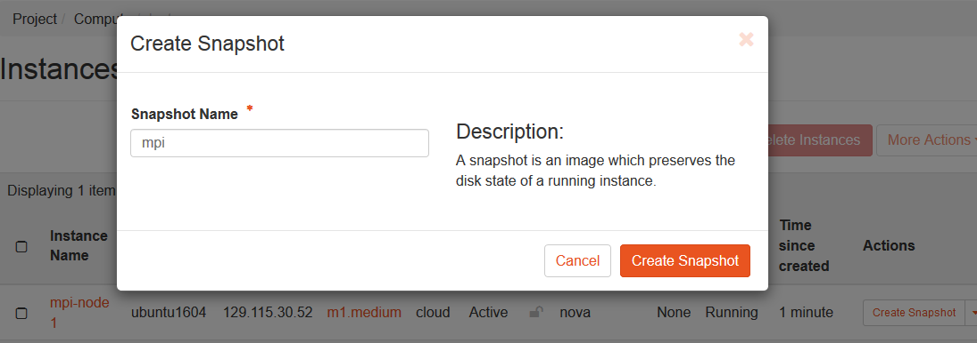
Create a Snapshot

Slide 17
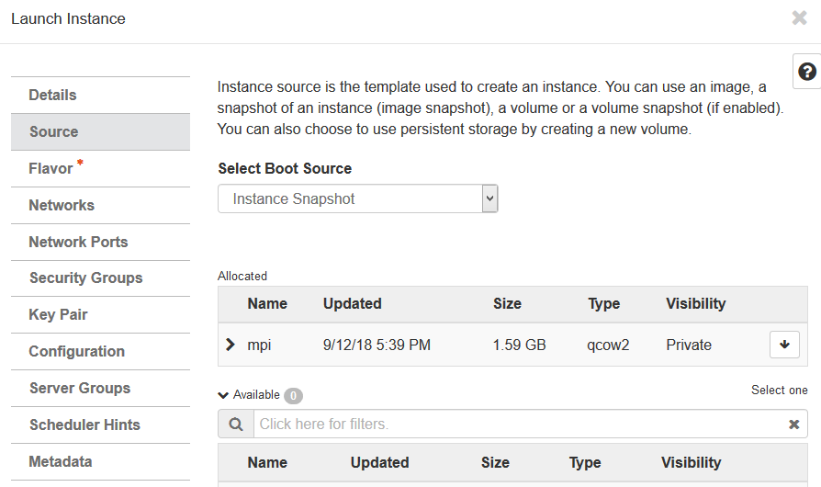
Launch VMs using the Snapshot

Slide 18
Runing MPI jobs in the cluster
mpiexec -mca btl ^openib --hostfile mpihosts -n 6 python -m mpi4py helloworld.py
mpiexec -mca btl ^openib --hostfile mpihosts -n 6 --display-map python -m mpi4py helloworld.py

Slide 19
Controlling how MPI processes are scheduled
Node list
--hostfile or --host
Default and Maximum slots on each node
Specified in the hostfile (e.g node0 slots =2 max_slots = 4)
Rule of thumb: slots = number of processors available
Scheduling Policy
--byslot
--bynode
Notes:
Slots represent how many processors (compute units) are available in the node. By default one slot per node. (unless slots= and maxslots= in hostfile)

Slide 20
Scheduling Policy
By slot
Default scheduling policy
Schedule processes on a node until all of its default slots are exhausted before proceeding to the next node
If default slot count is exhausted on all nodes, loop through the list of nodes again until all processes are scheduled

Slide 21
Scheduling Policy
By node
Schedule a single process on each node in a round-robin fashion until all processes are scheduled
Nodes are skipped once the default slot counts are exhausted
If default slot count is exhausted on all nodes, loop through the list of nodes again until all processes are scheduled
mpiexec -mca btl ^openib --hostfile mpihosts -n 6 --display-map --bynode python -m mpi4py helloworld.py
Notes:
What if ?
node0 slots=2 max_slots=4
node1 slots=4 max_slots=4

Slide 22
Oversubscribing nodes
Degraded Mode
When Open MPI thinks it is in oversubscribed mode (i.e., more processes are running than there are processors available), MPI processes will frequently yields the processor to its peers so that everyone makes progress.
e.g slots = 2 (specified in mpihosts file) and -n 4 (specified with mpiexec)
Aggressive Mode
When Open MPI thinks it is not oversubscribed
Never voluntarily give up processor to other processes
Providing wrong information to Open MPI may cause severe performance issues

Slide 23
Reference
http://www.open-mpi.org/

