Slide 1

CS4843: Cloud Computing Server Clusters and Programming Models
Palden Lama, Ph.D.
Department of Computer Science
University of Texas at San Antonio
http://cs.utsa.edu/~plama

Slide 2
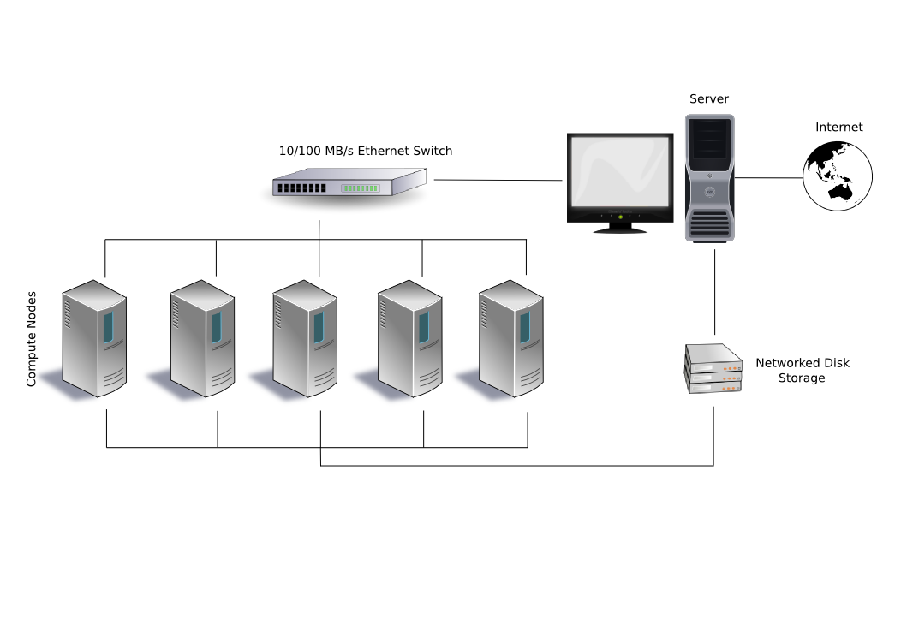
Server Cluster
A (computer) server cluster is a set of interconnected computer servers that work together as one unit. e.g web cluster, HPC cluster, storage cluster, Hadoop cluster, Kubernetes cluster, Cloud Computing cluster etc.
A loosely-coupled cluster consists of computers that are running with a minimum of communication and cooperation among them.
A tightly-coupled cluster consists of a group of computers that are communicating and cooperating to a great degree among each other.
Benefits:
High availability
High performance
Load balancing
Beowulf Cluster
(Beowulf is a way of building a supercomputer out of a bunch of smaller computers.)

Slide 3
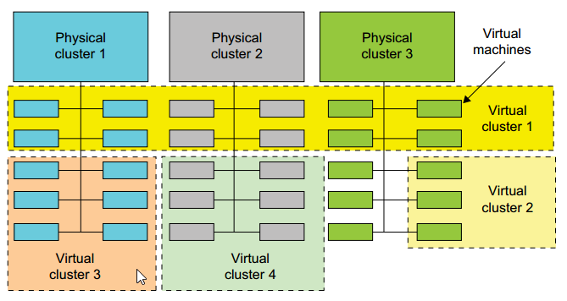
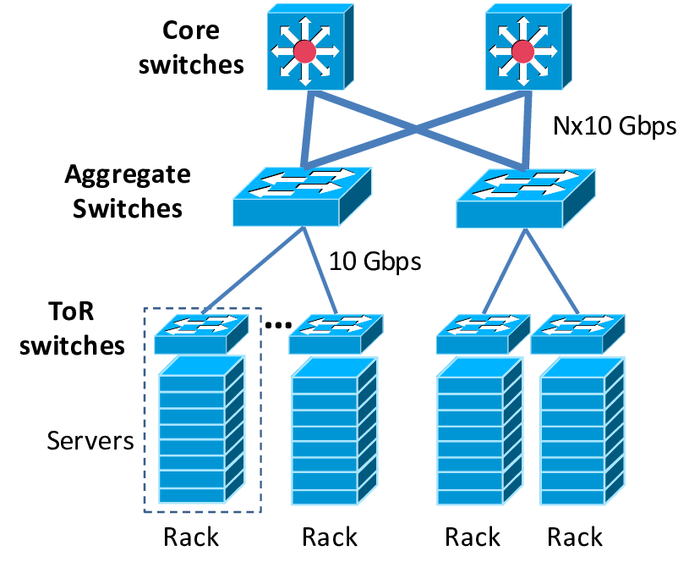
Physical vs. Virtual Clusters
Benefits of Virtual Clusters
- Consolidate multiple functionalities on shared Cluster of servers.
- Size of the virtual clusters can grow or shrink dynamically.
Notes:
Each physical server is virtualized with a hypervisor
Virtual network between VMs

Slide 4
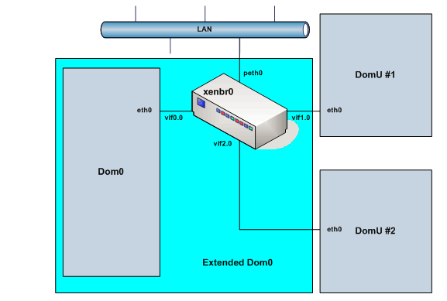
Networking between VMs in Xen
DomUs : User VMs
Dom0: Controller VM
vifx.x : virtual network interface
xenbr0 : software bridge

Slide 5
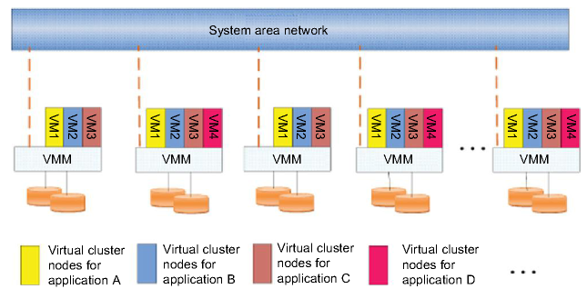
Virtual Clusters per Application
Issues: how to decide VM placement ?
Notes:
Placement : capacity constraints (cpu core, memory, etc) + affinity rules, special hardware constraints, etc.
VMware DRS and DPM features… vSphere software

Slide 6
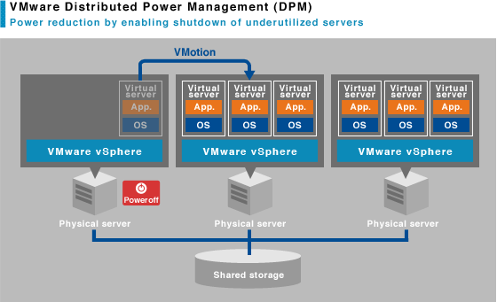
VM Placement Issues
Capacity constraints
Cpu cores, Memory (capacity vs. demand)
Affinity Rules
Place my VMs on different hosts, or same host
Load Balancing
Energy efficiency
OpEx
Peak Power Constraints
CapEx
Power Oversubscription

Slide 7
VM Live Migration
Copy memory and CPU state from source to target node
Pre-copy
Transfer all memory pages
Copy only modified pages (iteratively) for minimal downtime
When VM working set becomes small, suspend VM, and do final copy
Resume VM in new location
Post-copy
Suspend VM and copy all memory pages
Resume VM in new location after copy is done
Reduces migration time but increases downtime
Notes:
Performance degradation due to network bandwidth usage in iterative copy of dirty pages

Slide 8
VM Live Migration
Avoid copy of virtual disk image
network-accessible shared storage system
drastically reduces migration time
VM network identity and network connections are preserved
Application keeps running without reconfiguration
Each VM has virtual IP address and virtual MAC address
In a single LAN, unsolicited ARP (address resolution protocol) reply is sent to indicated that IP has moved to a new location..
In a switched network, relies on network switch to detect its move to a new port

Slide 9
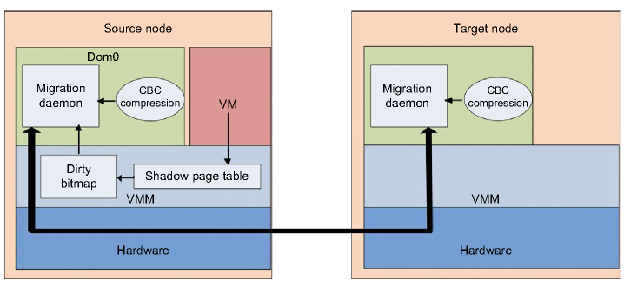
Xen Live Migration
Notes:
Shadow page table traces the modifications to memory page in migrated VMs, and corresponding flags are set in the dirty bitmap.
At start of each precopy, bitmap is sent to daemon
Memory pages are compressed before sending to destination

Slide 10
Cloud Programming Models
How to utilize virtual clusters in the Cloud ?
Parallel and distributed computing paradigm
Computation partitioning
Data partitioning
Synchronization
Scheduling
Parallel computing can be done in a single multi-core system as well as a server cluster.
Shared-memory model (e.g OpenMP, Silk, etc.)
Message passing model (e.g MPI, MapReduce, etc.)

Slide 11
Cloud Programming Models: Computation and Data Partitioning
Computation Partitioning
Split the job/program into smaller tasks that can run concurrently
Assign different workers/compute units to different tasks
Different tasks may process different data or copy of same data
Data Partitioning
Split the data into smaller pieces
Assign different workers to process different data pieces
Usually same task runs on different workers but using different data
Notes:
Cocurrently : independent of each other

Slide 12
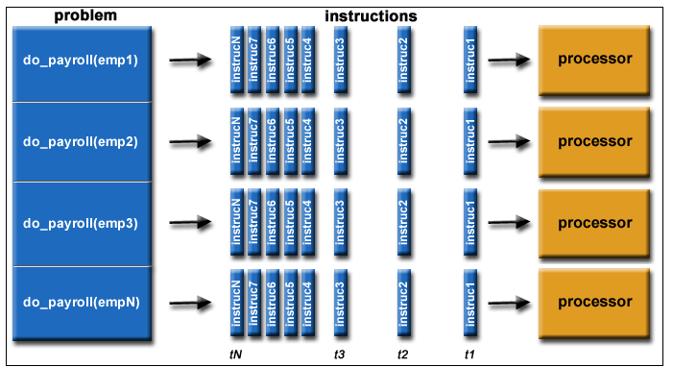
Computation and Data Partitioning Example

Slide 13
Cloud Programming Models: Synchronization and Communication
Prevent Race Conditions
Address Data Dependencies
Barrier Synchronization
Implicit (MapReduce)
Explicit (MPI)
Communication
Implicit (MapReduce)
Explicit (MPI)

Slide 14
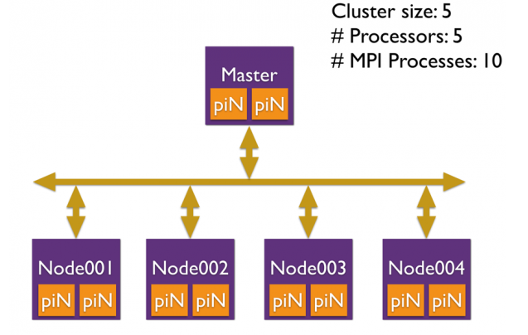
Cloud Programming Models: Scheduling
Scheduler selects a sequence of tasks or data pieces to workers
Scheduling granularity
Program/job level
Which job to run next ?
Task level
Which nodes to use ?
Task to node assignment
Master-Worker Model
Notes:
HTCondor, MOAB, MapReduce, etc.

Slide 15
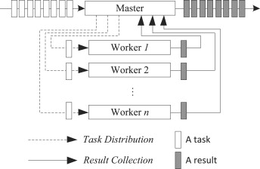
MPI (Message Passing Interface)
MPI is a specification for the developers and users of message passing libraries (e.g MVAPICH, OpenMPI, Intel MPI, etc)..
Master-Worker Model

Slide 16
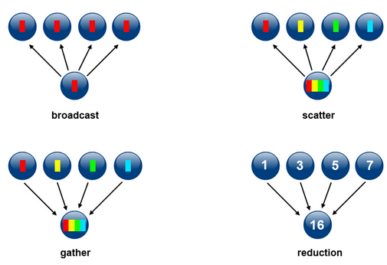
MPI Communication
Collective Communication
Point-to-Point Communication
Worker
Worker
receive
send
Master

Slide 17
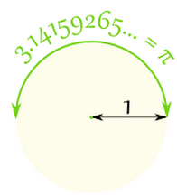
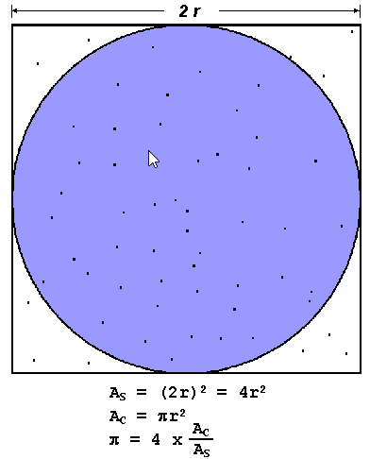
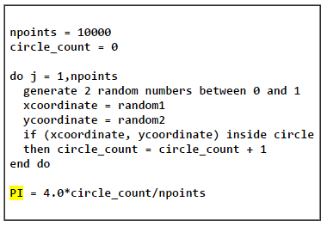
Computation Partitioning Examples Calculate the value of Pi : Serial Program
Notes:
Pi = ratio of circumference of a circle to its diameter
Unit circle : x^2 + y^2 = 1 (center (0,0) radius 1)

Slide 18
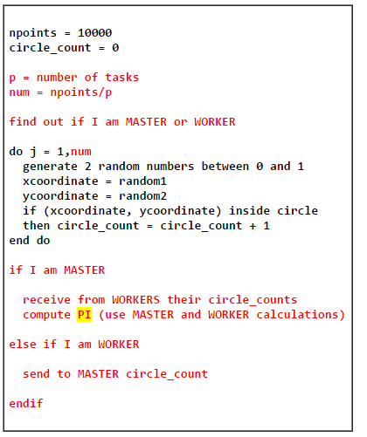
Computation Partitioning Examples Calculate the value of Pi : Parallel Program
Pseudo code for MPI program

Slide 19
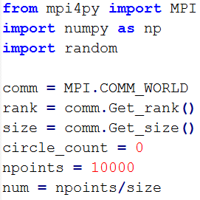
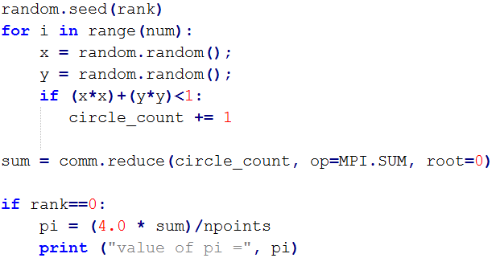
Calculate the value of Pi with MPI
To run the program: mpiexec -n 10 python –m mpi4py calc_pi.py

Slide 20
Python MPI installation
Installing OpenMPI
Installing mpi4py
Installing numpy
sudo apt-get update
sudo apt-get install build-essential
sudo apt-get install openmpi-bin openmpi-checkpoint openmpi-common openmpi-doc libopenmpi-dev -y
sudo apt-get install python-dev
sudo apt-get install python-pip
sudo pip install mpi4py
sudo apt-get install python-numpy

Slide 21
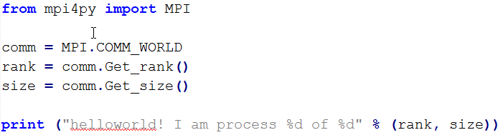
Helloworld.py

Slide 22


MPI Program Execution
Execute the program on localhost
Execute on multiple hosts (helloworld.py must be available on all hosts)
mpiexec -mca btl ^openib -n 5 python -m mpi4py helloworld.py
mpiexec -mca btl ^openib --hostfile mpihosts -display-map -n 5 python -m mpi4py helloworld.py
Output 1
Output 2

Slide 23
Point-to-Point Communication
Send a message from one process to another
Message can contain any number of native or user defined types with an associated message tag
MPI4Py (and MPI) handle the packing and unpacking for user defined data types
Two types of communication: Blocking and non-Blocking

Slide 24
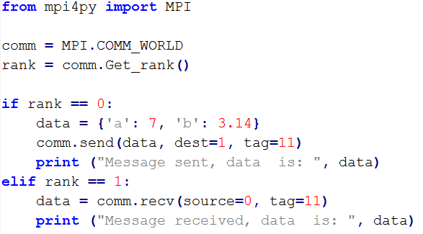
Point-to-Point Communication (blocking)

Slide 25
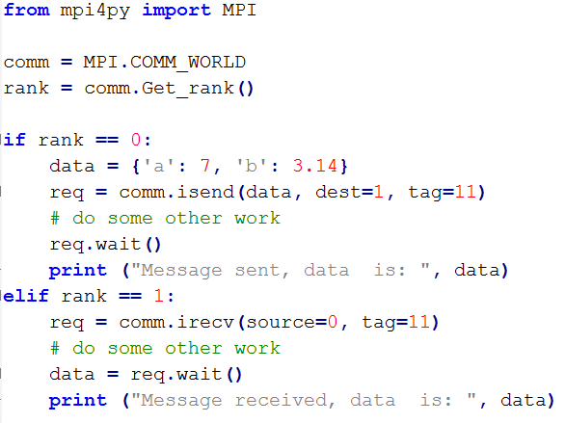
Point-to-Point Communication (non-blocking)

Slide 26
Collective Communication
Collective Communications allow multiple processes within the same communicator to exchange messages and possibly perform operations
Collective Communications are always blocking, there are no tags
Functions perform typical operations such as Broadcast, Scatter, Gather, Reduction and so on

Slide 27
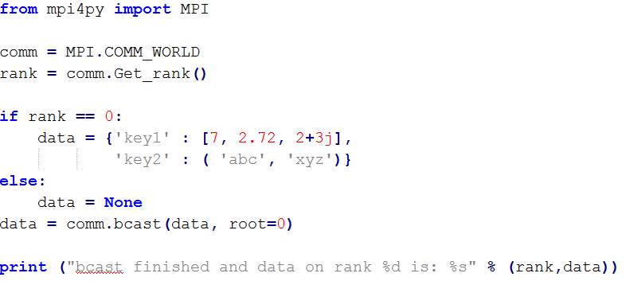
Collective Communication: Broadcast

Slide 28
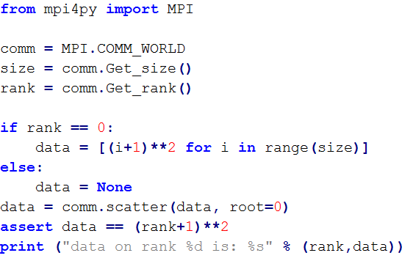
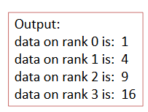
Collective Communication: Scatter

Slide 29
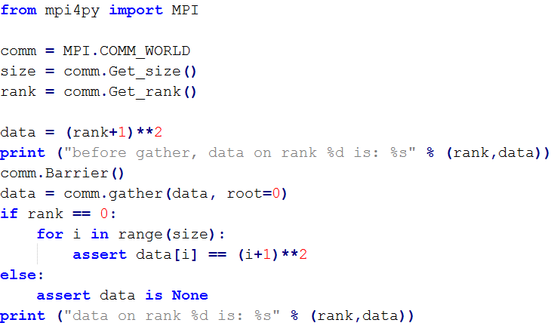
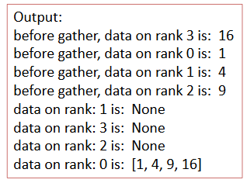
Collective Communication: Gather and Barrier

Slide 30
DEMO
https://openstack.tacc.chameleoncloud.org/dashboard/auth/login/

Slide 31
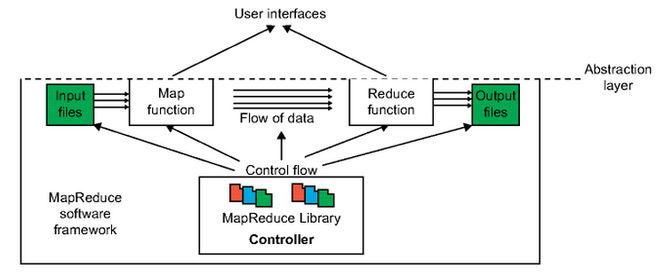
MapReduce framework
Parallelize Computation and Data Access
Most suitable for data partitioning

Slide 32
Hadoop MapReduce Framework
User Program
- Map, Reduce functions
Master
assign map
assign reduce
Input Data
Worker
Worker
Output File 0
Split 0
Split 1
Split 2
Worker
Worker
Output File 1
Worker
(intermediate result)
local write

Slide 33
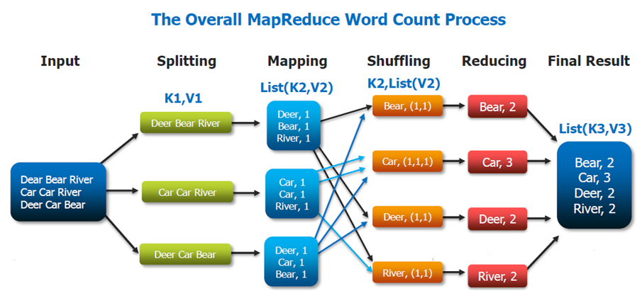
Data Partitioning Example : WordCount

Slide 34
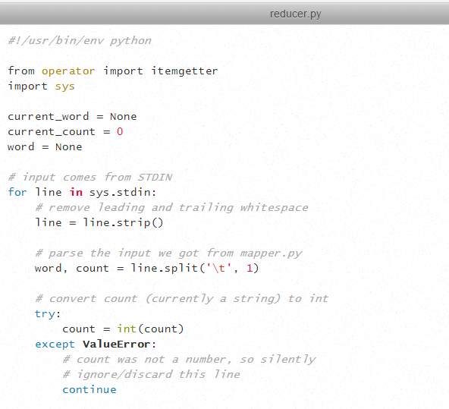
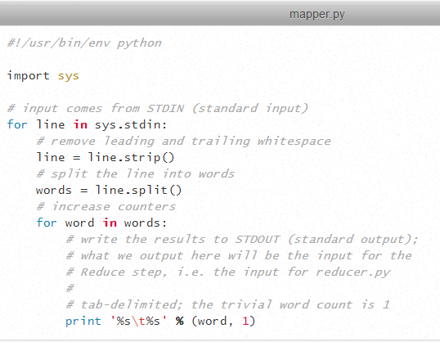
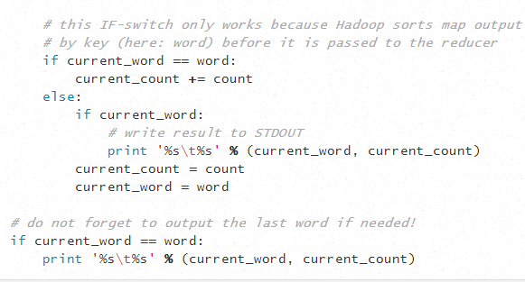
Data Partitioning Example : WordCount

Slide 35
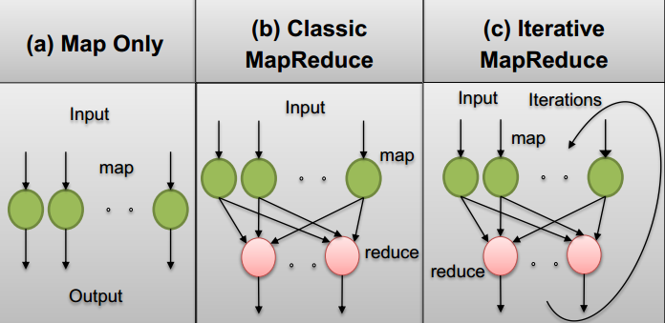
MapReduce Patterns
MORE ON MAPREDUCE LATER …..

