Slide 1
CS 4843 Cloud Computing Hadoop Cluster Setup
Palden Lama, Ph.D Department of Computer Science University of Texas at San Antonio

Slide 2
Agenda
Hadoop Installation and Cluster Setup
HDFS Operations
MapReduce Execution

Slide 3
Setting up a Hadoop Cluster
Step 0. Create a VM and login to your VM
Step 1. Set up Hadoop user
Step 2. Install Hadoop
Step 3. Setup Passwordless Authentication
Step 4. Hadoop Configuration Setup
Step 5. Clone your VM (create snapshot + create more instances)
Step 6. Edit /etc/hosts file on all of your VMs
Step 7. Edit /user/local/hadoop-1.2.1/conf/slaves file on the master VM

Slide 4
Step 0: OpenStack Dashboard
http://10.100.11.11/horizon
Create a new VM of ‘medium’ flavor.
The key-pair created in Assignment 1 can be reused for this VM.
[Alternatively, you may reuse the VM created in Assignment 1.]
Login to your VM via ssh.
First, login to fox server then type
ssh -i cloud.key ubuntu@<ipaddress>

Slide 5
1. Setting up Hadoop user
Create a Hadoop user on your Master VM
sudo addgroup hadoop
sudo adduser --ingroup hadoop hduser

Slide 6
2. Installing Hadoop
Download installation script
wget http://cs.utsa.edu/~plama/CS4843/hadoop-install.sh
Assign execute permission
chmod u+x hadoop-install.sh
Run script
./hadoop-install.sh

Slide 7
3. Passwordless Authentication Setup
Configuring passwordless ssh authentication
su - hduser
ssh-keygen -t rsa -f ~/.ssh/id_rsa
cat ~/.ssh/id_rsa.pub >> ~/.ssh/authorized_keys
mkdir /home/hduser/.ssh (only if .ssh does not exist)
sudo sh -c 'echo "StrictHostKeyChecking no" >> /home/hduser/.ssh/config'

Slide 8
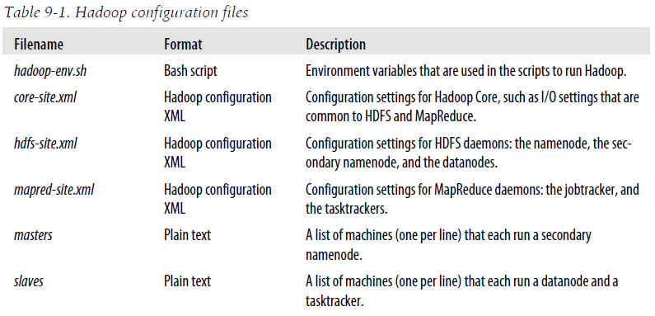
4. Hadoop Configuration Setup

Slide 9
4. a) Hadoop Configuration Setup (cont’d)
Edit /usr/local/hadoop-1.2.1/conf/hadoop-env.sh file to set the environment variable JAVA_HOME to the Java JDK directory.
export JAVA_HOME=/usr/lib/jvm/java-7-openjdk-amd64

Slide 10
4. b) Hadoop Configuration Setup (cont’d)
Edit /usr/local/hadoop-1.2.1/conf/core-site.xml file as follows:
<configuration>
<property>
<name>hadoop.tmp.dir</name>
<value>/app/hadoop/tmp</value>
<description>A base for other temporary directories.</description>
</property>
<property>
<name>fs.default.name</name>
<value>hdfs://master_ipaddress:54310</value>
<description>The name of the default file system. Provide the ip address of
your master node. The port number must be 54310 or 8020. </description>
</property>
</configuration>
Use private ip address

Slide 11
4. c) Hadoop Configuration Setup (cont’d)
Edit /usr/local/hadoop-1.2.1/conf/mapred-site.xml file as follows:
<configuration>
<property>
<name>mapred.job.tracker</name>
<value>master_ipaddress:54311</value>
<description>The host and port that the MapReduce job tracker runs
at. Provide the ip address of your master node. The port number must be 54311 or 8021.
</description>
</property>
</configuration>
Use private ip address

Slide 12
Hadoop Configuration Setup (cont’d)
Edit /usr/local/hadoop-1.2.1/conf/hdfs-site.xml to change the default replication factor.
<configuration>
<property>
<name>dfs.replication</name>
<value>2</value>
<description>Default block replication.
The actual number of replications can be specified when the file is created.
The default is used if replication is not specified in create time.
</description>
</property>
</configuration>

Slide 13
5. Clone your VM
Create snapshot of your VM from the OpenStack Dashboard.
Create more instances using the snapshot.
(Multiple instances can be created in one step.)

Slide 14
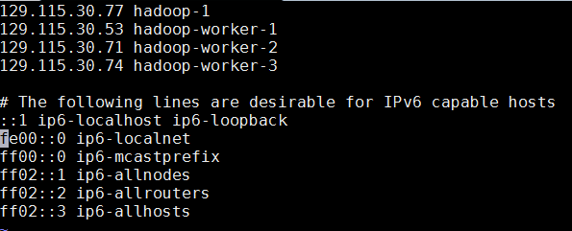
6. Edit /etc/hosts file on all VMs
Login to each VM as ubuntu user
(In case you are already logged in as hduser, type “exit” command to switch to ubuntu user.)
Edit /etc/hosts file to map ipaddress with hostnames using “sudo vi /etc/hosts”
For example
ssh -i cloud.key ubuntu@<ipaddress>

Slide 15

7. Edit slaves, and masters file on the master VM
Login to the master VM as hduser
su - hduser
The /usr/local/hadoop-1.2.1/conf/slaves file should contain the hostnames of the worker VMs.
The /usr/local/hadoop-1.2.1/conf/masters file should be empty.
(we don’t want to run secondary namenode due to limited memory space)

Slide 16
Starting the Hadoop Cluster
su - hduser
Format the HDFS cluster from the Master node
$HADOOP_PREFIX/bin/hadoop namenode -format
c) Start HDFS daemons from the Master node
$HADOOP_PREFIX/bin/start-dfs.sh
d) Start MapReduce daemons from the Master node
$HADOOP_PREFIX/bin/start-mapred.sh
e) Check the status of daemon processes on all nodes
jps
$HADOOP_PREFIX/bin/start-all.sh
OR
You can examine the success or failure of daemon processes by inspecting the log file in the $HADOOP_PREFIX/logs directory

Slide 17
HDFS Operations
Login to the master VM and download example input data locally.
(We will use three ebooks from Project Gutenberg for this example)
The Outline of Science, Vol. 1 (of 4) by J. Arthur Thomson
The Notebooks of Leonardo Da Vinci
Ulysses by James Joyce
Download each ebook as text files in Plain Text format and store the files in a local temporary directory on the master VM as follows:
sudo - hduser
mkdir /tmp/gutenberg
cd /tmp/gutenberg
wget http://www.gutenberg.org/cache/epub/20417/pg20417.txt
wget http://www.gutenberg.org/files/5000/5000-8.txt
wget http://www.gutenberg.org/files/4300/4300-0.txt

Slide 18
HDFS Operations (cont’d):
Change the current directory to $HADOOP_PREFIX before running Hadoop related commands
Copy local example data to HDFS
View files uploaded to HDFS
cd $HADOOP_PREFIX
bin/hadoop fs -put /tmp/gutenberg /user/hduser/gutenberg
bin/hadoop fs -ls /user/hduser/gutenberg

Slide 19
Other HDFS Operations
Creating a directory
Viewing data from HDFS
Download file(s) from HDFS
Delete a file/directory from HDFS
bin/hadoop fs -mkdir /user/hduser/gutenberg
bin/hadoop fs -cat /user/hduser/gutenberg/4300-0.txt
bin/hadoop fs -get /user/hduser/gutenberg /tmp/gutenberg
bin/hadoop fs –rmr /user/hduser/gutenberg

Slide 20
Running a MapReduce Job
Create mapper and reducer programs (in Python) in the master VM.
e.g mapper.py and reducer.py for Wordcount.
First perform a quick local test of the mapper and reducer programs without using the Hadoop cluster.
cat /tmp/gutenberg/pg20417.txt | python ~/mapper.py | sort | python ~/reducer.py

Slide 21
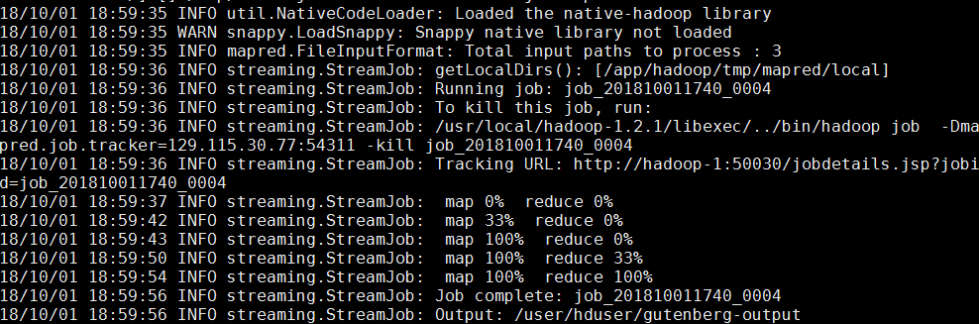
Running a MapReduce Job (cont’d)
$HADOOP_PREFIX/bin/hadoop jar $HADOOP_PREFIX/contrib/streaming/hadoop-streaming-*.jar \
-input /user/hduser/gutenberg \
-output /user/hduser/gutenberg-output \
-file /home/hduser/mapper.py \
-mapper /home/hduser/mapper.py \
-file /home/hduser/reducer.py \
-reducer /home/hduser/reducer.py

Slide 22
Check the Output
How to download the output file from HDFS ?
$HADOOP_PREFIX/bin/hadoop fs -ls /user/hduser/gutenberg-output/
$HADOOP_PREFIX/bin/hadoop fs -cat /user/hduser/gutenberg-output/part-00000
$HADOOP_PREFIX/bin/hadoop fs -get /user/hduser/gutenberg-output/part-00000 /home/hduser

Slide 23
Running a MapReduce Job (cont’d)
Run MapReduce wordcount job in the Hadoop cluster
$HADOOP_PREFIX/bin/hadoop jar $HADOOP_PREFIX/contrib/streaming/hadoop-streaming-*.jar \
-input /user/hduser/gutenberg \
-output /user/hduser/gutenberg-output \
-file /home/hduser/mapper.py \
-mapper /home/hduser/mapper.py \
-file /home/hduser/reducer.py \
-reducer /home/hduser/reducer.py

Slide 24
Running a MapReduce Job (cont’d)
Running multiple reduce tasks
$HADOOP_PREFIX/bin/hadoop jar $HADOOP_PREFIX/contrib/streaming/hadoop-streaming-*.jar \
-D mapred.reduce.tasks=2 \
-input /user/hduser/gutenberg \
-output /user/hduser/gutenberg-output \
-file /home/hduser/mapper.py \
-mapper /home/hduser/mapper.py \
-file /home/hduser/reducer.py \
-reducer /home/hduser/reducer.py
Note: every mapreduce job must use a different output path. To use the same output path as before, the output directory must be deleted first.

Slide 25
Running a MapReduce Job (cont’d)
Using KeyFieldBasedPartitioner
$HADOOP_PREFIX/bin/hadoop jar $HADOOP_PREFIX/contrib/streaming/hadoop-streaming-*.jar \
-D map.output.key.field.separator=. \
-D mapred.text.key.partitioner.options=-k1,2 \
-D mapred.reduce.tasks=2 \
-input /user/hduser/ip-in \
-output /user/hduser/ip-out \
-file /home/hduser/mymapper.py \
-mapper /home/hduser/mymapper.py \
-file /home/hduser/myreducer.py \
-reducer /home/hduser/myreducer.py \
-partitioner org.apache.hadoop.mapred.lib.KeyFieldBasedPartitioner

Slide 26
Stopping the Hadoop Cluster
From the Master node
$HADOOP_PREFIX/bin/stop-dfs.sh
$HADOOP_PREFIX/bin/stop-mapred.sh
$HADOOP_PREFIX/bin/stop-all.sh
Data is not LOST when the hadoop cluster is stopped !

Slide 27
References
http://wiki.apache.org/hadoop/GettingStartedWithHadoop
Hadoop: The Definitive Guide (Chapter 9: Setting up Hadoop a Cluster)

Slide 28
EXTRAs

Slide 29
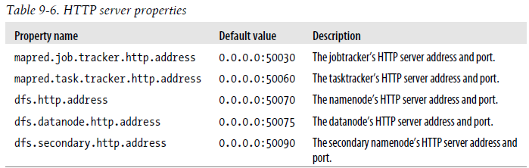
Hadoop Daemon Ports
Use public ipaddress of the Master VM
Must add a security rule to allow Ingress TCP on port 50030

