Slide 1



Slide 2




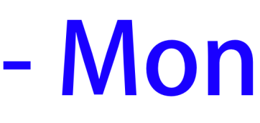
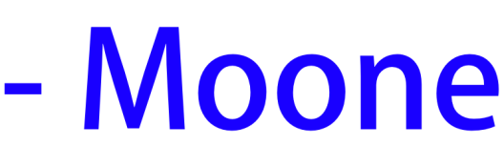
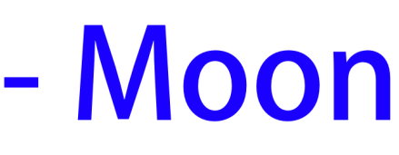
Points: 0

Slide 3
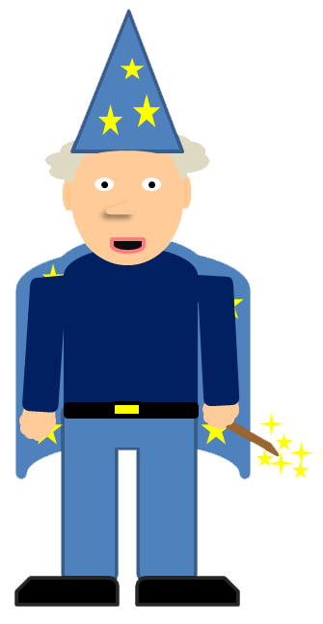


Points: 1
You got it right!

Slide 4


Points: 0
You got it wrong!

Slide 5
Points: 0
You got it wrong!

Slide 6


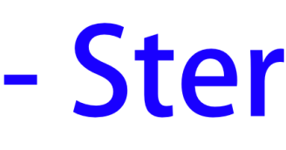
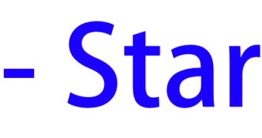

Points: 1

Slide 7
Points: 2
You got it right!

Slide 8
Points: 1
You got it wrong!

Slide 9
Points: 1
You got it wrong!

Slide 10
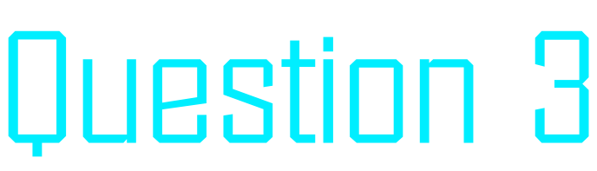


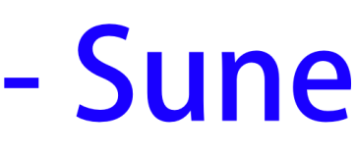
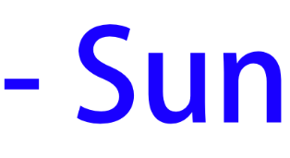
Points: 2

Slide 11
Points: 3
You got it right!

Slide 12
Points: 2
You got it wrong!

Slide 13
Points: 2
You got it wrong!

Slide 14





Points: 3

Slide 15
Points: 4
You got it right!

Slide 16
Points: 3
You got it wrong!

Slide 17
Points: 3
You got it wrong!

Slide 18
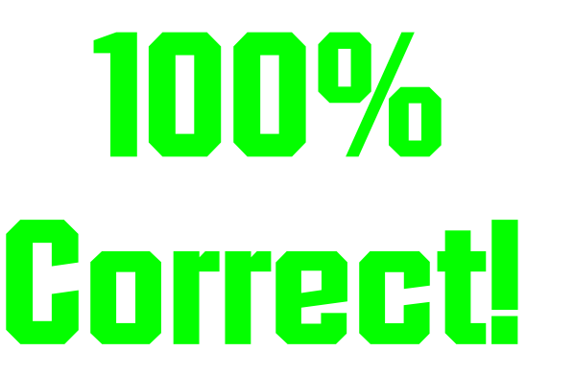

Points: 4
You finished the quiz!

