Slide 1


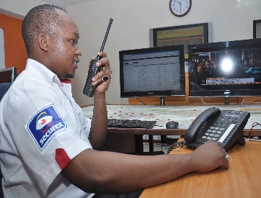





Welcome to Securex EA Intranet
Executive Directors Office
Group Managing Directors Office
Staff Announcements and News
Social Media Corner
Departments
Policies
Employee Directory
Documents
Securex Products Awareness

