Slide 1
AGENDA
Java 8 overview
Functional Paradigm
Lambda
Default Methods (Virtual Extension Methods)
Functional Interfaces
Method references
Foreach, Removelf, Sort
Stream
Optional
Map
Date API
Nashhorn JavaScript Engine
Repetition Anotation

Slide 2
Overview
Release Date: March 2014
Codename: Spider (7: Dolphin, 6: Mustang, 5:Tiger, 4: Merlin, 3: Kestrel, 2: Playground, 1: Oak)
Principal features: Lambda Expressions, Date and Time API, Nashhorn JavaScript Engine, Security Improvements
What is new on java 8

Slide 3
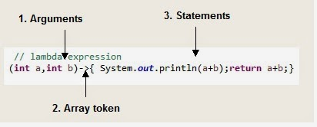
Lambda
Implementation of simples anonymous classes or functions
What is new on java 8

