Slide 1
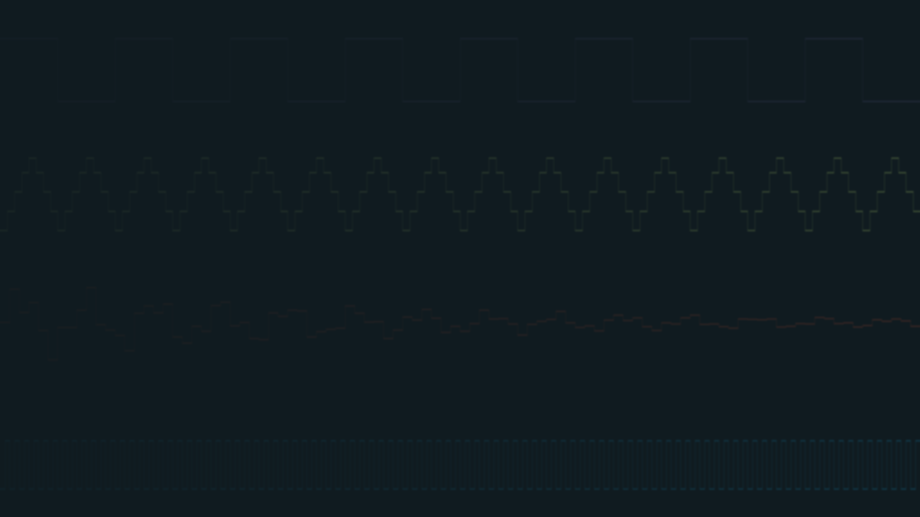
Tracker pattern
Row | Note | Instrument
00 | C-4 | 01
04 | E-4 | 01
08 | G-4 | 01
RhYMe
and YMX
Prepared register rows
Offline instrument data
Frame | R0 | R1 | R8
0 | DE | 01 | 0F
24 | 7B
48 | 3F |  | 0C
Atari ST playback
A blank marks an omitted write.

Slide 2
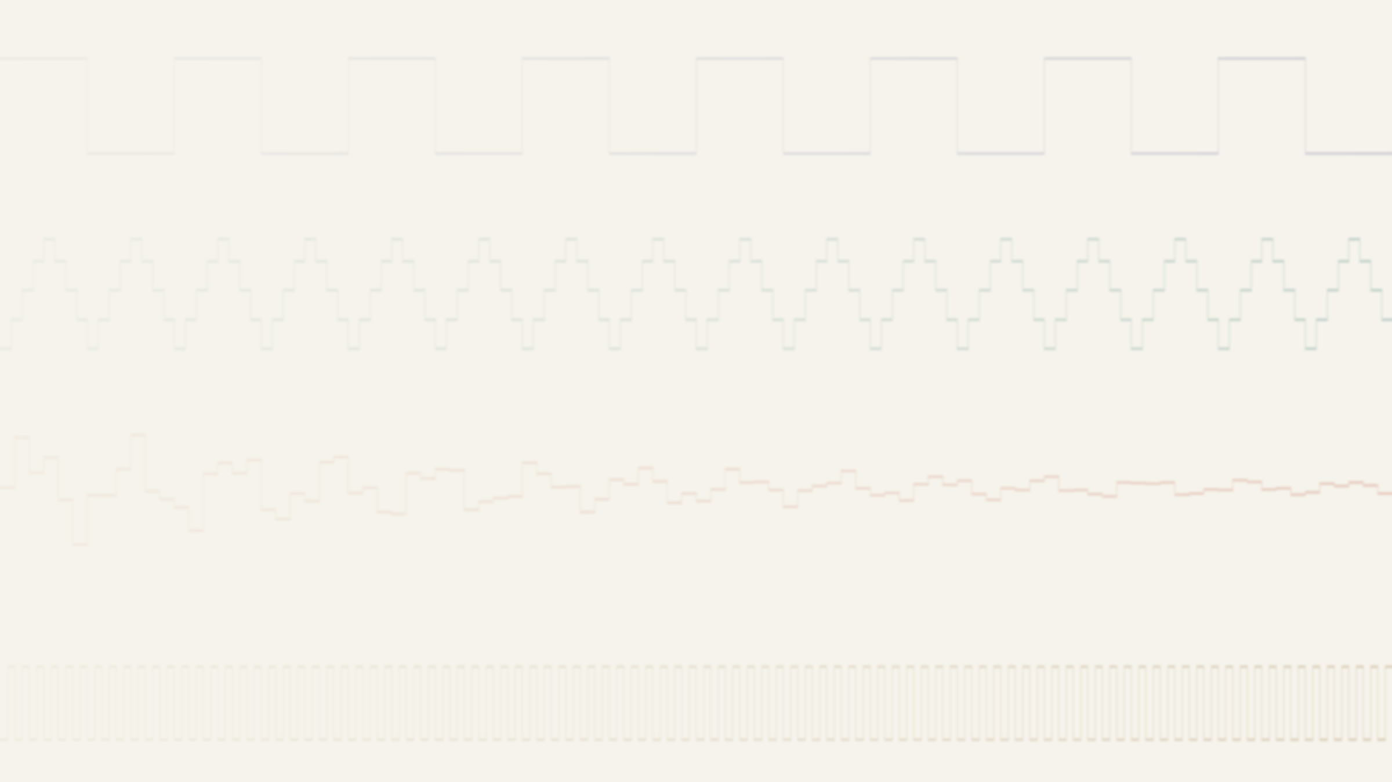
YM formats and YMX
YM1
YM2
YM3
YM4
YM5
YM6
YM7
…
YMX
Release unverified
Public references
No public source found
X = any number
YM6 frame data
Sound registers | Effects
Frame 1
Frame 2
Frame 3
YMX is a family of technologies
YMXS | ST4 | DTX | YMXR
Tune abstraction | 68000 compression | Table abstraction | Tune file and player
YM format family by Leonard / Oxygene (Arnaud Carré)

Slide 3
Tat’s minymiser
Register streams
Rolling buffers
R0 | R2 | R8
28 | 92 | 15
28 | 91 | 14
30 | 91 | 12
30 | 90 | 10
31 | 90 | 08
R0 | 30 | 30 | 31
R2 | 91 | 90 | 90
Decode as needed
R8 | 12 | 10 | 08
LZSA-style compression with a 68000 decoder
minymiser by Tat / Avena (Steven Tattersall)

Slide 4
Batching column refills
Read the current row
Refill one column for later frames
Frame | A | B | C | D |  | Column | Frame 5 | Frame 6 | Frame 7 | Frame 8
1 | A1 | B1 | C1 | D1 |  | A | A5 | A6 | A7 | A8
2 | A2 | B2 | C2 | D2 |  | B | B5 | B6 | B7 | B8
3 | A3 | B3 | C3 | D3 |  | C | C5 | C6 | C7 | C8
4 | A4 | B4 | C4 | D4 |  | D | D5 | D6 | D7 | D8
Decoder calls per frame
4 × 1 B
1 × 4 B
N columns, N bytes per refill

Slide 5
Compression for the 68000
ZX0
ZX1
ST1
ST4
Size target
Byte-oriented format
Pause and resume
68000 alignment
ZX1 interleaved stream
Encoder
DB | 41 | 42 | 43 | FA | 40 | FF | FF
Decoder
ABCABCABC
ABCABCABC
Bit byte
Literals
Offset
Bit byte
End marker
ST4 separate streams
Bits | Literals | Byte offsets | Word offsets
ST1 / ZX1
ST4 copy ladder
move.b (a2)+,(a1)+
move.w (a3)+,(a1)+
1 byte per move
2 bytes per move
ZX0 and ZX1 by Einar Saukas

Slide 6
Frame rows and timer ticks
One frame, enlarged
Wavetable after retune (2.4 kHz)
48 timer ticks per frame
20 ms at 50 Hz
Frame 140
Frame 141
100
110
120
130
140
150
160
Host frames
One tune row per frame
SID
Wavetable · 30 frames
Timer A
Idle
Retune
Remap
1.2 to 2.4 kHz
New volume lookup
Sync buzzer
Timer B
Digidrum · 20 frames
Timer D
Start on a frame
Effect active
Stop on a frame

Slide 7
YMXS and YMXR
YMXS
YMXR
Tune abstraction
Atari ST binary format
68000 player
Frame rows and timer sources
DTX tables
YM2149 playback
Text encodings
Another YMXS player
JSON or CSV
Different layout
Game or demo player

Slide 8
YMXR frame table columns
Register writes
Columns 0–13
Tone A |  | Tone B |  | Tone C |  | Noise | Mixer | Volume |  |  | Envelope
R0 | R1 | R2 | R3 | R4 | R5 | R6 | R7 | R8 | R9 | R10 | R11 | R12 | R13
Timer operations
Columns 14–33
Timer | Count Reload value | Control Divider + flags | Source index | Mapping index | Target index
A | 17 | 16 | 2 | 0 | 8
D | 21 | 20 | 1 | 0 | 9
B | 25 | 24 | 3 | 1 | 14
C | 29 | 28 | 4 | 2 | 19
30 columns in v7–v9. v10 adds four mappings.
Count and Control show column positions.
Mapping 0 uses identity. 1 and 2 select lookups.

Slide 9
Timer sources and targets
Source values
Target register
Square-wave SID
13
Two levels on repeat
0
Digidrum
R8
8 | 9 | 10 | 11 | …
Sample plays once
Voice A volume
Wavetable
One cycle on repeat
0
4
8
12
15
12
8
4
Sync buzzer
0
R13
One value on repeat
Envelope shape
One value per timer tick

Slide 10
Source, mapping and target indices
Timer B example
Source 3
Mapping 1
Target 14
63, 1
1 → 2
63, 2
Example source index
Fixed target codes
Source | DTX1 table | Columns
1 | SID loop 1 | 1
2 | Digidrum sample 1 | 1
3 | Tone period | 2
4 | Pitch and volume | 3
5 | SID loop 2 | 1
6 | Digidrum sample 2 | 1
Target | Registers | Use
8 | R8 | Voice A volume
9 | R9 | Voice B volume
10 | R10 | Voice C volume
13 | R13 | Envelope shape
14 | R0, R1 | Voice A tone
17 | R0, R1, R8 | Voice A tone and volume
21 | R11, R12, R13 | Envelope period and shape
22 | R6, R8 | Noise and voice A volume
Source 0 stops the timer.
Each tick reads a row, maps its last value and writes the target registers.

Slide 11
YMX architecture
RhYMe export
Tune file data
Atari ST playback
RhYMe
Frame
Host frame clock
Register writes
DTX3 tune table
Apply tune row
YMXS tune
ST4 compression
Timer control
Start / remap
MFP timers
Active mapping
Lookup tables
YMXR tools
Optional
Interrupt
SNDH / PRG
Timer tick
Target writes
YM2149
DTX1 sources
Read source row
Map last value
Identity or lookup

Slide 12
YM6 and DTX sizes
Wicked Polygons
92.0% smaller
Synergy Megademo · 3D screen
Bytes
Uncompressed YM6
1,278,499
DTX image
102,080
SNDH with player · 123,752 bytes
Player core | Bound tune data | Workspace and other bytes | DTX image
3,402 | 408 | 17,862 | 102,080
Packing options
-k1 -m780 -copies
SNDH option
-link
Standalone YMXR tune · 101,036 bytes
Music by Scavenger / Synergy

Slide 13
YMXR frame cost
Average 68000 cycles per frame
DTX advance
Other frame work
Effect timer interrupts
Frame call
Timers
Total
% of 160k
Chambers of Shaolin
1,131
0
1,131
0.71%
Register writes only
DBA 5
1,551
2,747
4,298
2.69%
SID voice
Synergy Credits
1,995
4,228
6,223
3.89%
Two SID timers
Deeper
2,150
11,304
13,454
8.41%
SID, samples, sync buzzer
160,000 cycles per frame at 8 MHz and 50 Hz.

Slide 14
Development timeline
AI
AI-assisted development
Mostly Claude Opus 5 and 5.5
2026
16 Aug
25 Aug
10 Sep
11 Sep
21 Oct
3 Nov
YX6 streams
RhYMe
YMXS tune
RhYMe uses
DTX3 in
YMXR
YM dumps
adopts YMX
model
YMXR tools
YMXR
lookups
GitHub activity
As of 8 November 2026
Repository | Commits on main | Published releases
ST4 | 280 | 25
YMX | 185 | 9
YMXR | 389 | 67
YMXS | 110 | 24
DTX | 143 | 25

Slide 15
Hydrophobic
Sealant
HYDROPHO.PRG
by Steen / Soep
RhYMe export
Atari ST playback

