Slide 1
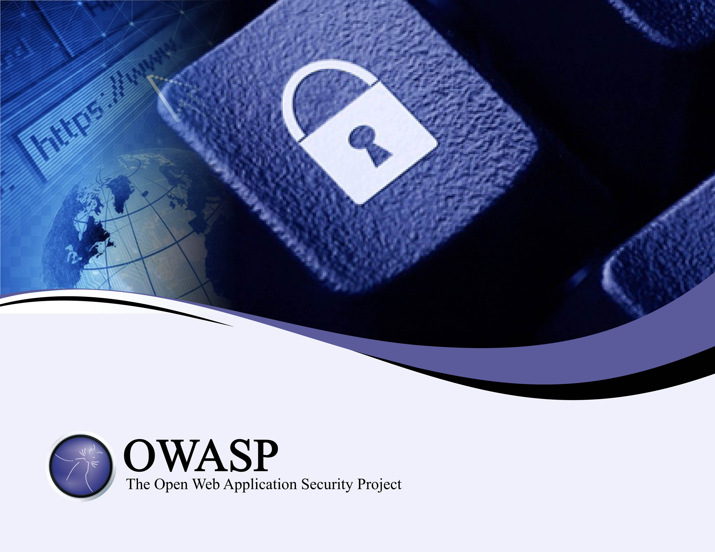
Application Security in a cyber security program
Tony Clarke
tony.clarke@owasp.org

Slide 2
Contents
Cyber Security Programs
Current Application Security
Future Application Security Considerations
Assurance & Metrics

Slide 3
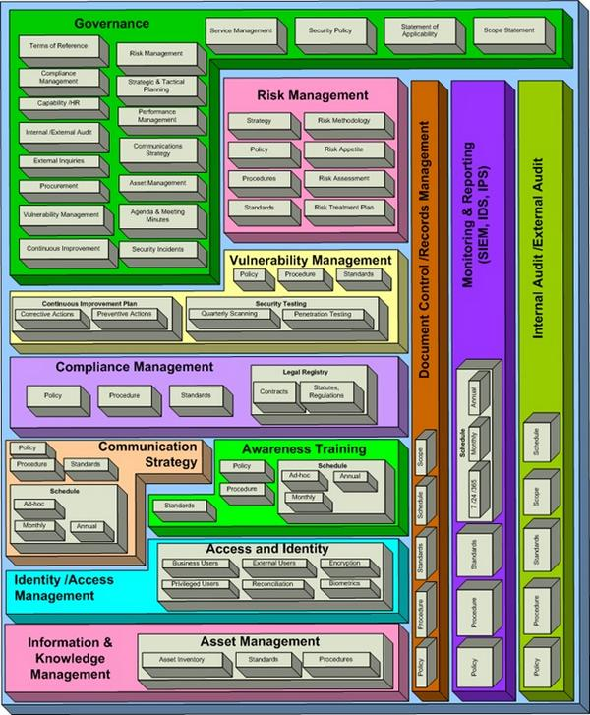
Existing Cyber Security Programs
Application Security
Small but important portion of a cyber security program

Slide 4
ISO-27001:2013 ISMS
ISO27001 - 14 Domains & 114 controls
9 controls relate to “Security in development and support processes” (A.14.2)
Information Security Policies
Asset Management
Operations
Security
System Acquisition, Development & Maintenance
Access Control
Organisation of Information Security
Communications
Security
Supplier Relationships
Cryptography
Security Incident Management
Human Resources Security
Physical & Environmental Security
Information Security Aspects of Business Continuity Management
Compliance

Slide 5
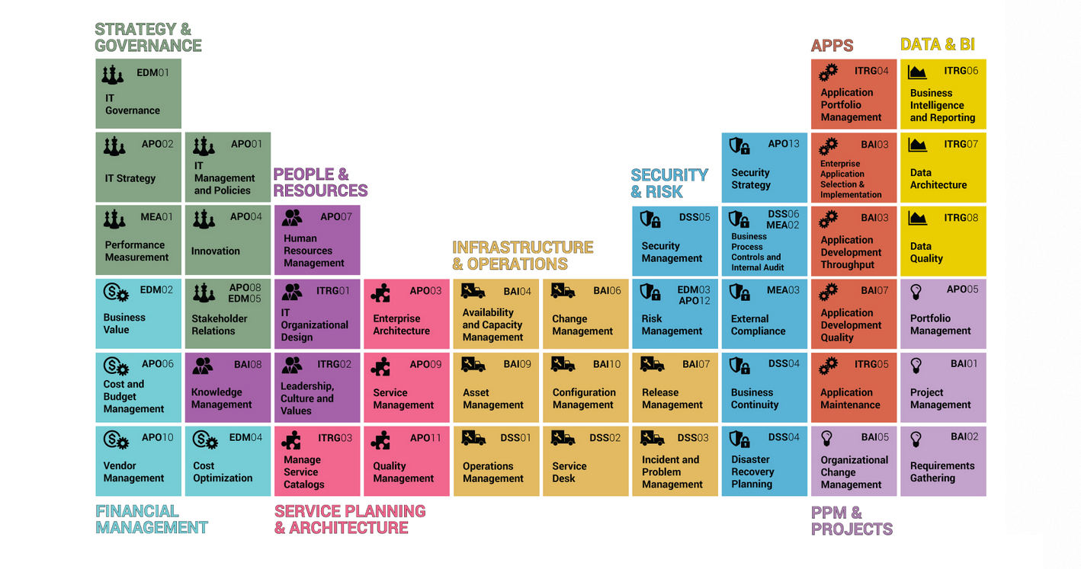
CoBIT 5

Slide 6
Data Breaches - Vtech
Vtech Data Breach (28th November 2015)
4.8 million records lost;
Data breach was due to SQL injection vulnerability;
Children and parental information;
Passwords were a straight MD5 hash;

Slide 7
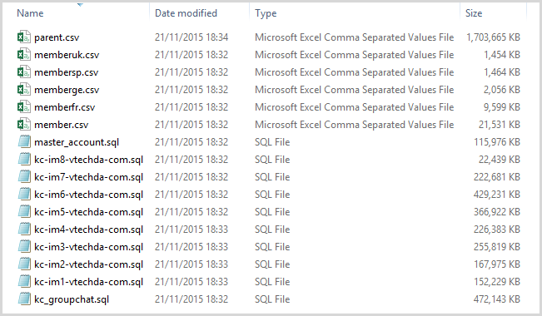
Data Breaches - Vtech
The following files were provided to journalist Lorenzo Bicchierai.

Slide 8
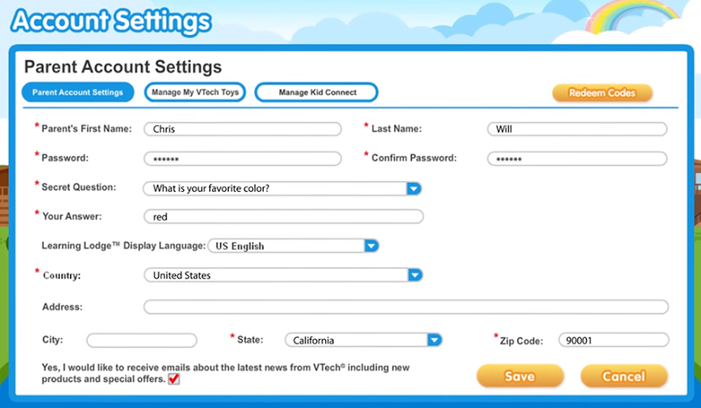
Data Breaches - Vtech
Records include:
id
email
encrypted_password
first_name
last_name
password_hint
secret_question
secret_answer
email_promotion
active
first_login
last_login
login_count
free_order_count
pay_order_count
client_ip
client_location

Slide 9
Hmmm
So Application Security is part of many Cyber Security Programs but clearly something isn’t working.
Why?

Slide 10

Application Layer Vulnerabilities
Application Layer Vulnerabilities typically not protected by a firewall.
Web Application Attacks
Web Application
Code and Content
Web Server
Vulnerabilities
Known Web Server Exploits
Operating System
Vulnerabilities
OS Attacks
Network Layer
Exposed Host
Networks Attacks

Slide 11
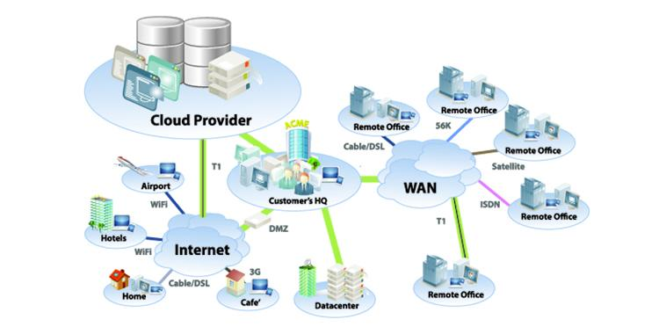
Organisation Structure

Slide 12
IT Security and Controls
Extended Perimeter
Perimeter
Business
Partners
VPN
Toolsets
Wireless AP
Access Control
Remote
Users
Firewall
Identity & Access
Management
Resources
IDS
Customers
Data
VLAN
Policy
Management
Managed
Security
Service
Branch
Offices
Devices
Applications
Operating
Systems
Vulnerability
Management
SSO
VDI
Mobile
Users
Malware
Email Security
Wireless
LAN
Proxy
DMZ
SaaS

Slide 13
IT Operations
CIO
Development
Developers
Partners
Applications
Business
Operations
Infrastructure
Servers
Networks
Database
Storage
Service Desk
IT operations
IT Applications
PMO
SMO
IT Operations
Architecture
Innovation
Security
Networks Team
Applications Team
Database Team
Windows Team
Unix Team
Storage Team
Security Team
Service Owners
Business Owners
….

Slide 14
Existing Security Models
Current Application Security Models relies on (maybe):
Security Policies & Standards;
Network Controls (firewall, IDS, etc);
Quarterly Patching;
Annual Penetration Testing;

Slide 15
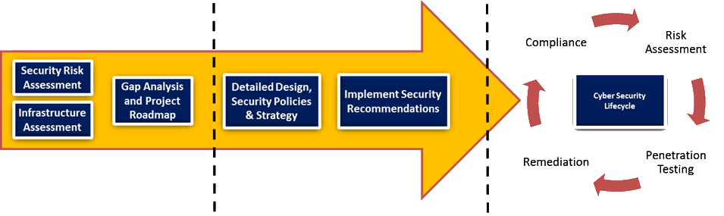
Application Life Cycle
Typical Application Life cycle.
Annual(ish) Penetration Testing.

Slide 16
Existing Models - Assessment
Is an annual pen test effective if you have:
multiple applications;
multiple releases per applications;
network equipment and OS’s aren't patched;
administrative interfaces are available;
architecture doesn’t use ‘defence in depth’;
policies and processes aren't in place;
no detection capabilities;

Slide 17
Existing Models - Architecture
Many organisations:
still rely only on a firewall to provide security from the outside;
Perform annual auditing/assurance;
Don’t subscribe to ‘defence in depth’ model;
Rely on detection and have limited prevention capabilities;
Many terminate SSL behind the firewall which means encrypted (HTTPS) traffic cannot be inspected;

Slide 18
Existing Models - Assessment
Annual Auditing usually based on compliance:
ISO-27001;
CoBIT;
SOX;
“best practice”;
Depends on auditors, skills, experience, etc

Slide 19
Existing Models - Compliance
Being secure can help with achieving compliance, and compliance can be a by-product of security but being secure is not automatically a by-product of compliance

Slide 20
Existing Models - Detection
Detection mostly relying on SIEM or SIM type products. Which consist of:
Logs
Analytics Engine
Logs
Logs
Logs
SIEM
Logs
Logs

Slide 21
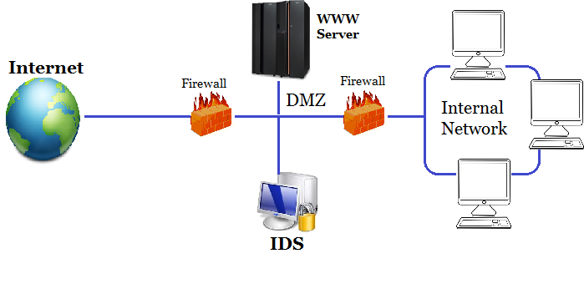
Existing Models - Prevention
Preventions mostly relying on network appliance

Slide 22
Existing Models - Response
Response usually is an afterthought and rarely in place or practiced.

Slide 23
Reality Check
Current approaches to Application Security aren’t working and don’t integrate well with operational or development models;
There are numerous issues in relation to:
support;
architecture;
prevention and detection capabilities;
assurance and compliance;

Slide 24
Reality Check
Its not always going to be possible to:
Find every vulnerability;
Patch every server or network device at every layer;
Harden every servers;
Have adequate operational resources;
Pen test every release;
Review every log entry;
…

Slide 25
Future Detection Capabilities
Detection capabilities will need to include:
Continuous Monitoring, including availability, compliance, patching;
Move to ‘real-time’ compliance;
Continuous vulnerability scans (internal & external);
Analysis of all logs e.g. servers, clients, applications, databases, webservers, firewalls, switches, routers, etc;
Threat intelligence specific to organisational context and vertical;

Slide 26
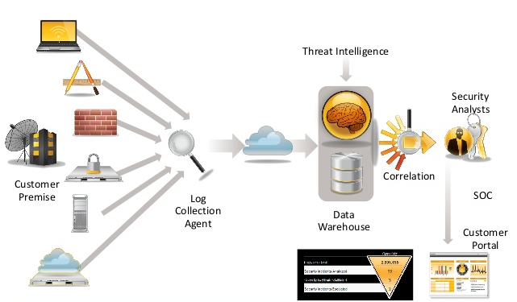
Future Detection
Future Detection will need to leverage:
Automation and monitoring;
Scale;
Global threat intelligence;
24x7x365 monitoring;
Context Aware;

Slide 27
Future Prevention Capabilities
Prevention capabilities will need to include:
Defence in depth;
Micro-segmentation;
Web Application Firewalls;
2-Factor authentication;
Hardening;
Intrusion Detection and Prevention;
Security Awareness training;
Cyber Insurance;

Slide 28
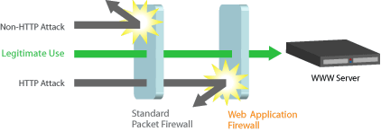
Future Prevention
Prevention model incudes:
WAF
IDS
Micro-segmentation

Slide 29
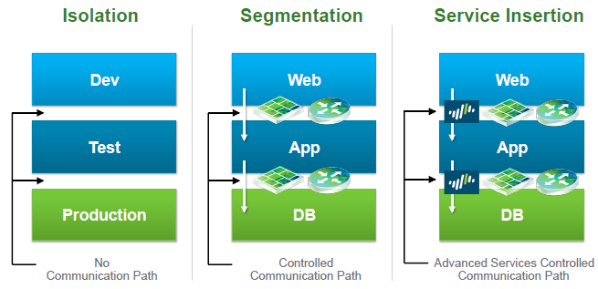
Future Prevention
Micro-segmentation

Slide 30
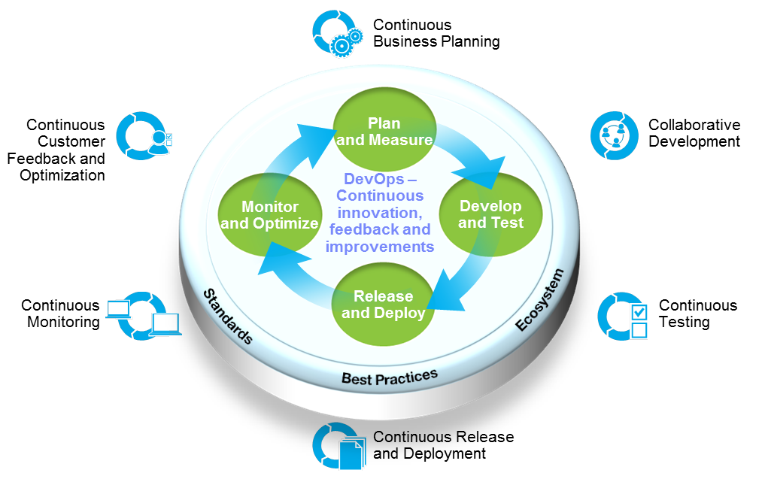
Future Development
DevSecOps

Slide 31
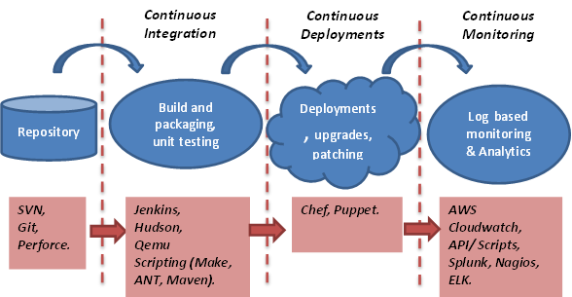
Future Development
DevSecOps

Slide 32
Future Auditing Capabilities
Many standards have requirements for continuous improvement:
ISO-27001:2013
COBIT 5 (C5I) – COBIT 5 for Information Security
Auditing will be continuous and use real-time compliance;
Notes:
Compliance not bad – its enforces a reasonably consistent level e.g. like doing your leaving certificate but I don’t think that anyone would suggest that the leaving certificate prepares you for every role or aspect of life.
Interesting quote I saw the other day.

Slide 33
Future model - IT Security Operations
Compliance & Business Context
Security Devices
Servers & Clients
Event Correlation
Logs
Flows
IP reputation
Geo-Location
Alerting & Reporting
Investigations
Malware Analytics
Visualization
Data Leakage
Network Activity
Incident Management Response & Workflow
Database Activity
Application Activity
Activity Baselining & Anomaly Detection
User Activity
Database Activity
Application Activity
Network Activity
Configuration Information
Active Defence & Remediation
Vulnerability Information
Users & Identities
Security Processes
Security Policies (ISMS)
Threat Intelligence

Slide 34
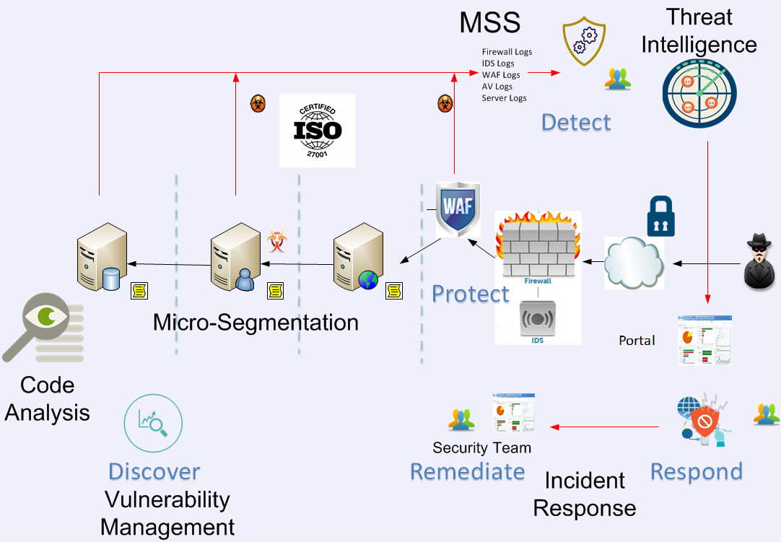
Future Model - Architecture

Slide 35
Metrics
Metrics require organizational context and threat assessment
Information Gathering
Threat Assessment
Metrics Definition & Approval
Implement Metrics
Communicate Metrics

Slide 36
Metrics – ISO-27001:2013
Leadership View
Communications security
A5
A6
A7
A8
A9
A10
A11
A12
A13
80%
A14
A15
A16
A17
A18
Senior IT management view
A
A.13.1
A.13.2
Security management view
A.13.1.1
A.13.1.2
A.13.1.3
A.13.2.1
A.13.2.2
A.13.2.3
A.13.2.4
KPI
KPI
KPI
KPI
KPI
KPI
KRI
KRI
KRI
KRI
KRI
Operations view
KPI’s
KRI’s
KPI
KRI
KRI
PI1
RI1
PI2
RI2
PI3
RI3
PI4
RI4
M1
M2
M3
M4

Slide 37
Application Metrics Dashboard
Internet Attacks
Authorized
Scans
High
Risks
Missing Patching
Security Policy Compliance
Authorized Changes
200
113
79
523
20%
112
Attacks
Authorized Scans
270 port scans
3 active attacks
112 out of 200 Monthly Internal Vulnerability Scans
17 out of 20 Monthly External Vulnerability Scans
Risks
Attack | Attack Origin | Status
8 | SEVERE | Open
12 | HIGH | Open
33 | MEDIUM | Open
43 | LOW | Open
130 | INSIGNIFICANT | Open
Patching
523 patches missing across 100 servers
Security Standard Compliance
Authorized Changes
Database layer compliant
Webserver and OS not compliant to security standards
270 changes approved (200 reviewed by security)
3 Changes rejected

Slide 38
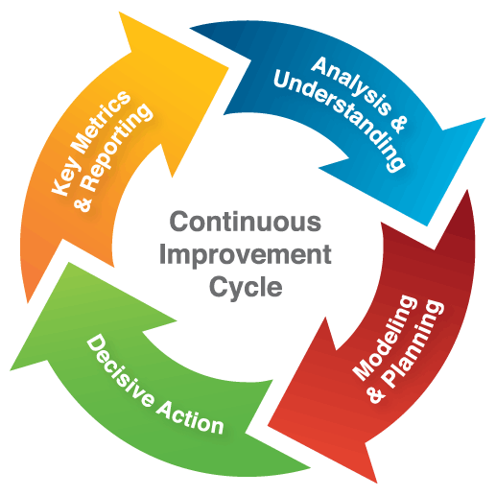
Continuous Improvement
“The organization shall continually improve the suitability, adequacy and effectiveness of the information security management system.”
“Top management shall establish an information security policy that includes a commitment to continual improvement of the information security management system.”

Slide 39

Cyber security program like Health & Well being;
App Security is similar to preventing a disease, virus or illness;
Healthy Life Style
Continuous
Prevention
Detection
Metrics

