Slide 1

Web 2.0 and Your Brand
How to Gain Meaningful Results Without
Breaking the Bank
September 25, 2008
-- Confidential and Proprietary --

Slide 2


















Good Company
-- Confidential and Proprietary --

Slide 3
Why Web 2.0?
How?
-- Confidential and Proprietary --
Notes:
Business impact.
It may seem trite, but its not. You do not own your brand or your message.
Talk about USMC video.
Ask for their help – discuss impact of Idea Mine.

Slide 4
Technologies are the detail.
The point is the forces at work.
Concentrate on the relationships, not the technologies.
-- Confidential and Proprietary --
Notes:
Business impact.
It may seem trite, but its not. You do not own your brand or your message.
Talk about USMC video.
Ask for their help – discuss impact of Idea Mine.

Slide 5
Millennial Generation
12-29 years old (1980-1997)
-- Confidential and Proprietary --
Notes:
Business impact:
Think Blue Ocean/Red Ocean.
They are simply the largest generation in the history of the world. Approximately 25% of US population and 33
% of the global population.
They think, act, communicate radically different than any other generation before.

Slide 6
83,000,000
The number of Millennials living in the U.S. today.
-- Confidential and Proprietary --
Notes:
Business impact:
Think Blue Ocean/Red Ocean.
They are simply the largest generation in the history of the world. Approximately 25% of US population and 33
% of the global population.
They think, act, communicate radically different than any other generation before.

Slide 7
So, why should I care about Millennials if they are not my target customer?
-- Confidential and Proprietary --
Notes:
Wikipedia 55%.

Slide 8
9/11/01
The date that changed everything for this generation.
80% actively involved in community (up from 60%)
Decision making = impact
Voting
Community service
Vacation planning
-- Confidential and Proprietary --
Notes:
Business impact:
To sell to them, they have to like you. In order for them to like you, you must have a relationship with them – and know where they’re coming from.
This generation is defined by 9/11. The oldest members were entering their senior year of college, the youngest was starting first grade.
9/11 was a catalyst on many fronts: civic participation, multi-lateral world view – idea of helping others, not leaving others to solve the world’s problems by themselves.

Slide 9
They influence their parents and their innovations are affecting everyone.
-- Confidential and Proprietary --

Slide 10
$200,000,000,000
Estimated spending power.
-- Confidential and Proprietary --
Notes:
Business impact:
Obvious.
In addition, they should be considered co-purchasers of almost every household purchase.
81% clothing apparel
77% groceries
68% computers
59% vacation
55% TV
52% cars
48% furniture

Slide 11
22%
Percent who find corporate or product advertising credible.
-- Confidential and Proprietary --
Notes:
Business impact.
They are not listening to you. Help them help you. Old ways of adv, mktg and research are DEAD.
Wikipedia 55%.

Slide 12
60%
Percent of teens who create content online.
-- Confidential and Proprietary --
Notes:
Business impact.
It may seem trite, but its not. You do not own your brand or your message.
Talk about USMC video.
Ask for their help – discuss impact of Idea Mine.

Slide 13
They think, act, communicate are radically different from other generations.
-- Confidential and Proprietary --

Slide 14
How do I start?
-- Confidential and Proprietary --
Notes:
OKAY…. SO WHERE DO YOU START. FIRST NEED TO BE EXPLICIT ABOUT OBJECTIVES.

Slide 15
Listen.
-- Confidential and Proprietary --
Notes:
OKAY…. SO WHERE DO YOU START. FIRST NEED TO BE EXPLICIT ABOUT OBJECTIVES.

Slide 16
Listening
Customers have always had an idea about what your brand signifies.
  an idea that may vary from the image you are projecting.
  inside companies, your employees are connecting on social networks, building ideas with online collaboration tools, and discussing the pros/cons of your policies and priorities

Slide 17
Listening
"The value of a brand belongs to the market, and not to the company. The company in this sense is a tool to create value for the brand."
- Ricardo Guimaraes, Brand Theorist
M.D. Anderson (proton therapy center)
Lynn Perry (cancer patient)

Slide 18
Case Study: Listening
M.D. Anderson
M.D. Anderson prides itself on its reputation as a major cancer treatment center.
U.S. News & World Report ranks it tops in the nation.
Spent $125 million on proton therapy treatment, the most advanced technology there is.
If there’s a cancer to be treated, we can do it.
-- Confidential and Proprietary --

Slide 19
Case Study: Listening
M.D. Anderson
“They’re very insistent on patient promptness I am there right on the button I sit there, wait an hour, hour and a half, two hours….Patients complain if the wait is too long, they won’t go to that treatment center. ‘I had to sit there for four hours,’ they say and they won’t go back again."
- Lynn Perry, M.D. Anderson cancer patient. Blogger.

Slide 20
Case Study: Listening
M.D. Anderson
M.D. Anderson has now made listening to patients like Perry a priority.
Improving its scheduling because its figured out ways to integrate opinions into research.
-- Confidential and Proprietary --

Slide 21
Listen to realize our problems/ areas for growth, so we can be explicit about our objectives.
-- Confidential and Proprietary --
Notes:
OKAY…. SO WHERE DO YOU START. FIRST NEED TO BE EXPLICIT ABOUT OBJECTIVES.

Slide 22
Traditional Listening Tactics
Market Research
  Valuable for mapping trends, but it doesn’t tell you what people are thinking
Surveys
  Answer questions you can think up, but they can’t tell you what you never thought to ask
Focus Groups
  Gets a spontaneous reaction and you may be lucky enough to get someone like Lynn Perry
These methods answer questions, but they don’t tap into consumer insights. (Brand participation)

Slide 23

Case Study.
Thoroughbred Horse Racing
Thoroughbred racing had a new CEO but faced old problems
Use of steroids and breakdowns seriously damaging sport’s image
Growing lack of relevance to emerging fan audiences
Limited exposure in media and marketing budget
-- Confidential and Proprietary --

Slide 24
Case Study.
Thoroughbred Horse Racing
Objective of Web 2.0 Program
Create new channels to communicate directly with fans
Partner with fans to develop meaningful reforms
Empower fans to help execute reform and marketing plans – peer to peer, bottom up rather than TV and top down
-- Confidential and Proprietary --

Slide 25
Case Study.
Thoroughbred Horse Racing
“The ultimate power within this game lies with those whose wagering dollars fuel the pari-mutuel engine. Because these people are largely nameless and faceless, their potential too often goes untapped. This is a mistake that the industry can no longer afford to make. In the coming months, you can expect to hear the NTRA speaking up on a number of key issues. To our horseplayers, we at the NTRA give our word that you will be an important part of that process. We’ve always appreciated your business. We will now do a better job of appreciating your ideas.”
- Alex Waldrop, March 7, 2008
-- Confidential and Proprietary --

Slide 26
ROI of Web 2.0
Hard Measures
Soft Measures
Lead Generation
Product Development
Customer Support
Brand Building
Marketing Research
Public Relations
-- Confidential and Proprietary --

Slide 27
Case Study.
ROI of 164% in 8 Months.
Lead Generation
Created 100% volunteer-led Ambassador Program.
Pilot test for seven sessions,137% booking.
23% 1st time customers.
Almost all said they’d come back and bring friends.
-- Confidential and Proprietary --

Slide 28
Case Study.
ROI of 164% in 8 Months.
Product Development.
Recruited active commenters on our blog and other bloggers based on ORBIT.
Created online community, 1,094 messages between members in 5 weeks.
Result is 48 page strategic presented at industry summit.
-- Confidential and Proprietary --

Slide 29
Case Study.
ROI of 164% in 8 Months.
Customer support.
801 comments on a blog in 48 hours. Release valve.
Personal email responses to questions, comments and complaints.
-- Confidential and Proprietary --

Slide 30
Cast Study.
ROI of 164% in 8 Months.
Brand building.
CEO interviewed on NBC Sports, Charlie Rose, New York Times – referred to as CEO blogger. Connected to fans. A new day for the sport.
-- Confidential and Proprietary --

Slide 31
Cast Study.
ROI of 164% in 8 Months.
Marketing Research.
No decisions are made without the input or consultation with customers/fans.
Database of 140,000 core customers brings cost of research down 50% compared to old methods.
-- Confidential and Proprietary --

Slide 32
Cast Study.
ROI of 156% in 8 Months.
Public Relations.
After 2 day meeting in Las Vegas, the most prominent bloggers considered “retirement” – “nothing to complain about.”
After a “dream come true” weekend, they will and they have championed our client and their agenda.
-- Confidential and Proprietary --

Slide 33
ROI Calculations
These initiatives have given NTRA marketing and technology flexibility. To value flexibility, we used Black-Scholes based model.
Three costs: consulting fees, technology, time. All three are mitigated by expected risk within the sport and need for crisis communications.
Taking all these factors into account, Total Economic Impact of our efforts is 164% (71% if instituted individually).
  43% “Straight Up” blog;
  41% Idea Mine;
  16% ORBIT Report.
-- Confidential and Proprietary --
Notes:
Business impact:
To sell to them, they have to like you. In order for them to like you, you must have a relationship with them – and know where they’re coming from.
This generation is defined by 9/11. The oldest members were entering their senior year of college, the youngest was starting first grade.
9/11 was a catalyst on many fronts: civic participation, multi-lateral world view – idea of helping others, not leaving others to solve the world’s problems by themselves.

Slide 34
Strategies for Entering Social Media
What are my customers ready for? (People)
What are my goals? (Objectives)
  “If you don't enter social media with a goal, you will fail”
  (Li, Groundswell, 70)
How do you want relationships with your customers to change? (Strategy)
What applications should you build/employ? (Technology)

Slide 35
Three Questions To Ask
Are more people engaging in a dialogue with our company more often?
Is that dialogue translating itself into more action (sales, ideas, etc.)?
Is that action helping our company meet its objectives?
-- Confidential and Proprietary --

Slide 36
Social Technographics Profile: focuses on technology behaviors
---------------------- helps to understand how social technologies are being adopted by any group of people. If that group happens to be your customers, you can use their STP to build an appropriate social strategy (Li, 45)
-- Confidential and Proprietary --

Slide 37
Social Technographics Profile
Helps to understand how social technologies are being adopted by any group of people.
If that group happens to be your customers, you can use their STP to build an appropriate social strategy
-- Confidential and Proprietary --

Slide 38
What metrics should be used?
-- Confidential and Proprietary --

Slide 39
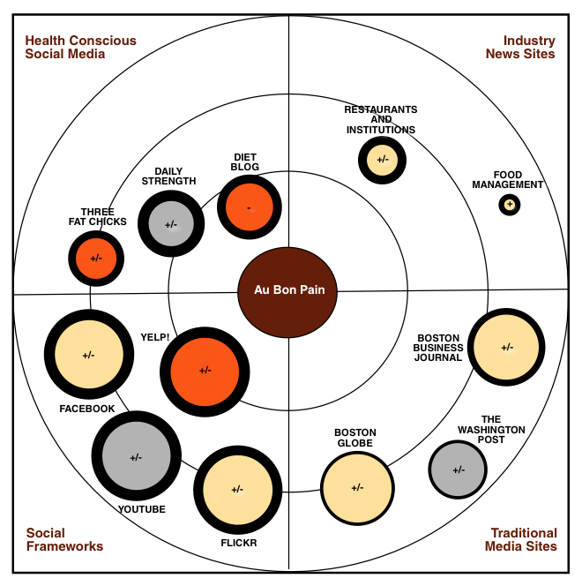
ORBIT™ Methodology
-- Confidential and Proprietary --
Notes:
4 quadrants
2 axes

Slide 40
How to get started for next to nothing.
-- Confidential and Proprietary --
Notes:
Wikipedia 55%.

Slide 41
Get to know Google.
-- Confidential and Proprietary --
Notes:
Wikipedia 55%.

Slide 42
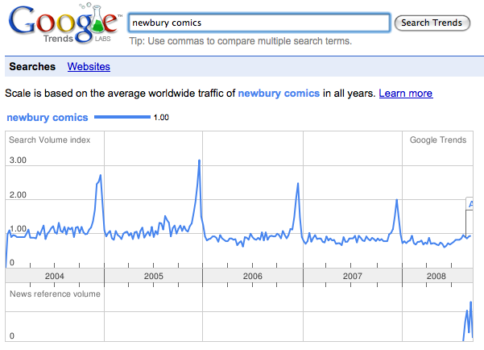
News cycles and search volume
-- Confidential and Proprietary --

Slide 43
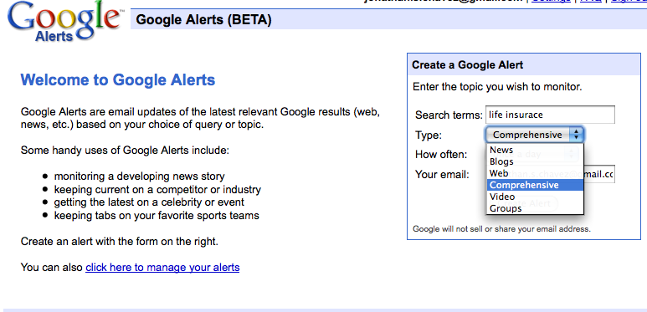
Alerts
-- Confidential and Proprietary --
Notes:
Business impact.
It may seem trite, but its not. You do not own your brand or your message.
Talk about USMC video.
Ask for their help – discuss impact of Idea Mine.

Slide 44
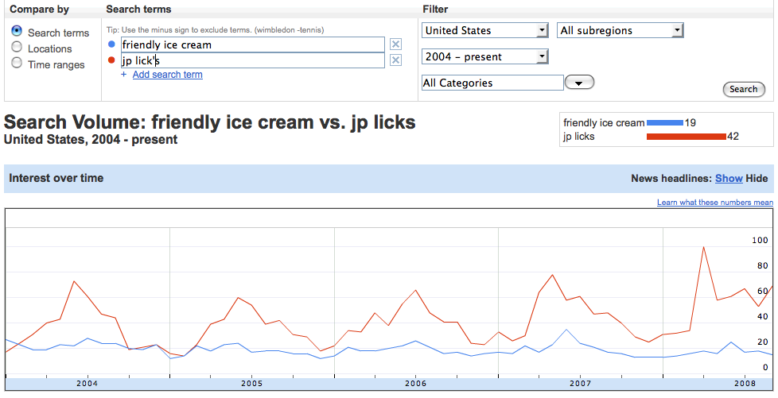
Insights
-- Confidential and Proprietary --

Slide 45
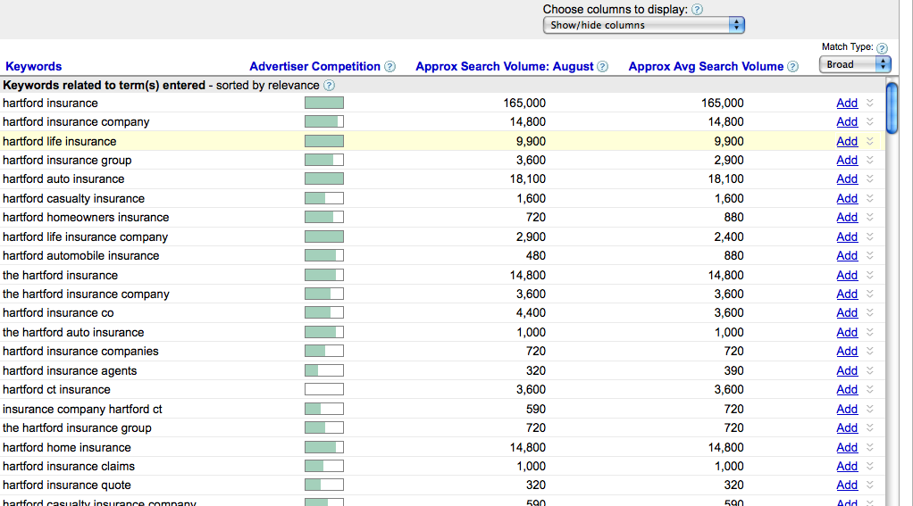
Adwords
-- Confidential and Proprietary --

Slide 46
Blog monitoring. A lot of tools, none of them perfect.
-- Confidential and Proprietary --

Slide 47





-- Confidential and Proprietary --

Slide 48
Monitoring Social Networks. It’s hard.
-- Confidential and Proprietary --

Slide 49
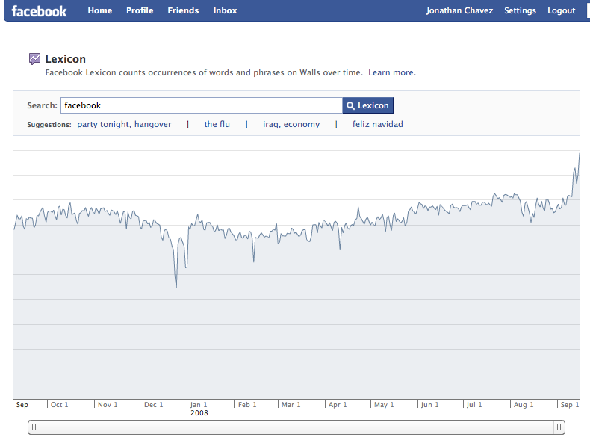
-- Confidential and Proprietary --

Slide 50
Message boards still matter.
-- Confidential and Proprietary --

Slide 51
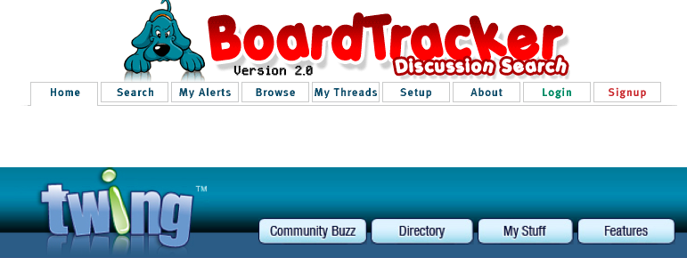
-- Confidential and Proprietary --

Slide 52
And, don’t forget about the mainstream.
-- Confidential and Proprietary --

Slide 53

-- Confidential and Proprietary --

