Slide 1
Talent Mismatch – the Gap Widens

Slide 2





ManpowerGroup
ManpowerGroupTM is the world leader in innovative workforce solutions. We leverage our global reach and local expertise of tens of thousands of people across more than 80 countries, making it possible for businesses to access the talent they need when they need it.
ManpowerGroupTM Solutions provides clients with human resources outsourcing services primarily in the areas of large-scale recruiting and outcome-based workforce-intensive initiatives, thereby sharing in the risk and reward with our clients.
ExperisTM is the global leader in professional resourcing and project-based workforce solutions. With operations in more than 50 countries, we deliver 53 million hours of professional talent specializing in IT, Finance and Engineering to accelerate clients’ businesses each year.
Right Management® is the global leader in talent and career management workforce solutions. Through our innovative and proprietary process, we leverage our expertise to successfully increase productivity and optimize business performance.
Manpower® is the global leader in contingent and permanent recruitment workforce solutions. We provide the personal flexibility and agility businesses need with a continuum of staffing solutions.

Slide 3
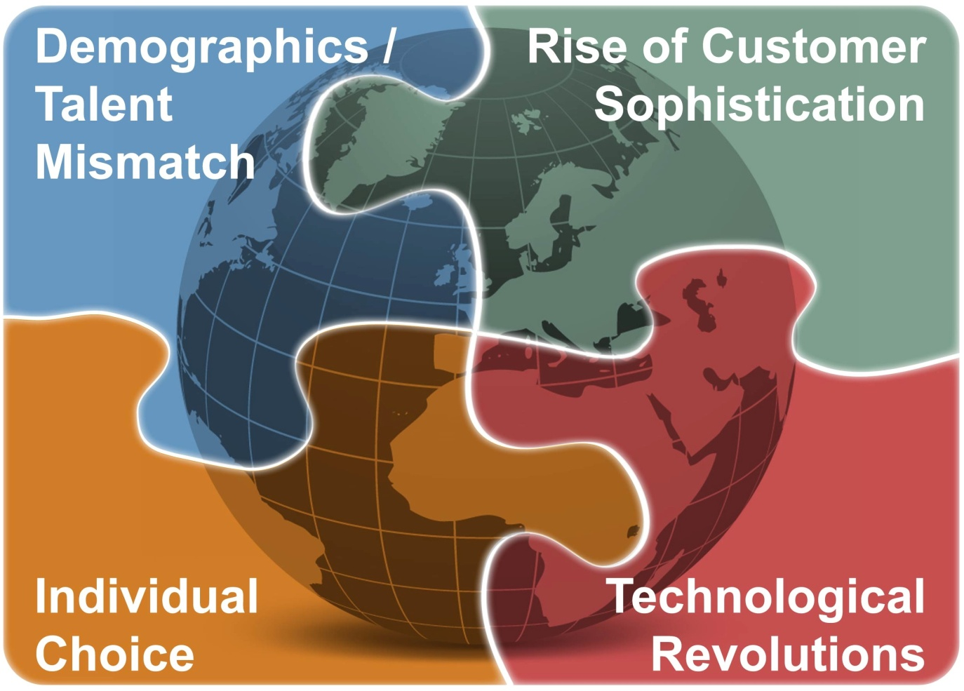
World of work trends

Slide 4


The Talent Mismatch is deepening as the working age
population declines and the nature of work changes

Slide 5
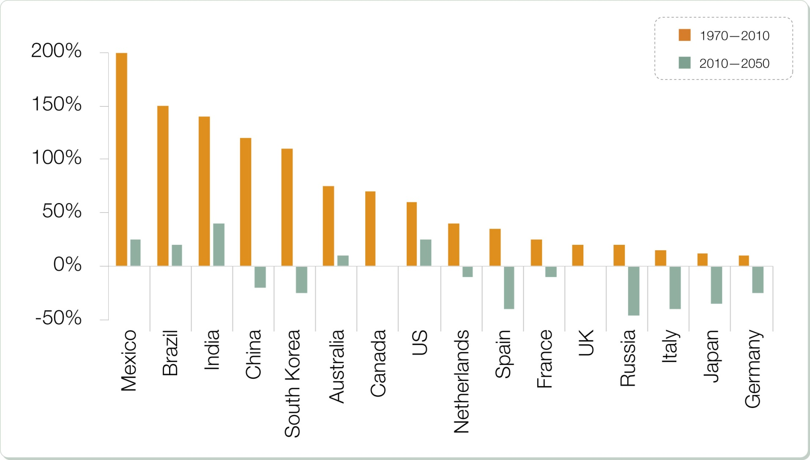
The working age population is shrinking
Source: Deloitte Research/UN Population Division, It’s 2008: Do You Know Where Your Talent Is? Why Acquisition and Retention Strategies Don’t Work, p.6

Slide 6

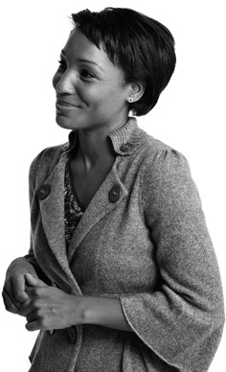
Consider Under Tapped Talent Sources
Pave the Way for Women
  Women comprise 55% of college graduates worldwide, yet in many companies and in many countries they are an underused and underappreciated resource.
  In a recent survey in more than 100 countries, 89% of women who voluntarily left their jobs for a period of time want to go back, but only 40% of these were able to find fulltime main stream jobs.
Consider Talent/Work Migration
  There are over 200 million immigrants in the world today– about 3% of the global population
  Emigration rates tend to be highest in the most educated segments of the population
  Move Work to People Virtually and Geographically
Individual Choice will be exercised by those with the
skills that are most in demand
Source: WEF Global Talent Risk Seven Responses, Center for Work Life Policy .

Slide 7

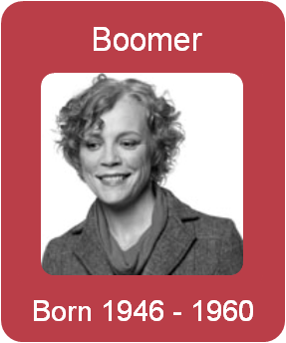


One size fits One
Generation X
Born 1961 - 1979
Hierarchical
Idealistic
Pragmatic
Immediate
Each generation approaches work differently and is shaped by the economic, social and political forces of their time – ultimately forming their individual preferences.
Source: Tammy Erickson

Slide 8

A 5th generation enters the workforce by 2020
Shared experiences
  Recession
  Resource shortages
  Refinancing
Common characteristics
  Reality
  Renewal
  Regeneration
The Re-Generation

Slide 9

Technological Revolutions have the power to change where, when and how we work

Slide 10
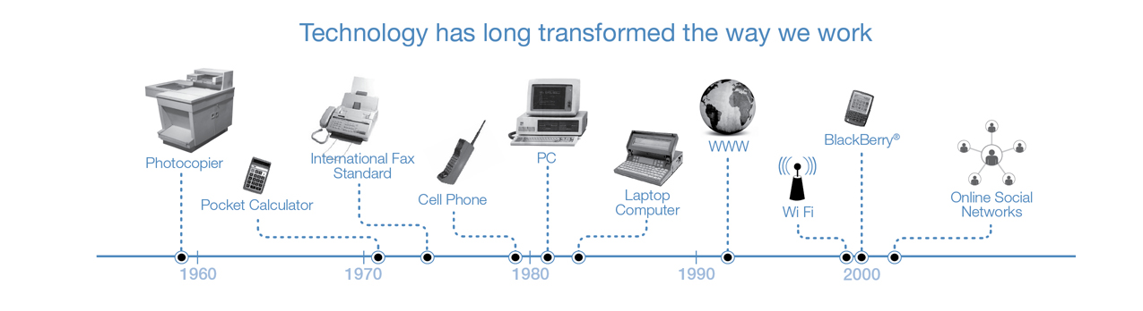
Technology has long changed the way we work
It matters less what we know and more what we can find
It matters less what we do ourselves and more how we collaborate with others
It matters less how we look when we work and more how much work we get done
It matters less what skills we have mastered in the past and more how well we learn new skills in the future

Slide 11

Rising Customer Sophistication requires businesses to deliver greater value and efficiency

Slide 12

In a globally connected world…
Customers know and expect more:
  Product problems become global issues overnight.
  We exhaustively research all purchasing decisions.
  Transparent information means we all have access to everything.

Slide 13
2011 ManpowerGroup Talent Survey

Slide 14

The U.S. is still wrestling with high unemployment, but…
52%
of employers report difficulty filling open positions.
ManpowerGroup 2011

Slide 15
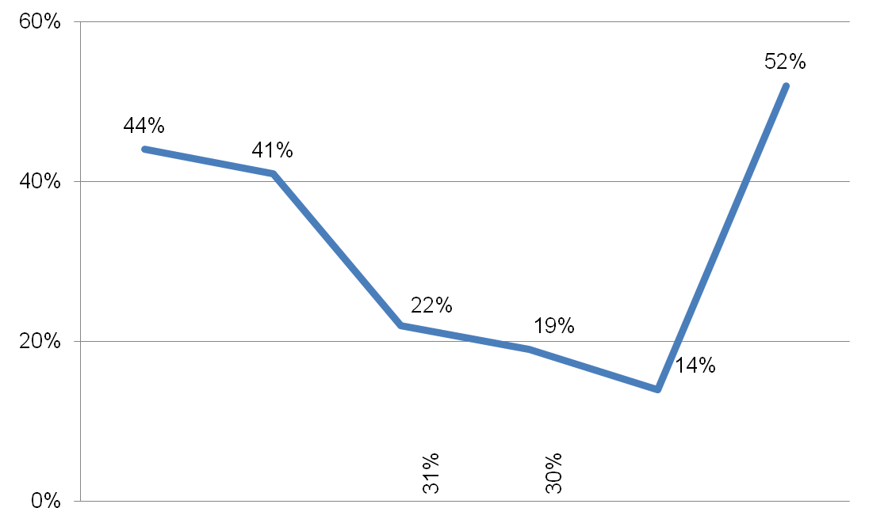




Percentage of U.S. employers having difficulty
US
Global
2006
2007
2008
2009
2010
2011

Slide 16
Top ten jobs in the U.S.
Skilled Trades
Sales Representatives
Engineers
Drivers
Accounting & Finance
IT Staff
Management/Executives
Teachers
Secretaries, PAs, Admins
Machinist/Machine Operator

Slide 17
Why are employers having difficulty?
Looking for more pay than is offered
Lack of "hard" job skills or technical skills
Lack of experience
Lack of available applicants/no applicants
Don't possess the right values and mindset
Lack of "soft" skills or interpersonal and communication skills
Undesirable geographic destination

Slide 18
What strategies are you pursuing?
Changing recruitment strategies
Focusing more on staff retention in jobs where recruitment is difficult
Providing additional training and development to new hires as well as existing staff to fill vacancies
Broadening search outside of region/country
Partnering with educational institutions to create curriculum aligned to talent needs
Providing virtual work approaches to applicants
Increasing starting salaries

Slide 19

By 2020 there will be
123 million
high-skill, high-pay jobs available in the U.S., but only
50 million
Americans with the right education to fill them.
Economist Intelligence Unit

Slide 20
Thank you!
Melanie Cosgrove Holmes
414.906.6383
melanie.holmes@manpowergroup.com
www.manpowergroup.com
For more go to www.manpowergroup.com/research/

