Slide 1
Network Security Threats

Slide 2
TCP/IP
Internet: Network of Networks
  Connected by routers, no central control
  Using common set of protocols
TCP/IP - Two-level package of protocols for Internet
  Transmission Control Protocol (TCP) -- sequencing of series of packets to transmit data reliably over Internet
  Internet Protocol (IP) -- flexible routing of information from source to destination
  TCP is not only protocol running on top of IP:
    UDP - one-directional burst of packets
    ICMP - network management protocol
    UGMP - multicast management protocol

Slide 3
How IP Works
Packet switched:
  Flow of information broken into chunks
  Each routed independently by best route to destination
  Destination must reassemble into correct order
  Errors handled by retransmission
  Internet Address:
  Logical network (location) & Logical host (identity)
  Most frequently translated into dotted decimal:
  10110110 11100111 00011000 10101010
  182 231 24 170
  182.231.24.170
  V4 (1982) -- current version (32 bit addresses)
  V6 (1999) -- forthcoming version (128 bit addresses)

Slide 4
Routing and Hostnames
Each router in Internet:
  List of known network links
  List of connected hosts
  Link for unknown networks (“other”)
  Route information passed between routers
  Accessible networks
  Cost of linkage (speed, load, distance, etc.)
  Hosts mapped by IP address
  One host, several IP addresses (multiple interfaces)
  One IP address, several hosts (dynamic assignment)

Slide 5
IP Security
Many problems:
  Network sniffers
  IP Spoofing
  Connection Hijacking
  Data spoofing
  SYN flooding
  etc.
  Hard to respond to these attacks:
  Designed for trust
  Designed without authentication
  Evolving -- employed for uses beyond design

Slide 6
Network Redirection
Intruders can fool routers into sending traffic to unauthorized locations
Notes:
Fix is to have routers listen only to approved information sources, but this may involve pressure on vendors to fix current problems, as well as defining what an “approved information source” is. Many sites cannot afford to sacrifice flexibility in connectivity, so may have some tradeoffs here.

Slide 7
Email
Here is the program you’ve been waiting for.
33
VIP@XXX.GOV
Trusted Colleague
A postcard written in pencil, with trusted cargo attached

Slide 8
Email Forgery
It is pretty simple to create email from a computer or user other than the real sender
Notes:
Fix here is to have trusted means for proving identity of email authors, which has significant policy issues (sufficient trust, maintaining trust, signature authority, etc.)
Lots of use on around April 1 (Chernenko@moskvax), but also to conceal attacks.

Slide 9
Network Flooding
Intruders can stimulate responses to overload the network
Notes:
Note animation here.
Easy to do, lots of ways to do it, no easy fix except careful control on ISP end, which requires contractual support, and possibly authority to cut normal internet connection.

Slide 10

Distributed Flooding
Notes:
Note pretty lengthy animation here: (sample tool: Tribal Flood Network)
Basic net -- seen before, represents Internet and connected systems
Intruder with toolkit -- not only do intruders magnify impact of kit by passing along to others, but are aggressively pursuing distributed technologies
Initial intrusion -- intruder selects site with lax (or no) security
Bomb factory -- installs software to coordinate distributed attack
Bomb distribution -- either the intruder or the bomb factory scans broadly for vulnerable sites for attack agent installation (ref back to Internet Auditing Project)
Bomb installation -- attack agents are loaded on a broad group of sites
Flooding -- either on command or at a prefixed time, attack agents all hit designated target site. Hosts send 32,000 byte packets at designated rate for designated time
Crashes -- 500 hosts sending 32,000 byte packets can easily overwhelm Internal host, internal LAN segments, internet connection
Attack used in early 2000 web flooding.
No simple or single-point defense for this, must have preparation at ISP and be able to coordinate response with attack-agent sites, also do what we can to reduce the vulnerable population of sites. Your security depends on the security of others. (If time, discuss regulatory role in fixing vulnerabilities in embedded systems.)
Current tools work to attack routers with illegally formatted packets.

Slide 11
Cross-Site Scripting
Malicious code
Try this: link <malicious code>
trusted site
Internal data
http://ts.gov/script.cgi?id=<script> evil </script>
Notes:
What is diagrammed here is only one (simplest) variant. Very tough to block them all.
Intruder sends to victim a link to the trusted site with malicious code embedded.
The victim contacts the trusted site, inadvertently passing the malicious code on to be immediately sent back to the victim.
Victim’s browser executes malicious code as if it came from the trusted site, doing whatever the intruder wanted, including release of internal data.
Link at bottom of screen shows simplest form of embedding code, with actual html code replacing “evil”.
See CERT Advisory 2000-02 for more details.

Slide 12
Staged Attack
1
2
3
Notes:
This is more modern approach - tools that specifically trade off actions across computers in order to make investigation and defeat much more difficult.
This breaks a lot of intrusion detection schemes.

Slide 13


Intruder Trends
Packaging
and Internet
Distribution
Notes:
Anyone can use a toolkit--Include anecdote about DOS/Unix.
Increased sophistication of intruder methods
Increased availability of shrink-wrapped intruder toolkits
Increased number of capable intruders
Leads to
Greater chance of a successful intrusion at organizations
Greater difficulty detecting intrusions because of stealthiness of toolkits
Bottom line: You must anticipate and prepare for how you will detect and respond to incidents.
Also mention CERT/CC website, where event trend data is updated regularly and defensive tools and methods are available. Attacks on the following slides are ones seen currently.

Slide 14
Attack Sophistication vs.
Intruder Technical Knowledge
Cross site scripting
Tools
“stealth” / advanced scanning techniques
High
Staged
attack
packet spoofing
denial of service
sniffers
distributed
attack tools
Intruder
Knowledge
sweepers
www attacks
automated probes/scans
GUI
back doors
disabling audits
network mgmt. diagnostics
hijacking
sessions
burglaries
Attack
Sophistication
exploiting known vulnerabilities
password cracking
self-replicating code
Attackers
Low
password guessing
1980
1985
1990
1995
2000
Notes:
Use as recap of preceding slides (Note LOTS of attack methods). Note shift from “standard” CERT/CC slide to reflect that attacks are currently available to very close to the lowest level of intruder knowledge (Point-and-click level). Slide is also updated for 2000.
The gold curve indicates the knowledge needed to perform an attack. It does not mean that intruders are becoming more stupid, although the average expertise level may be declining because of dilution of new, you, inexperienced attackers and there have been intruders with significantly below-normal intelligence. The precise curve points on this curve are estimates.
The red line indicates the sophistication of the tools and toolkits used by attackers.
Leveraging use of currently available technologies (code reuse, GUI, web, etc.)
Creating easy-to-use exploitation scripts
Developing increasingly sophisticated toolkits
Transferring expertise to novices (lots of web sites with downloads)
Scanning large blocks of addresses (ref Internet Auditing Project)
Increasing impact by targeting the infrastructure.
The cumulative effect of both curves is that the information need to break into a system is relatively flat over time. What is trading off is how much of that information is embedded in the tool vs. the user; and adding more to the tool allows many more users to do a given attack.
Relate story of intruder who used tool to get into UNIX box and gain administrator privileges, then couldn’t use it because intruder did not know UNIX commands. Also note that many view administrator access as easier to automatically gain than user access, so that even attacks that don’t require administrator access are done at that level.

Slide 15
Vulnerability Exploit Cycle
Novice Intruders
Use Crude
Exploit Tools
Automated
Scanning/Exploit
Tools Developed
Intruders Begin
Using New Types
of Exploits
Crude
Exploit Tools
Distributed
Widespread Use
of Automated
Scanning/Exploit
Tools
Advanced
Intruders
Discover New
Vulnerability
Notes:
Shape of curve is apocryphal, reflecting number of reports.
Note that tool creation and use is getting much more sophisticated as intruders adopt open-source development style, building off of each other’s tools.
Talk about cumulative effect of multiple bumps

Slide 16
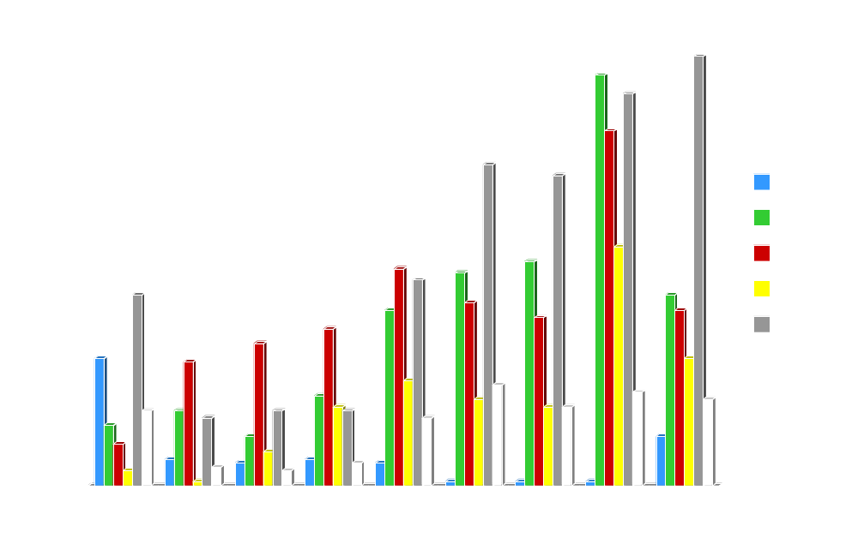
Service Shifts
Notes:
Graph is of the involvement of network services in any incident active during the given month (whether as attack vector or attack target).
Note trade-off during June-July of DNS and FTP exploitation in incidents, due to publication of the format string exploit.

Slide 17
Countermeasures for IP Security
Deny service
  Encrypt data
  Link
  End-to-end
  Application
  Separate authentication
  Firewalls

Slide 18
Securing Services
Any network service needs
  System for storing information
  Mechanism for updating information
  Mechanism for distributing information
Provision of security capabilities is independent, need is not

Slide 19
Running a Secure Server
General:
  Minimize complexity
  Minimize OS Capabilities
  No arbitrary command execution on server
  Input checking (length and content)
  Untrusted server
UID Must be root at start (port access), Changed ASAP
Directory: content, access
Secure Programs: includes, environment, trust, secrecy

Slide 20
Firewalls
Middle ground between protected and public nets
Damage detection and limitation
Uses
  Block access
  Selected prevention
  Monitor
  Record
  Encryption

Slide 21
Firewall Components
Packet Filter
  Default: Permit or Deny
  Router or special equipment
Servers
  Untrusted, exposed
  Public, fast access
Bastion Host
  Circuit Level or Application Proxy
  Represents/conceals protected net
  Clients and Proxies

Slide 22
Firewall Architectures
Lots of choices
Simple filter
Dual-ported hosts
Screened host
Screened subnet (DMZ)
Multiple firewalls

Slide 23
Internal Firewalls
Large organization
Limit trust, failures, damage
Ease recovery
Guidelines
  No file access across firewall
  No shared login across firewall
  Separate DNS
  No trusted hosts or users across firewall

Slide 24
Building Firewalls
Do it yourself – Don’t
Firewall Toolkits
Complete Firewall
Managed Security Provider
Questions:
  What am I protecting?
  How much money?
  How much access is needed?
  How do I get users to use firewall?

Slide 25
Wrappers, Proxies and Honeypots
Wrappers – server-based software to examine request before satisfying it
Proxies – bastion-based software to examine request before passing to server
Honeypots – False response to unsupported services (for attack alarm, confusion)

Slide 26
Bastion Considerations
Make bastion a pain to use directly
Enable all auditing/logging
Limit login methods/file access
Allow minimal file access to directories
Enable process/file quotas
Equivalent to no other machine
Monitor! Monitor! Monitor!

Slide 27
Common Firewall Failures
Installation errors
Policy too permissive
Users circumvent
Users relax other security
Attract attacks (less common)
Insiders
Insufficient architecture
Conclusion: Plan security as if firewall was failure

Slide 28
Connectivity
Bellovin - “The best firewall is a large air gap between the Internet and any of your computers, and a pair of wire cutters is the most effective network protection mechanism.”
Do users need to access the Internet?
Can they use shared access to some services?
What services are:
  Work-required
  Work-related
  Moral boosters
  Unneeded

Slide 29
Telecom Security
Computers are communication
Telephone access
  Modem (telephone or cable)
  Serial, direct connection
Double-edged sword

Slide 30
Modems and Security
Modems are a popular tool for breaking security
  Dial out: release secrets, attack
  Dial-in: intrude on computers and networks
Secure in layers

Slide 31
Securing Modems
As objects: physical, configuration, sequence
As phone number: false-list, carrier-answer, restrict publication, change
As phone lines: disable services, one-way, caller-id
Cable communication: encryption, restricted access
All of these approaches have limits

Slide 32
Modems and Eavesdropping
Your premises
Wires/Cable
Central Office
Transmission links
Countermeasures:
  inspection,
  Electronic sweeps
  Encryption

Slide 33
Additional Security
Call-back modems
Password modems
Encrypting modems
Caller-ID modems

