Slide 1
TIPC
Transparent Inter Process Communication Protocol
Jinqing Yan 05/28/2019

Slide 2
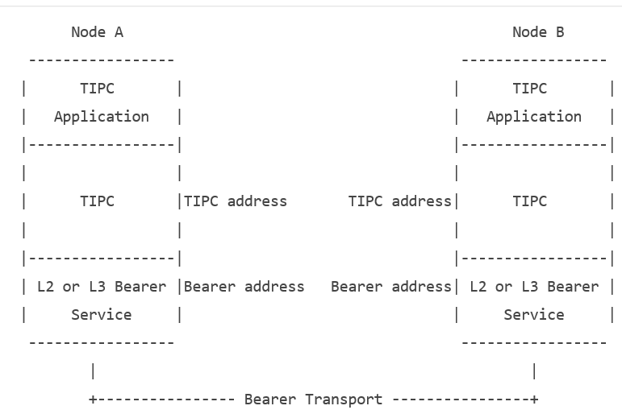
Architectural view of TIPC

Slide 3
Architectural view of TIPC
TIPC should be seen as a layer between an application using TIPC and a packet transport service such as Ethernet, InfiniBand, UDP, TCP, or SCTP. The latter are denoted by the generic term "bearer service", or simply "bearer".
TIPC provides reliable transfer of user messages between TIPC users, or more specifically between two TIPC ports, which are the endpoints of all TIPC communication. A TIPC user normally means a user process, but may also be a kernel-level function or a driver.

Slide 4
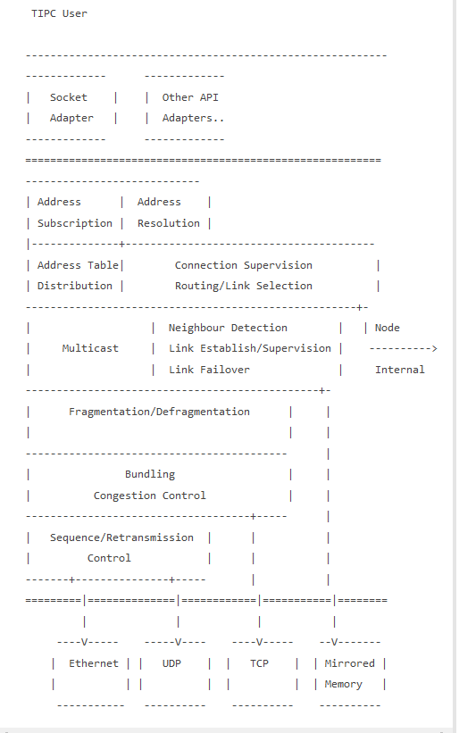
TIPC Functionality

Slide 5
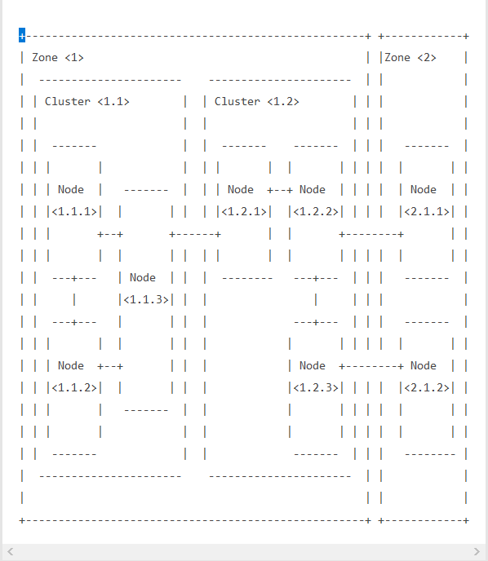
Network Topology

Slide 6
The communication channel between pairs of nodes is called Link.
The endpoint of all data traffic inside each node is called Port, typically accessible for its users via a standard socket API.
LWLB open two ports: control port and message port.

Slide 7
Address
TIPC provides two services types: port name and port name sequence for location transparency, and two physical address types: network address and port identity for physical location knowledge.
Network address: <zone(8bit).cluster(12b).node(12b)>,e.g 0x03001005 (<3.1.5>), to denote a physical entity.
Port Identity: A physical address that uniquely identifies a TIPC port within a network;
u32 reference; u32 network address, to denote a port, similar to socket.
Port Name: A service address that identifies a TIPC port as being capable of providing a specific service;
<type, instance>, bind a port to port name is similar to bind a socket to port number.
Port Name Sequence: <type, lowest instance, highest instance>
Multicast Address: The concept of service addressing is also used To provide multicast functionality. If the sender of a message indicates a port name sequence instead of a port name, a replica of the message will be sent to all ports bound to a name sequence fully or partially overlapping with the sequence indicated.
Refer to “serviceSendMessage” for usages.

Slide 8
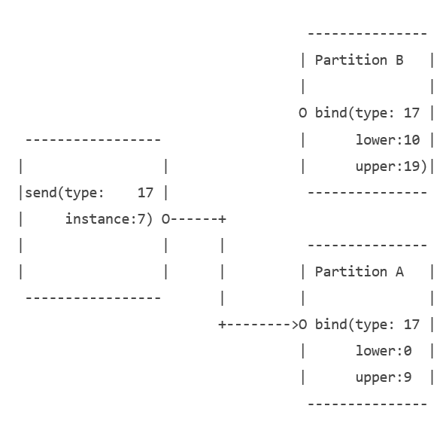
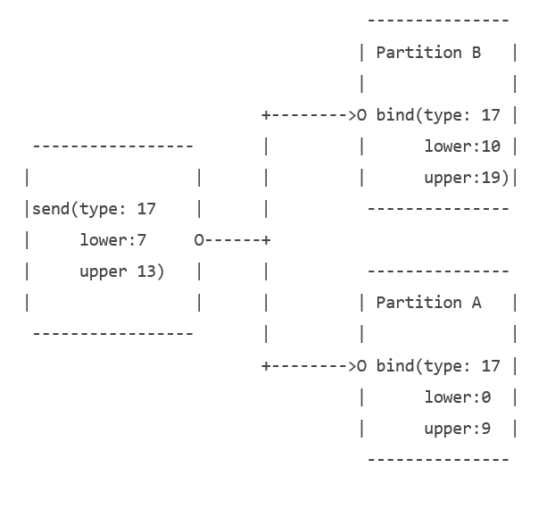

Slide 9
Neighbor Detection Protocol
Whenever TIPC detects that a new interface has become active, it periodically broadcasts Link Request messages from that interface
A node initiates neighbor detection by sending a "link request" message to all of its potential neighbors over each bearer that the node has been configured to use.
This message identifies the requesting node and specifies both the subset of network nodes the node is willing to establish links to and the media address to be used by such links
1107 10:29:57.654721 1.1.11 1.1.0 TIPC 74 Ngbr Disc Request
Frame 1107: 74 bytes on wire (592 bits), 74 bytes captured (592 bits)
Ethernet II, Src: fa:16:3e:19:ed:ce (fa:16:3e:19:ed:ce), Dst: Broadcast (ff:ff:ff:ff:ff:ff)
Transparent Inter Process Communication(TIPC)
010. .... .... .... .... .... .... .... = Version: 2
...1 101. .... .... .... .... .... .... = User: Neighbour Discovery Protocol (13)
.... ...1 111. .... .... .... .... .... = Header size: 15 = 60 bytes
.... .... ...1 .... .... .... .... .... = Non-sequenced: 1
.... .... .... ...0 0000 0000 0011 1100 = Message size: 60
000. .... .... .... .... .... .... .... = Message type: Request (0)
.... .... 0010 0111 .... .... .... .... = Minor protocol version: 39
.... .... .... .... 0110 0010 0000 1011 = Node signature: 25099
Destination Domain: 1.1.0
Previous Node: 1.1.11
0000 0000 0000 0000 0001 0010 0110 0111 = Network Identity: 4711
.... .... .... .... .... .... 0000 0001 = Media Id: 1
Bearer Level Originating Address: fa163e19edce00000000000000000000

Slide 10
Neighbor Detection Protocol
A node that receives a link request message and determines that a new link between the nodes must be established must return a "link response" message to the requesting node;
This message identifies the receiving node and specifies the receiving node's own media address.
1119 10:29:58.037871 1.1.28 1.1.0 TIPC 74 Ngbr Disc Response
Frame 1119: 74 bytes on wire (592 bits), 74 bytes captured (592 bits)
Ethernet II, Src: fa:16:3e:a2:69:60 (fa:16:3e:a2:69:60), Dst: fa:16:3e:19:ed:ce (fa:16:3e:19:ed:ce)
Transparent Inter Process Communication(TIPC)
010. .... .... .... .... .... .... .... = Version: 2
...1 101. .... .... .... .... .... .... = User: Neighbour Discovery Protocol (13)
.... ...1 111. .... .... .... .... .... = Header size: 15 = 60 bytes
.... .... ...1 .... .... .... .... .... = Non-sequenced: 1
.... .... .... ...0 0000 0000 0011 1100 = Message size: 60
001. .... .... .... .... .... .... .... = Message type: Response (1)
.... .... 0010 0111 .... .... .... .... = Minor protocol version: 39
.... .... .... .... 0110 1011 0000 0011 = Node signature: 27395
Destination Domain: 1.1.0
Previous Node: 1.1.28
0000 0000 0000 0000 0001 0010 0110 0111 = Network Identity: 4711
.... .... .... .... .... .... 0000 0001 = Media Id: 1
Bearer Level Originating Address: fa163ea2696000000000000000000000

Slide 11
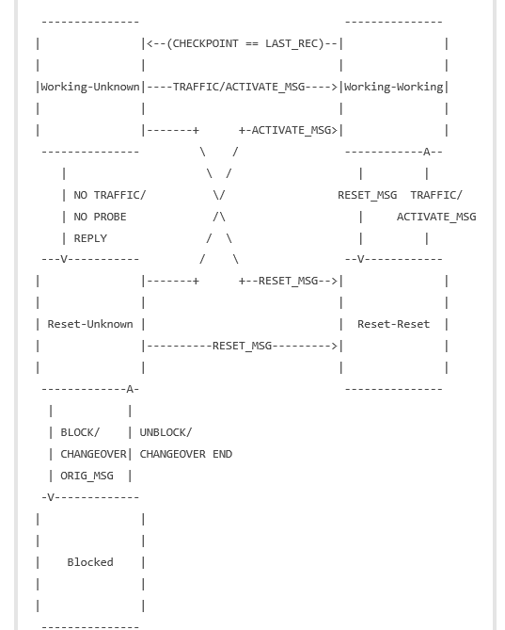
Link Creation
After the neighbor discovery, both endpoints create link to peer. The follow fsm describe how a link is activated and supervised

Slide 12
A newly created link endpoint starts from the state Reset-Unknown. The recommended default value for LINK_TOLERANCE is 0.8 s.
Reset-Unknown
Own link endpoint reset, i.e. queues are emptied and sequence numbers are set back to their initial values. The state of the peer endpoint is unknown. LINK_PROTOCOL/RESET_MSG messages are sent periodically at CONTINUITY_INTERVAL. If a LINK_PROTOCOL/ ACTIVATE_MSG message is received in this state, the link endpoint knows that the peer is already in state Reset-Reset, and can itself move directly on to state Working-Working.
Reset-Reset
Own link endpoint reset, peer endpoint known to be reset. The link endpoint is periodically at CONTINUITY_INTERVAL sending ACTIVATE_MSG messages. Cause peer to transfer to state Working-Working. The own endpoint will also transfer to state Working-Working as soon as any message which is not a RESET_MSG is received.
Working-Working
Own link endpoint working. Peer link endpoint known to be working, i.e. both can send and receive traffic messages. A periodic timer with the interval CONTINUITY_INTERVAL checks if anything has been received from the peer during the last interval. If not, state transfers to state Working-Unknown.
Working-Unknown
Own link endpoint working. Peer link endpoint in unknown state. LINK_PROTOCOL/STATE_MSG messages with the PROBE bit set are sent at an interval of CONTINUITY_INTERVAL/4 to force a response from peer. If a calculated number of probes (LINK_TOLERANCE/(CONTINUITY_INTERVAL/4) remain unresponded, state transfers to Reset-Unknown. Own link endpoint is reset, and the link is considered lost. If, instead, any kind of message, except LINK_PROTOCOL/RESET_MSG and LINK_PROTOCOL/ACTIVATE_MSG is received, state transfers back to Working-Working. Reception of a RESET_MSG in this situation brings the link to state Reset-Reset. ACTIVATE_MSG will never received in this state.
Blocked
The link endpoint is blocked from accepting any packets in either direction, except incoming, tunneled CHANGEOVER_PROTOCOL/ORIG_MSG.

Slide 13
Distributed Name Table Protocol
Name Table:
The Name Table is a distributed data base that keeps all port names that have been published in the network. It is used for translation from a port name to a corresponding port identity, or from a port name sequence to a corresponding set of port identities.
In order to achieve acceptable translation times and fault tolerance, a replica of the table must exist on each node.
The replicas of the table must be kept consistent with the other instances within the same domain, and there must be no unnecessary delays in the synchronization between neighbouring table instances when a port name sequence is published or withdrawn.

Slide 14
Name Distributor Message Processing
When a node establishes contact with a new node in the cluster or the zone, it must immediately send out the necessary number of NAME_DISTRIBUTOR/ PUBLICATION messages to that node, in order to let it update its local NAME TABLE instance.
10:29:58.355666 1.1.28 1.1.11 TIPC 234 Name Dist Publication type:1442907172 inst:-1608974337
1128 10:29:58.355667 1.1.28 1.1.11 TIPC 74 Name Dist Publication type:0 inst:16781340 control port
10:29:58.355676 1.1.11 1.1.28 TIPC 74 Name Dist Publication type:0 inst:16781323 control port
When a node looses contact with another node, it must immediately clean its NAME TABLE from all entries pertaining to that node.
When a port name sequence is published on a node, TIPC must immediately send out a NAME_DISTRIBUTOR/PUBLICATION message to all nodes within the publishing scope, in order to have them update their tables.
10:30:06.428978 1.1.11 1.1.28 TIPC 74 Name Dist Publication type:65347 inst:1001
When a port name sequence is withdrawn on a node, TIPC must immediately send out a NAME_DISTRIBUTOR/WITHDRAWAL message to all nodes within the publishing scope, in order to have them remove the corresponding entry from their tables.
155 10:29:06.868047 1.1.11 1.1.28 TIPC 74 Name Dist Withdrawal type:65347 inst:1001

Slide 15
Topology Service
TIPC provides a message-based mechanism for an application to learn about the port names that are visible to its node. This is achieved by communicating with a Topology Service that has knowledge of the contents of the node's name table.
A "topology subscription" is a request by a subscriber to TIPC, telling TIPC to indicate when a port name sequence overlapping the requested range is published or withdrawn. Subscription for an individual port name is requested by specifying a port name sequence with whose lower and upper instance values are identical.
An "event" is a response by TIPC to a subscriber, telling the subscriber about a change in availability of the port name(s) specified by a subscription, or in the status of the subscription itself.

Slide 16
An application subscribing for the availability of port name sequences must follow these steps:
Establish a TIPC connection to the Topology Server, using the port name {1,1}.
tipc_addr.family = AF_TIPC;
tipc_addr.addrtype = TIPC_ADDR_NAME;
tipc_addr.addr.name.name.instance = TIPC_TOP_SRV;
tipc_addr.addr.name.name.type = TIPC_TOP_SRV;
res = connect(ctrl_fd, (const struct sockaddr *) &tipc_addr, sizeof(tipc_addr));
Send a subscription message on the new connection for each port name sequence to be monitored.
tipc_sub.filter = TIPC_SUB_PORTS;
tipc_sub.timeout = TIPC_WAIT_FOREVER;
tipc_sub.seq.type = EVIP_TIPC_CLUSTER;
tipc_sub.seq.lower = 1;
tipc_sub.seq.upper = NUM_OF_NODES;
tipc_sub.usr_handle[0] = EVIP_TIPC_FACTORY;
if (send(ctrl_fd, &tipc_sub, sizeof(tipc_sub), 0) != sizeof(tipc_sub)) {}
Wait for arrival of event messages indicating status changes for the requested port name sequence(s).
while (select(group->ctrl_fd + 1, &read_fds, NULL, NULL, &timeout) != 0)
tipc_confchg(group, struct tipc_event*, int size)

Slide 17
struct tipc_subscr {
struct tipc_service_range seq; /* range of interest */
__u32 timeout; /* subscription duration (in ms) */
__u32 filter; /* bitmask of filter options */
char usr_handle[8]; /* available for subscriber use */
};
#define TIPC_PUBLISHED 1 /* publication event */
#define TIPC_WITHDRAWN 2 /* withdrawal event */
#define TIPC_SUBSCR_TIMEOUT 3 /* subscription timeout event */
struct tipc_event {
__u32 event; /* event type */
__u32 found_lower; /* matching range */
__u32 found_upper; /* " " */
struct tipc_socket_addr port; /* associated socket */ port identity
struct tipc_subscr s; /* associated subscription */
};
struct tipc_socket_addr {
__u32 ref;
__u32 node;
};

Slide 18
TIPC Node Up
May 27 02:29:58.356 [lwlb_wb] <10> [src/adc/lwlb/: 358]: TIPC: node UP for node 16781323, port id node 16781323 (ref 0)
Frame 1130: 74 bytes on wire (592 bits), 74 bytes captured (592 bits)
Ethernet II, Src: fa:16:3e:19:ed:ce (fa:16:3e:19:ed:ce), Dst: fa:16:3e:a2:69:60 (fa:16:3e:a2:69:60)
Transparent Inter Process Communication(TIPC)
010. .... .... .... .... .... .... .... = Version: 2
...1 011. .... .... .... .... .... .... = User: Name Table Update Protocol (11)
.... ...1 010. .... .... .... .... .... = Header size: 10 = 40 bytes
.... .... ...0 .... .... .... .... .... = Non-sequenced: 0
.... .... .... ...0 0000 0000 0011 1100 = Message size: 60
000. .... .... .... .... .... .... .... = Message type: Publication (0)
.... .... .... .... 0000 0000 0000 0000 = Broadcast Acknowledge Number: 0
0000 0000 0000 0000 .... .... .... .... = Link Level Acknowledge Number: 0
.... .... .... .... 0000 0000 0000 0010 = Link Level Sequence Number: 2
Previous Node: 1.1.11
word 4 unused for this user
word 5 unused for this user
Originating Node: 1.1.11
Destination Node: 1.1.28
0000 0000 0000 0000 0000 0000 0000 0000 = Transport Sequence No: 0
0000 0000 .... .... .... .... .... .... = Item Size: 0
0000 0000 0000 0000 0000 0000 0000 0000 = Published port name type: 0
0000 0001 0000 0000 0001 0000 0000 1011 = Lower bound of published sequence: 16781323
0000 0001 0000 0000 0001 0000 0000 1011 = Upper bound of published sequence: 16781323
0000 0000 0000 0000 0000 0000 0000 0000 = Random number part of port identity: 0
0000 0001 0000 0000 0001 0000 0000 1011 = Key (Use for verification at withdrawal): 16781323
We can see one tipc node up, it has network address <1,1,11>

Slide 19
TIPC Service Up or Port UP
May 27 02:30:06.429 [lwlb_wb] <10> [src/adc/lwlb/: 358]: TIPC: factory UP for node 1001, port id node 16781323 (ref 2474174164)
Frame 3117: 74 bytes on wire (592 bits), 74 bytes captured (592 bits)
Ethernet II, Src: fa:16:3e:19:ed:ce (fa:16:3e:19:ed:ce), Dst: fa:16:3e:a2:69:60 (fa:16:3e:a2:69:60)
Transparent Inter Process Communication(TIPC)
010. .... .... .... .... .... .... .... = Version: 2
...1 011. .... .... .... .... .... .... = User: Name Table Update Protocol (11)
.... ...1 010. .... .... .... .... .... = Header size: 10 = 40 bytes
.... .... ...0 .... .... .... .... .... = Non-sequenced: 0
.... .... .... ...0 0000 0000 0011 1100 = Message size: 60
000. .... .... .... .... .... .... .... = Message type: Publication (0)
.... .... .... .... 0000 0000 0000 1111 = Broadcast Acknowledge Number: 15
0000 0000 0000 0011 .... .... .... .... = Link Level Acknowledge Number: 3
.... .... .... .... 0000 0000 0001 0011 = Link Level Sequence Number: 19
Previous Node: 1.1.11
word 4 unused for this user
word 5 unused for this user
Originating Node: 1.1.11
Destination Node: 1.1.28
0000 0000 0000 0000 0000 0000 0000 0000 = Transport Sequence No: 0
0000 0000 .... .... .... .... .... .... = Item Size: 0
0000 0000 0000 0000 1111 1111 0100 0011 = Published port name type: 65347
0000 0000 0000 0000 0000 0011 1110 1001 = Lower bound of published sequence: 1001
0000 0000 0000 0000 0000 0011 1110 1001 = Upper bound of published sequence: 1001
1001 0011 0111 1000 1110 0110 1101 0100 = Random number part of port identity: 2474174164
1001 0011 0111 1000 1110 0110 1101 0101 = Key (Use for verification at withdrawal): 2474174165
Here, we have port name range: {65347, 1001, 1001} and port identifier: { <1,1,11>: 2474174164 }

Slide 20
Nodes with different domain
bay3:~ # kpe pn-0 -c pn-0 -- tipc-config -l
Links:
broadcast-link: up
1.8.21:eth0-1.8.25:eth0: up
1.8.21:eth0-1.8.28:eth0: up
1.8.21:eth0-1.8.29:eth0: up
bay3:~ # kpe pn-0 -c pn-0 -- tipc-config -netid
current network id: 8888
bay3:~ # kpe pn-0 -c pn-0 -- tipc-config -nt
Type Lower Upper Port Identity Publication Scope
0 16810005 16810005 <1.8.21:0> 16810005 zone
0 16810009 16810009 <1.8.25:0> 16810009 cluster
0 16810012 16810012 <1.8.28:0> 16810012 cluster
0 16810013 16810013 <1.8.29:0> 16810013 cluster
1 1 1 <1.8.21:1802452340> 1802452341 node
2 16810009 16810009 <1.8.21:0> 16810009 node
2 16810012 16810012 <1.8.21:0> 16810012 node
2 16810013 16810013 <1.8.21:0> 16810013 node
65347 1000 1000 <1.8.25:3462321764> 3462321765 cluster
65347 1000 1000 <1.8.21:1278074412> 1278074413 cluster
65347 1001 1001 <1.8.28:1116275188> 1116275189 cluster
65347 1001 1001 <1.8.29:1250726744> 1250726745 cluster
bay3:~/k8s/yjq # kpe test-1 -c test -- tipc-config -a
node address: <1.1.27>
bay3:~/k8s/yjq # kpe test-1 -c test -- tipc-config -netid
current network id: 8888
bay3:~/k8s/yjq # kpe test-1 -c test -- tipc-config -l
Links:
broadcast-link: up
bay3:~/k8s/yjq # kpe test-1 -c test -- tipc-config -n
Neighbors:
No nodes found

Slide 21
Node with different netid
bay3:~/k8s/yjq # kpe test-1 -c test -- tipc-config -a
node address: <1.1.27>
bay3:~/k8s/yjq # kpe test-1 -c test -- tipc-config -netid
current network id: 8888
bay3:~/k8s/yjq # kpe test-1 -c test -- tipc-config -l
Links:
broadcast-link: up
bay3:~/k8s/yjq # kpe test-1 -c test -- tipc-config -n
Neighbors:
No nodes found
bay3:~ # kpe pl-0 -- tipc-config -netid
current network id: 4711
bay3:~ # kpe pl-0 -- tipc-config -n
Neighbors:
<1.1.1>: up
<1.1.4>: up
<1.1.5>: up
bay3:~ # kpe pl-0 -- tipc-config -l
Links:
broadcast-link: up
1.1.3:eth0-1.1.1:eth0: up
1.1.3:eth0-1.1.4:eth0: up
1.1.3:eth0-1.1.5:eth0: up

