Slide 1
Linux NETFILTER && IPTABLES
By Jinqing Yan, 2017/11/27

Slide 2
Netfilter
Netfilter is a kernel framework for packet filtering. It can be used to do packet filtering, connection track, NAT and Qos….
It introduces ‘HOOK’ at five key points of the TCP/IP stack to achieve those functions.
PRE_ROUTING;
LOCAL_IN;
FORWARD;
LOCAL_OUT;
POST_ROUTING.
Link: http://www.netfilter.org/

Slide 3
Work Flow of NetFilter
PRE_ROUTING
ROUTE
FORWARD
ip_rcv
POST_ROUTING
LOCAL_IN
LOCAL HOST
ROUTE
LOCAL_OUT

Slide 4
iptables
Correspondingly, iptables defines 5 built-in chains to support the packet filter.
There are 4 default tables defined in iptables:
> raw table: NOTRACK or packet counter
> mangle table: TOS, TTL,MARK
> nat table: NAT
> filter table: filtering packets
http://www.iptables.info/en/index.html
https://www.frozentux.net/iptables-tutorial/chunkyhtml/index.html

Slide 5
Work Flow of Iptables
ip_output
backlog queue
ROUTE
PREROUTING
FORWARD
POSTROUTING
NIC
skb
ip_fragment
ip_rcv
ip_forward
ip_local_deliver
ip_local_out
netif_rx
ip_defrag
tunneled
tunneled
No
LOCAL HOST
OUTPUT
Yes
INPUT
ROUTE
reroute check
Yes
ipip_tunnel_xmit
No
ipip_rcv
NIC

Slide 6
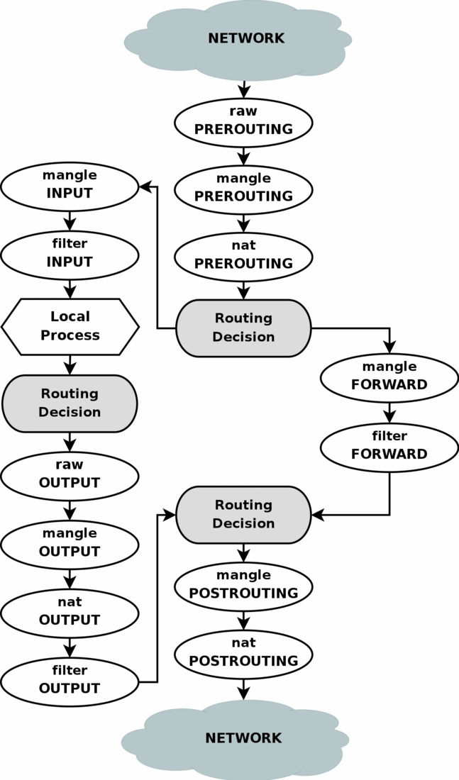
Working Flow of Iptables

Slide 7
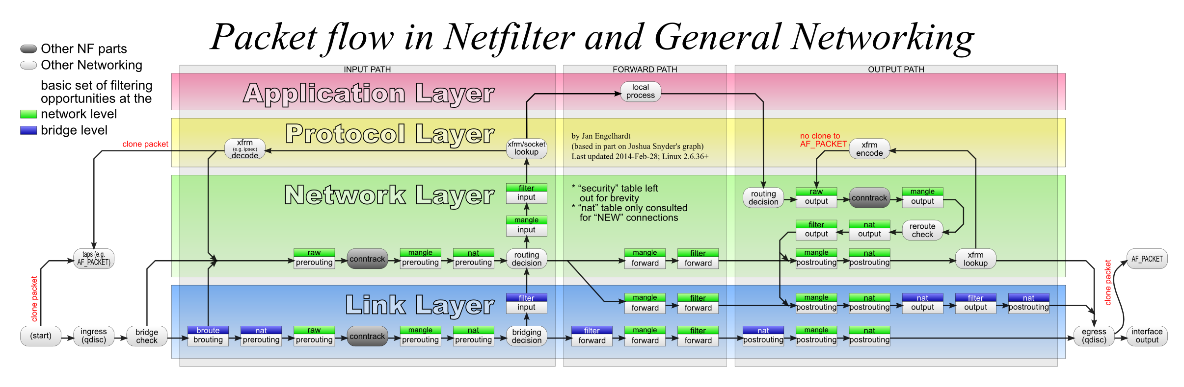
PREROUTING
OUTPUT
INPUT
FORWARD
POSTROUTING

Slide 8
priority \ nf_hooks
PRE_ROUTING
LOCAL_IN
FORWARD
LOCAL_OUT
POST_ROUTING
defrag_ipv4
ipv4_conntrack_defrag
ipv4_conntrack_defrag
raw/-300
iptables_raw_hook
iptables_raw_hook
conntrack/-200
ipv4_conntrack_in
ipv4_conntrack_local
mangle/-150
iptables_mangle_hook
iptables_mangle_hook
iptables_mangle_hook
iptables_mangle_hook
iptables_mangle_hook
-98
ip_vs_in
-99
ip_vs_out (vs/nat)
nat_dst/-100
iptables_nat_ipv4_in
iptable_nat_ipv4_local_fn
filter / 0
iptable_filter_hook
iptable_filter_hook
iptable_filter_hook
98
ip_vs_out (VS/NAT r2c)
99
ip_vs_in (DR,TUN,NAT c2r)
ip_vs_forward_icmp
nat_src/100
iptable_nat_ipv4_fn
ip_vs_out (VS/NAT r2c)
iptable_nat_ipv4_out
ct_helper/300
ipv4_helper
ipv4_helper
ct_confirm
ipv4_confirm
ipv4_confirm

