Slide 1

Predicting Home Sale Prices in Douglas County, Colorado
Odes Mullins
Regis University
MSDS 696 – Practicum II Project
Date: 12/21/2019

Slide 2
INTRODUCTION
Goal of this project was to predict home sale prices for Douglas County, Colorado
Home sales data for years 2014 through 2018 was extracted from the Douglas County assessor’s office
Single family detached homes only were used for this project
Over 28,000 home sales in Douglas County for the 5 year period
R was used for all evaluation and all commands are contained in the R Markdown file

Slide 3
Data Collection and Cleaning
Highlight
Data source was the Douglas County assessor’s office website under the Online Services/Advance Search option
Three reports extracted and used were as follows
Property Improvement (Segments Report)
Building Summary Report
Sales Information Report
Three extracted .csv files placed in RStudio project working directory
Total of 69 columns with 8 key columns leaving 45 columns for evaluation for three files
Data loaded and cleaned in RStudio including imputing missing values

Slide 4
Data Collection and Cleaning
Summary of Final Data Frame Features
FEATURES | DESCRIPTION | UNIT
Acres | Lot Size | acres
Improvmnt SF | above ground home size | square feet
Garage SF | garage size | square feet
Basement SF | total basement size | square feet
Finished Basement SF | basement finished size | square feet
Total Porch SF | total porch size | Square feet
Year Built | year home built | number
Situs Zip Code | property zip code | factor
Sale Year | property sale year | factor
Style | type of home such as ranch | factor
Stories | number of stories tall | factor
Bedroom Count | number of bedrooms | factor
Bathroom Count | number of bathrooms | factor
Quality | home quality rating | factor
Walkout Basement | is there a walkout basement | factor

Slide 5
Exploratory Data Analysis
Original home sales data frame had 31,587 rows
15 independent variables and one dependent variable with 28,523 rows after bad or missing data removed or imputed
Home prices min was $150,000.00 and max was $6,750,000.00 in final file

Slide 6
Mapping Home Sales
Extracting Douglas County Map Coordinates
Got map coordinates from the United States Census Bureau to draw entire US map
Got coordinates from US Census Bureau for entire US and extracted Colorado map coordinates only
Extracted only Douglas County map coordinates from Colorado map coordinates
Removed voting districts from Douglas County map and sequenced coordinates to correctly draw map

Slide 7
Exploratory Data Analysis
Property Coordinates Extraction
Created property location addresses for each home sold
Created Bing student account and got access key from Bing Maps Account Administration
Extracted Latitude and Longitude of property location addresses from Bing
Got free education key from Bing Maps Enterprise Account Administration
Created location address from street address, city, state, and zip code
Ran Bing process in RStudio to extract property coordinates from Bing

Slide 8
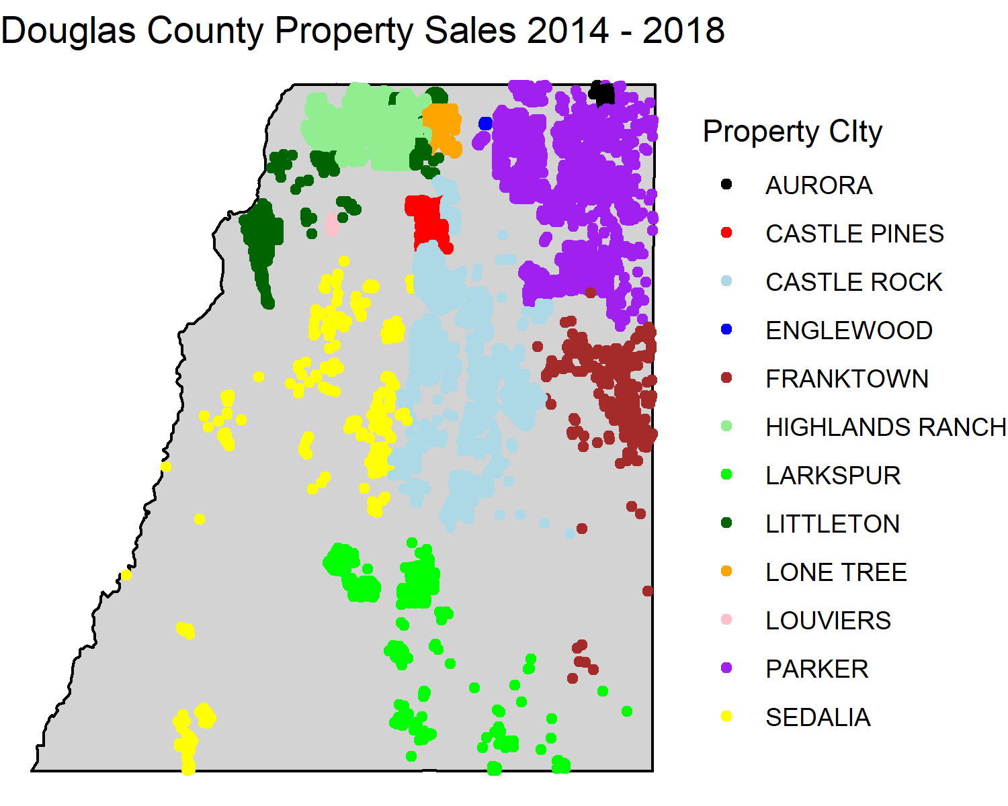
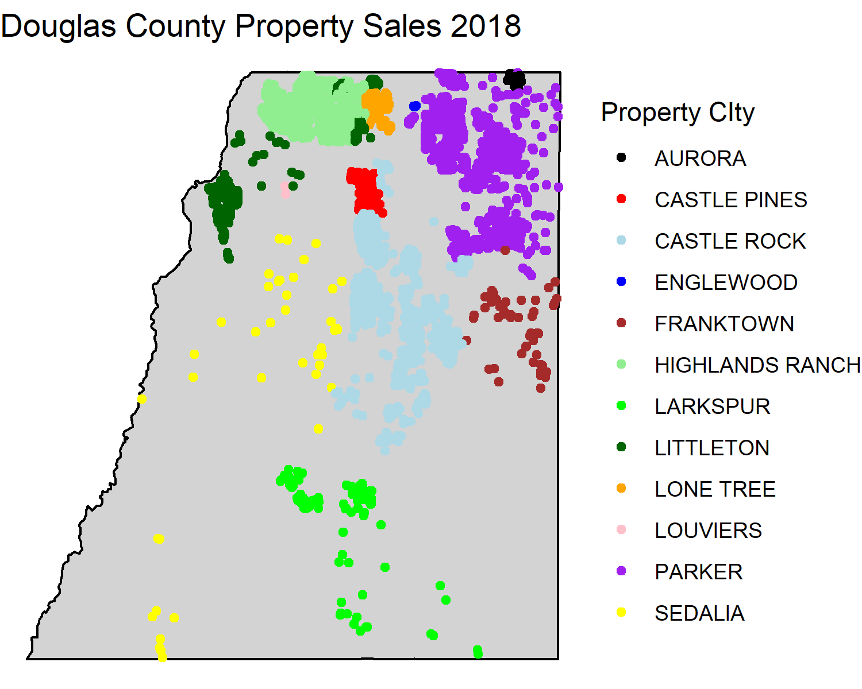
Exploratory Data Analysis
Mapped Sales

Slide 9
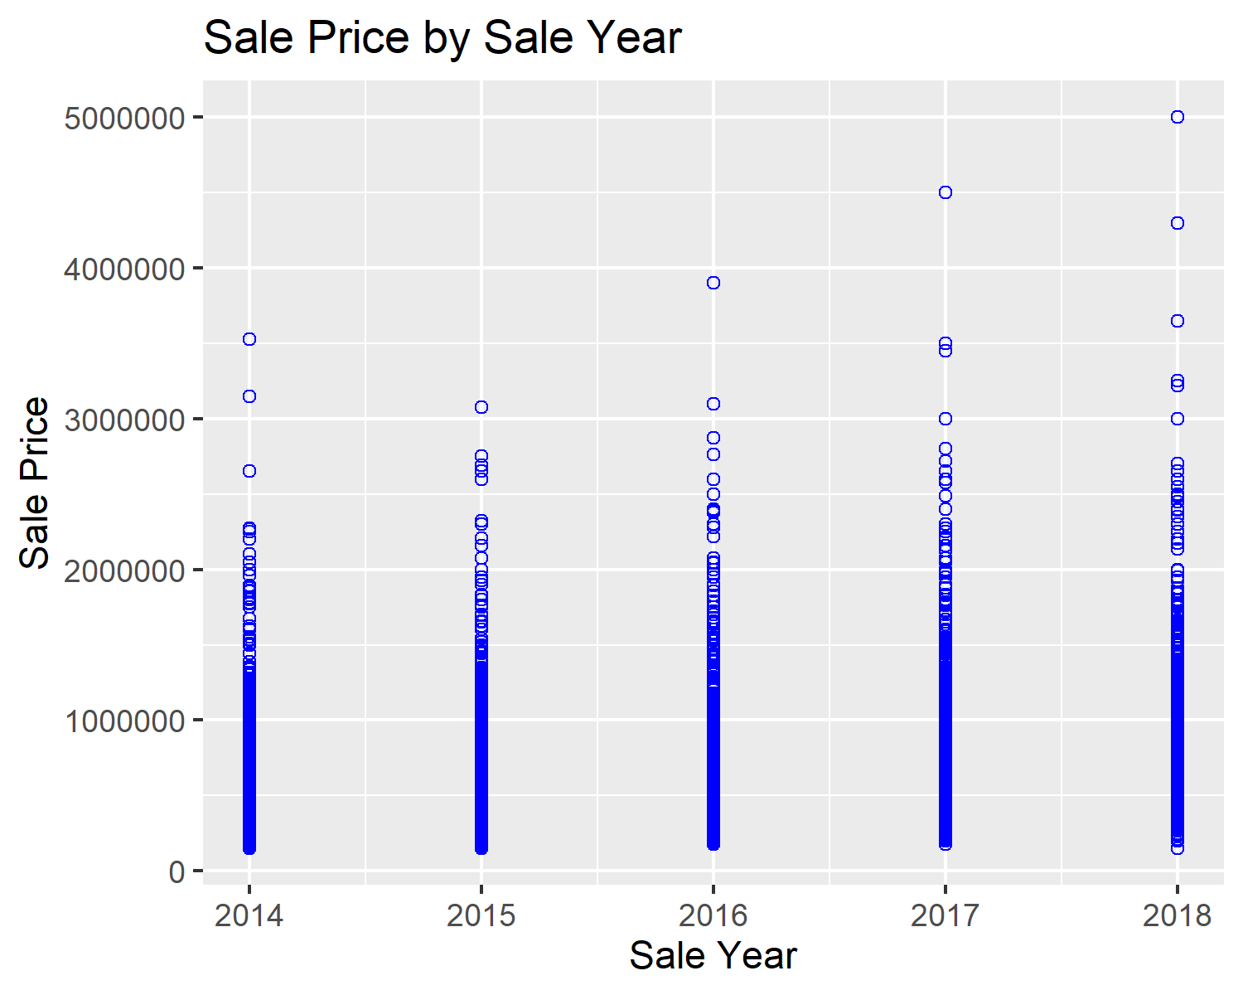
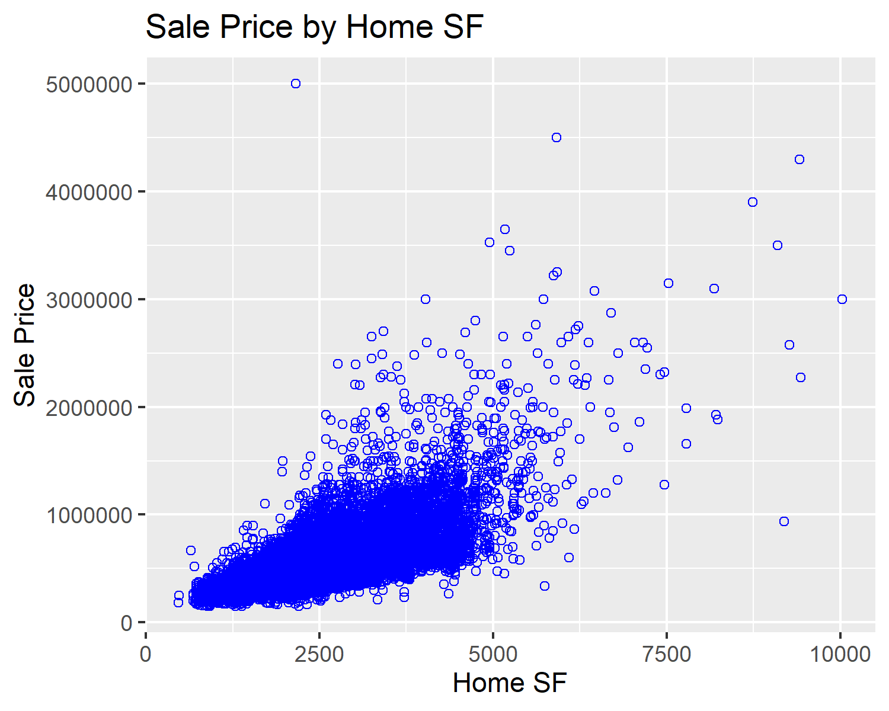
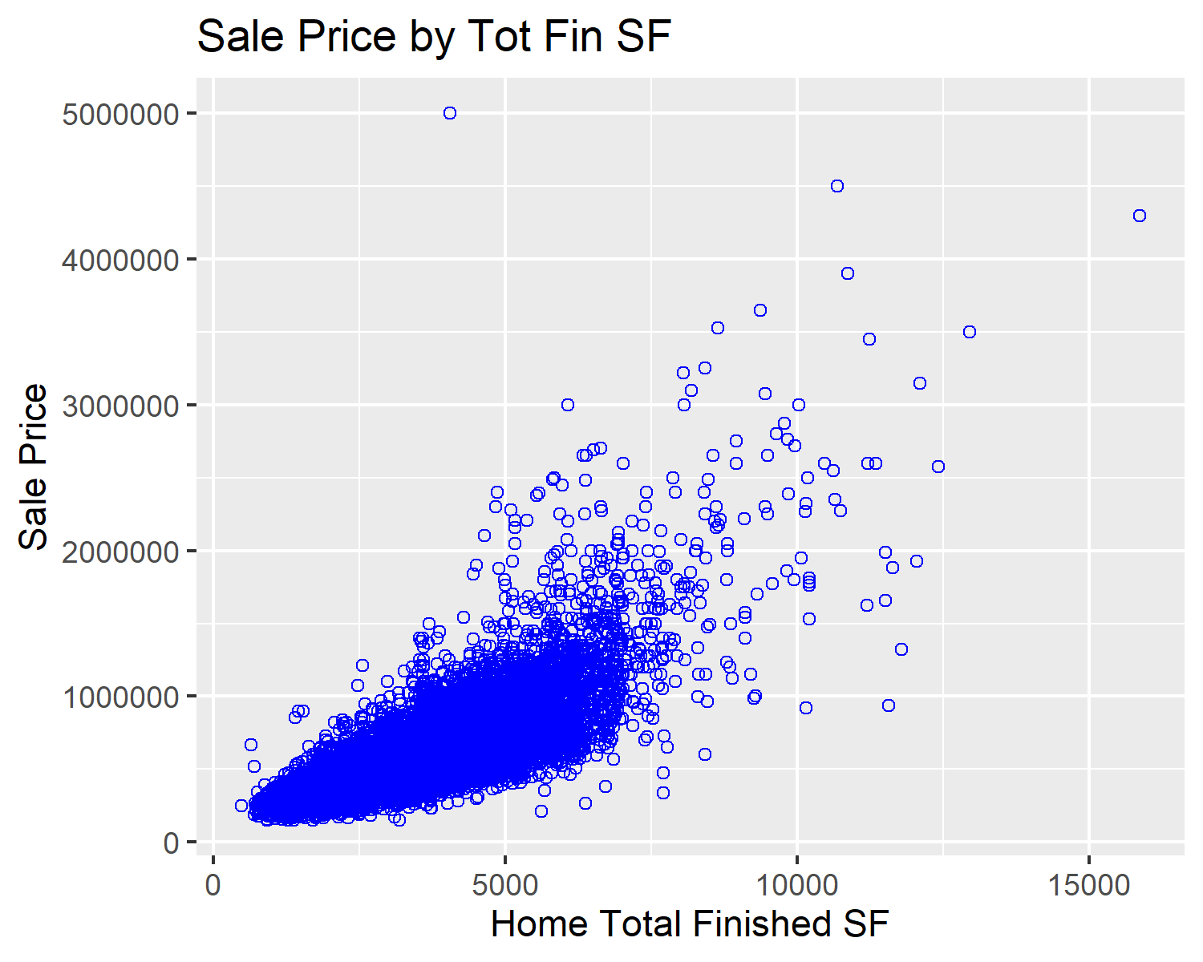
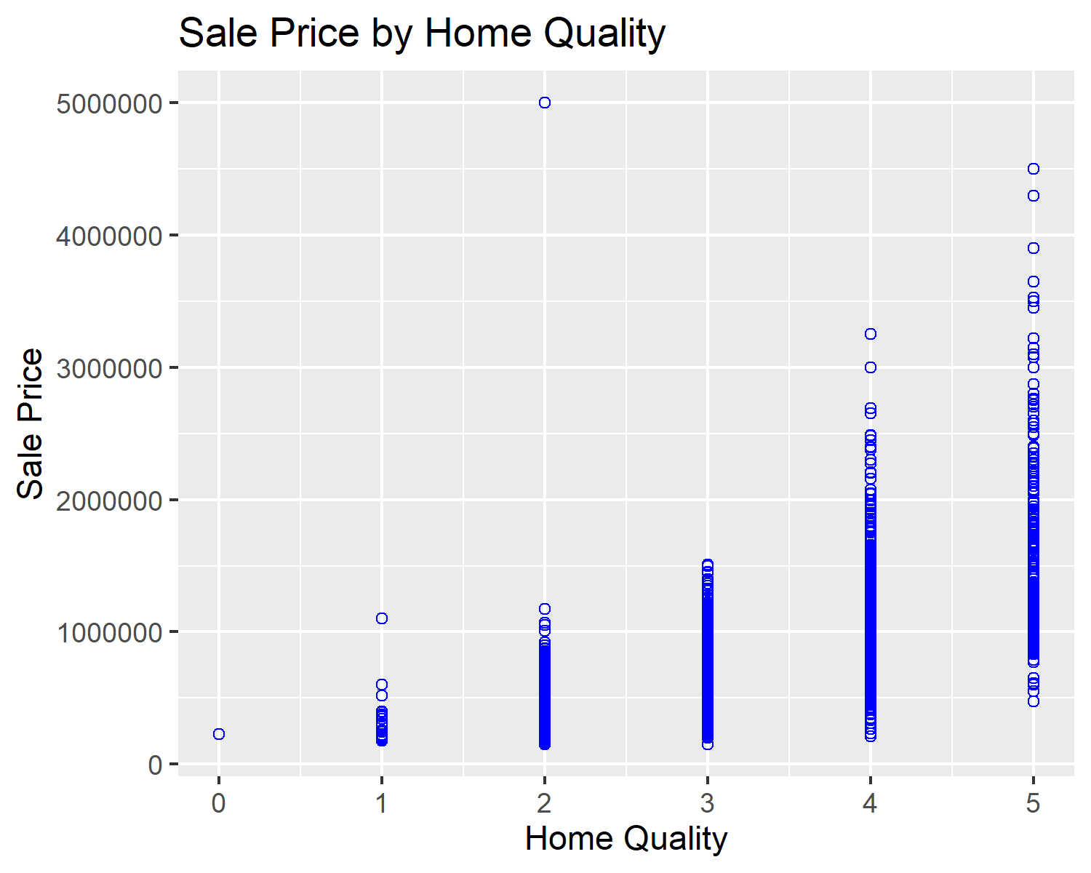
Exploratory Data Analysis
Independent Variables to Sale Price

Slide 10
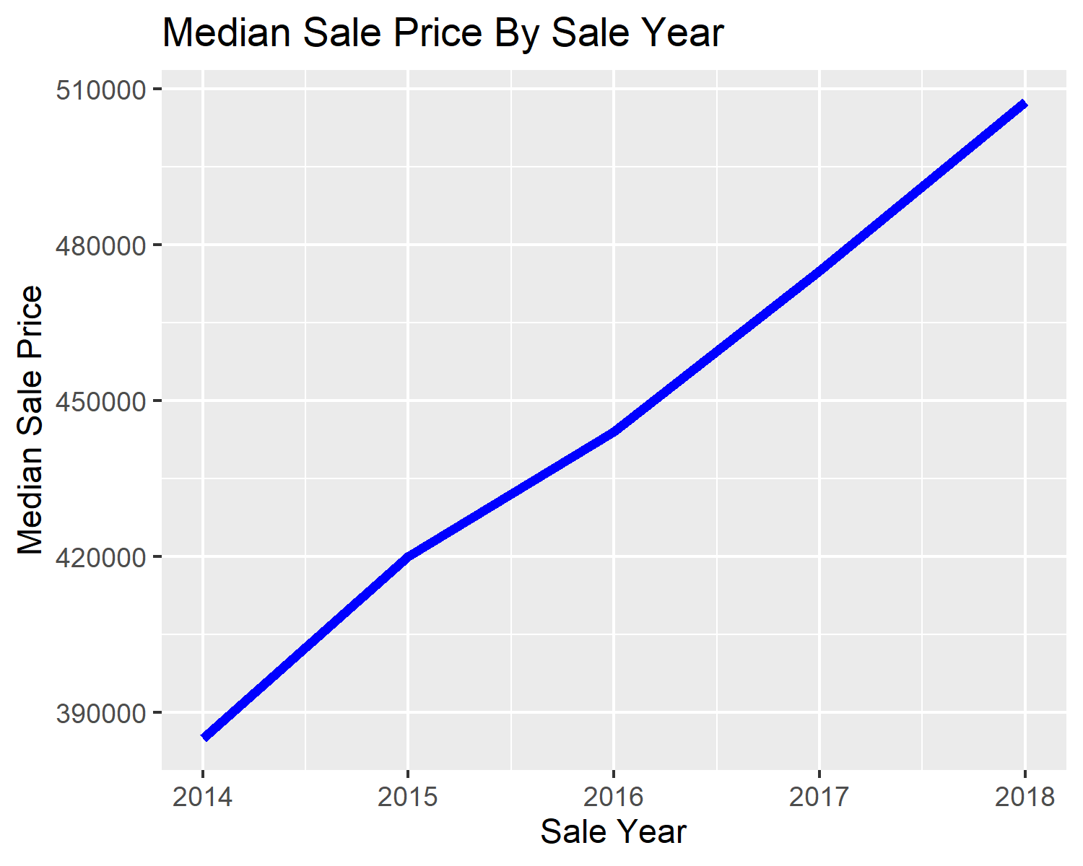
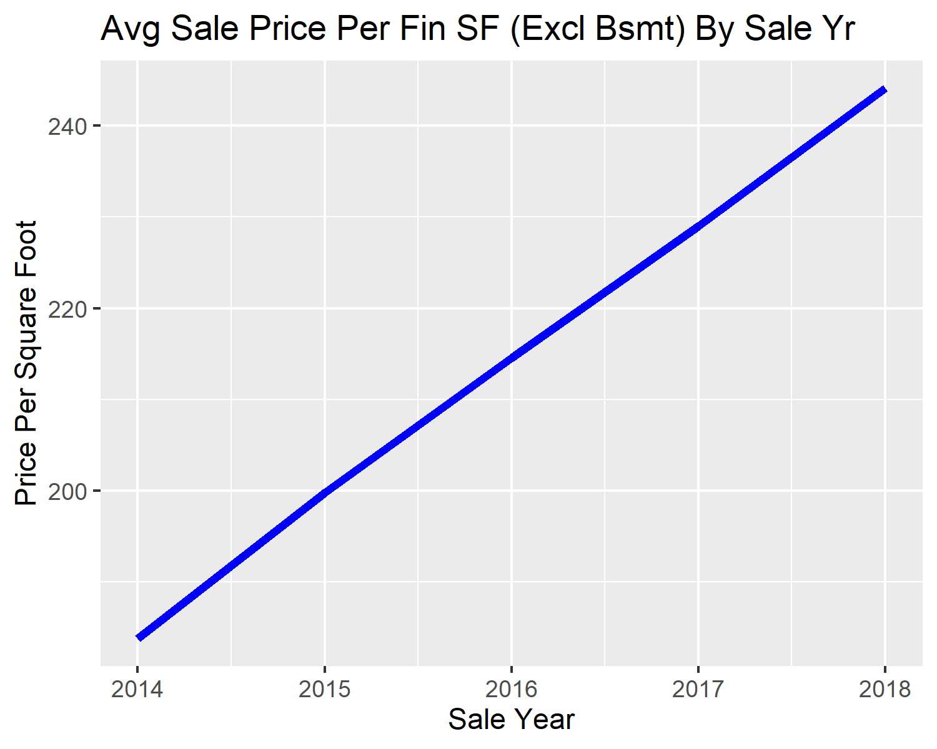
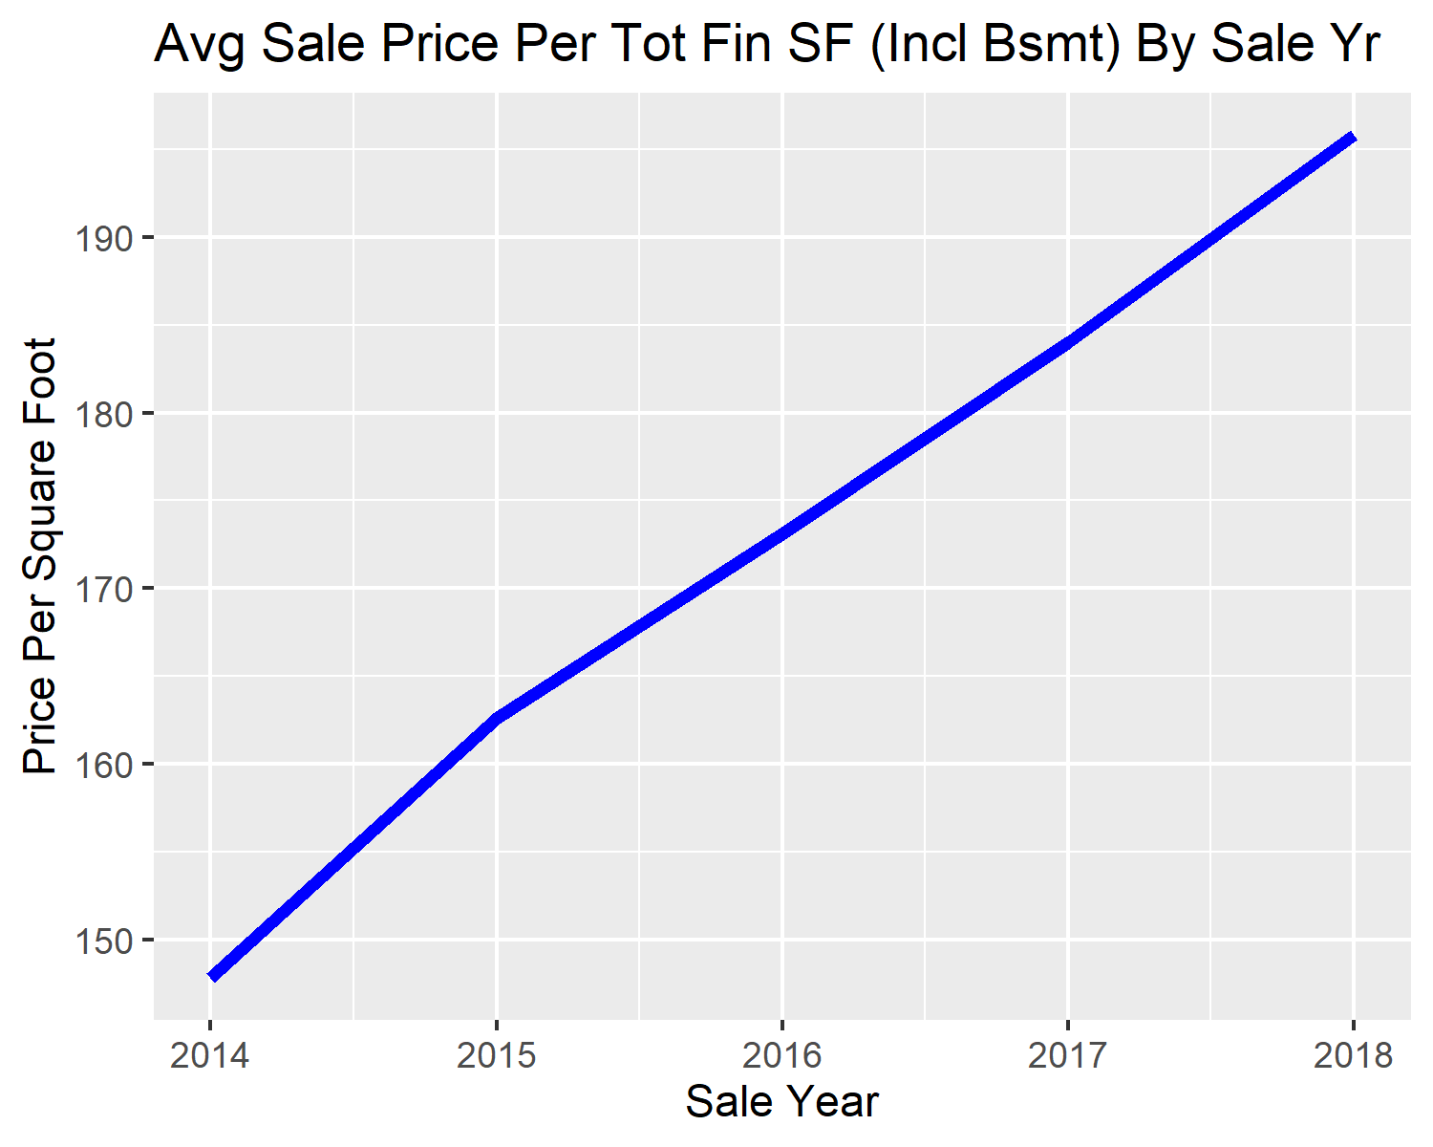
Exploratory Data Analysis
Combination and Mean Values to Sale Year

Slide 11
Regression Models
Set Up and Execution
Data frame split into train and test data frames
Used set.seed(123) for repeatable results
5 regression models with machine learning created to train and used to predict home sales prices
Linear Regression
Random Forest with Cross Validation
Gradient Boosting with Cross Validation
Extreme Gradient Boosting with Cross Validation
Support Vector Machine
The models were analyzed and modified to determine which model had the greatest predictive accuracy

Slide 12
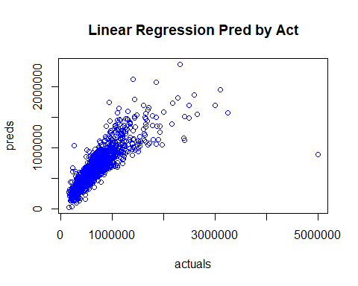
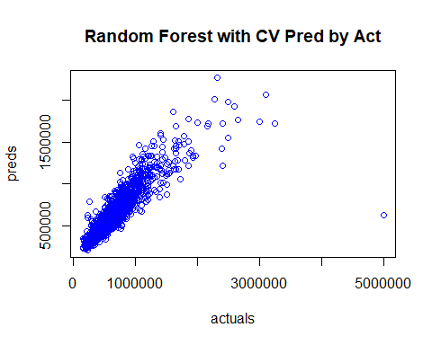
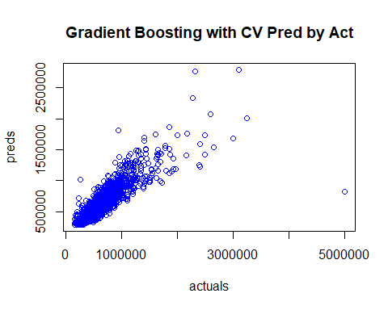
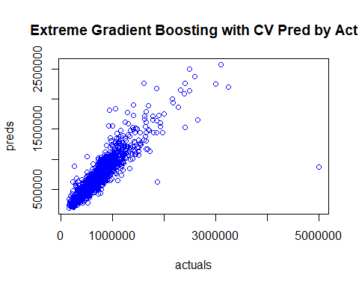
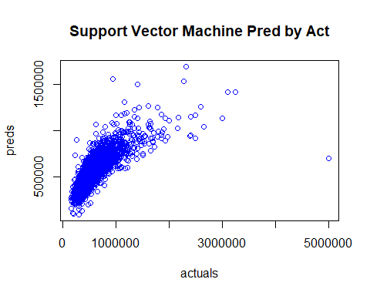
Regression Models
Predictions by Actuals

Slide 13
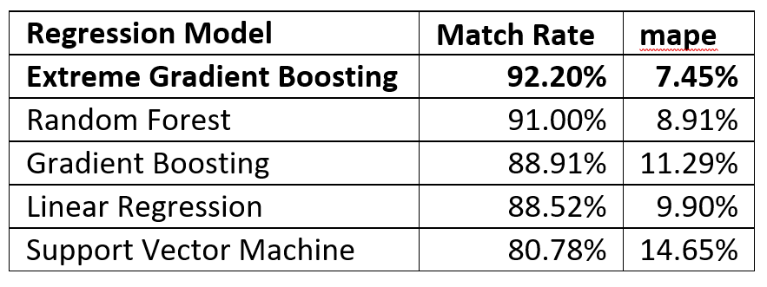
Regression Models
Regression Models Evaluation

Slide 14
Possible Future Projects
Remove the few hundred homes with higher sale prices from model
Additional tuning of existing models
Remove home sales with higher acreage
Compare home sale prices to assessor home price estimator and use features to identify if there is a factor to apply to assessor estimator price to approximate sales

Slide 15
Conclusion
Home sale prices approximator can be a useful tool
Tree models worked best at approximating home sale prices
Models could be refined to give even better home sale price estimates

Slide 16
References
https://apps.douglas.co.us/assessor/advanced-search/
https://homepage.divms.uiowa.edu/~luke/classes/STAT4580/maps.html
https://www2.census.gov/geo/tiger/GENZ2010/
https://www.microsoft.com/en-us/maps/create-a-bing-maps-key
https://www.microsoft.com/en-us/maps/create-a-bing-maps-key

