Slide 1


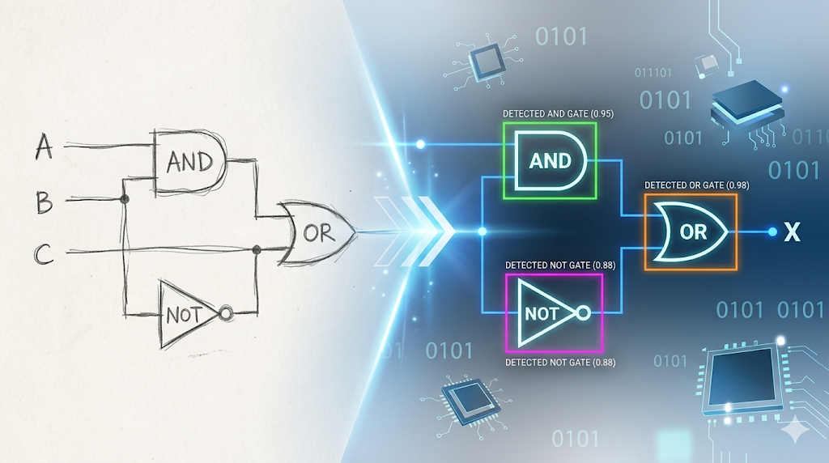
DIGITIZING HAND-DRAWN LOGIC CIRCUITS USING COMPUTER VISION
Interim Project Review
Oshadha Naghawatte - S/21/444

Slide 2
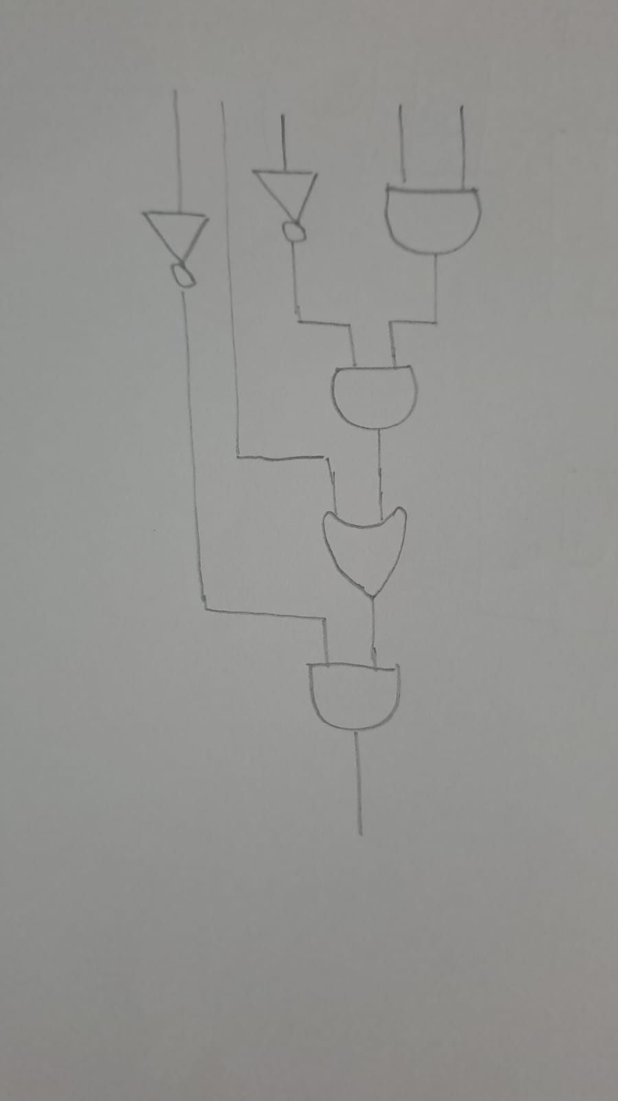

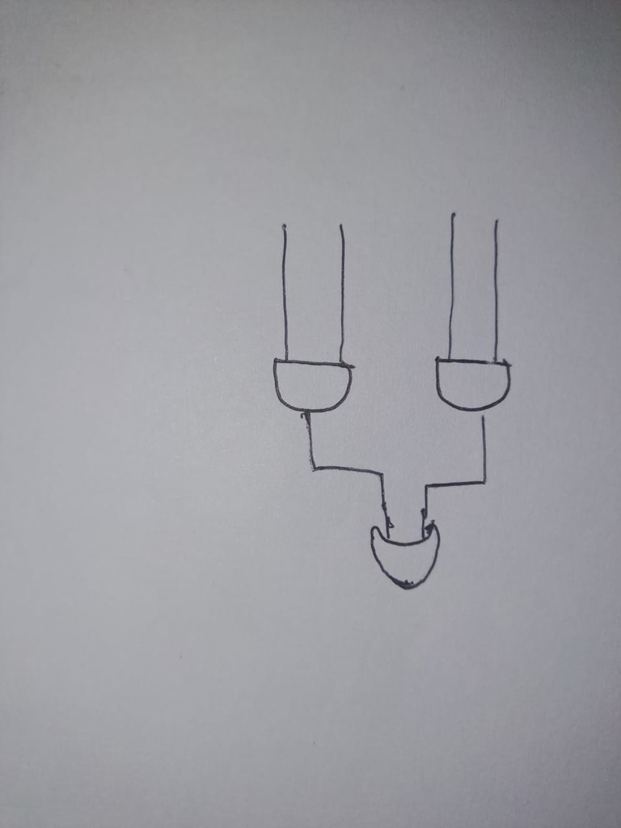
THE PROBLEM:
Translating inconsistent, hand-drawn logic circuits into functional digital netlists using pure Computer Vision.
THE CHALLENGE OF HUMAN VARIANCE:
Heavy ink and overlapping traces.
Wobbly lines and imperfect geometry.
THE DATASET:
A custom collection of hand-drawn circuits on paper, scaling from simple 2/3-gate topologies to complex structures.

Slide 3
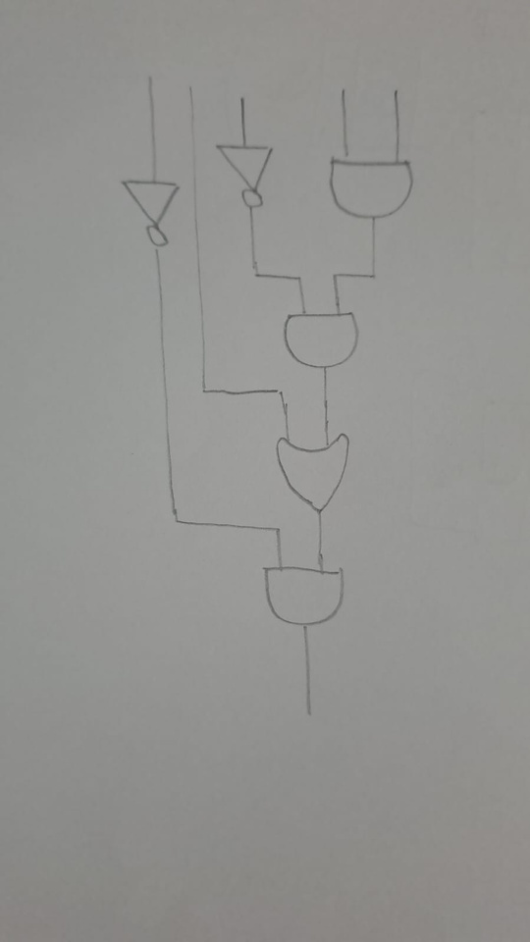
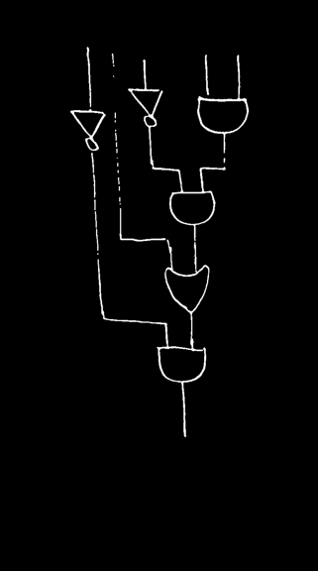
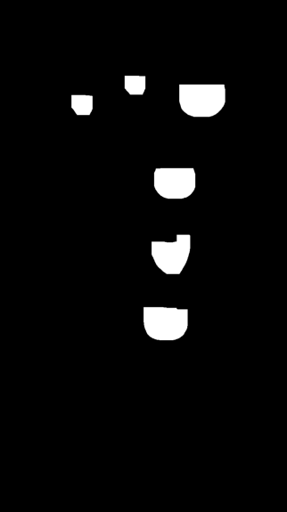
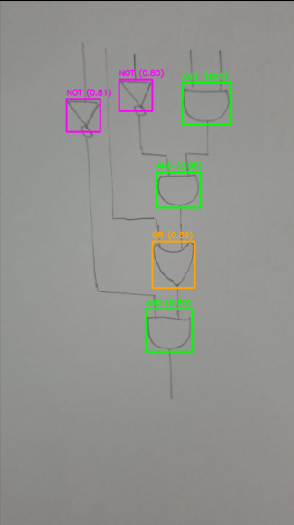
THE MULTI-STAGE IMAGE PROCESSING PIPELINE
STEP 1: PREPROCESSING
STEP 2: GAP SEALING & FLOOD FILL
STEP 3: ADVANCED SEGMENTATION
Grayscale conversion, Median Blur, Gaussian Adaptive Thresholding.
Morphological closing to handle human variance in pen pressure.
"Jaws of Life" Heavy-Duty Morphological Opening (35x35 kernel).

Slide 4
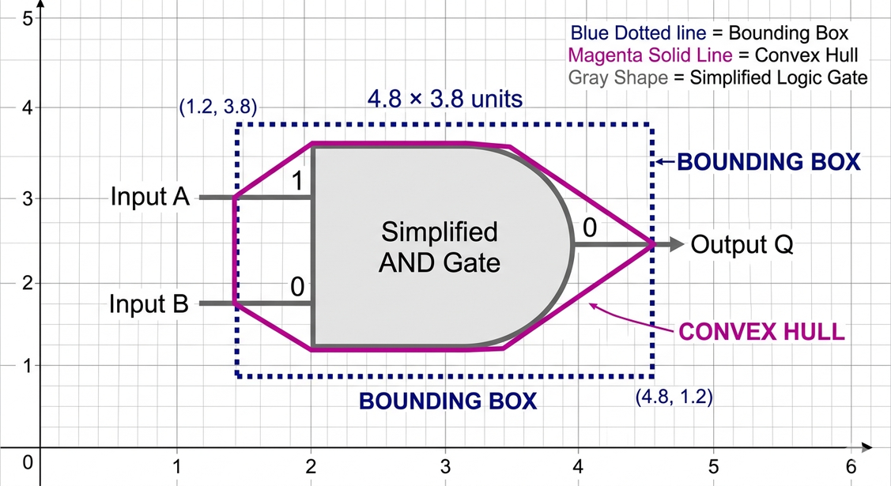
DETERMINISTIC HEURISTIC CLASSIFICATION
Utilizing deterministic pure geometry rather than probabilistic machine learning models.
Metric 1: Solidity: (Area / Convex Hull Area). Detects the complex "dent" in the back curve of an OR gate versus the solid block of an AND gate.
Metric 2: Extent: (Area / Bounding Box Area). The ultimate "Triangle Trap." A triangle mathematically cannot fill its bounding box, instantly isolating NOT gates regardless of size.
Generalization Success: High robustness against human variance in geometry, wobbly lines, and sizing.

Slide 5
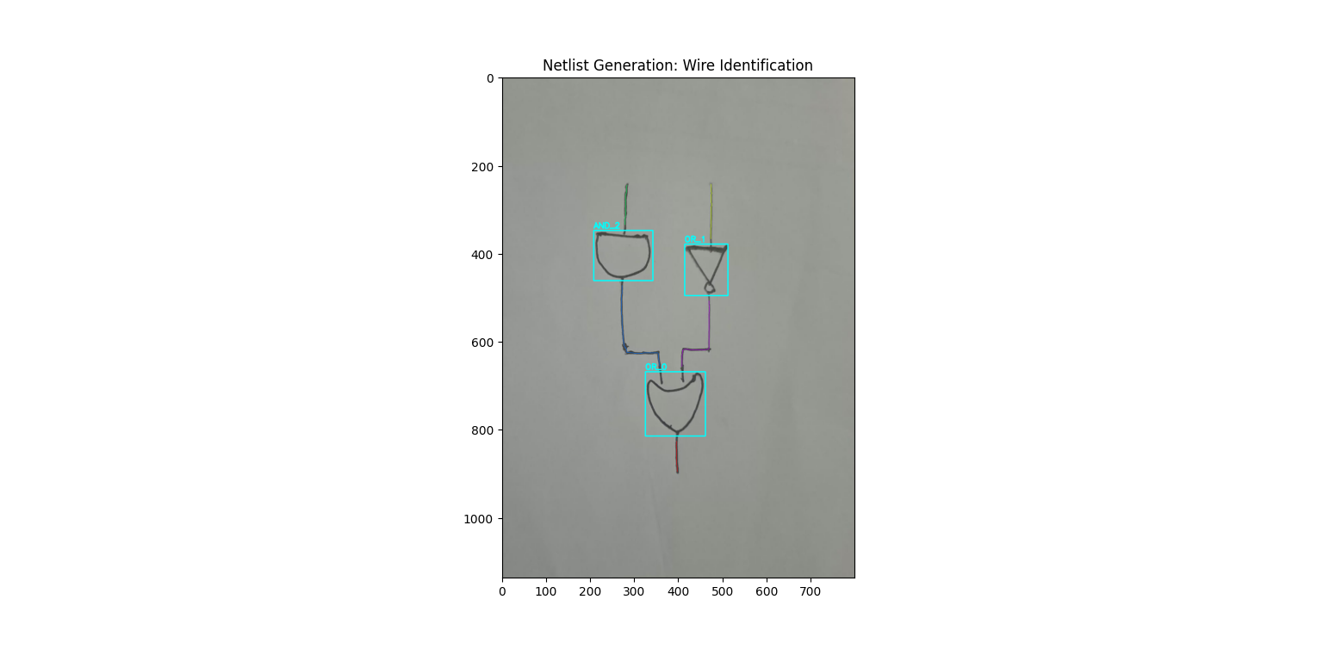
FROM PIXELS TO LOGIC
NETLIST GENERATION
Gate Masking: Erasing detected bounding boxes to isolate the raw, unconnected wire pixels.
Skeletonization: Applying morphological thinning to compress thick, wobbly hand-drawn traces into precise 1-pixel-wide paths.
Graph Pathfinding: Treating gates as 'Nodes' and skeletonized wires as 'Edges' to map connections and export a structured JSON Netlist.
LOGIC EXECUTION
Parsing the JSON Netlist to virtually rebuild the circuit geometry.
Applying standard Boolean logic to automatically calculate and output the final Truth Table.
CURRENT STATUS :
A fully functional, end-to-end pipeline from physical paper to digital simulation.

Slide 6
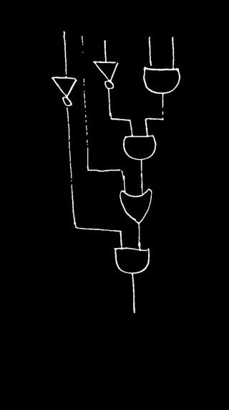

TECHNICAL CHALLENGES
The Segmentation vs. Integrity Paradox: Weak morphological operations left interconnecting wires, creating "Giant Blobs." Stronger operations cleanly severed wires but "decapitated" tiny NOT gates, destroying their geometric signature.
Solution: Developed a localized, surgical "Goldilocks scalpel" (13x13 elliptical opening) applied strictly within padded bounding boxes.
Brittle Thresholding (Overfitting): Static limits (e.g., Solidity > 0.85 or specific corner counts) failed when human variance produced borderline geometry (e.g., a wobbly line registering as 8 corners).
Solution: Pivoted to a multi-factored, deterministic decision tree where Extent acts as the ultimate "Triangle Tie-Breaker" rule.

Slide 7
FUTURE SCOPE & REMAINING WORK
NEXT PHASE 1:
NEXT PHASE 2:
Expanding the Combinational Library
The Sequential Logic Leap
Extending the geometric classifier to identify complex derived gates: NAND, NOR, XOR, and XNOR.
Moving beyond feed-forward combinational logic to detect circuits with state and memory.
Tuning the pipeline to handle extremely dense, tightly packed circuit diagrams.
Identifying feedback loops and sequential elements like Latches and Flip-Flops (D, T, SR, JK).

Slide 8
THANK YOU

