Slide 1
Shrinkage Methods in Machine Learning
Marta Fajlhauer

Slide 2
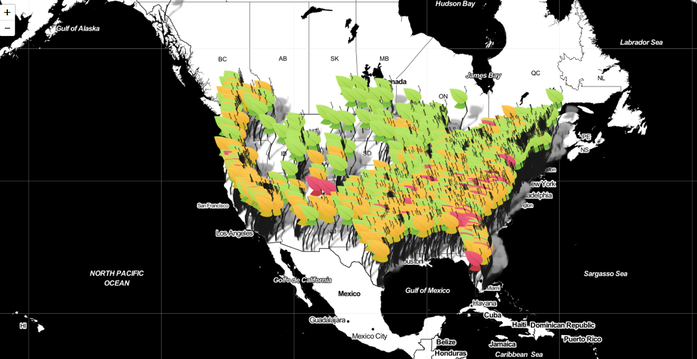
Main goal: Investigate what factors can influence the rise of violent crimes in a given population. (personality type, demographic variables and geographic locations)
Two datasets: Texas Death Row and UCI ML Repository
Techniques: Supervised learning OLS, Stepwise, Ridge LASSO, Elastic Net
UCI ML repository: 128 variables and nearly 2000 observations. The data combines US Census data, law enforcement data and FBI crime data. There are 9 the most dangerous states including South Carolina and the safest place is North Dakota. There was some controversy concerning the counting of rapes which resulted in incorrect values for per capita violent crime.
Cities with the biggest urban areas are Minnesota, Tennessee, Wisconsin and N. Dakota

Slide 3
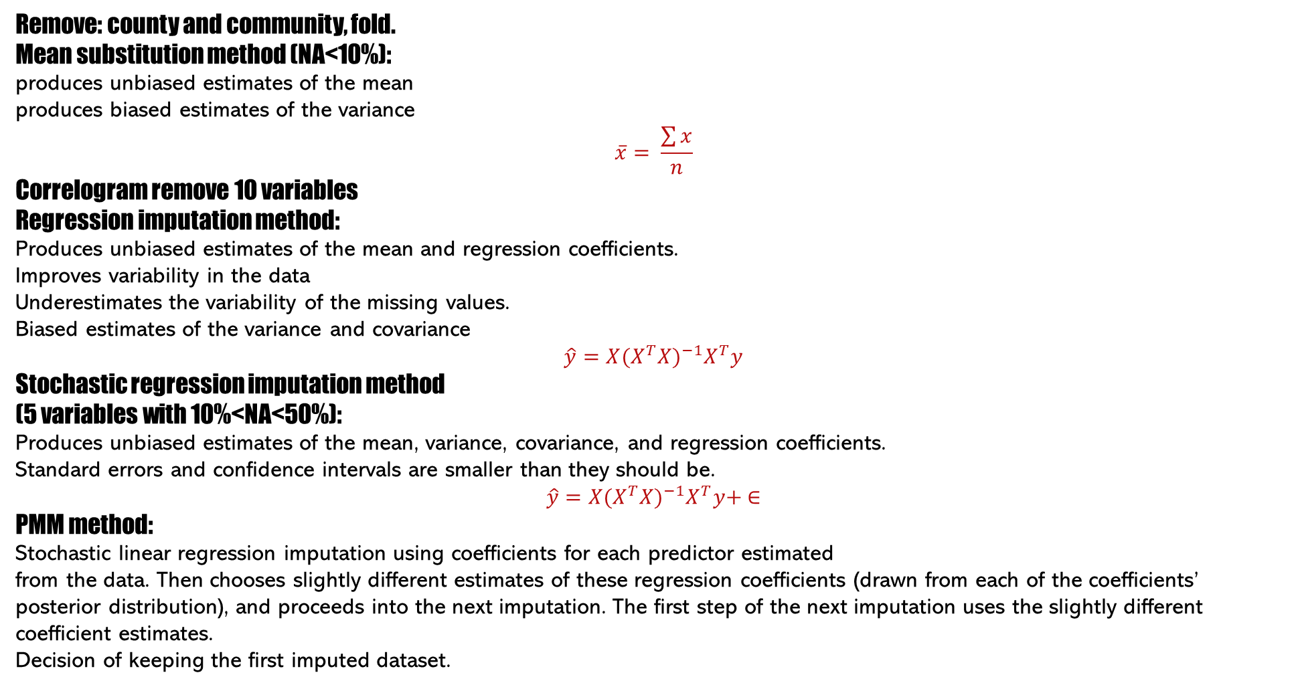
Remove: county and community, fold.
Mean substitution method (NA<10%):
produces unbiased estimates of the mean
produces biased estimates of the variance
$$\overline{x}= \frac{\sum{x}}{n}$$
Correlogram remove 10 variables
Regression imputation method:
Produces unbiased estimates of the mean and regression coefficients.
Improves variability in the data
Underestimates the variability of the missing values.
Biased estimates of the variance and covariance
$$\hat{y}={X(X^{T}X)}^{−1}X^{T}y$$
Stochastic regression imputation method
(5 variables with 10%<NA<50%):
Produces unbiased estimates of the mean, variance, covariance, and regression coefficients.
Standard errors and confidence intervals are smaller than they should be.
$$\hat{y}={X(X^{T}X)}^{−1}X^{T}y+ ∈$$
PMM method:
Stochastic linear regression imputation using coefficients for each predictor estimated
from the data. Then chooses slightly different estimates of these regression coefficients (drawn from each of the coefficients’ posterior distribution), and proceeds into the next imputation. The first step of the next imputation uses the slightly different coefficient estimates.
Decision of keeping the first imputed dataset.

Slide 4


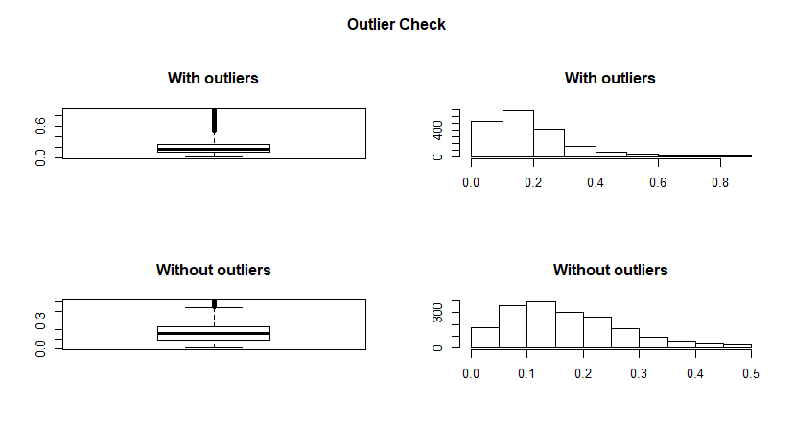
Outliers Detection
variables are coming from the population we might think should be normally distributed.
Due to the decision of removing all observations that were 0 or 1 we expect that the problem with outliers is minimalised.
Methods: F-statistics from ANOVA table. Different states may have different tendencies: Check F-test, remove outliers by calculating mean for given state Tukey method That uses quartiles which are resistant to extreme values. The Tukey’s method is good for skewed data as it does not depends on mean or variance. Removing outliers if No. of removed observations <10% or more if it cleans nicely after first iteration. the more skewed the data, the more observations may be detected as outliers.
7 variables checked on scatterplot and density plots to understand further. Decision of removing 4 variables.
Without knowledge of the geographic area, we cannot say if the specific record is an outlier or not hence the decision of leaving the variables without cleaning.

Slide 5
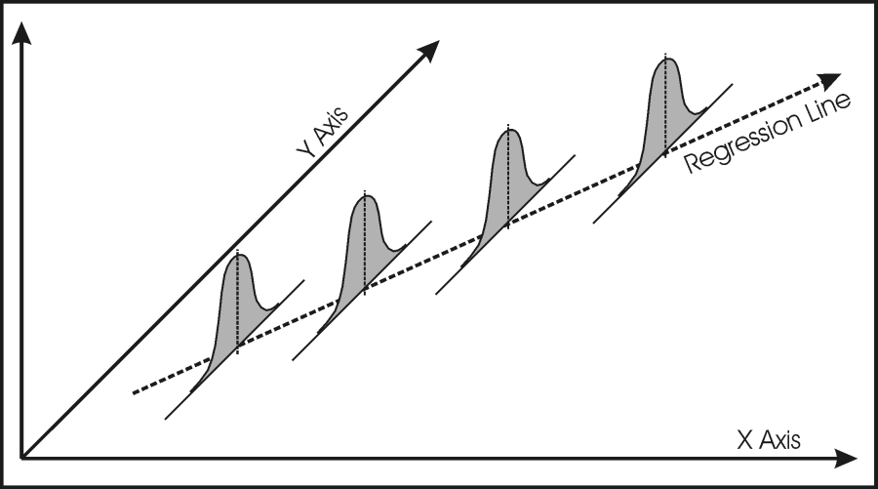
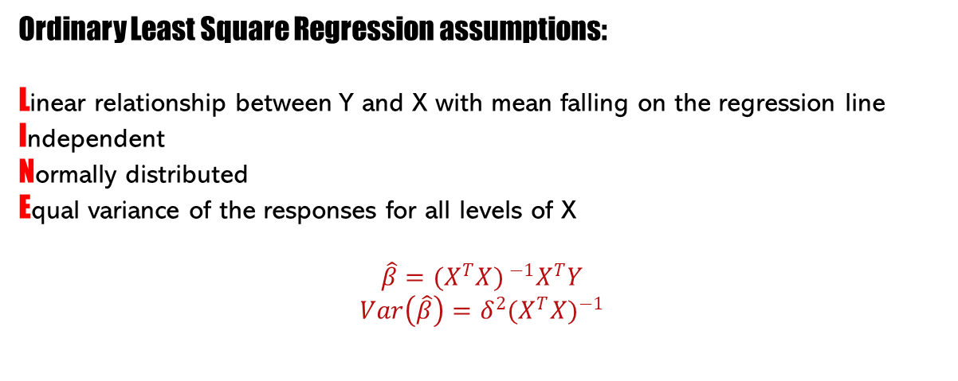
Decision: Fit the OLS method and see what will happen.
Ordinary Least Square Regression assumptions:
Linear relationship between Y and X with mean falling on the regression line
Independent
Normally distributed
Equal variance of the responses for all levels of X
$$\hat{β}={{(X}^{T}X) }^{−1}X^{T}Y$$
$$Var\left(\hat{β}\right)=δ^{2}{(X^{T}X)}^{−1}$$

Slide 6
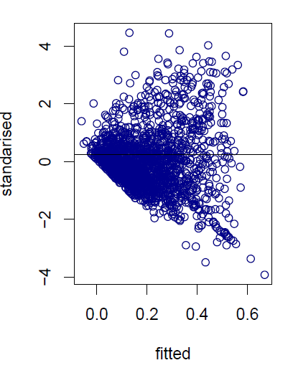
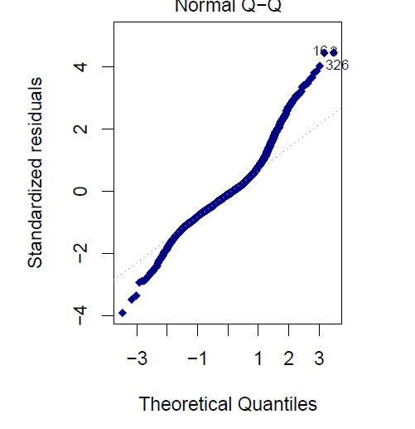
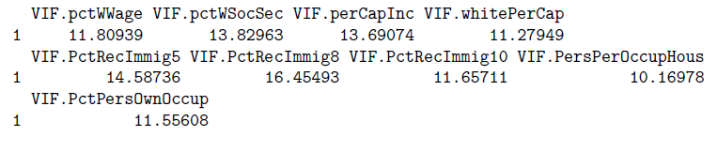

Increase of variance Before Logarithmic Transformation
High VIF so no independent Before and After Log Transformation.
Normality assumption violated the data is heavily skewed
Problem with not constant variance and non-linearity we may try to overcome using log transformation.
Shapiro - Wilk test of normality
Assumption 1: The Y-values are independent is met
Assumption 2: The Y-values can be expressed as a linear function of the X-variable is met
Assumption 3: Variation of observations around the regression line is constant is met.

Slide 7
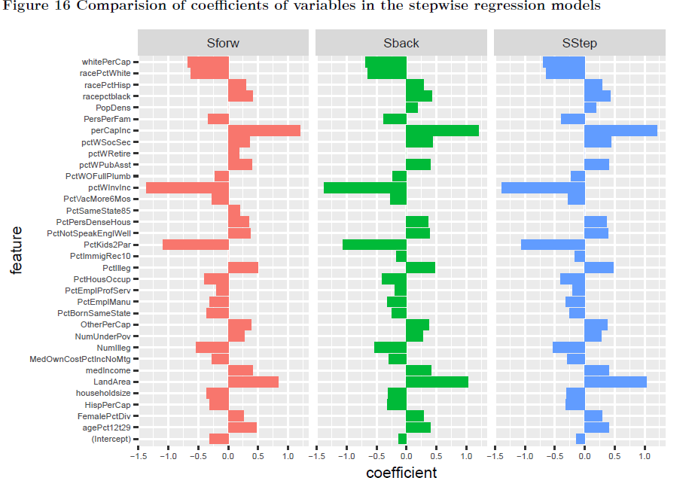
Fitting the best model:
Backward elimination Fit all check for smallest AIC, take variable out.
Forward
Fit the null model: mean of violent crimes per population. Add one variable at the time with the smallest AIC.
combination of both in the stepwise regression
Fit the null model. Add or remove one variable at the time
The lower the AIC value is the better the model is.
Take one variable at the time as variable that was colinear to it may
have changed behaviour a bit.
The most important features
per capita income
percentage of households with investment / rent income
percentage of kids in family housing with two parents
Land Area,

Slide 8

Shrinkage Methods Are Not BLUE: Best Linear Unbiased Estimators
RIDGE
LASSO
ELASTIC NET
Benefits:
We don’t need normality assumption and shrinkage methods takes care of multicollinearity
But nothing is Normal.

Slide 9
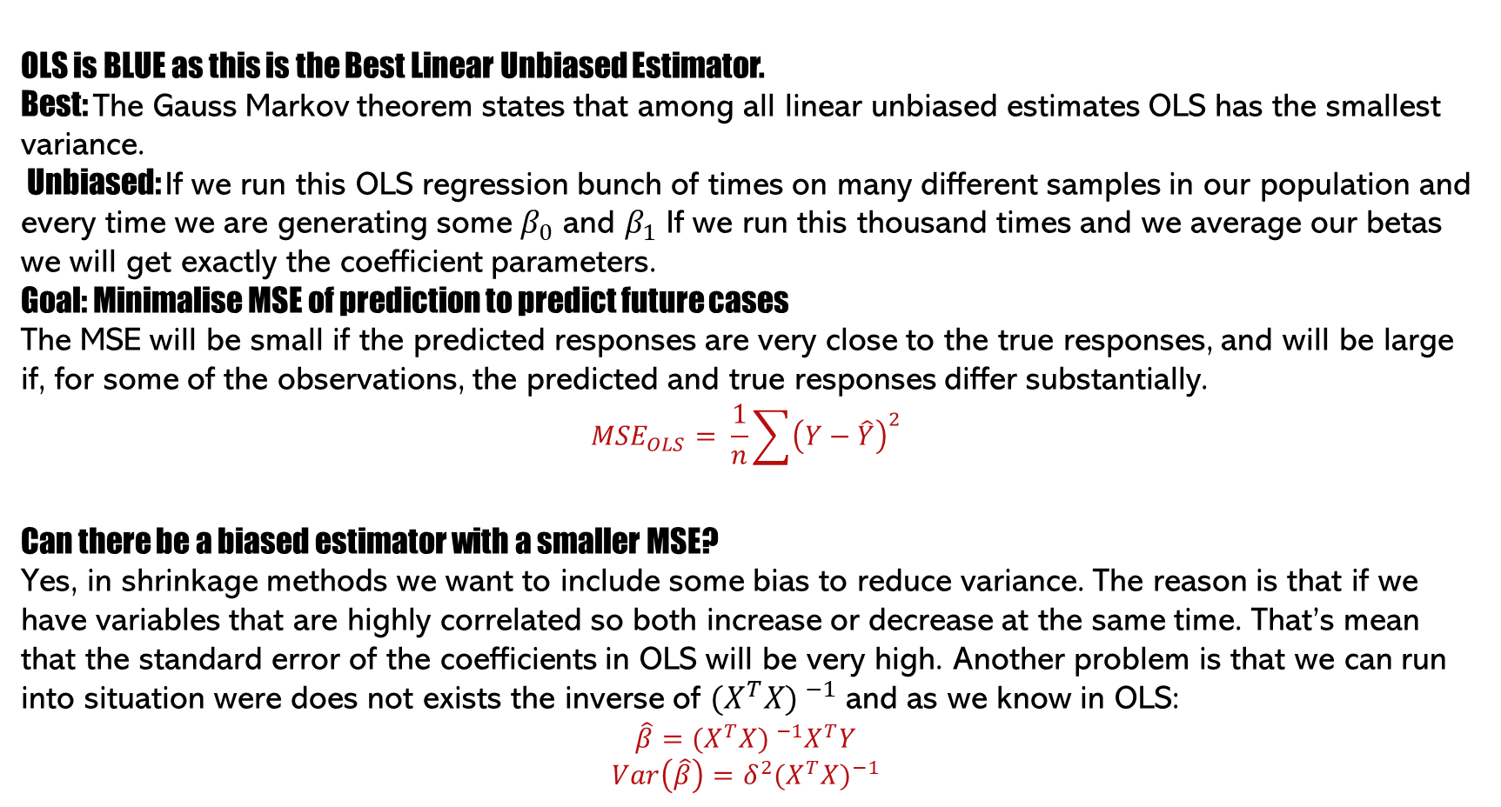
OLS is BLUE as this is the Best Linear Unbiased Estimator.
Best: The Gauss Markov theorem states that among all linear unbiased estimates OLS has the smallest variance.
Unbiased: If we run this OLS regression bunch of times on many different samples in our population and every time we are generating some $β_{0}$ and $β_{1}$ If we run this thousand times and we average our betas we will get exactly the coefficient parameters.
Goal: Minimalise MSE of prediction to predict future cases
The MSE will be small if the predicted responses are very close to the true responses, and will be large if, for some of the observations, the predicted and true responses differ substantially.
$${MSE}_{OLS}= \frac{1}{n}\sum{{\left(Y−\hat{Y}\right)}^{2}}$$
Can there be a biased estimator with a smaller MSE?
Yes, in shrinkage methods we want to include some bias to reduce variance. The reason is that if we have variables that are highly correlated so both increase or decrease at the same time. That’s mean that the standard error of the coefficients in OLS will be very high. Another problem is that we can run into situation were does not exists the inverse of ${{(X}^{T}X) }^{−1}$ and as we know in OLS:
$$\hat{β}={{(X}^{T}X) }^{−1}X^{T}Y$$
$$Var\left(\hat{β}\right)=δ^{2}{(X^{T}X)}^{−1}$$

Slide 10
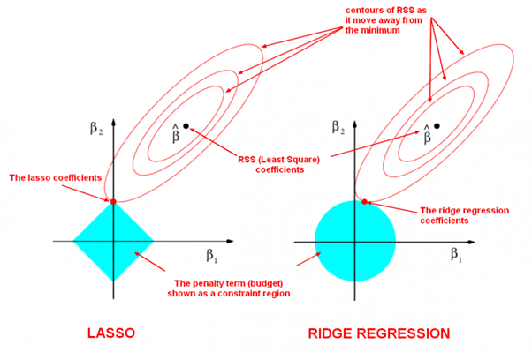
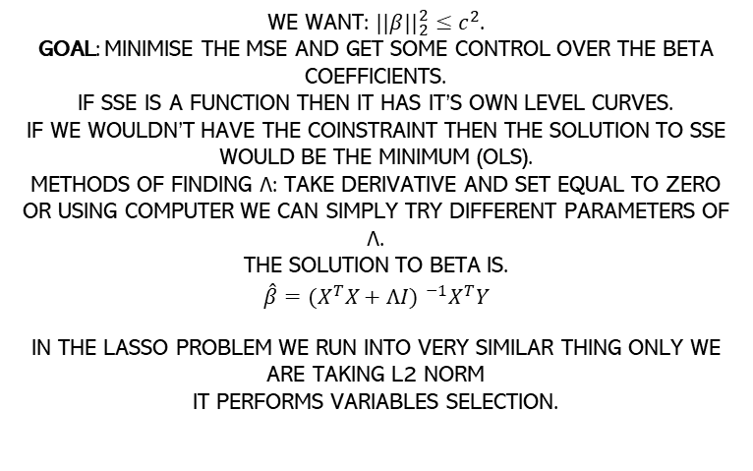
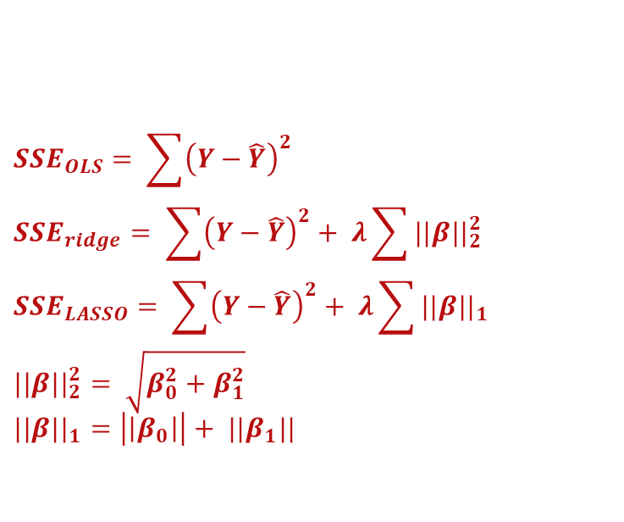
$${SSE}_{OLS}= \sum{{\left(Y−\hat{Y}\right)}^{2}} \\ {SSE}_{ridge}= \sum{{\left(Y−\hat{Y}\right)}^{2}+ λ\sum{{||β||}_{2}^{2}}} \\ {SSE}_{LASSO}= \sum{{\left(Y−\hat{Y}\right)}^{2}+ λ\sum{{||β||}_{1}}} \\ {||β||}_{2}^{2}= \sqrt{β_{0}^{2}+β_{1}^{2}} \\ {||β||}_{1}=\left|\left|β_{0}\right|\right|+ {||β}_{1}||$$
We want: ${||β||}_{2}^{2}≤c^{2}$. Goal: minimise the MSE and get some control over the beta coefficients. If SSE is a function then it has it’s own level curves. If we wouldn’t have the coinstraint then the solution to SSE would be the minimum (OLS). Methods of finding λ: Take derivative and set equal to zero or using computer we can simply try different parameters of λ. The solution to Beta is.
$$\hat{β}={{(X}^{T}X+λI) }^{−1}X^{T}Y$$
In the LASSO problem we run into very similar thing only we are taking L2 norm It performs variables selection.

Slide 11
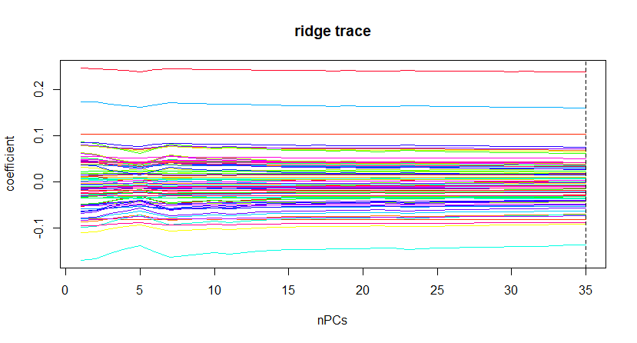
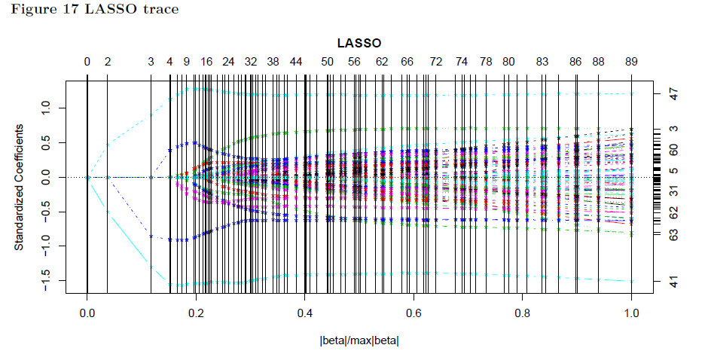
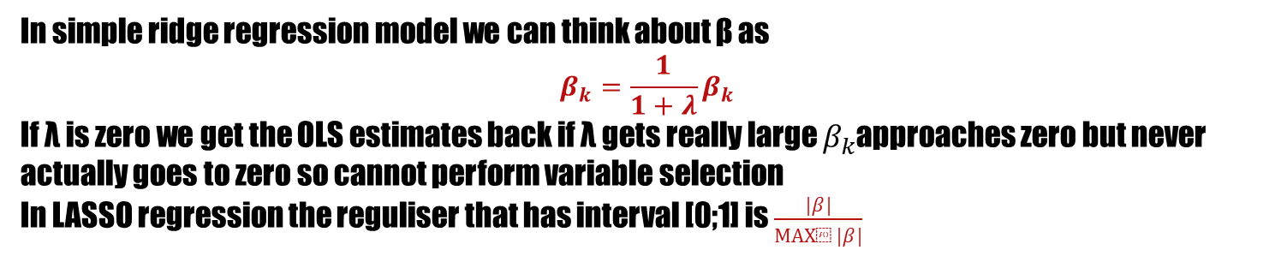
In simple ridge regression model we can think about β as
$$β_{k}=\frac{1}{1+λ}β_{k}$$
If λ is zero we get the OLS estimates back if λ gets really large $β_{k}$approaches zero but never actually goes to zero so cannot perform variable selection
In LASSO regression the reguliser that has interval [0;1] is $\frac{|β|}{max⁡|β|}$
The new variables were coming in: PctKids2Par, PctIlleg, racePctWhite, PctPersDenseHous

Slide 12
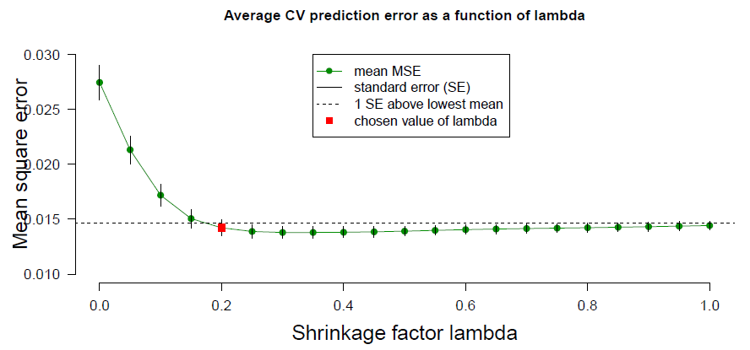
The graph shows mean MSE for each value of λ.
The chosen value of λ is the first one that is below the distance of 1 SE above lowest mean.
We are selecting variables: racepctblack, racePctWhite, pctWInvInc, FemalePctDiv, PctKids2Par, PctIlleg,
PctNotSpeakEnglWell, PctPersDenseHous, MedRentPctHousInc, PctBornSameState, MedOwnCostPctInc-
NoMtg into the model.

Slide 13
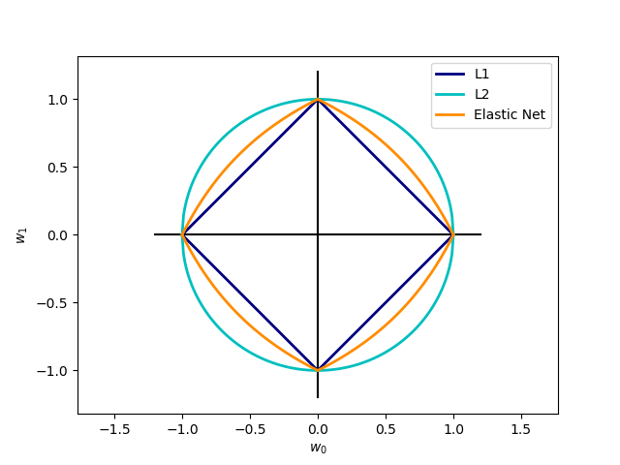
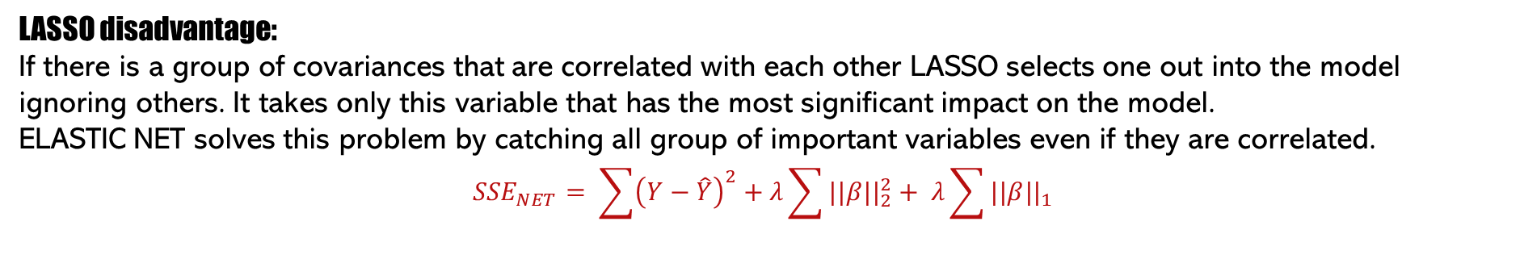
LASSO disadvantage: If there is a group of covariances that are correlated with each other LASSO selects one out into the model ignoring others. It takes only this variable that has the most significant impact on the model. ELASTIC NET solves this problem by catching all group of important variables even if they are correlated.
$${SSE}_{NET}= \sum{{\left(Y−\hat{Y}\right)}^{2}+λ\sum{{||β||}_{2}^{2}}+ λ\sum{{||β||}_{1}}}$$

Slide 14
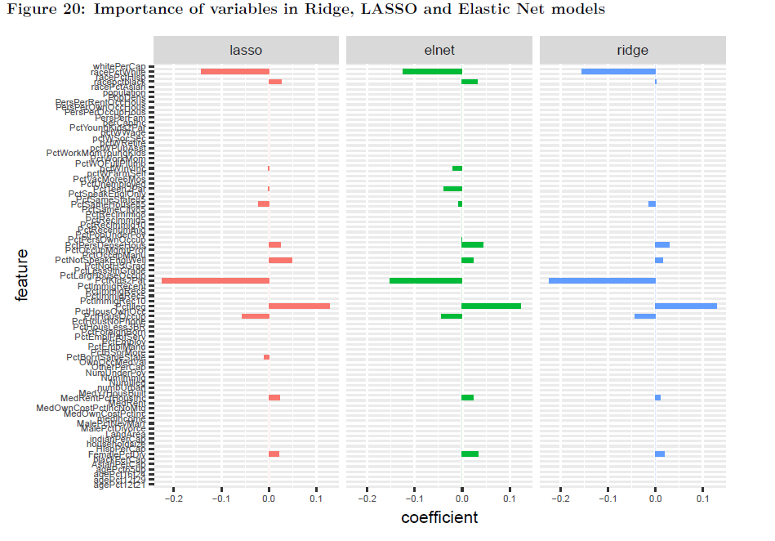
LASSO:
3 additional variables Percentage of public assistance,
PctVacMore6Mos NumbUrban. Six variables selected by ElNet and LASSO models: RacePctWhite, RacePctBlack, PctNotSpeakEnglishWell, PctKids2Par, PctIlleg
Pct House Occup less significant variables are:
PctWInvInc, PctTeen2Par, PctSameHouse85, PctPersDenseHouse, PctBornSameState, MedRentPctHouseInc,
FemalePctDiv.
68 percent variability explained in the data [elastic net]

Slide 15
Proposed improvements:
We should not remove outliers as we deal with behavior of people, observational study and we do not have enough information to make any decision regards unusual observations.
We can argue that in such big dataset this is quiet often that we expect cases larger than 3 standard deviations from the mean we should not remove the 0 or 1 at the beginning
The first step performs stochastic linear regression imputation using coefficients for each predictor estimated from the data. That shouldn’t be a surprised that we decided to use the first dataset.
If in final stage I am using shrinkage methods especially LASSO and elastic net that performs variables selection I could keep all variables in the dataset.
In my project I made the mistake claiming in one moment that they are normally distributed and that there is no problem with multicollinearity on page 17. That I corrected on page 18 but I should have removed the previous statement that I didn’t do it.

