Slide 1
SOCIAL BUZZ DATA ANALYSIS

Slide 2
TODAY’S AGENDA
Project recap
Problem
The Analytics team
Process
Insights
Summary

Slide 3
PROJECT RECAP
Over the past 5 years, Social Buzz has reached over 500 million active users each month
.
They have scaled quicker than anticipated and need the help of an advisory firm to oversee their scaling process effectively, hence the need for analysis of their huge data to provide insight and recommendation for their scaling process

Slide 4
PROBLEM
An audit of their big data practice
Recommendations for a successful IPO
An analysis of their content categories that highlights the top 5 categories with the largest aggregate popularity

Slide 5
THE ANALYTICS TEAM
Andrew Fleming (Chief Technical Architect)
Marcus Rompton ( Senior Principle)
Omogoroye Odunayo ( Data Analyst)

Slide 6
DATA ANALYSIS PROCESS
Below are the processes carried out to analyze the dataset given by the organization.
Dataset Selection
Data Cleaning
Data Modelling
Querying the Dataset for an Explorative Data Analysis
Visualization

Slide 7
DATA SELECTION
We have a lot of dataset gotten from the organization but not all are relevant to the data analysis we carried out and as such the dataset to be used were carefully selected

Slide 8
DATA CLEANING
After careful selection of data, the selected dataset were then cleaned to ensure we prepare our dataset properly for the analysis.
This process was carried out using Dtale library in jupyter notebook.
During this process, the datatype of each column was examined to ensure they are in the right datatype.

Slide 9
DATA MODELLING
This step was carried out in Postgre SQL, three dataset (Reaction, Content and Reaction type) was merged together based on the column similar to each dataset. This is to ensure we have our dataset in a single table to make our querying easier.

Slide 10
QUERYING THE DATASET
The merged dataset was then queried so as to have insight about the dataset and to provide relevant information to the organization

Slide 11
VISUALIZATION
This step was carried out in Tableau, the result of the query was then visualized in Tableau in order to emphasize on the insight gotten from the analysis

Slide 12
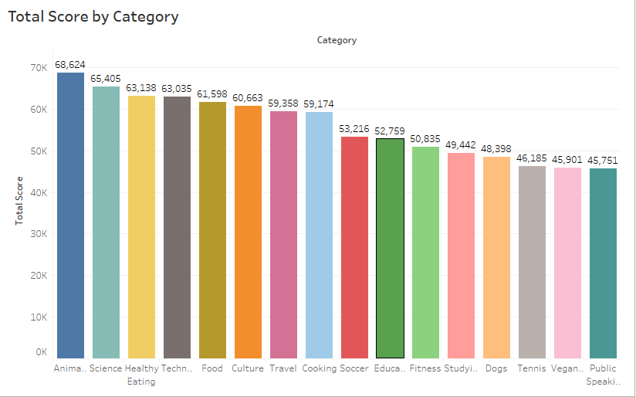
INSIGHTS FROM THE ANALYSIS
The top 5 categories with the largest aggregate popularity are Animal, Science, Health Eating, Technology and Food

Slide 13
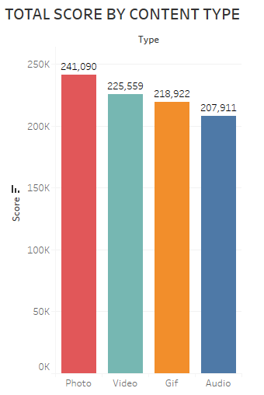
INSIGHTS FROM THE ANALYSIS
The best Content type with the largest aggregate popularity is Photo while the least is Audio

Slide 14
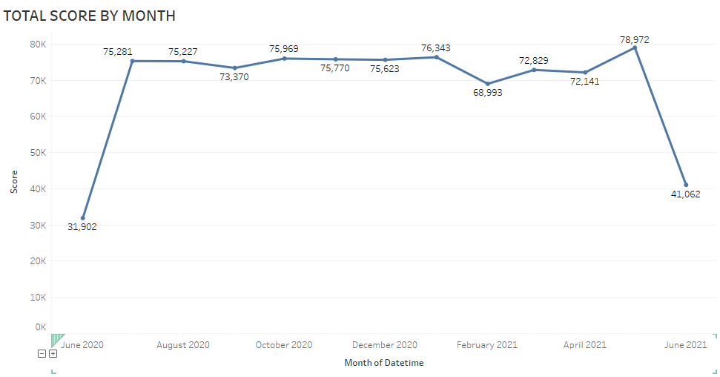
INSIGHTS FROM THE ANALYSIS
The month with the largest aggregate popularity is the month of May 2021 while the least is the month of June 2020
There is a drastic decline in the aggregate popularity from the month of May 2021 to June 2021

Slide 15
SUMMARY
To ensure that the scaling process is effective, emphasis should be placed on Photo and Video content type because the have more aggregate popularity
The Operations Records between the month of May 2021 and June 2021 should be looked into, because of the drastic decline in the aggregate popularity between these two months.
To ensure that the scaling process is effective, emphasis should also be placed on the top five (5) content categories which are Animal, Science, Health Eating, Technology and Food.

