Slide 1
Email Marketing Campaign

Slide 2
TODAY’S AGENDA
Project recap
Problem
Process
Insights
Summary
Recommendation

Slide 3
PROJECT RECAP
Analyzing the performance of a recent email marketing campaign. Dataset containing email open rates, click-through rates, and conversion rates was provided for this analysis.
There is a significant drop in website traffic overtime, hence the need for this analysis to provide insight to the data and recommendation to the marketing team.

Slide 4
PROBLEM
What are the key performance indicator(KPI) that determine the campaign’s success or areas that need improvement?
What is the trend of email open rates, click-through rates, and conversion rates overtime?
What are the Potential reason for the drop in these rates over time?

Slide 5
DATA ANALYSIS PROCESS
Below are the processes carried out to analyze the dataset given by the organization.
Dataset Selection
Data Cleaning
Explorative Data Analysis (EDA)
Visualization

Slide 6
DATA SELECTION
We have a lot of information gotten from the organization but not all are relevant to the data analysis I carried out and as such the dataset to be used were carefully selected based on the problem statement.

Slide 7
DATA CLEANING
After careful selection of data, the selected dataset were then cleaned to ensure we prepare our dataset properly for the analysis.
This process was carried out using Power Query in PowerBI.
During this process, the datatype of each column was examined to ensure they are in the right datatype.

Slide 8
EXPLORATIVE DATA ANALYSIS
This step was carried out in PowerBI, this is to give us insight into the data and how we can provide solution to the problem statement.

Slide 9
VISUALIZATION
After carrying out the Explorative Data Analysis(EDA), the result was visualized in PowerBI, in order to emphasize on the insight gotten from the analysis.

Slide 10
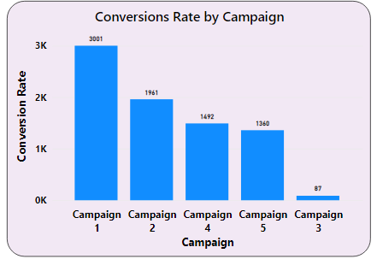
INSIGHTS FROM THE ANALYSIS
Campaign 1 has the highest conversion rate of 3001
Campaign 3 has the least conversion rate of 87

Slide 11
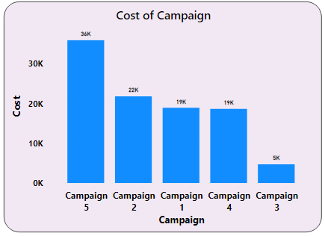
INSIGHTS FROM THE ANALYSIS
Campaign 5 has the highest cost of 36,000
Campaign 3 has the lowest cost of 5,000

Slide 12
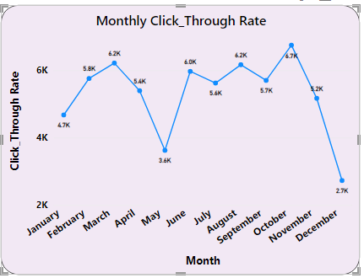
INSIGHTS FROM THE ANALYSIS
The month with the highest Clickthrough rate is the month of October while the least is December
There is a drastic decline in Clickthrough rate from the month of October to December

Slide 13
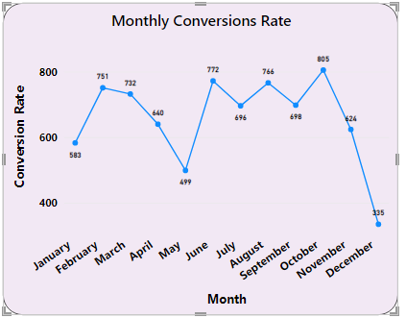
INSIGHTS FROM THE ANALYSIS
The month with the highest Conversion rate is the month of October while the least is December
There is a drastic decline in Conversion rate from the month of October to December

Slide 14
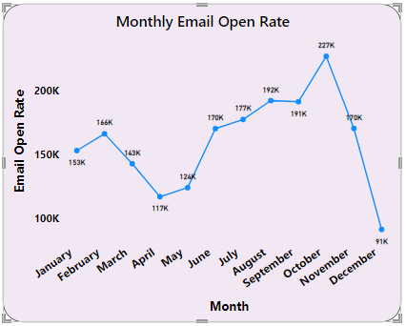
INSIGHTS FROM THE ANALYSIS
The month with the highest Email Open rate is the month of October while the least is December
There is a drastic decline in Email Open rate from the month of October to December

Slide 15
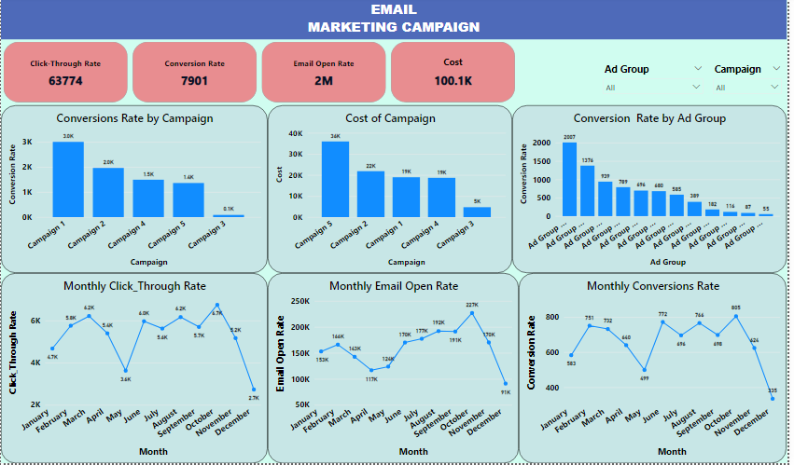
INSIGHTS FROM THE ANALYSIS
This is the dashboard capturing the overview of the data with the Key Metrics

Slide 16
SUMMARY
Campaign 3 is the best Campaign in terms of cost effectiveness while Campaign 1 is the best campaign in terms of Conversion rate
Conversion rate, Clickthrough rate and Email Open rate peaked in October and then reduced drastically till the end of the year.

Slide 17
RECOMMENDATION
The drastic drop in the website traffic from October to December can be as a result of end of the year activities that may distract people from visiting the website, so the marketing team should ensure that the marketing strategy is tailored towards the festive season.
The Marketing team should focus on Campaign 1 with the highest conversion rate but also work on optimizing the cost involved.
The Marketing team should ensure that Campaign 3 is really worked on by refining it because its the best campaign in terms of cost but with the least conversion rate. This will enhance cost effectiveness.

Slide 18
THANK YOU FOR LISTENING

