Slide 1
The Effects of COVID-19 on US Exercise Behavior
Michael O’Donnell, 12/4/2020

Slide 2
Agenda
Motivation for research
Problem statement
Data Collection
Literary Review
Analysis Methodology
Hypothesis test and Results

Slide 3
Motivation for Research
As highlighted in our 2nd class discussion, the monumental significance of COVID-19 caused a need for research into new problems
I was interested in how COVID-19 changed behavior:
Housing
Work
Education
Finances
Habits

Slide 4
Narrowing Topic for Research
Behavior was too broad
How could I narrow my research?
How narrow is too narrow?
Why US Exercise?
Narrow research gave my project more depth
Behavioral Change
US Behavioral Change
US Exercise Behavior Change

Slide 5
Problem Statement
Which types of exercise are more popular in the US post-COVID-19?
Types of exercise researched:
Running
Cycling
Swimming
Walking
Weightlifting
CrossFit
Yoga
Could this research provoke more uses of social data for COVID-19 changes?

Slide 6







Data Collection
Most of my project was data collection. I explore far and wide for US Exercise data:

Slide 7

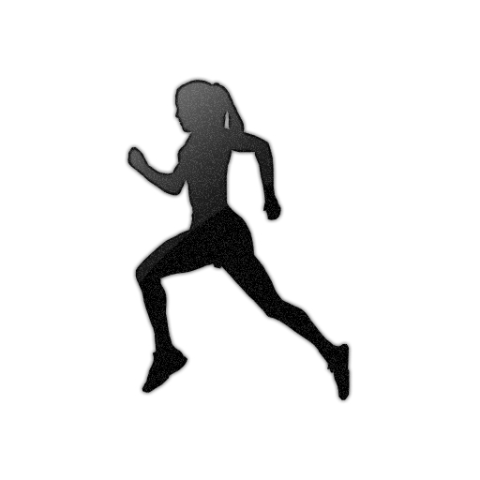
Literary Review
At this point, the project has a problem statement and data
But, how could I connect the data to the problem statement with the Literary Review?
My project hinged on this connection:
(Podcast Episode Descriptions)

Slide 8
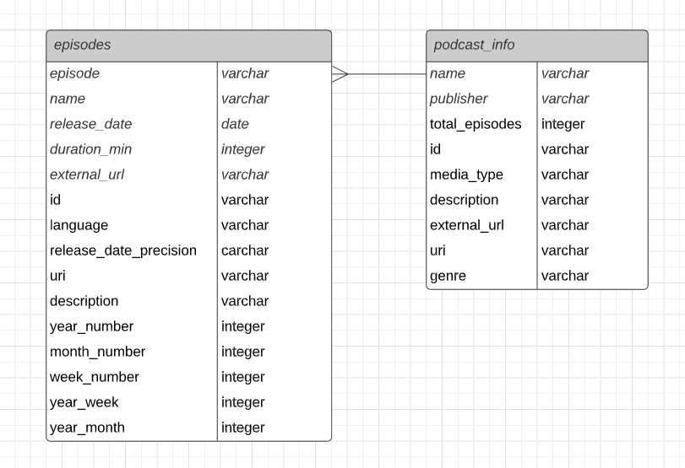
Final Dataset
Acquired 11,447 episodes from 47 unique podcasts

Slide 9
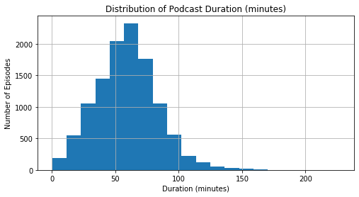
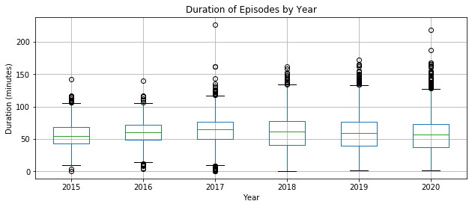
Exploratory Data Analysis Example

Slide 10
Proposed Methodology
Define keywords related to each type of exercise in the problem statement (running, cycling, weightlifting, etc.)
Use Natural Language Processing to count the number of keywords for each type of exercise in each episode description
Use a “Two-Sample t-test for Difference of Means” to compare the number of keywords used pre-COVID-19 versus post-COVID-19
Note: this hypothesis test compares the mean number of keywords used per episode pre-COVID vs post-COVID with consideration for standard deviation, variance, and sample size
Conclude which types of exercise become more popular

Slide 11
Assumptions
The 37 podcasts in the research are a proper sample of the population of US exercise podcasts
The keywords searched for in the Natural Language Processing are the most accurate keywords for each type of exercise

Slide 12
Conceptual Model
10,472 podcast episode descriptions
Natural Language Processing to count keywords in each episode
Separate results between pre-COVID-19 and post-COVID-19 episodes
Two-Sample t-test for Difference of Means
Exercise is more popular
Exercise is less popular
Exercise has no change
Repeat for each type of exercise

Slide 13
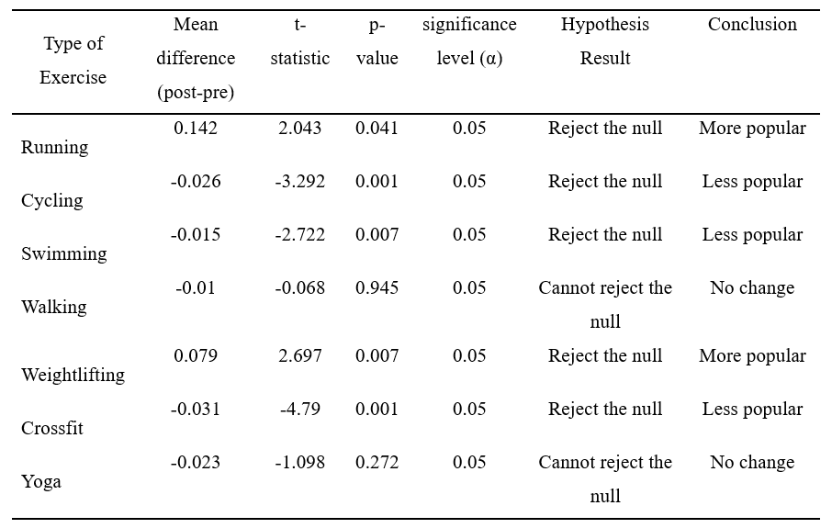
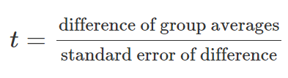
Hypothesis Test and Results
Two-Sample T-Test for Difference of Means

Slide 14
Possibility of Future Works
Add more podcasts
Incorporate more data in a meaningful way
Such as Twitter, Garmin, Stock, or Strava data
Localize research to only NYC running data
Change topic from exercise to another subject of interest

Slide 15
Appendix

Slide 16
Data Exploration

Slide 17
Data Exploration

Slide 18
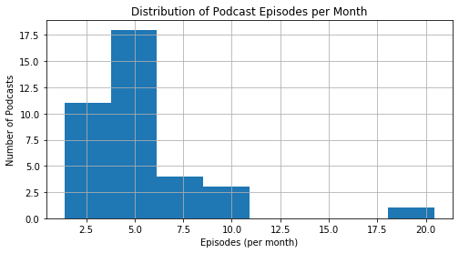
Data Exploration

Slide 19
Data Preparation Decisions
Which podcasts to keep for analysis? Which to cut?
Verdict: Kept podcasts that had >= 1 episode per month from January 2020 to October 2020.
This threshold filtered out 10 podcast totaling 975 episodes. This left 37 podcasts totaling 10,472 episodes.

Slide 20
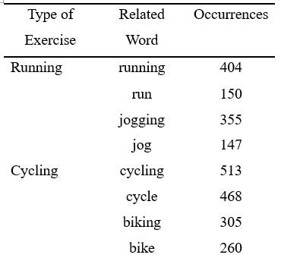
Natural Language Processing (NLP)
Used python library NLTK to analyze every episode description for keywords.
Methodology:
Read in CSV
Format description column
Tokenize descriptions, remove stopwords
Create dataframe for analyses
Count related words per episode
(example output)

