Slide 1

Turtle Trading Simulator
DATA 604 Final Project, Spring 2020, Michael O’Donnell

Slide 2
Problem
This project aims to create a simulator that implements the famous "Turtle Trading" strategy on any stock for any time frame and displays the results.
The rules of the "Turtle Trading" strategy (the original Trend Trading strategy) are:
each trading unit is 1% of your total investment dollars
enter at a stock's 55-day high with 1 unit
add another unit if the stock climbs to .5N (N is the Average True Range)
exit if the stock dips below latest entry price minus N

Slide 3
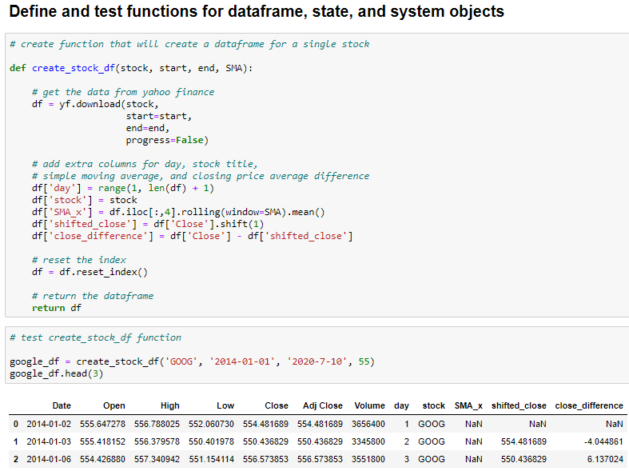

Data
All data in this project is from Yahoo Finance.
The Yahoo Finance data is imported into pandas dataframes via the python library “yfinance” (example shown in screenshot)

Slide 4
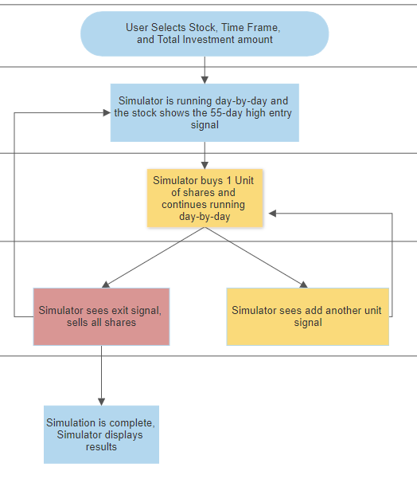
Flow Chart

Slide 5
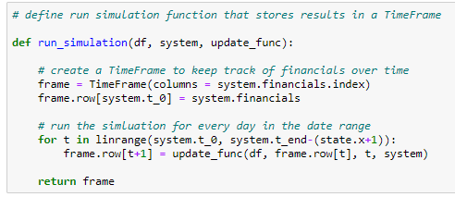
Tools used from DATA 604
State object
System object
Model with an Update Function
TimeFrame
linrange
SweepSeries

Slide 6
Functions
Create a stock price dataframe
Create a State object function with moving financial numbers
Create a System object function with static financial numbers
Update function (follows flow chart on previous slide)
Run Simulation function with a TimeFrame()
Plot results function to show results of simulation
Function for the end user that incorporates all the above functions!

Slide 7
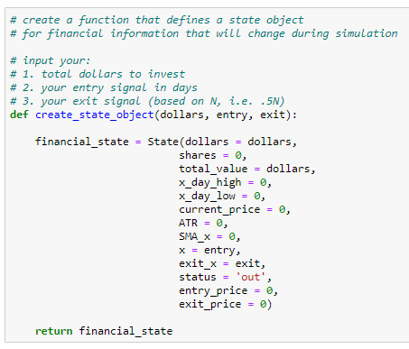
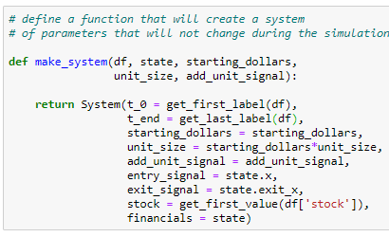
Functions (continued)

Slide 8
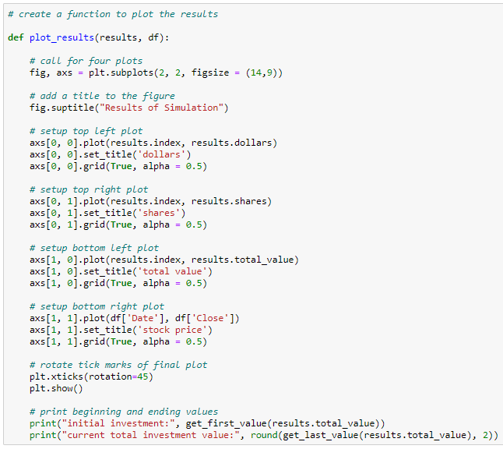
Functions (continued)

Slide 9
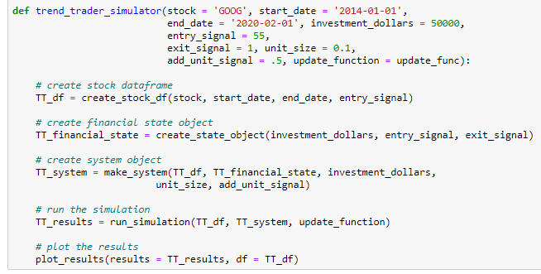
Functions (continued)

Slide 10
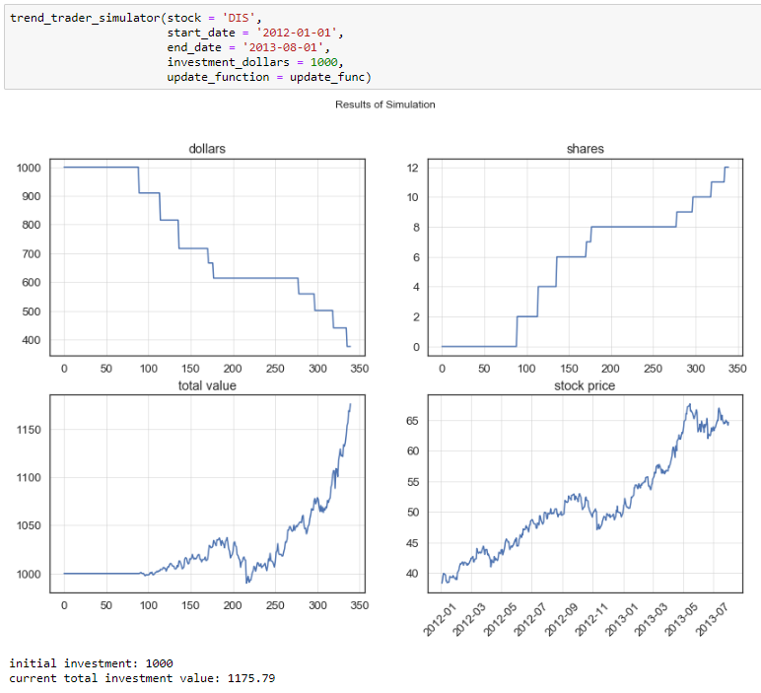
Results #1
Stock: Disney
Start Date: Jan 1, 2012
End Date: Aug 1, 2013
Total investment amount: $1,000

Slide 11
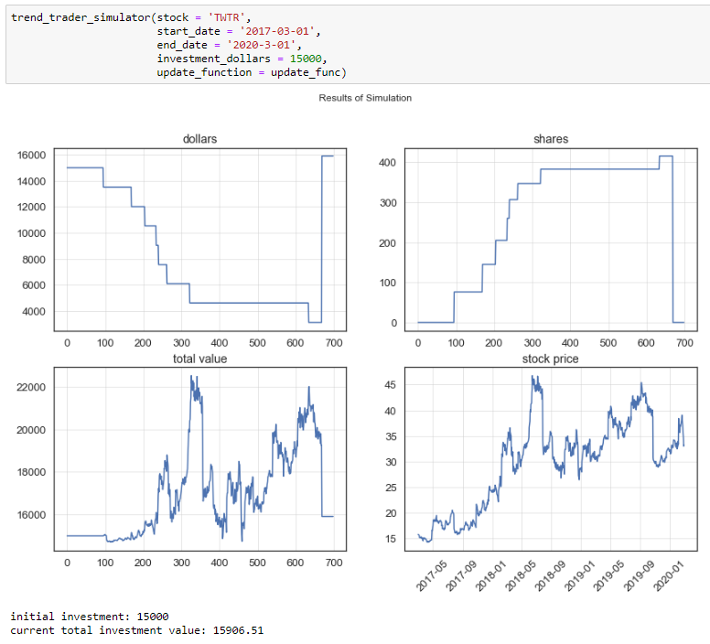
Results #2
Stock: Twitter
Start Date: Mar 1, 2017
End Date: Mar 1, 2020
Total investment amount: $15,000

Slide 12
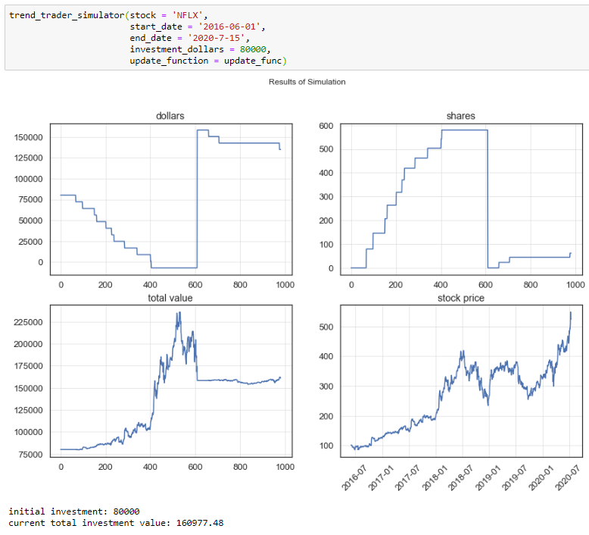
Results #3
Stock: Netflix
Start Date: Jun 1, 2016
End Date: yesterday
Total investment amount: $80,000

Slide 13
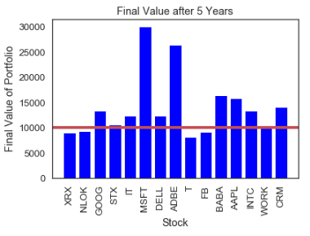
Aggregated Results
Results of 15 different tech stocks from:
Start date: Jan 1, 2015
End date: July 15, 2020
Starting dollars: $10,000

Slide 14
Future State
Implements a SweepSeries to tune your own entry signal, exit signal, and unit size
Turn this into a Dash app hosted on Heroku!

