Slide 1
Applied Machine Learning
Today's Objective: Learn the process of implementing a Linear Regression algorithm in Python.
12/6/2023

Slide 2
Lesson Agenda
Supervised Machine Learning
What is Linear Regression?
Case Study: Housing Price Prediction

Slide 3

Supervised Machine Learning
What are the four types of machine learning algorithms?
Supervised
Unsupervised
Semi-supervised
Reinforcement
What is the defining characteristic of Supervised Learning?
Training an algorithm on a labeled dataset. Then, the algorithm learns to map input data to corresponding output labels.
Notes:
What is Machine Learning? A branch of Computer Science that uses data and algorithms to imitate the ways humans learn, and gradually improves its accuracy with more data.

Slide 4
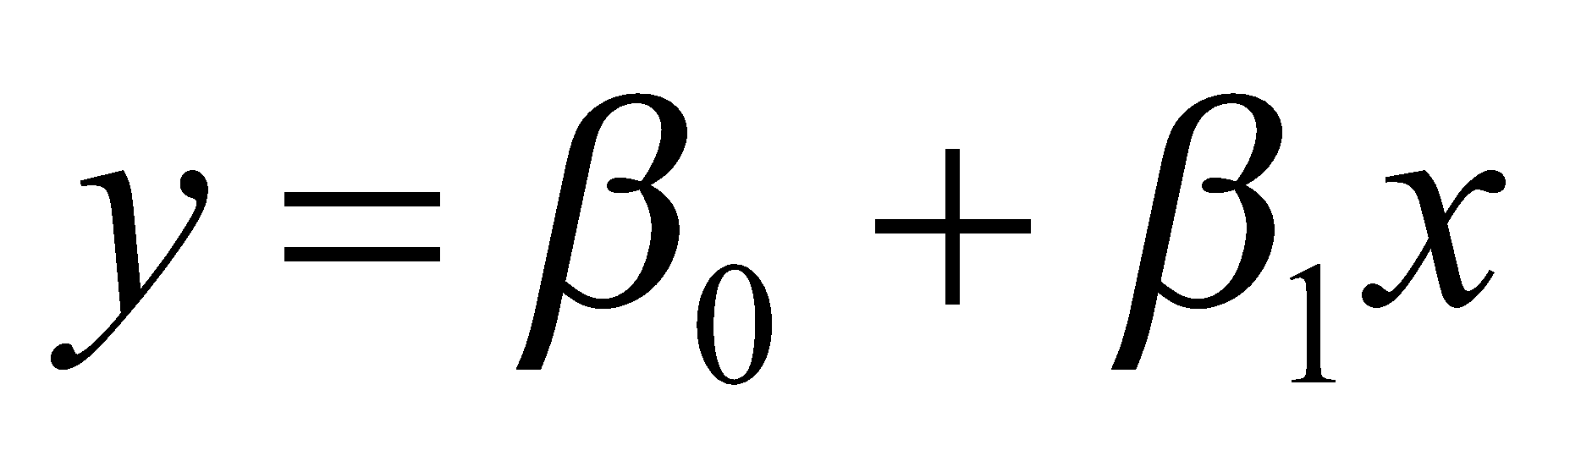
What is Linear Regression?
y
-Ordinary Least Squares (OLS)
-Least Absolute Deviations (LAD) or L1 Regression
-Ridge Regression (L2 Regularization)
Regression Line
$840K
Residual
House Price ($)
House Size (ft²)
x
3200 ft²

Slide 5
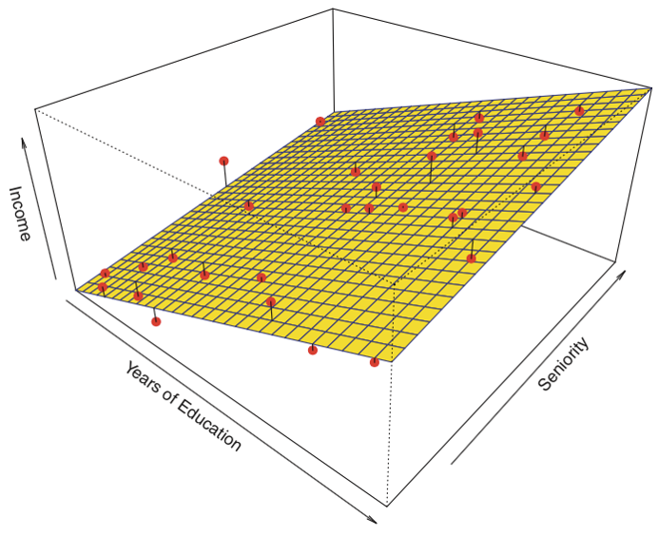
What if you have >1 Independent Variable?
Multiple Linear Regression

Slide 6


How to evaluate Linear Regression?
Root Mean Squared Error (RMSE)
Lower scores represent higher accuracy
Intuitive output, the units are the same as y-axis
1
R² (R Squared)
Represents the proportion of the variance in the dependent variable that is predictable from the independent variable(s)
Ranges from 0-1
2
Notes:
For example, an R squared value of 0.80 means that 80% of the variance in the dependent variable is explained by the independent variables, and the remaining 20% is unexplained or accounted for by other factors.

Slide 7
When to use Linear Regression?
Try Linear Regression!
Avoid Linear Regression
A continuous dependant variable
Looking for Explainability
Want Computational Efficiency
Want identification of relationships
Linear relationship between dependent and independent variable(s)
High Collinearity
Noisy Data
Many Outliers
A non-normal distribution of Residuals

Slide 8
Case Study in Python
Please open the following Google Colab file

