Slide 1
A Corporate Accounting and Reporting Standard
Training Curriculum

Slide 2

Lesson Modules

Slide 3
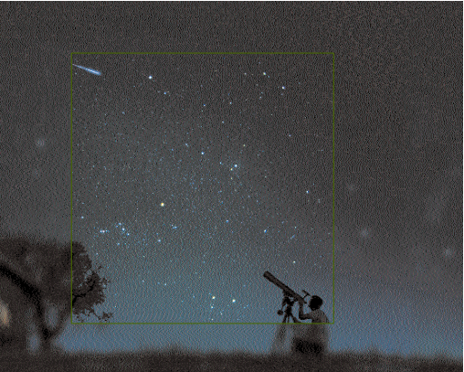
Identifying and Calculating Emissions
Lesson 6

Slide 4
Steps in Identifying and Calculating Emissions
Identify Sources
Select Calculation Approach
Collect Data and Choose Emissions Factors
Apply Calculation Tools
Roll-up Data to Corporate Level

Slide 5
Emission Sources Categories
Identify Sources
Select Calculation Approach
Collect Data & Choose Emissions Factors
Apply Calculation Tools
Roll-up Data to Corporate Level
Stationary combustion: fuel burned in stationary sources
Ex: boilers and heaters
Mobile combustion: fuel burned during transportation
Ex: cars, airplanes, ships
Process emissions: from physical or chemical processes
Ex: cement calcination, aluminum smelting
Fugitive emissions: intentional and unintentional releases
Ex: equipment leaks, cooling towers, CH4 from natural gas pipelines, HFCs from air conditioning and refrigeration
Consult Appendix D: Emissions by Industry Sector and Scope

Slide 6
Identifying Emissions
Process emissions usually only certain industry sectors
(oil, gas, aluminum, cement, etc.)
Almost all companies purchase electricity
Emissions along value chain
Upstream or downstream of owned operations
Scope 1
Scope 2
Scope 3

Slide 7
Calculating Approaches
Identify Sources
Select Calculation Approach
Collect Data & Choose Emissions Factors
Apply Calculation Tools
Roll-up Data to Corporate Level
1. Direct measurement: monitor GHG concentration and flow rate, such as with a filter on an exhaust pipe
Ex: Continuous Emissions Monitoring System (CEMS)
2. Stoichiometric calculation: measure which elements enter and leave the system
Ex: Mass balance approach
3. Estimate emissions: multiply activity data (ex: fuel use records) by appropriate emission factor
most common approach

Slide 8
Estimating Emissions: Basic Equation
Identify Sources
Select Calculation Approach
Collect Data & Choose Emissions Factors
Apply Calculation Tools
Roll-up Data to Corporate Level
activity data
x
emission factor
=
tonnes of emissions
(t)
tonnes of emissions
(t)
x
Global Warming Potential
(GWP)
=
carbon dioxide equivalent (CO₂e) of emissions
Notes:
Estimating Emissions: Basic Equation

Slide 9
Activity data
activity data
x
emission factor
=
t of emissions
t of emissions
x
GWP
=
CO₂e of emissions
Activity data: data on an activity resulting in emissions
Examples:
Electricity use (kilowatt hours)
Distance traveled (kilometers)
Gasoline use (gallons)

Slide 10
Finding Activity Data
Most companies should consult these records:
Scope 1: purchase records of fuels
Scope 2: metered electricity consumption record
Scope 3: Activity data such as fuel use, passenger miles, etc.
Industrial companies should consult sector-specific guidelines from
GHG Protocol website
Industry associations
Government agencies

Slide 11
Emission factors
activity data
x
emission factor
=
t of emissions
t of emissions
x
GWP
=
CO₂e of emissions
Emission factors convert activity data to emission values
Published by various entities, including government agencies and intergovernmental organizations
Presented in specific units, e.g.:
Kilograms of CO2 per air kilometer traveled
Pounds of CO2 per kWh of electricity
Kilograms of CO2 per liter of petrol/gasoline
Make sure units match
Use most recent available while maintaining consistency
Notes:
Emission factors for most sources can be found in units of CO₂ or CO₂-equivalent
When dealing with non-CO₂ gases that you will need to convert emission estimates from units of mass (e.g., kg of CH₄) to CO₂-equivalents using Global Warming Potential (GWP) values in order to aggregate all GHG emissions in your inventory.

Slide 12
Sources of Emission Factors
GHG Protocol (in calculation tools)
IPCC
Government agencies
Sector specific sources:
WBCSD Sustainable Cement Initiative
International Petroleum Industry
International Aluminum Institute

Slide 13
For calculating scope 2 emissions
For companies with operations only in markets that do not provide product or supplier-specific data or other contractual instruments:
Only one scope 2 figure shall be accounted and reported, based on the location-based method.
For companies with any operations in markets providing product or supplier-specific data in the form of contractual instruments (Currently this includes: EU Economic Area, the US, Australia, most Latin American countries, Japan, India among others)
Two scope 2 figures shall be accounted and reported, one for the market-based method and one for the location-based method.

Slide 14
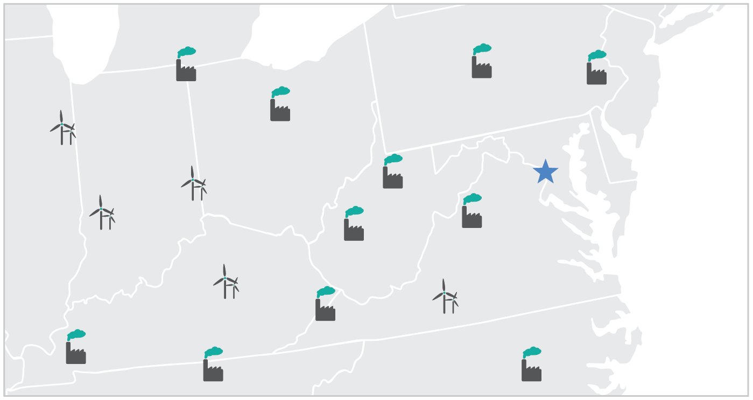
Location-based method
(map not representative)

Slide 15
Location-based method emission factor hierarchy
1. Regional or sub-national emission factors
2. National production emission factors
Data forms listed here should convey combustion-only (direct) GHG emission rates, expressed in metric tons per MWh or kWh.
Notes:
The goal is for the emission factors to reflect the mix of electricity actually used in the region where you are consuming. It should approximate a “distribution area,” which may be more accurately a sub-national boundary (such as US regions shown through eGRID) or multi-national boundaries (such as Nordic region, where there are many physical exchanges of energy across borders, making a regional factor more accurate than a national production factor only. However, a national factor’s accuracy for the location-based method can be improved if it takes into account emissions from physical energy exchanges across borders.

Slide 16
Market-based method
(map not representative)
Notes:
The premise of the market-based method is to linking specific units of electricity generation to consumers through a “contractual instrument.” Not limited to green power – as a method, needs to be completely and comprehensively applied to avoid double counting. Advantage: better reflects risks and opportunities associated with supplier portfolios. Your exposure to fluctuating costs, GHG regulation are shown to you through your supplier, not through a general regional figure. Furthermore, you have a chance to mitigate those risks through choosing cleaner supply and negotiating your own supply prices through contracts. Contractual instruments are the only way for consumers to influence supply through their demand, providing an additional lever to reduce overall emissions. Disadvantage: there can be questions/concerns with this method’s reliability and the overall impact voluntary purchasing has. However, as explained in the next few slides, this Guidance addressed some of those concerns.

Slide 17
Market-based method emission factor hierarchy
1. Electricity attribute certificates or equivalent instruments
2. Contracts for electricity, such as PPAs
3. Supplier/Utility emission rates
4. Residual mix (sub-national or national)
5. Other grid-average emission factors (sub-national or national) see location-based data
Notes:
These are listed in order from most precise to least, but this doesn’t reflect a “preference” about procurement method. In the first three, these instruments become carriers of GHG and other attribute information (if they meet the Quality Criteria). But not having qualifying data does not mean non-conformance: just means you should use the residual mix, or absent that a grid average factor. Residual mixes are not available everywhere yet, but in Europe widely available for each country. They are essentially grid average factors but with the tracked energy “removed”

Slide 18
Global Warming Potential (GWP)
activity data
x
emission factor
=
t of emissions
t of emissions
x
GWP
=
CO₂e of emissions
Global warming potential (GWP): measure of how much a greenhouse gas contributes to global warming relative to CO₂
Use GWPs to convert tonnes of a GHG to tonnes of carbon dioxide equivalent (CO2e) to calculate total emissions using a common unit

Slide 19
GWP Values
Higher GWP = more warming capacity
Use to calculate carbon dioxide equivalent (CO₂e)
Source: IPCC Assessment Reports
Choose 2nd or 5th Assessment Report values
GHG | GWP
CO₂ | 1
CH₄ | 21
N₂O | 310
HFCs | 140 - 11,700
PFCs | 6,500 - 9,200
SF₆ | 23,900
Source: IPCC, 2006
Notes:
POPOUT for “global warming potential”
Global Warming Potentials (GWPs) are intended as a quantified measure of the globally averaged relative radiative forcing impacts of a particular greenhouse gas. It is defined as the cumulative radiative forcing—both direct and indirect effects—integrated over a period of time from the emission of a unit mass of gas relative to some reference gas (IPCC 1996). Carbon dioxide (CO₂) was chosen as this reference gas. Direct effects occur when the gas itself is a greenhouse gas. Indirect radiative forcing occurs when chemical transformations involving the original gas produce a gas or gases that are greenhouse gases, or when a gas influences other radiatively important processes such as the atmospheric lifetimes of other gases. The relationship between gigagrams (Gg) of a gas and Tg CO₂ Eq. can be expressed as follows:
Tg CO2e = (Gg of gas) x (GWP) x (Tg / 1000 Gg)
Where:
Tg CO2e = Teragrams of Carbon Dioxide Equivalents
Gg = Gigagrams (equivalent to a thousand metric tons)
GWP = Global Warming Potential
Tg = Teragrams
GWP values allow policy makers to compare the impacts of emissions and reductions of different gases. According to the IPCC, GWPs typically have an uncertainty of roughly ±35 percent, though some GWPs have larger uncertainty than others, especially those in which lifetimes have not yet been ascertained.

Slide 20
Example: Transportation Emissions
How would you calculate the CO₂ emissions from travel in company-owned vehicles?
Find activity data
Consult fuel purchase records
or miles traveled by vehicles
Find emission factor
Consult GHGP
emission factors
Calculate
Multiply activity data by emission factor
activity data
x
emission factor
=
t of emissions
100 liters of gasoline
0.0023 t CO₂/liter
0.23 t CO₂
t of emissions
x
GWP
=
CO₂e of emissions
1
0.23 t CO₂e
Find GWP value
Calculate
Multiply t of emissions
by GWP
GHG | GWP
CO₂ | 1

Slide 21
Example: Electricity Emissions (location-based method)
How would you calculate the CH₄ (methane) emissions from use of purchased electricity?
Find activity data
Consult electricity bill
Find emission factor
Consult GHGP
emission factors
Calculate
Multiply activity data by emission factor
activity data
x
Emission factor
=
t of emissions
1,000 GWh of electricity
0.039 t CH₄/GWh
39 t CH₄
t of emissions
x
GWP
=
CO₂e of emissions
21
819 t CO₂e
Find GWP value
Calculate
Multiply t of emissions by GWP
GHG | GWP
CO₂ | 21

Slide 22
Example: Electricity Emissions (market-based method)
How would you calculate the CO₂ emissions from use of purchased electricity?
Find activity data
Consult electricity bill
Identify contractual instruments
Calculate
Multiply activity data by emission factor
activity data
x
Emission factor
=
t of emissions
1,000 GWh of electricity
0 t CO₂/GWh
0 t CH₄
t of emissions
x
GWP
=
CO₂e of emissions
1
0 t CO₂e
Find GWP value
Calculate
Multiply t of emissions by GWP
GHG | GWP
CO₂ | 1

Slide 23
GHG Protocol Calculation Tools
Identify Sources
Select Calculation Approach
Collect Data & Choose Emissions Factors
Apply Calculation Tools
Roll-up Data to Corporate Level
GHGP emissions calculation tools publicly available
http://www.ghgprotocol.org/calculation-tools
use not mandatory but encouraged
Advantages of tools:
Easier calculation
Reviewed by industry experts
Regularly updated
Best available

Slide 24
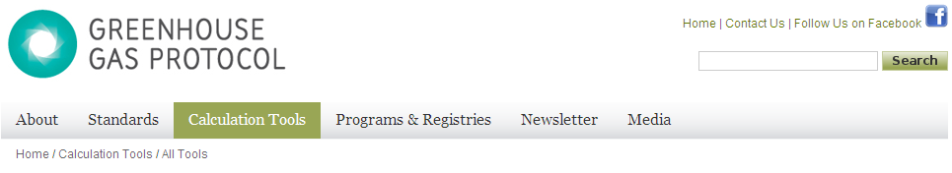
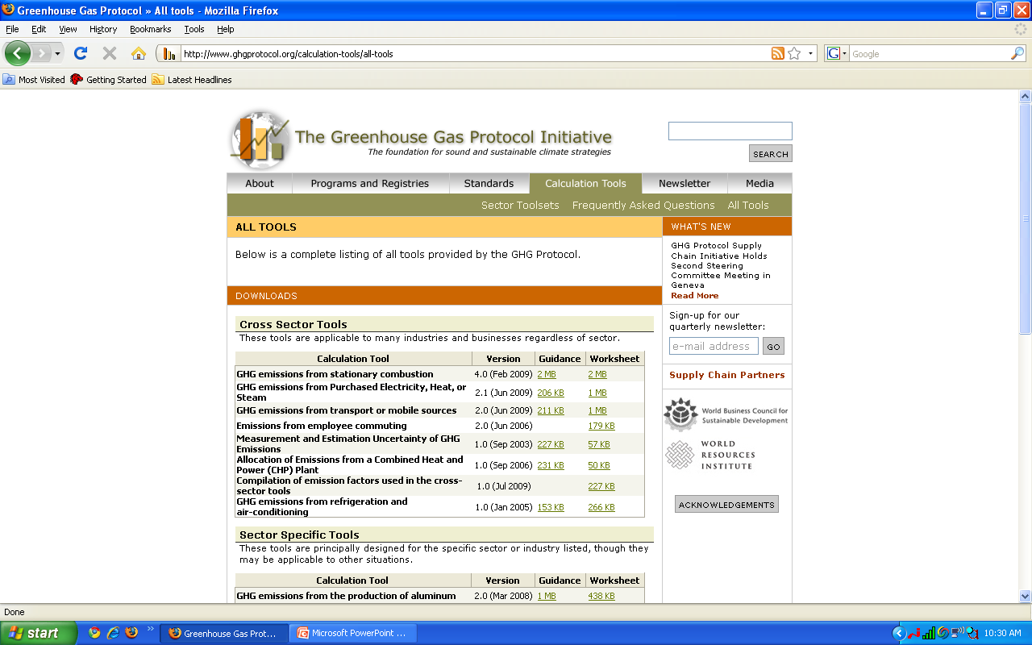
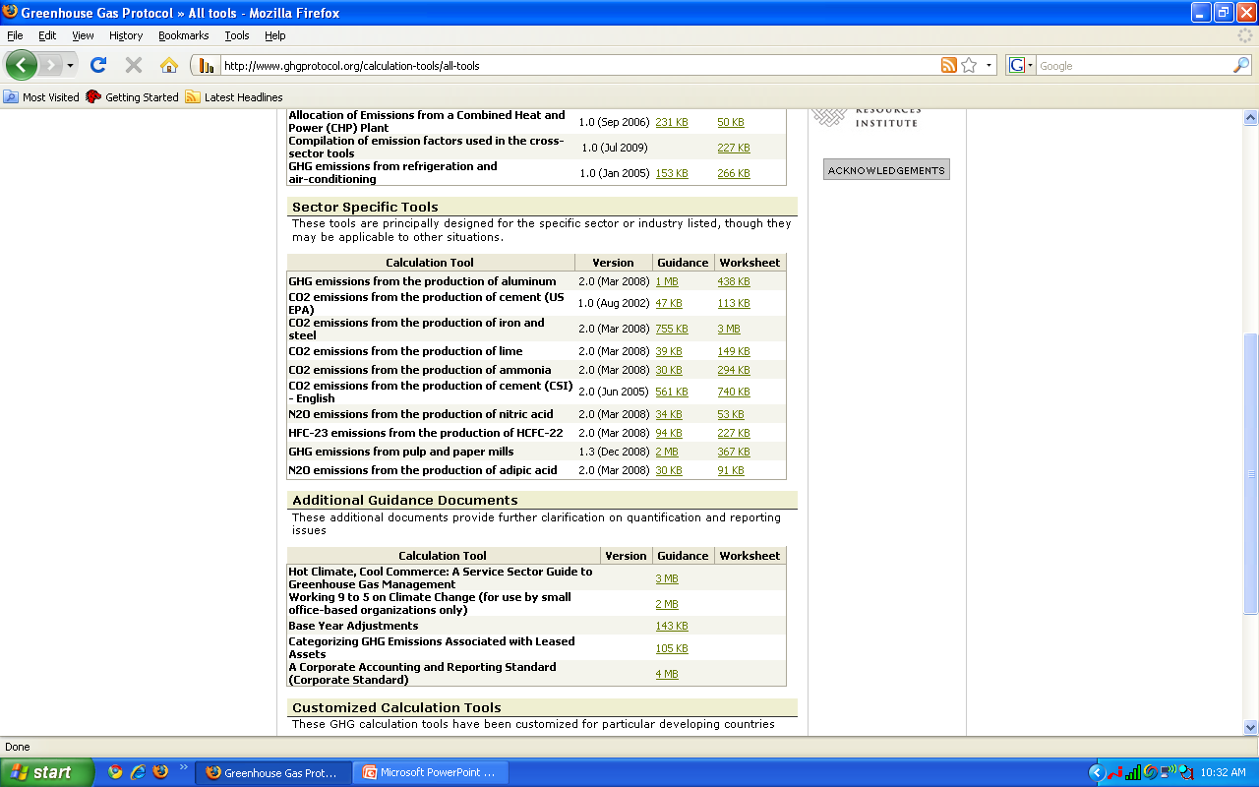
Available Tools
Cross Sector Tools
Stationary combustion
Mobile combustion
HFC use
Uncertainty
Sector Specific Tools
Aluminum
Iron and Steel
Cement
Pulp and Paper
etc.

Slide 25
Available Tools
Guidance
Purpose and process
Choosing activity data and emission factors
Calculation methods
Good practice guidance
Worksheet (tool)

Slide 26
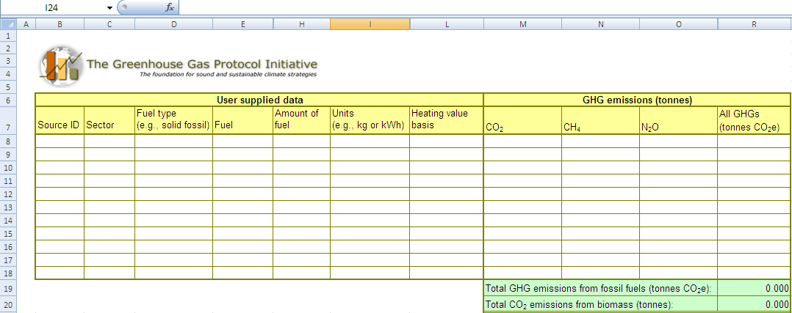

Example: Stationary Combustion Tool
Use tool to calculate emissions from burning 10,000 m³ of natural gas
(Find tool at http://www.ghgprotocol.org/calculation-tools/all-tools )

Slide 27
Identify Sources
Select Calculation Approach
Collect Data & Choose Emissions Factors
Apply Calculation Tools
Roll-up Data to Corporate Level
 | SITE LEVEL | CORPORATE LEVEL
CENTRALIZED | Each unit reports activity data | Emission factors and GWPs factored in, then all emissions added together at corporate level
DECENTRALIZED | Each unit reports emissions | Emissions added together at corporate level
2 APPROACHES

Slide 28
Summary
Identify Sources
stationary, mobile, process, fugitive
Select Calculation Approach
direct measurement, stoichiometry, estimate emissions
Collect Data and Choose Emissions Factors
Activity data
x
Emission factor
=
t of emissions
t of emissions
x
GWP
=
CO₂e of emissions
Apply Calculation Tools
http://www.ghgprotocol.org/calculation-tools
Roll-up Data to Corporate Level
report activity data and emissions estimates to corporate

Slide 29

Further Reading
The Greenhouse Gas Protocol: A Corporate Accounting & Reporting Standard
Chapter 6: Identifying and Calculating GHG Emissions
Appendix A: Accounting for Indirect Emissions from Purchased Electricity
Appendix D: Industry Sectors and Scopes
Hot Climate, Cool Commerce: A Service Sector Guide to Greenhouse Gas Management
Part 2, Step 4: Calculating Emissions
ISO 14064-1
Section 4.3: Quantification of GHG Emission and Removals

