Slide 1

The State of
Open Reasoning Models
Lewis Tunstall
Hugging Face
COLM 2025

Slide 2
STATE OF AI REPORT.
October 9, 2025
Nathan Benaich
AIR STREET CAPITAL.
stateof.ai
airstreet.com

Slide 3

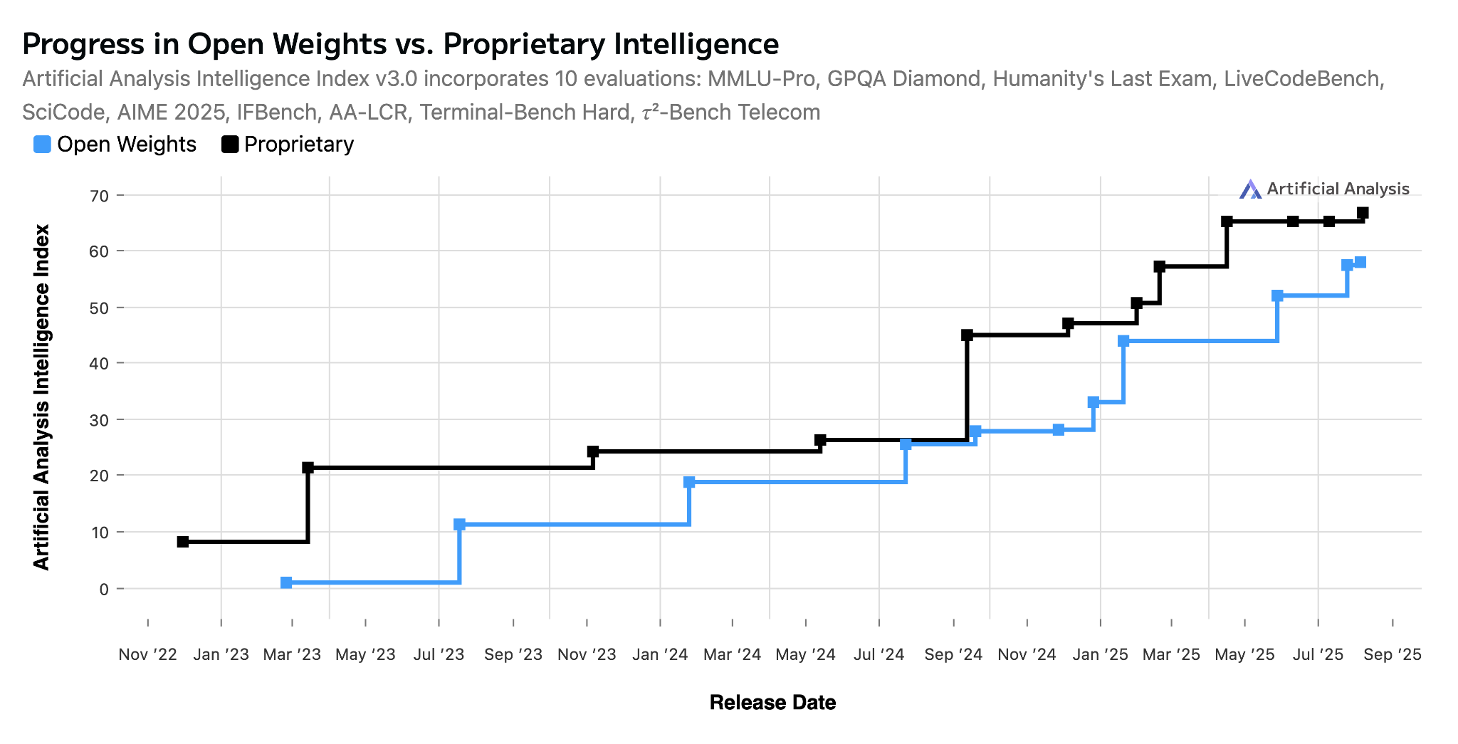
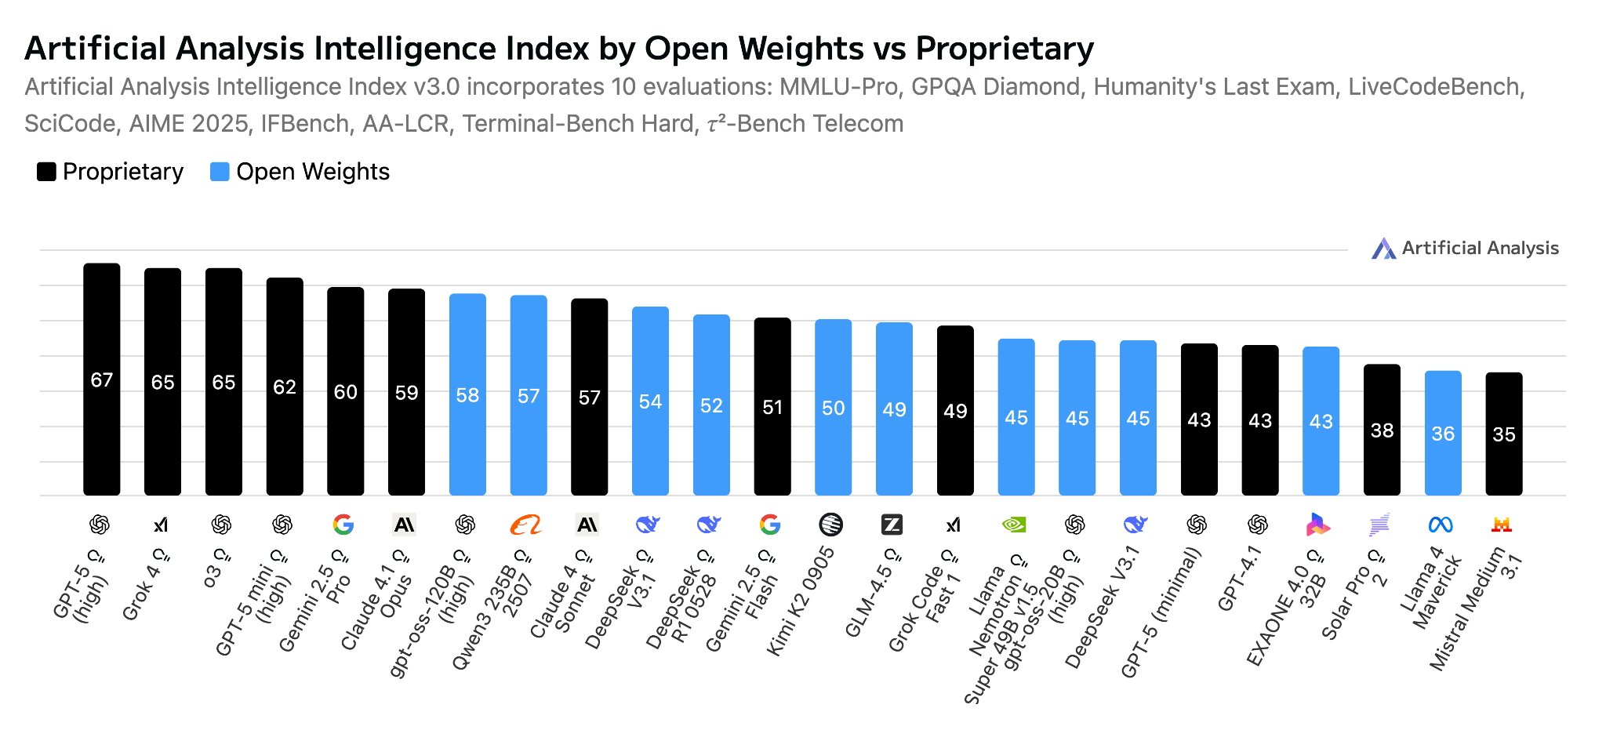
Introduction | Research | Industry | Politics | Safety | Survey | Predictions
| 42
📝 → 📝
Open source vs. proprietary: where are we now?
There was a brief moment around this time last year where the intelligence gap between open vs. closed models seemed to have compressed. And then o1-preview dropped and the intelligence gap widened significantly until DeepSeek R1, and o3 after it. Today, the most intelligent models remain closed: GPT-5, o3, Gemini 2.5 Pro, Claude 4.1 Opus, and new entrant, Grok 4. Beside gpt-oss, the strongest open weights model is Qwen. Pictured are the aggregate Intelligence Index, which combines multiple capabilities dimensions across 10 evaluations.
o3
o1
R1
stateof.ai 2025
Notes:
Source: https://artificialanalysis.ai/trends#progress-in-open-weights-vs-proprietary-intelligence
Source (retrieved 10 Sept 2025): https://artificialanalysis.ai/trends?models=gpt-4-1%2Cgpt-oss-120b%2Cgpt-oss-20b%2Cgpt-5%2Co3%2Cgpt-5-minimal%2Cgpt-5-mini%2Cllama-4-maverick%2Cgemini-2-5-pro%2Cgemini-2-5-flash-reasoning%2Cclaude-4-1-opus-thinking%2Cclaude-4-sonnet-thinking%2Cmistral-medium-3-1%2Cdeepseek-r1%2Cdeepseek-v3-1-reasoning%2Cdeepseek-v3-1%2Cgrok-code-fast-1%2Cgrok-4%2Csolar-pro-2-reasoning%2Cllama-nemotron-super-49b-v1-5-reasoning%2Ckimi-k2-0905%2Cexaone-4-0-32b-reasoning%2Cglm-4.5%2Cqwen3-235b-a22b-instruct-2507-reasoning#artificial-analysis-intelligence-index-by-open-weights-vs-proprietary

Slide 4
Three Lessons
from DeepSeek-R1
Lewis Tunstall
Hugging Face
COLM 2025

Slide 5
I Reasoning
can be distilled
II GRPO is (mostly)
all you need
III Pure reasoning
is the way

Slide 6
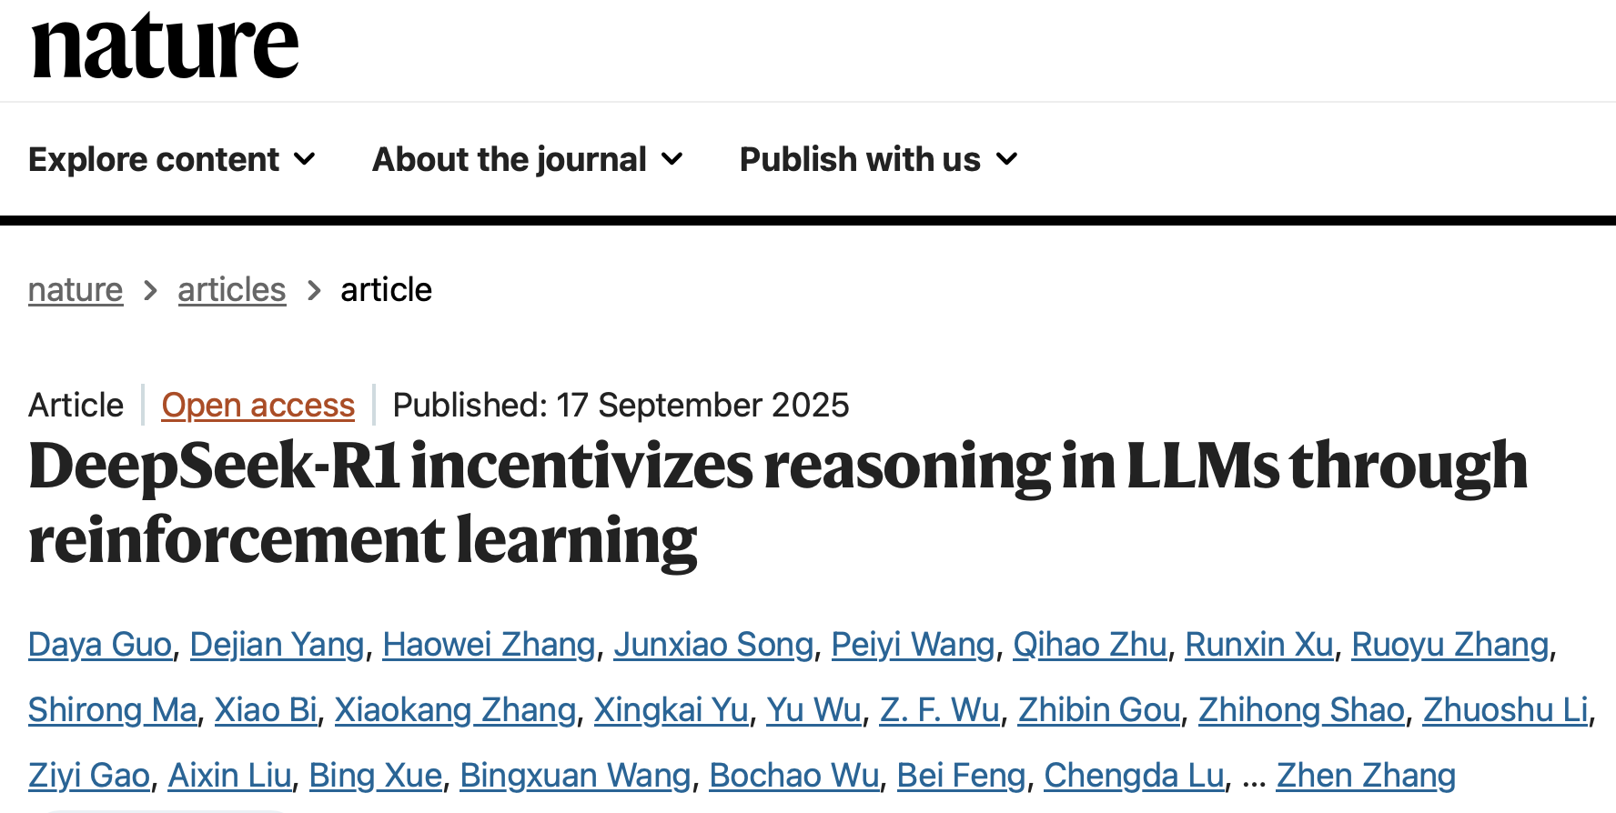
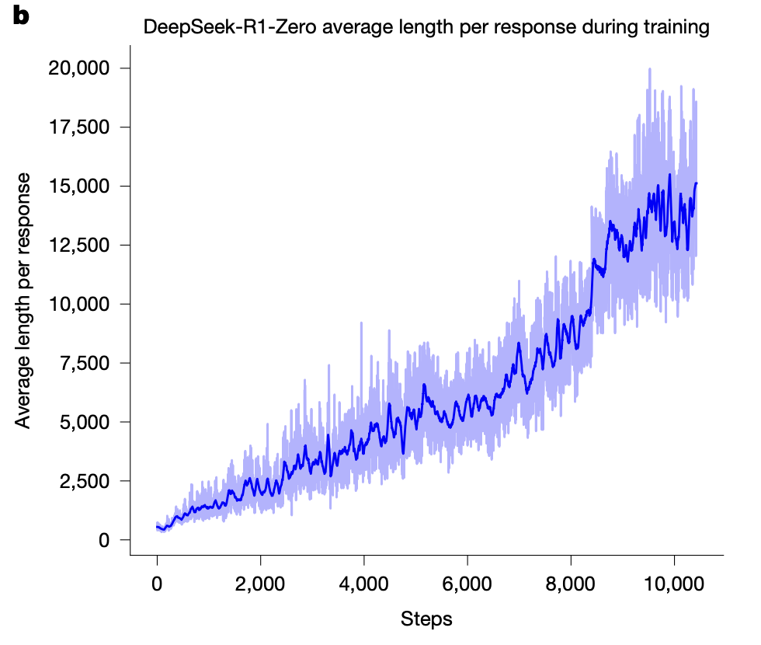
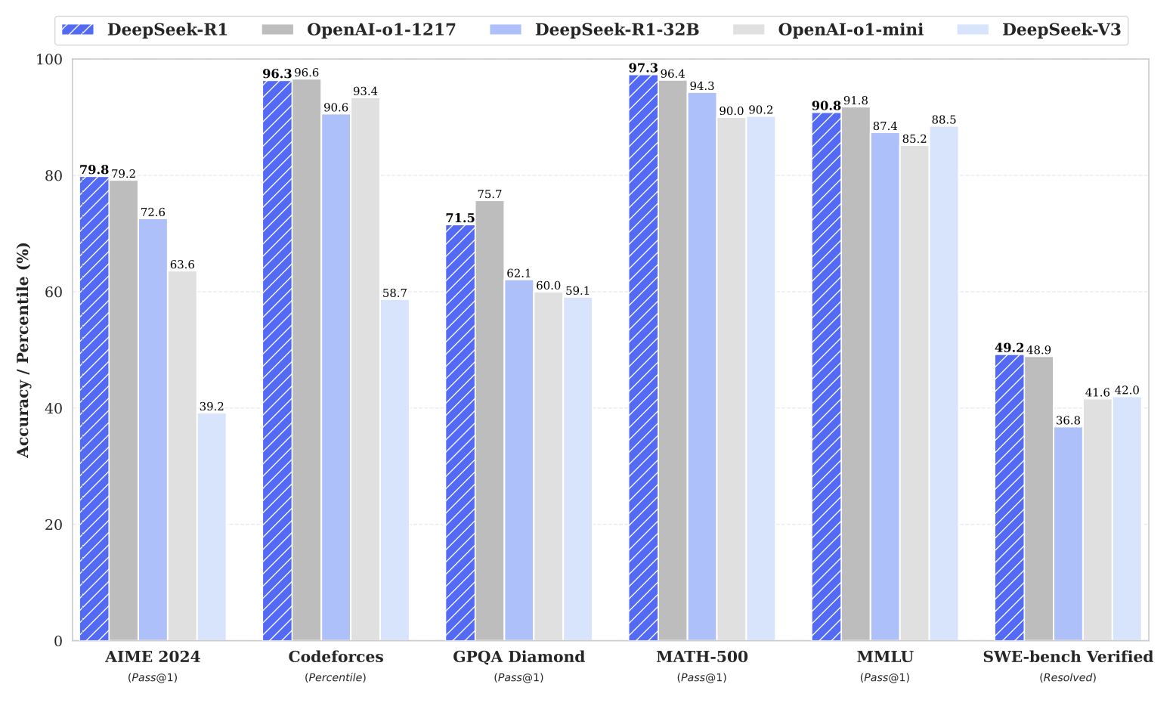
Many research breakthroughs:
RLVR is enough to generate long CoT
Performance matching frontier models

Slide 7
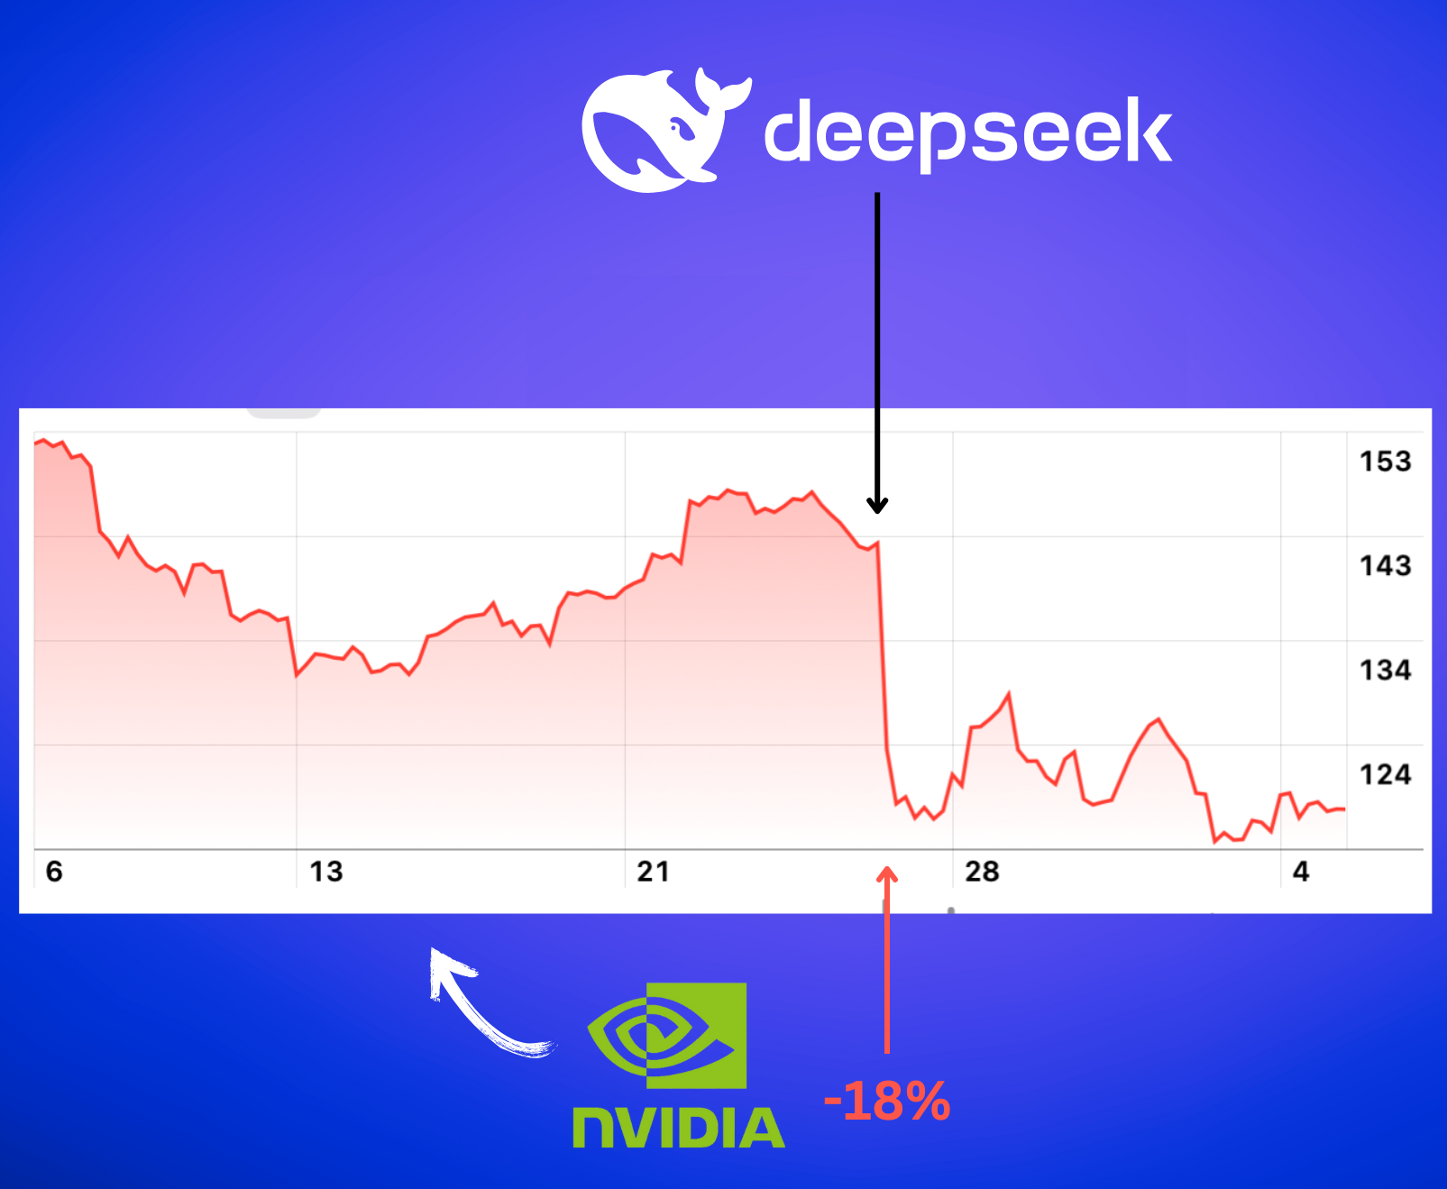
Many research breakthroughs:
RLVR is enough to generate long CoT
Performance matching frontier models
A tech report can crash the stock market :)

Slide 8
What have we learned
since DeepSeek-R1?
data, algorithms, recipes

Slide 9
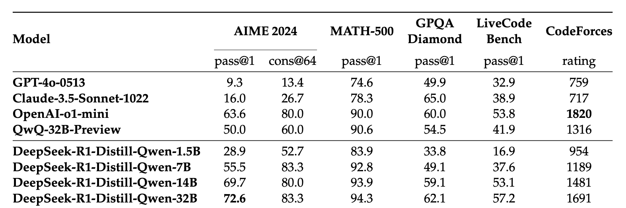
Lesson #1 – reasoning can be distilled
Main recipe:
600k reasoning + 200k non-reasoning samples
SFT on prior instruct models (Qwen2.5 & Llama 3)
Performance of 14B model comparable to o1-mini on reasoning evals

Slide 10
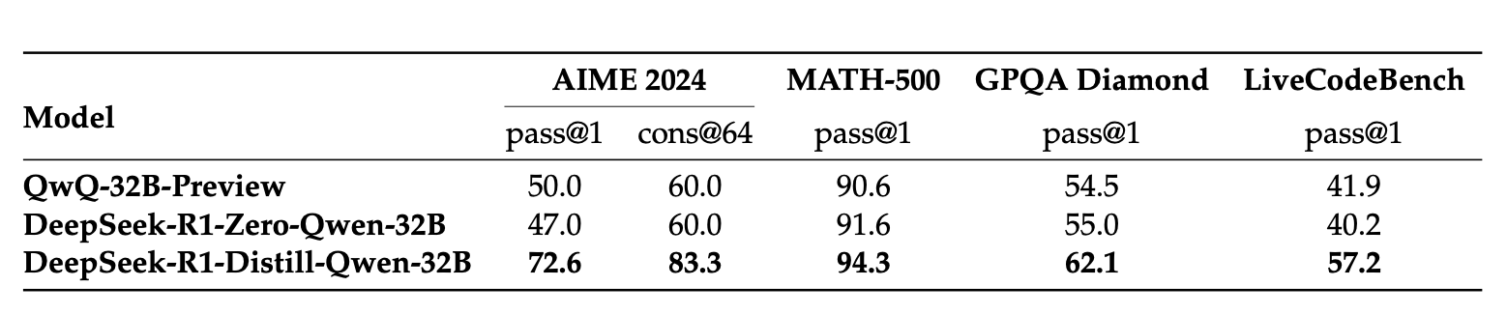
Lesson #1 – reasoning can be distilled
Distillation better (and cheaper!) than RL … at least at the 32B scale

Slide 11
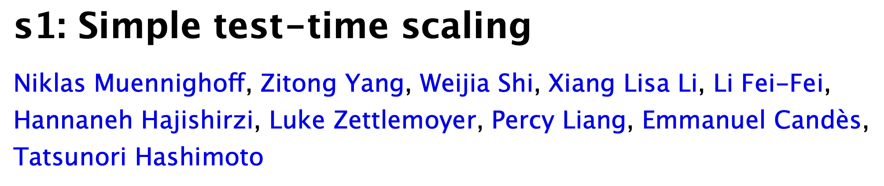
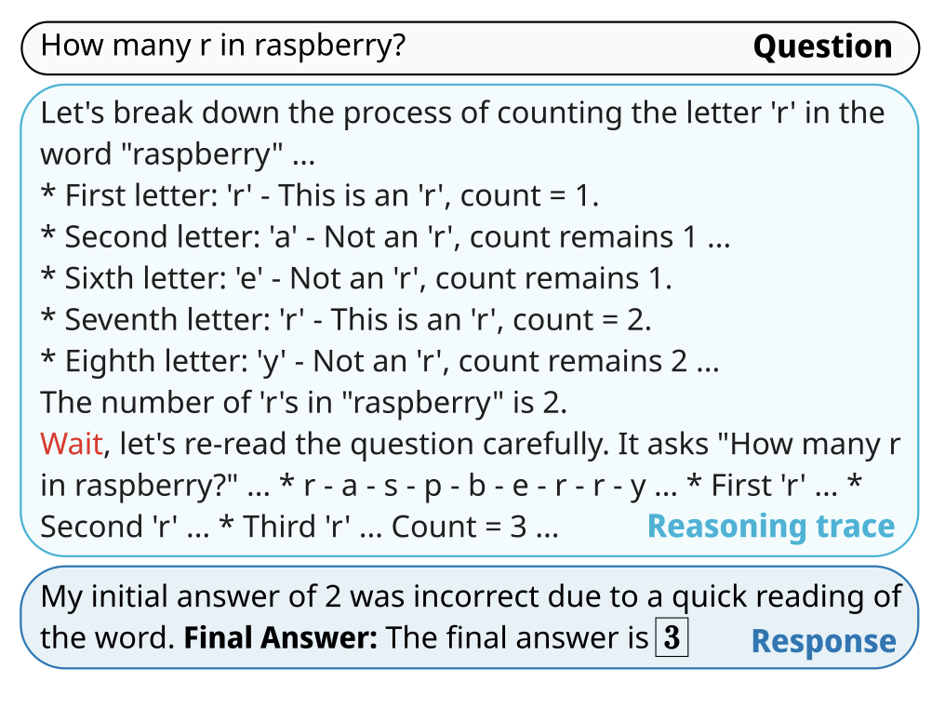
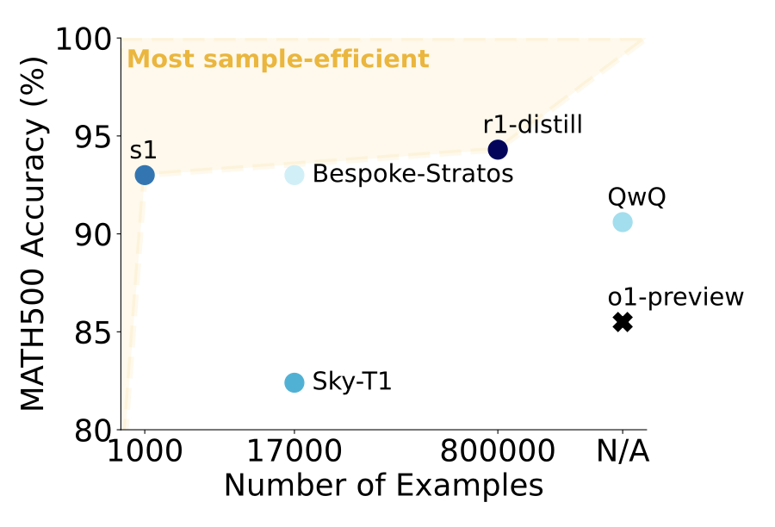
Lesson #1 – reasoning can be distilled
Only 1k reasoning samples
“budget forcing” for inference-time scaling

Slide 12
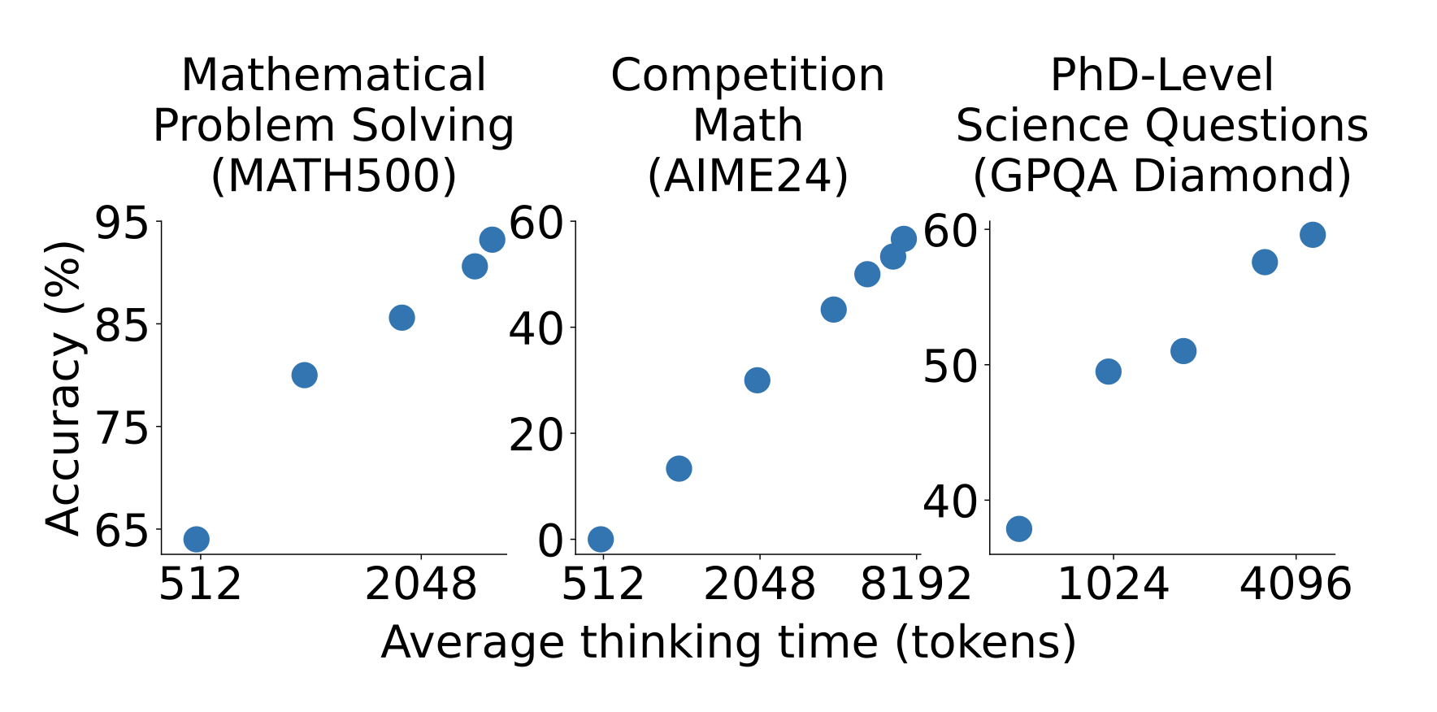
Lesson #1 – reasoning can be distilled
Only 1k reasoning samples
“budget forcing” for inference-time scaling

Slide 13







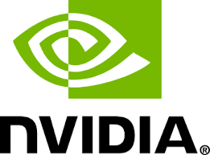

Open R1 Ecosystem
🧮 OpenR1-Math-220k
community datasets
community models & research
👨‍💻 CodeForces-CoTs
OpenThoughts3-1.2M
R1-Distilled-1.4M
OpenCodeReasoning
Llama-Nemotron
Open-Reasoner-Zero
VLM-R1
Magistral-Small
Open-R1-Multimodal
🧠 Mixture of Thoughts

Slide 14
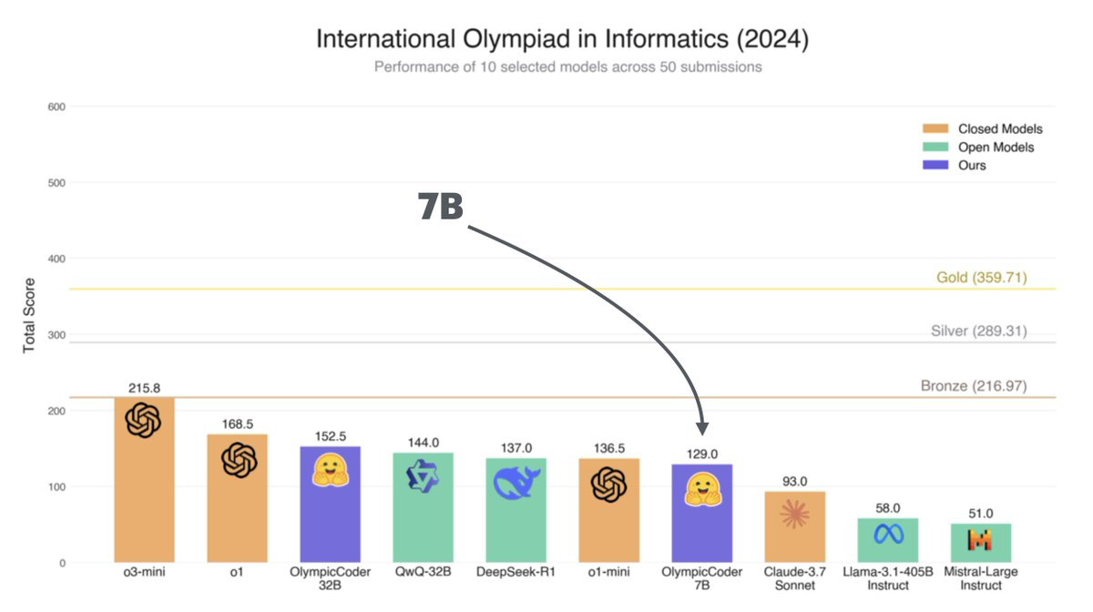
Lesson #1 – reasoning can be distilled

Slide 15

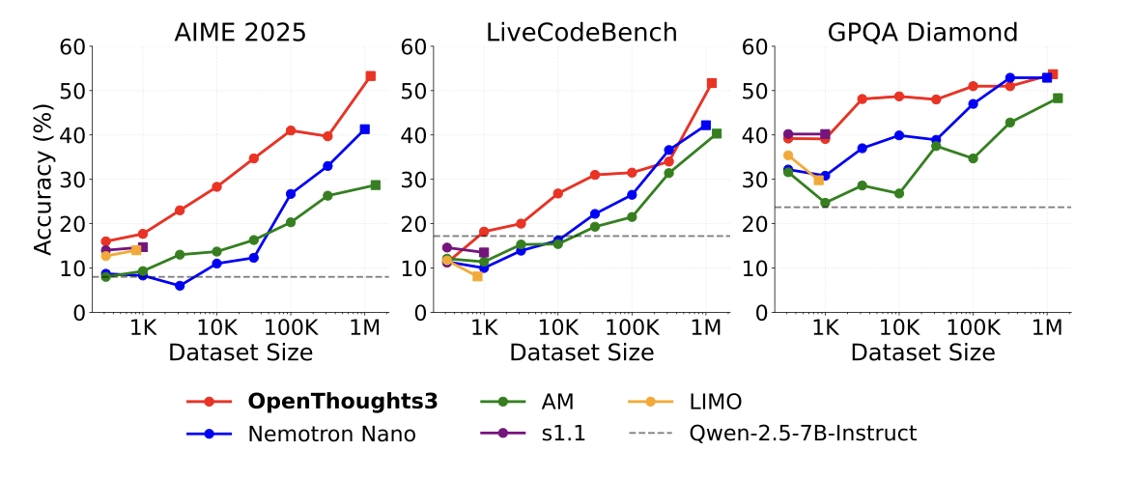
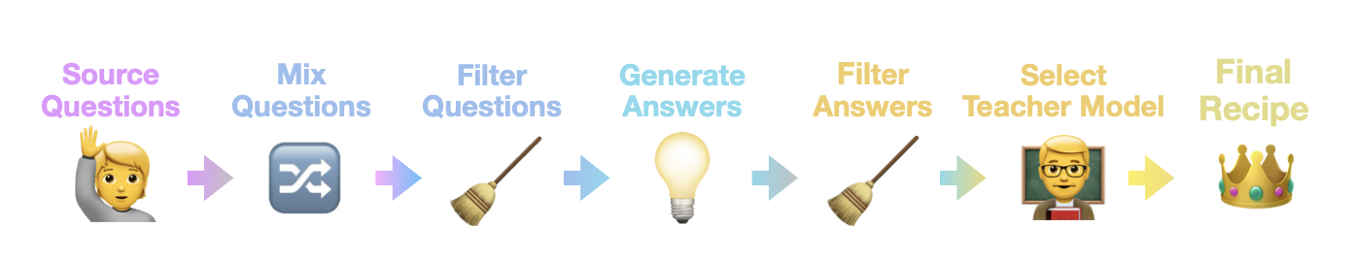
Lesson #1 – reasoning can be distilled
Main insights
1.2M reasoning samples for math, code, science
1000+ ablations
QwQ-32B > R1as teacher
prompt quality > diversity

Slide 16
I Reasoning
can be distilled
II GRPO is (mostly)
all you need
III Pure reasoning
is the way

Slide 17
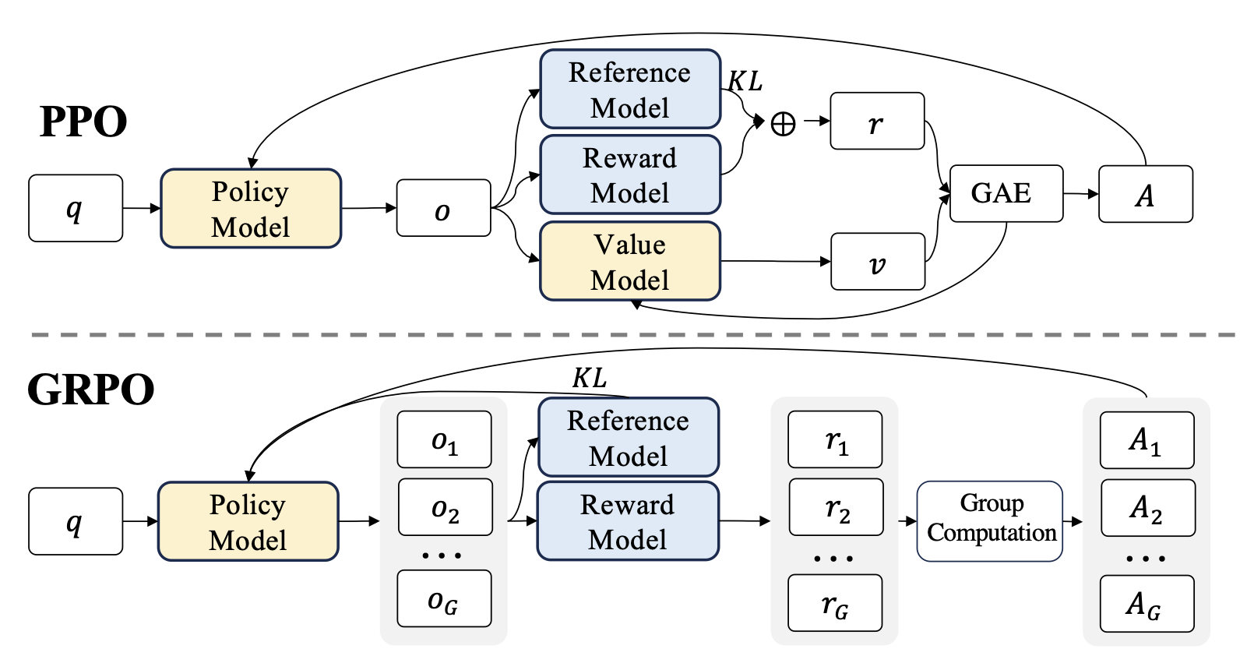
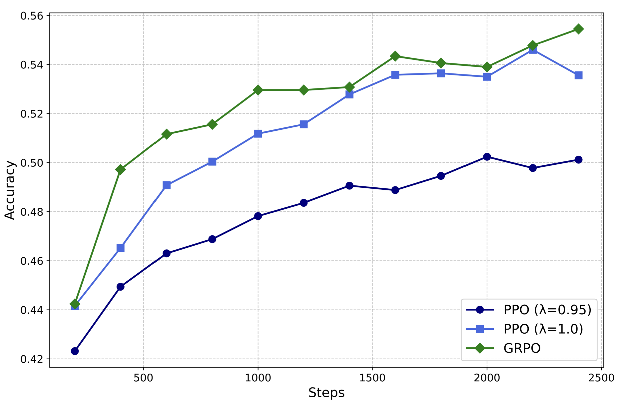
Lesson #2 – GRPO is (mostly) all you need
no value network, directly estimate advantage from intra-group reward distribution

Slide 18
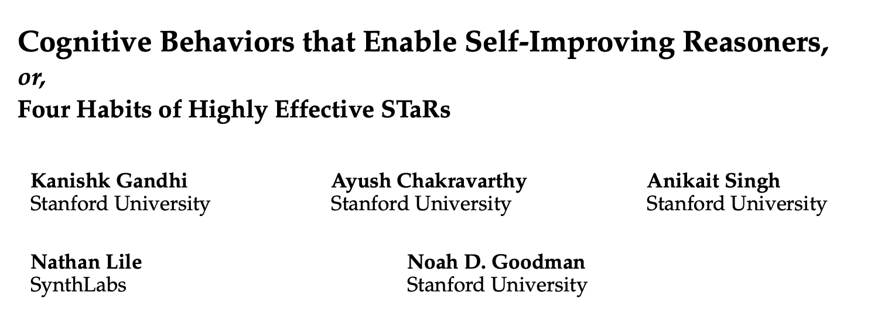
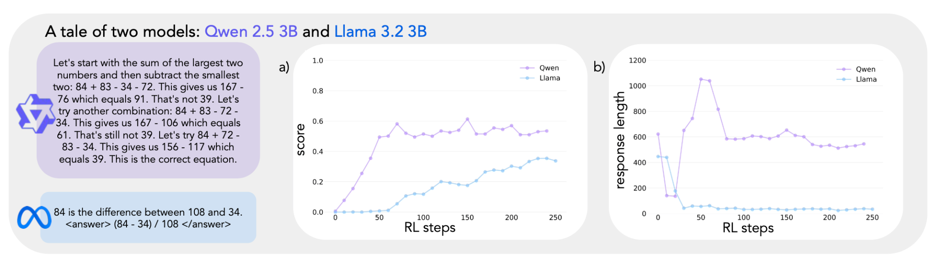
Lesson #2 – GRPO is (mostly) all you need
choice of base model matters for RL!

Slide 19
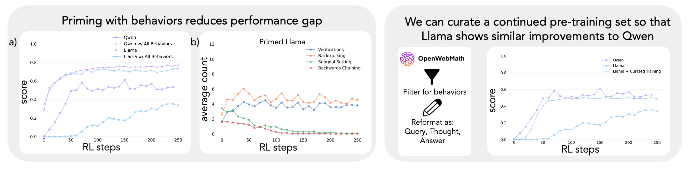
Lesson #2 – GRPO is (mostly) all you need
performance gap can be fixed with continued pretraining

Slide 20

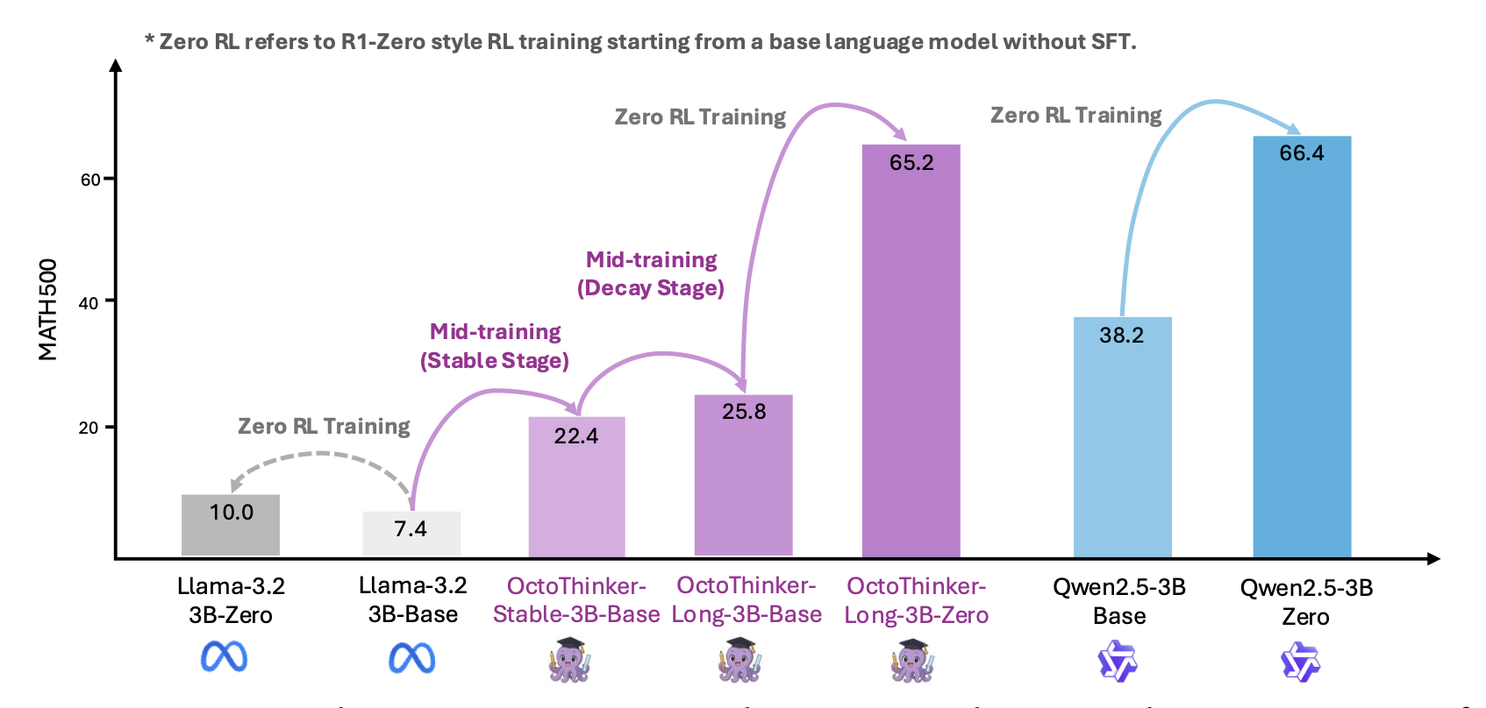
Lesson #2 – GRPO is (mostly) all you need
mid-training on QA-style & instruction following data key for RL
uses two-stage training (stable 200B & decay 20B)
R1-zero-like training bridges the Llama <> Qwen gap

Slide 21
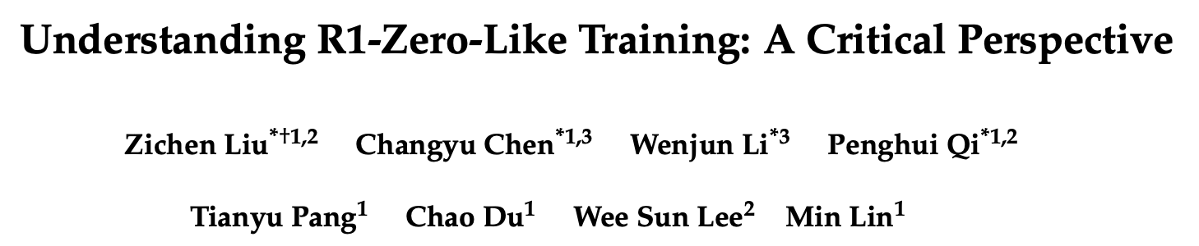
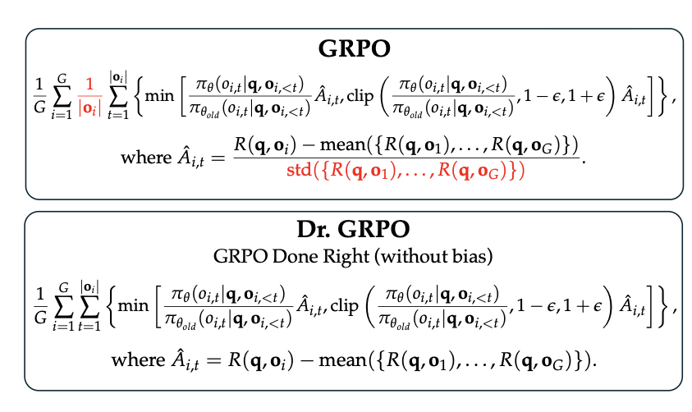
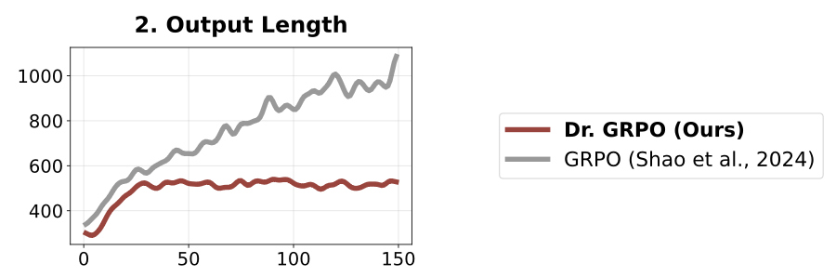
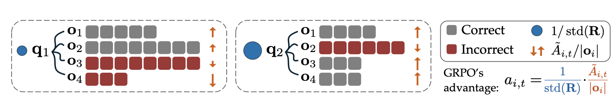
Lesson #2 – GRPO is (mostly) all you need
Improves GRPO in two main ways
no σ normalisation (difficulty bias)
no length normalisation

Slide 22
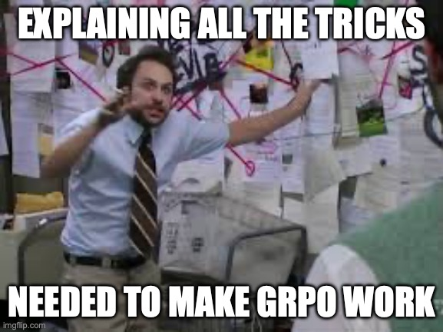
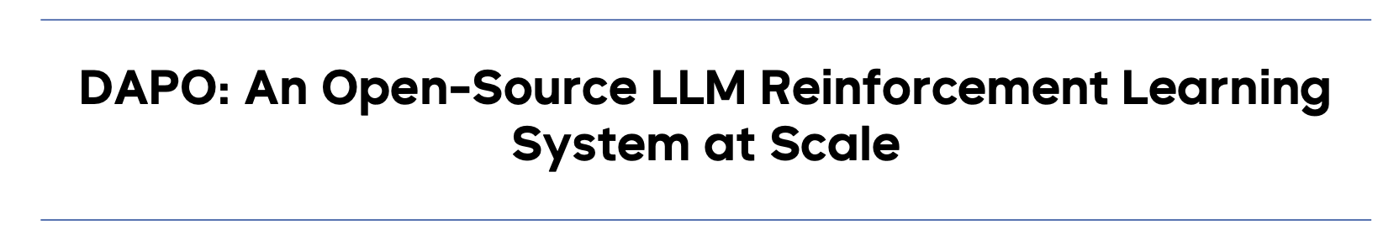
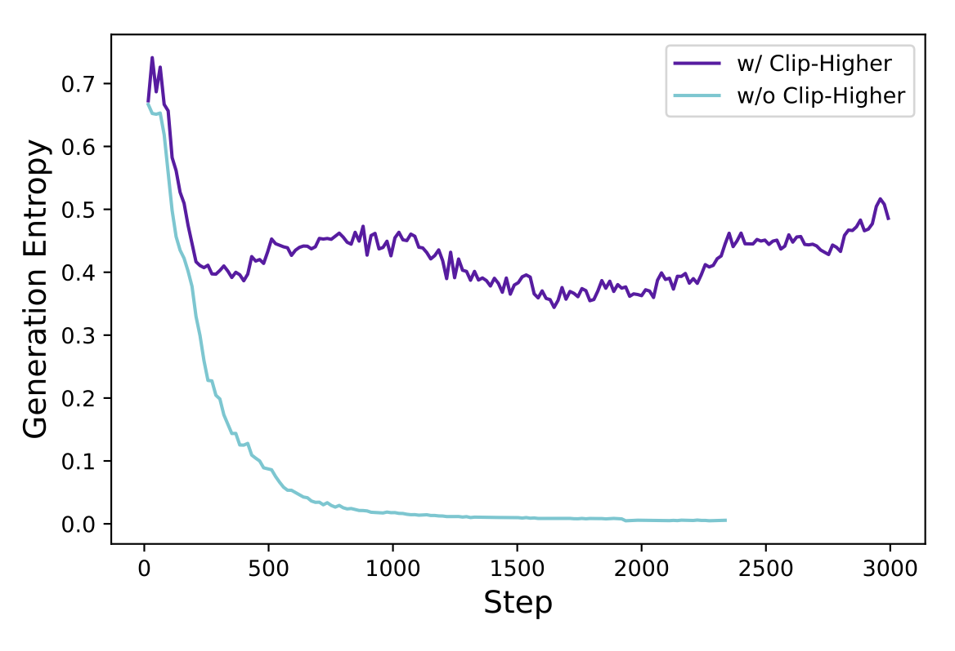
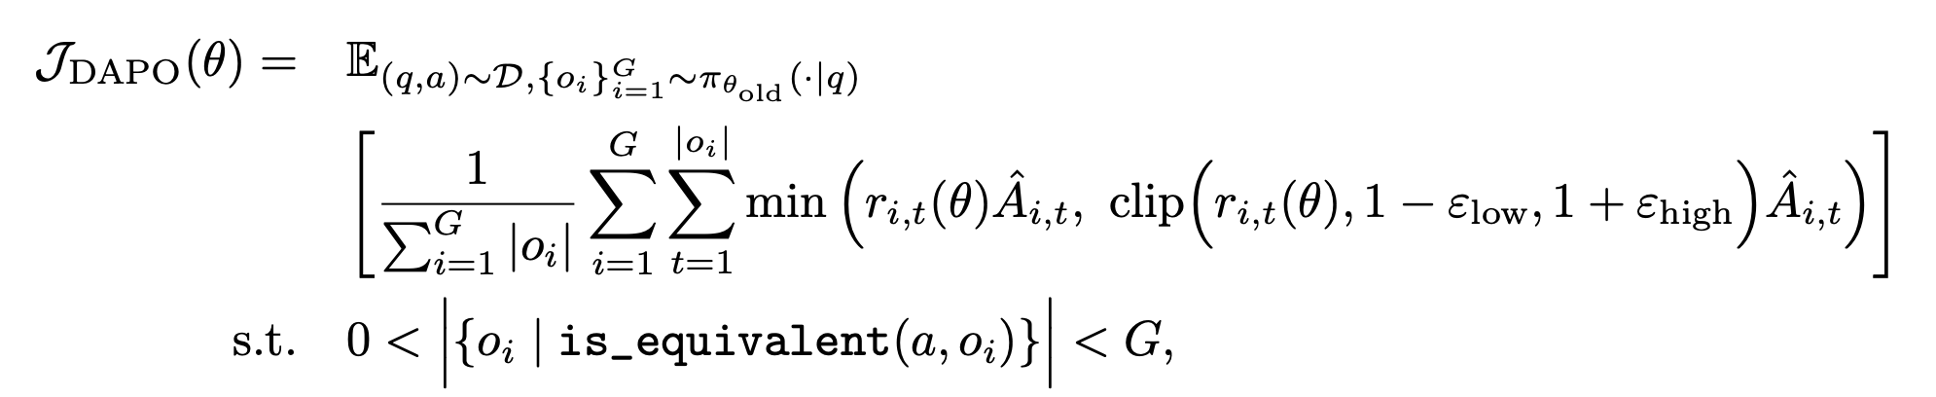
Lesson #2 – GRPO is (mostly) all you need
More tricks!?!
clip-higher to avoid entropy collapse
remove KL term
dynamic over-sampling
overlong reward shaping

Slide 23
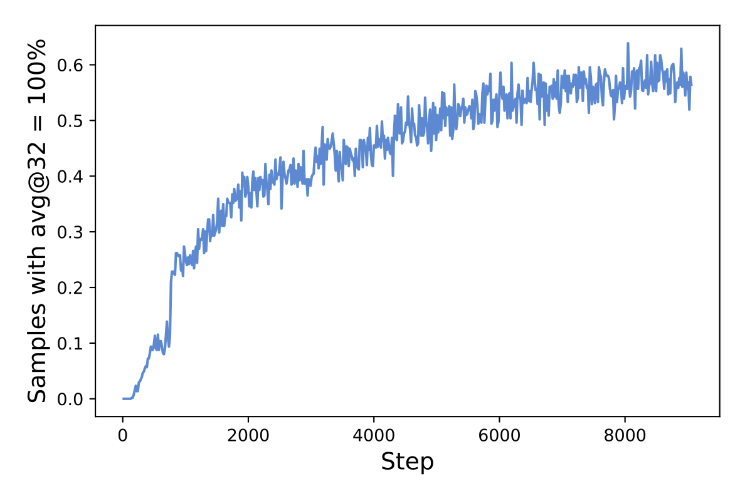
Lesson #2 – GRPO is (mostly) all you need
More tricks!?!
clip-higher to avoid entropy collapse
remove KL term
dynamic over-sampling
overlong reward shaping

Slide 24
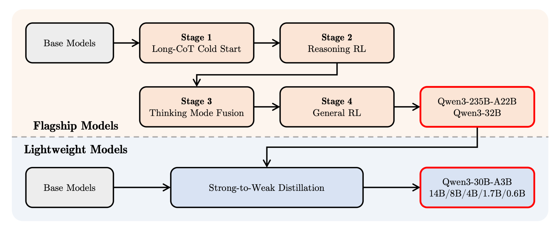
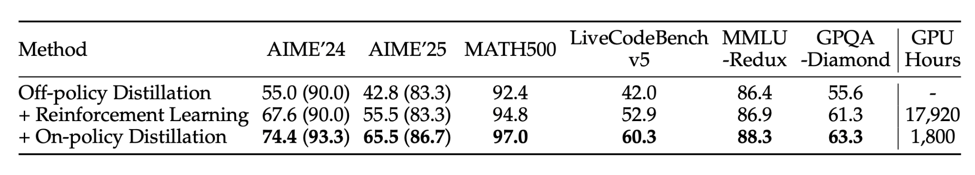
Lesson #2 – GRPO is (mostly) all you need
for smol models, on-policy distillation better than RL with 10x less compute

Slide 25
I Reasoning
can be distilled
II GRPO is (mostly)
all you need
III Pure reasoning
is the way

Slide 26
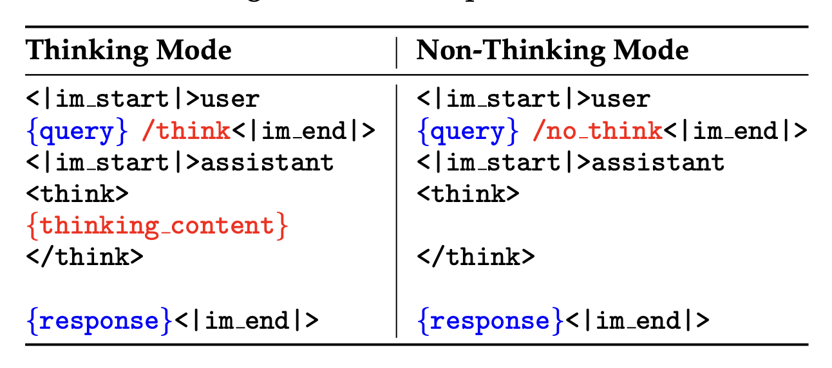
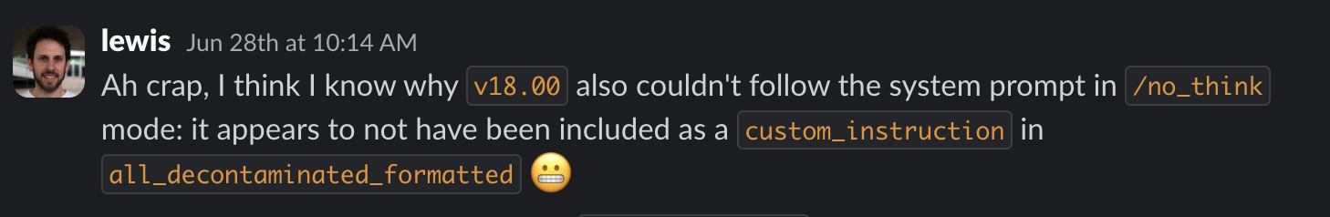
Lesson #3 – pure reasoning is the way
After DeepSeek-R1, various labs (NVIDIA, Nous, Qwen) explored hybrid reasoning models
Some lessons from SmolLM3:
requires paired data or your model will have a “split brain”
always vibe-test your models!

Slide 27
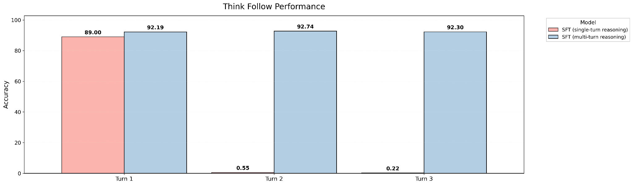
Lesson #3 – pure reasoning is the way
After DeepSeek-R1, various labs (NVIDIA, Nous, Qwen) explored hybrid reasoning models
Some lessons from SmolLM3:
requires paired data or your model will have a “split brain”
multi-turn reasoning data crucial for instruction following

Slide 28
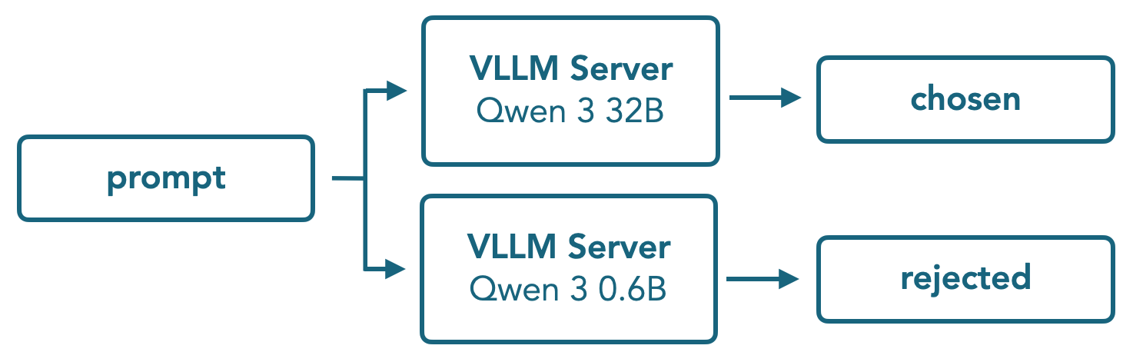
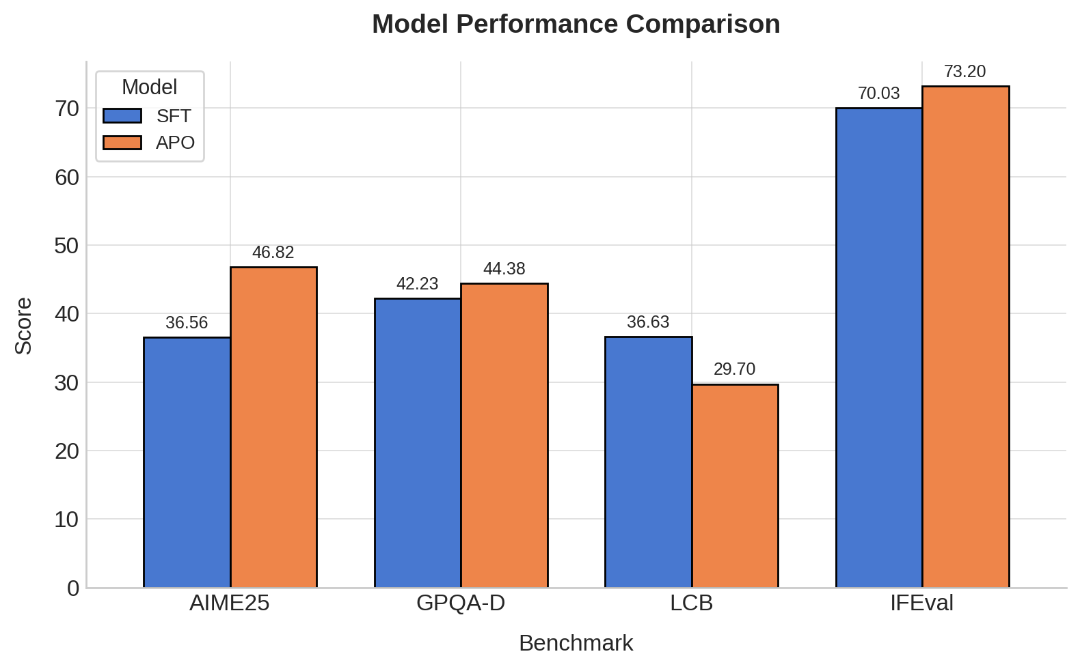
Lesson #3 – pure reasoning is the way
After DeepSeek-R1, various labs (NVIDIA, Nous, Qwen) explored hybrid reasoning models
Some lessons from SmolLM3:
requires paired data or your model will have a “split brain”
multi-turn reasoning data crucial for instruction following
offline preference optimisation works for reasoning (APO best)

Slide 29
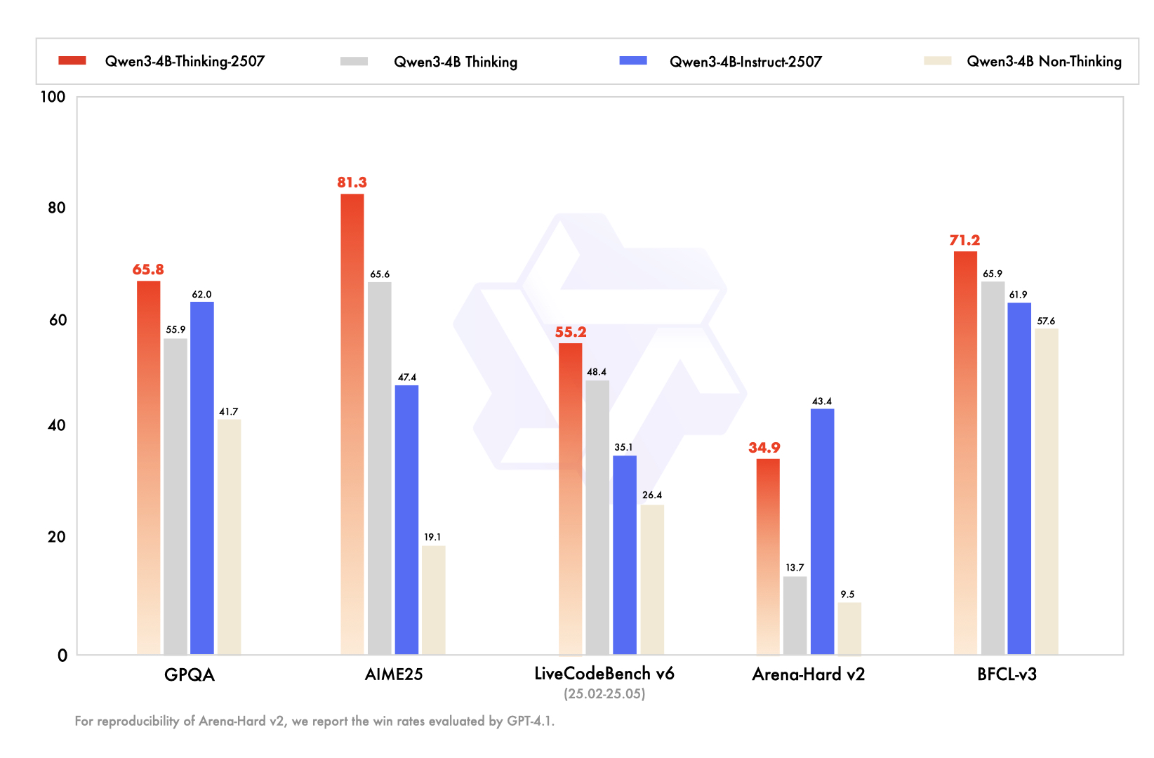
Lesson #3 – pure reasoning is the way
After DeepSeek-R1, various labs (NVIDIA, Nous, Qwen) explored hybrid reasoning models
Some lessons from SmolLM3:
requires paired data or your model will have a “split brain”
multi-turn reasoning data crucial for instruction following
offline preference optimisation works for reasoning (APO best)
generally a pain to post-train

Slide 30
Where to from here?
tokens, tooling, environments

Slide 31
Introduction | Research | Industry | Politics | Safety | Survey | Predictions
| 42
📝 → 📝
Open source vs. proprietary: where are we now?
There was a brief moment around this time last year where the intelligence gap between open vs. closed models seemed to have compressed. And then o1-preview dropped and the intelligence gap widened significantly until DeepSeek R1, and o3 after it. Today, the most intelligent models remain closed: GPT-5, o3, Gemini 2.5 Pro, Claude 4.1 Opus, and new entrant, Grok 4. Beside gpt-oss, the strongest open weights model is Qwen. Pictured are the aggregate Intelligence Index, which combines multiple capabilities dimensions across 10 evaluations.
o3
o1
R1
stateof.ai 2025
Notes:
Source: https://artificialanalysis.ai/trends#progress-in-open-weights-vs-proprietary-intelligence
Source (retrieved 10 Sept 2025): https://artificialanalysis.ai/trends?models=gpt-4-1%2Cgpt-oss-120b%2Cgpt-oss-20b%2Cgpt-5%2Co3%2Cgpt-5-minimal%2Cgpt-5-mini%2Cllama-4-maverick%2Cgemini-2-5-pro%2Cgemini-2-5-flash-reasoning%2Cclaude-4-1-opus-thinking%2Cclaude-4-sonnet-thinking%2Cmistral-medium-3-1%2Cdeepseek-r1%2Cdeepseek-v3-1-reasoning%2Cdeepseek-v3-1%2Cgrok-code-fast-1%2Cgrok-4%2Csolar-pro-2-reasoning%2Cllama-nemotron-super-49b-v1-5-reasoning%2Ckimi-k2-0905%2Cexaone-4-0-32b-reasoning%2Cglm-4.5%2Cqwen3-235b-a22b-instruct-2507-reasoning#artificial-analysis-intelligence-index-by-open-weights-vs-proprietary

Slide 32













Command A Reasoning
DeepSeek-R1
Jamba Reasoning
Llama-Nemotron
GPT-OSS
SmolLM3
Qwen3
LongCat-Flash-Thinking
Granite-3.3
Apriel-15B-Thinker
Phi-4
GLM-4.5/4.6
Hermes 4
pure reasoning
hybrid reasoning

Slide 33
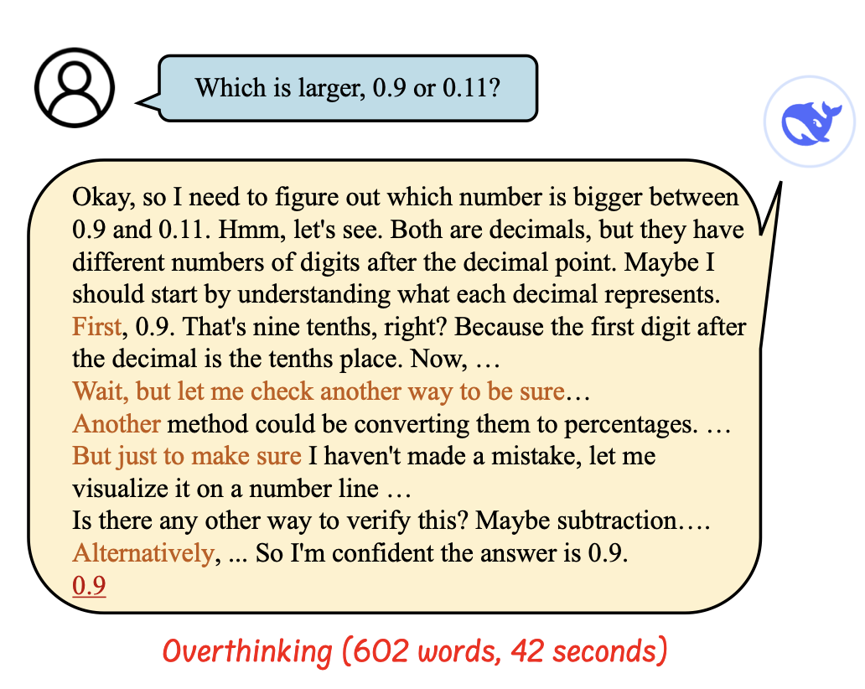
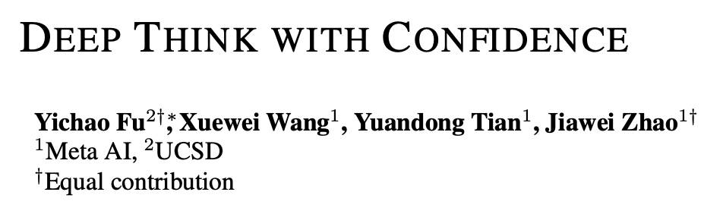

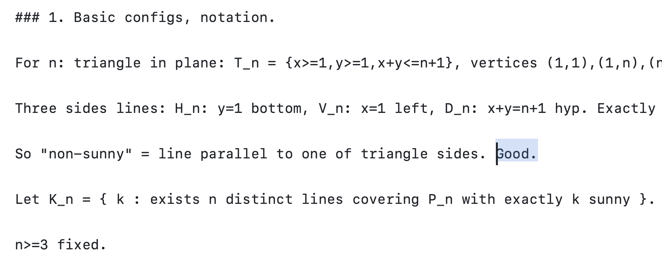
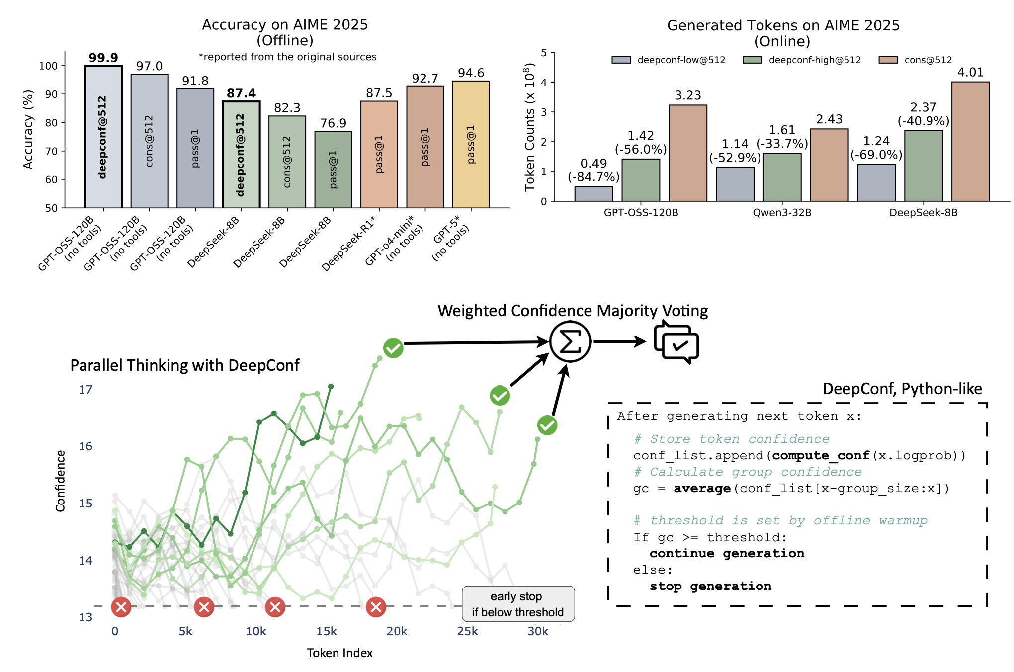
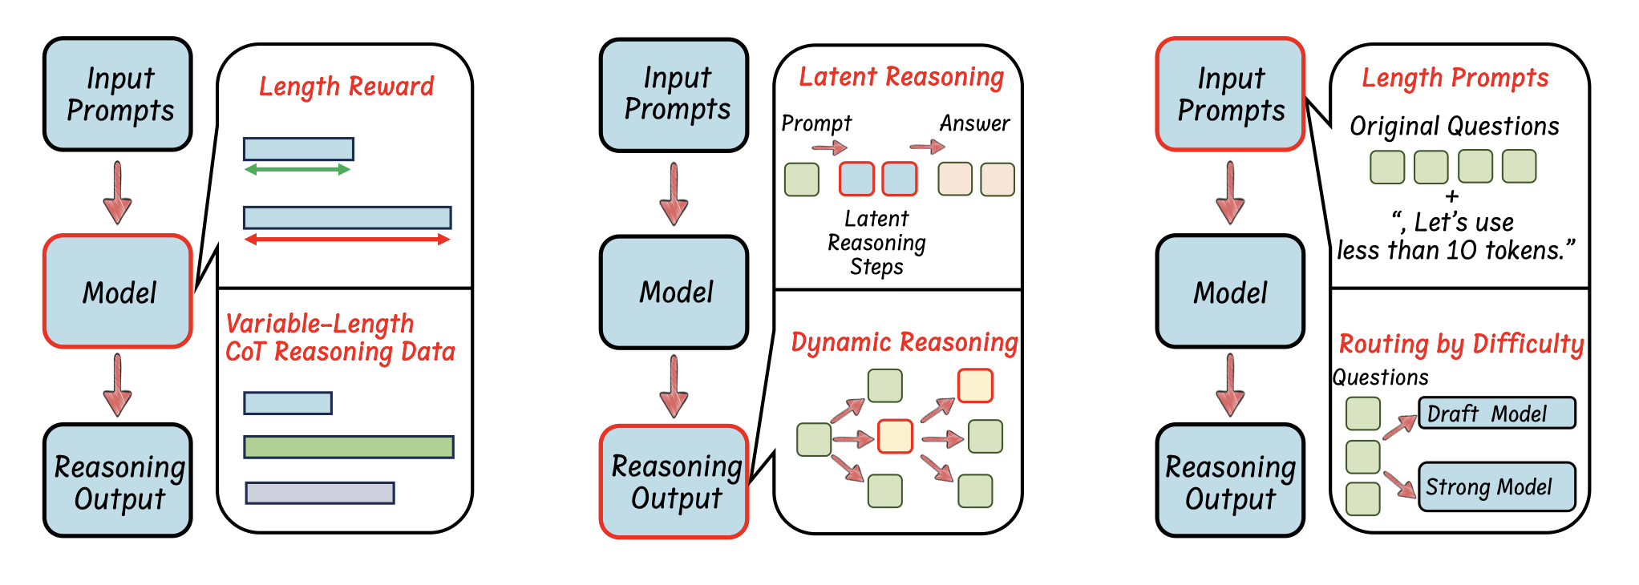
Less tokens – efficient reasoning models
https://arxiv.org/abs/2503.16419

Slide 34
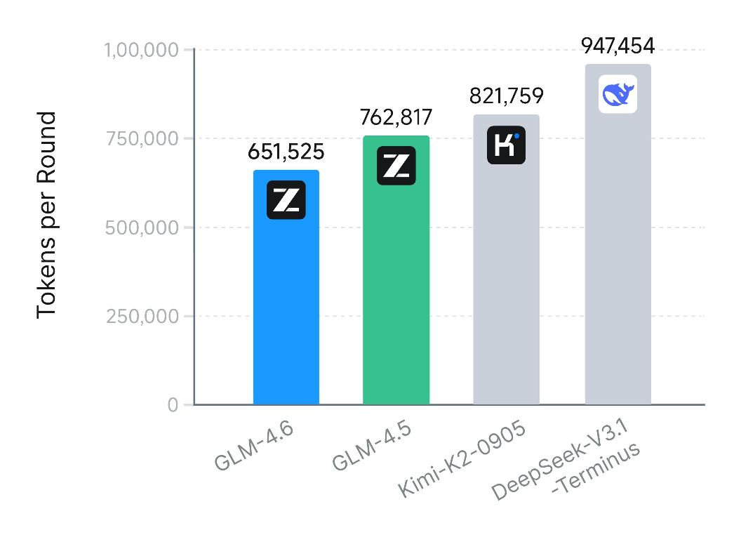
Less tokens – efficient reasoning models
https://arxiv.org/abs/2503.16419

Slide 35








Tooling for the RL era
scaling
verl
PipelineRL
open-instruct
FullFT
LoRA
FullFT & LoRA
ease of use
unsloth

Slide 36
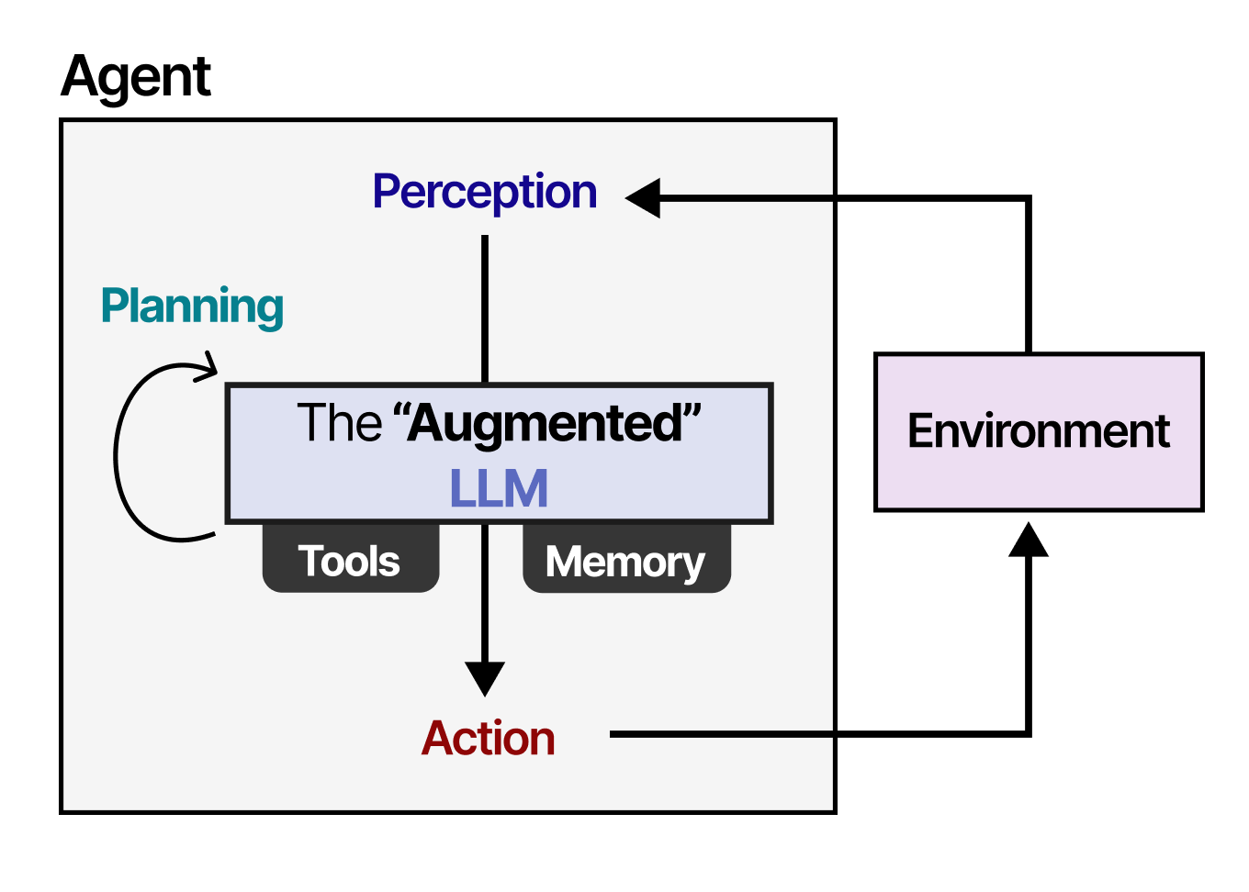


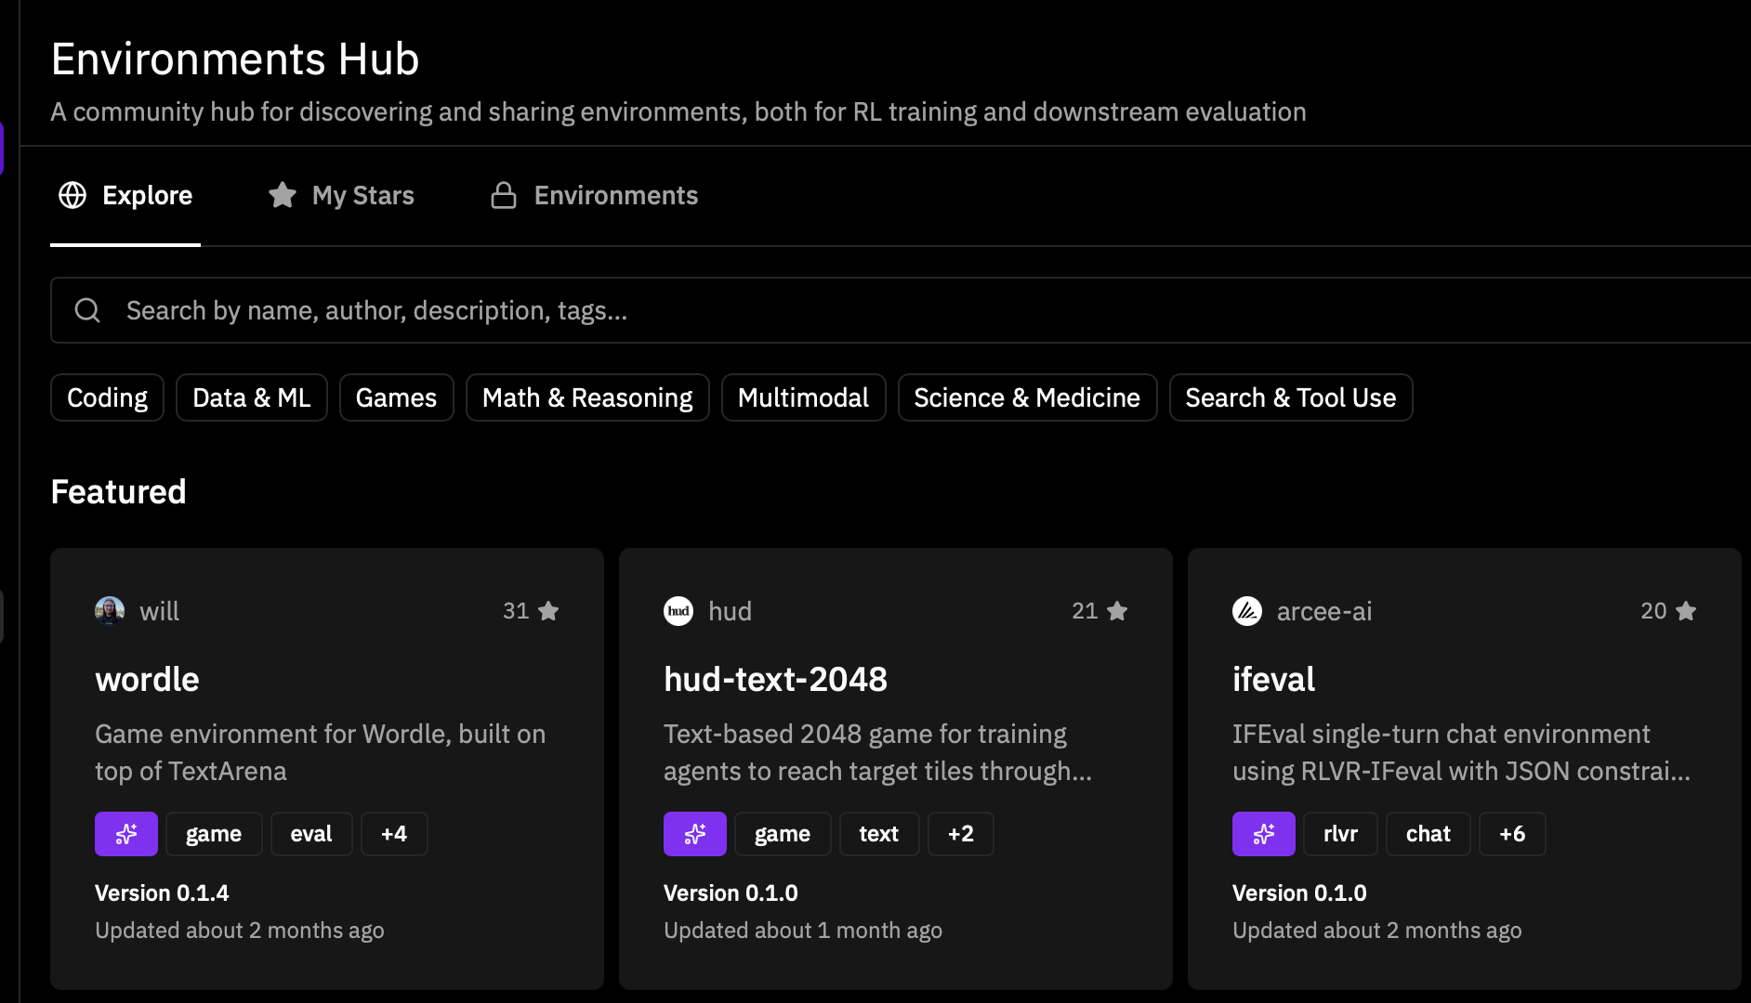
Environments – hype or the next frontier?

Slide 37





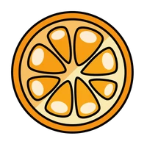












https://huggingface.co/science
Thank you!
@lewtun
@_lewtun

