Slide 1
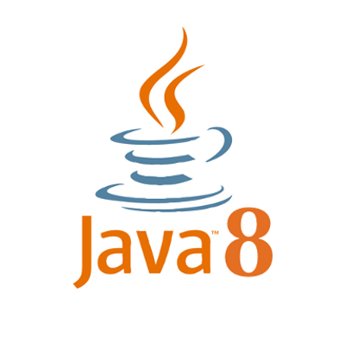
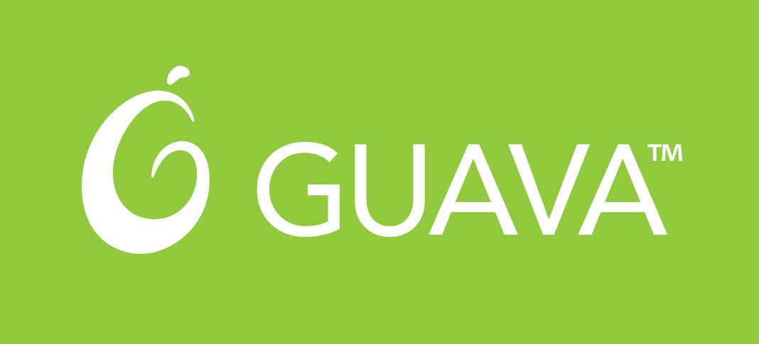
Guava vs java 8
use the best of both

Slide 2
Agenda
Remnants of old iterative approaches
Functional idioms
Guava and Java 8 implementations: Functional programming or the Purest OOP
Everything is lambda
We need more features: Optional, Splitter, Joiner, Range, Ordering

Slide 3
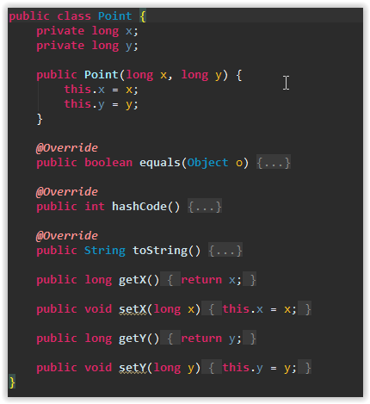
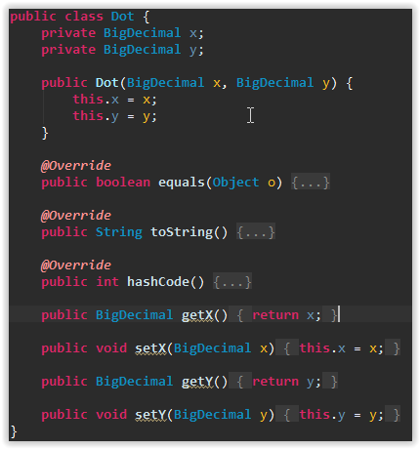

Slide 4
