Slide 1

Policy Graphs Clearing the Jungle of Stochastic Optimization Oscar Dowson*ª ª Department of Engineering Science, University of Auckland, New Zealand. *o.dowson@auckland.ac.nz

Slide 2
Definition 1. A stage t is a discrete interval in time in which the agent chooses a decision, and any uncertainty is revealed.

Slide 3
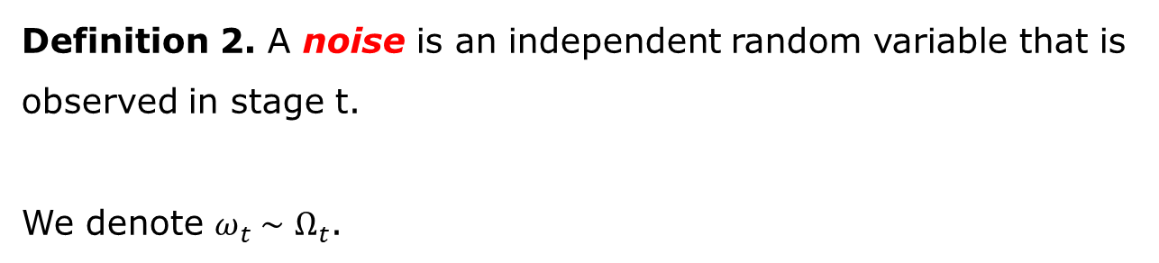
Definition 2. A noise is an independent random variable that is observed in stage t.
We denote $ω_{t}∼Ω_{t}$.

Slide 4
Definition 3. A state is the minimally dimensioned function of history that captures all the information we need to model a system from some point in time onward.

Slide 5
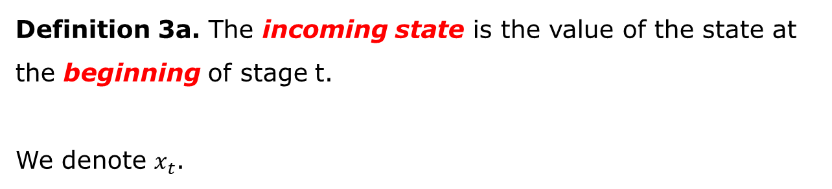
Definition 3a. The incoming state is the value of the state at the beginning of stage t.
We denote $x_{t}$.

Slide 6
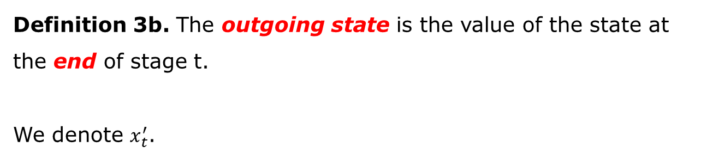
Definition 3b. The outgoing state is the value of the state at the end of stage t.
We denote $x_{t}^{′}$.

Slide 7
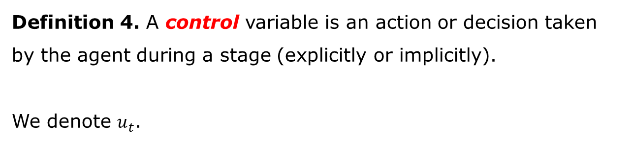
Definition 4. A control variable is an action or decision taken by the agent during a stage (explicitly or implicitly).
We denote $u_{t}$.

Slide 8
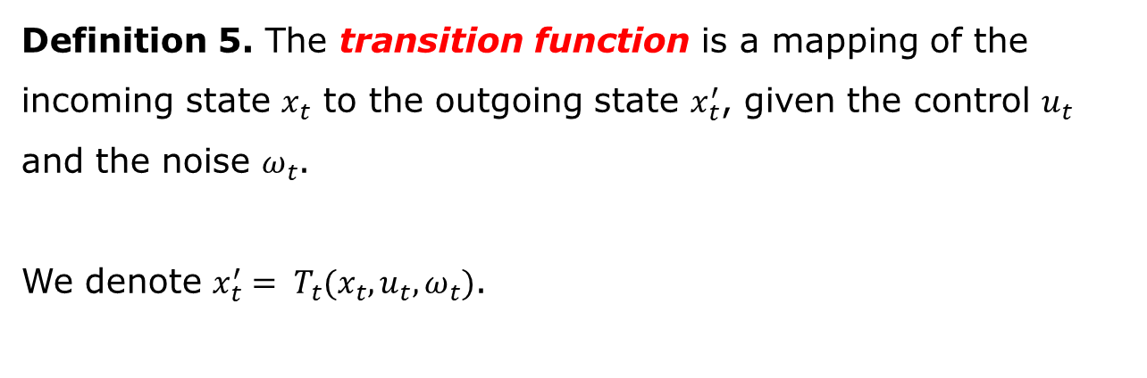
Definition 5. The transition function is a mapping of the incoming state $x_{t}$ to the outgoing state $x_{t}^{′}$, given the control $u_{t}$ and the noise $ω_{t}$.
We denote ${x_{t}^{′}= T}_{t}(x_{t},u_{t},ω_{t})$.

Slide 9
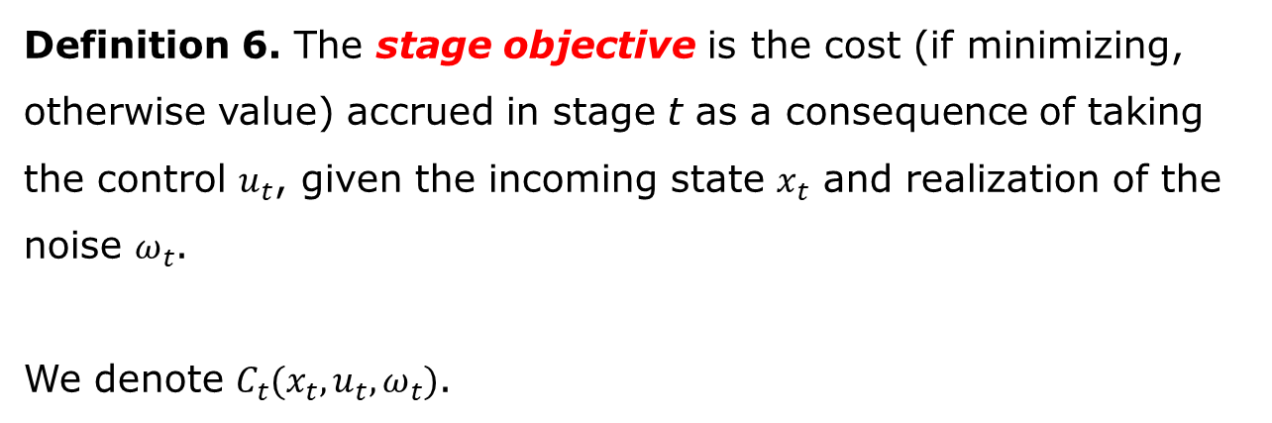
Definition 6. The stage objective is the cost (if minimizing, otherwise value) accrued in stage t as a consequence of taking the control $u_{t}$, given the incoming state $x_{t}$ and realization of the noise $ω_{t}$.
We denote $C_{t}(x_{t},u_{t}, ω_{t})$.

Slide 10
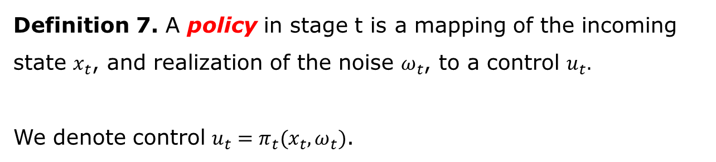
Definition 7. A policy in stage t is a mapping of the incoming state $x_{t}$, and realization of the noise $ω_{t}$, to a control $u_{t}.$
We denote control $u_{t}=π_{t}(x_{t},ω_{t})$.

Slide 11
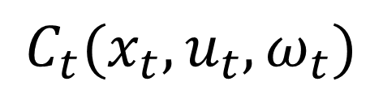
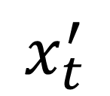
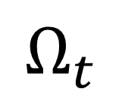
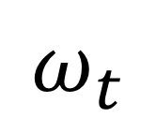
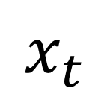
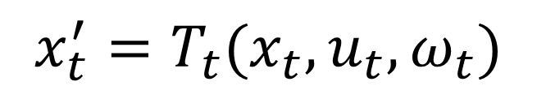
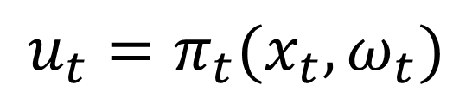
$$Ω_{t}$$
$$ω_{t}$$
$$x_{t}$$
$$u_{t}=π_{t}(x_{t},ω_{t})$$
$$x_{t}^{′}$$
$$x_{t}^{′}=T_{t}(x_{t},u_{t}, ω_{t})$$
$$C_{t}(x_{t},u_{t},ω_{t})$$

Slide 12
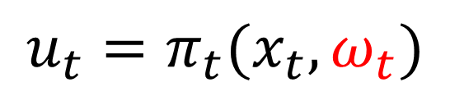
$$Ω_{t}$$
$$ω_{t}$$
$$x_{t}$$
$$u_{t}=π_{t}(x_{t},ω_{t})$$
$$x_{t}^{′}$$
$$x_{t}^{′}=T_{t}(x_{t},u_{t}, ω_{t})$$
$$C_{t}(x_{t},u_{t},ω_{t})$$

Slide 13
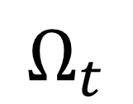
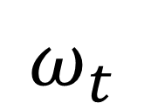
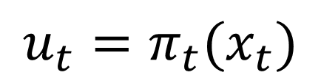
$$Ω_{t}$$
$$ω_{t}$$
$$x_{t}$$
$$u_{t}=π_{t}(x_{t})$$
$$x_{t}^{′}$$
$$x_{t}^{′}=T_{t}(x_{t},u_{t}, ω_{t})$$
$$C_{t}(x_{t},u_{t},ω_{t})$$

Slide 16

t=1
t=2
$$x_{1}^{′}=x_{2}$$

Slide 17

?
?
t=1
t=2
$$x_{1}^{′}=x_{2}$$

Slide 18
?
t=1
t=2
$$x_{1}^{′}=x_{2}$$

Slide 19

t=R
t=1
t=2
$$x_{R}^{′}=x_{1}$$
$$x_{1}^{′}=x_{2}$$

Slide 20
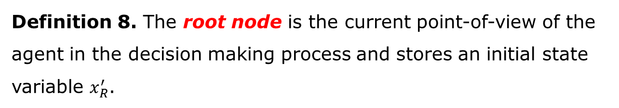
Definition 8. The root node is the current point-of-view of the agent in the decision making process and stores an initial state variable $x_{R}^{′}$.

Slide 21
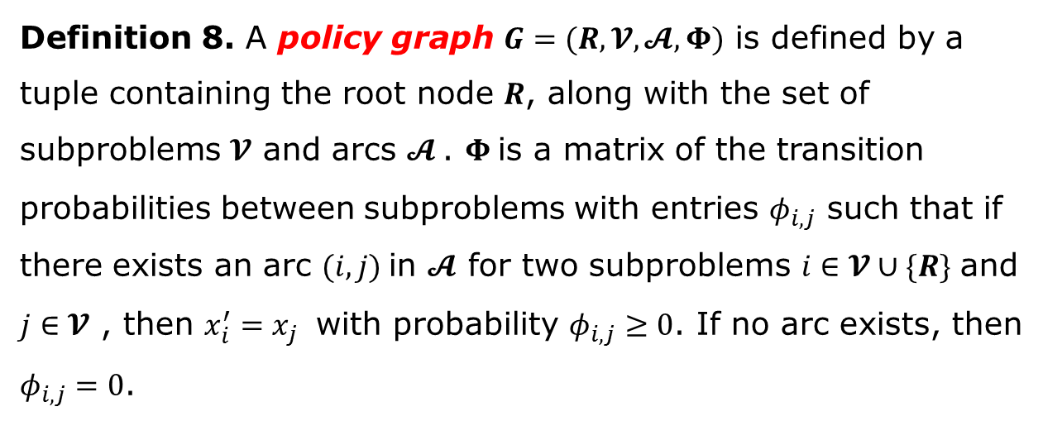
Definition 8. A policy graph $G=(R, 𝓥,𝓐, Φ)$ is defined by a tuple containing the root node $R$, along with the set of subproblems $𝓥$ and arcs $𝓐$. $Φ$is a matrix of the transition probabilities between subproblems with entries $φ_{i,j}$ such that if there exists an arc $(i,j)$in $𝓐$ for two subproblems $i∈𝓥∪\{R\}$ and $j∈𝓥$ , then $x_{i}^{′}=x_{j}$ with probability $φ_{i,j}≥0$. If no arc exists, then $φ_{i,j}=0$.

