Slide 1
MOO The Milk Output Optimiser
A management tool for New Zealand dairy farmers
Oscar Dowson, Andy Philpott Andrew Mason, Anthony Downward
Department of Engineering Science
University of Auckland

Slide 2
The Dairy industry
5 Million

Slide 3
The Dairy industry
20 Billion

Slide 4
The Dairy industry
25 %

Slide 5
The Dairy industry
$14 billion

Slide 6
The Dairy industry
Small improvements are big improvements

Slide 7
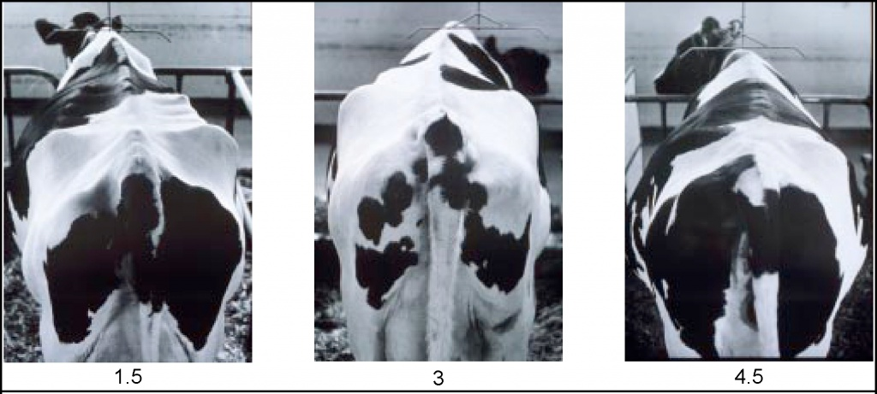
Tell Me All Your Worries
http://bizplan-uz.com/upload/medialibrary/d62/babcock_38.jpg
Cows
Pasture
Body Condition
Fertiliser
Lactation
Irrigation
Fertility
Silage
Stocking Rate
Supplement

Slide 8
Tell Me All Your Worries
http://bizplan-uz.com/upload/medialibrary/d62/babcock_38.jpg
Cows
Pasture
Body Condition
Fertiliser
Lactation
Irrigation
Fertility
Silage
Stocking Rate
Supplement

Slide 9
Tell Me All Your Worries
Cows
Pasture
Stochasticity
Body Condition
Fertiliser
Weather
Lactation
Irrigation
Financial
Fertility
Silage
Biological
Stocking Rate
Supplement

Slide 10
Tell Me All Your Worries
Cows
Pasture
Stochasticity
Body Condition
Fertiliser
Weather
Lactation
Irrigation
Financial
Fertility
Silage
Biological
Stocking Rate
Supplement

Slide 11
Tell Me All Your Worries
Farmers make complicated decisions under uncertainty

Slide 12

E-Cow
Supplement
Milk Decision
E-Cow
Body Condition
Environmental Parameters
Body Condition
Lactation
Lactation
Energy
Energy
Genetic Parameters
Quantity Supplement
Quantity Supplement
Milk

Slide 13
E-Cow
E-Cow has been validated for New Zealand pastoral farming systems

Slide 14
MOO I, II and III
Objective: maximise profit
Subject to: exceeding a Body Condition Score target at the end of the year
By Varying: the quantity of supplement each week and the length of lactation

Slide 15
MOO I, II and III

Slide 16
MOO I, II and III
MOO I

Slide 17
MOO I, II and III
MOO I
Fixed Lactation

Slide 18
MOO I, II and III
MOO I
Fixed Lactation
Unlimited Supplement

Slide 19
MOO I, II and III
MOO I
MOO II
Fixed Lactation
Fixed Lactation
Unlimited Supplement
Finite Supplement

Slide 20
MOO I, II and III
MOO I
MOO II
MOO III
Fixed Lactation
Fixed Lactation
Variable Lactation
Unlimited Supplement
Finite Supplement
Finite Supplement

Slide 21
MOO I: Fixed Lactation, Unlimited Supplement
Q: Is the optimal policy sensitive to the price of supplement?

Slide 22
MOO I: Fixed Lactation, Unlimited Supplement

Slide 23
MOO I: Fixed Lactation, Unlimited Supplement

Slide 24
MOO I: Fixed Lactation, Unlimited Supplement

Slide 25
MOO I: Fixed Lactation, Unlimited Supplement

Slide 26
MOO I: Fixed Lactation, Unlimited Supplement
Q: Is the optimal policy sensitive to the price of supplement?
A: Yes. The ratio of supplement to milk price is critical.

Slide 27
MoO II: Fixed Lactation, Finite Supplement
Q: Does optimisation add value?

Slide 28
MoO II: Fixed Lactation, Finite Supplement

Slide 29
MoO II: Fixed Lactation, Finite Supplement

Slide 30
MoO II: Fixed Lactation, Finite Supplement

Slide 31
MoO II: Fixed Lactation, Finite Supplement
+$4.50/year

Slide 32
MoO II: Fixed Lactation, Finite Supplement
Q: Does optimisation add value?
A: Not always. Simple solutions may be close to optimal.

Slide 33
MOO III: Variable Lactation, Finite Supplement
Q: Are high intensity farms more profitable than low intensity farms?

Slide 34
MOO III: Variable Lactation, Finite Supplement

Slide 35
MOO III: Variable Lactation, Finite Supplement

Slide 36
MOO III: Variable Lactation, Finite Supplement
Q: Are high intensity farms more profitable than low intensity farms?
A: Yes. But there is a diminishing return.

Slide 37
Conclusions
With the assumptions and parameters contained in MOO:
We can optimise supplementation and lactation length
Optimisation does add value, although simple policies may be just as good
At current prices, supplementation for milk production may have small returns
At current prices, supplementation to increase lactation length is beneficial

Slide 38
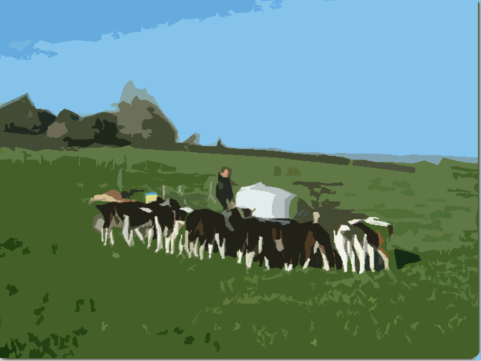
Questions

