Slide 1

SDDP.jl A Julia library for Stochastic Dual Dynamic Programming Oscar Dowson*ª, Lea Kapelevich^{b} ª Department of Engineering Science, University of Auckland, New Zealand. ^{b} Operations Research Center, Massachusetts Institute of Technology, Cambridge, MA. *odow003@aucklanduni.ac.nz

Slide 2
Two Problems
1. Hydro-thermal scheduling problem
2. Cow management problem

Slide 3
Hydro-Thermal Scheduling

Slide 4
Reservoir
Hydro-
turbine

Slide 5
Reservoir
Hydro-
turbine

Slide 6
Rainfall
Reservoir
Hydro-
turbine

Slide 7
Rainfall
Reservoir
Hydro-
turbine
Demand

Slide 8
Rainfall
Coal
Reservoir
Hydro-
turbine
Steam-
turbine
Demand

Slide 9
POWDER
The milk Production Optimizer incorporating Weather Dynamics and Economic Risk

Slide 10
POWDER
The milk Production Optimizer incorporating Weather Dynamics and Economic Risk
a.k.a. the shameless plug for Thursday morning.

Slide 11
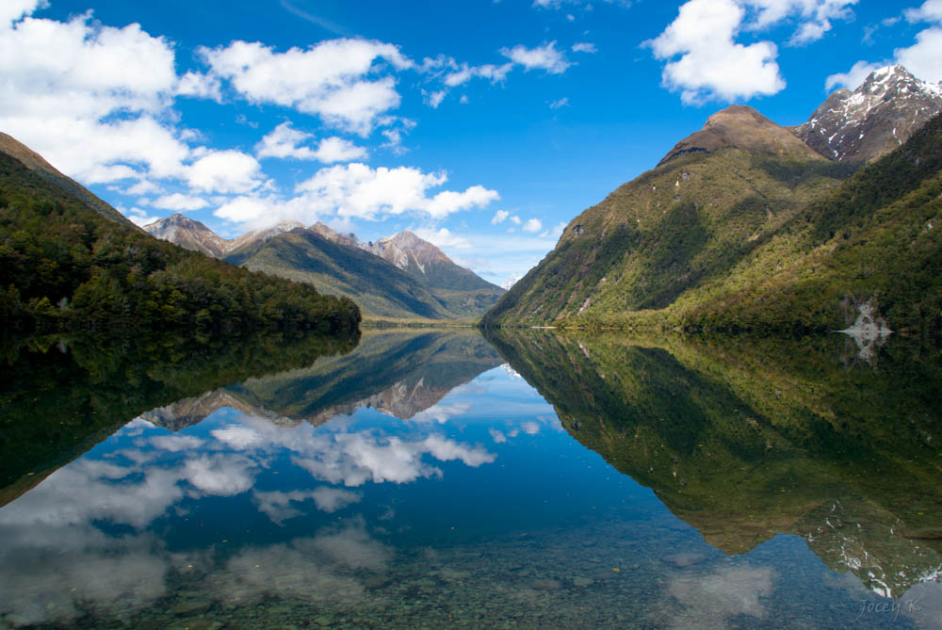
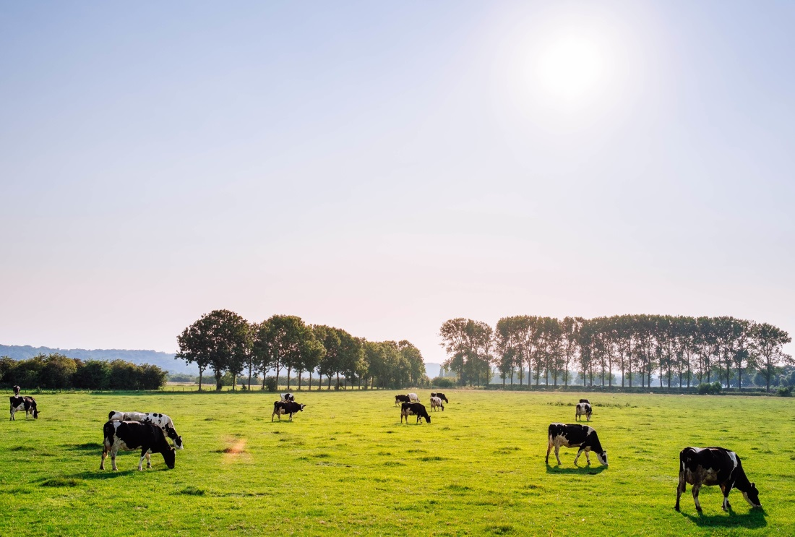
Paddocks are lakes of Grass and Cows are lakes of Energy

Slide 12
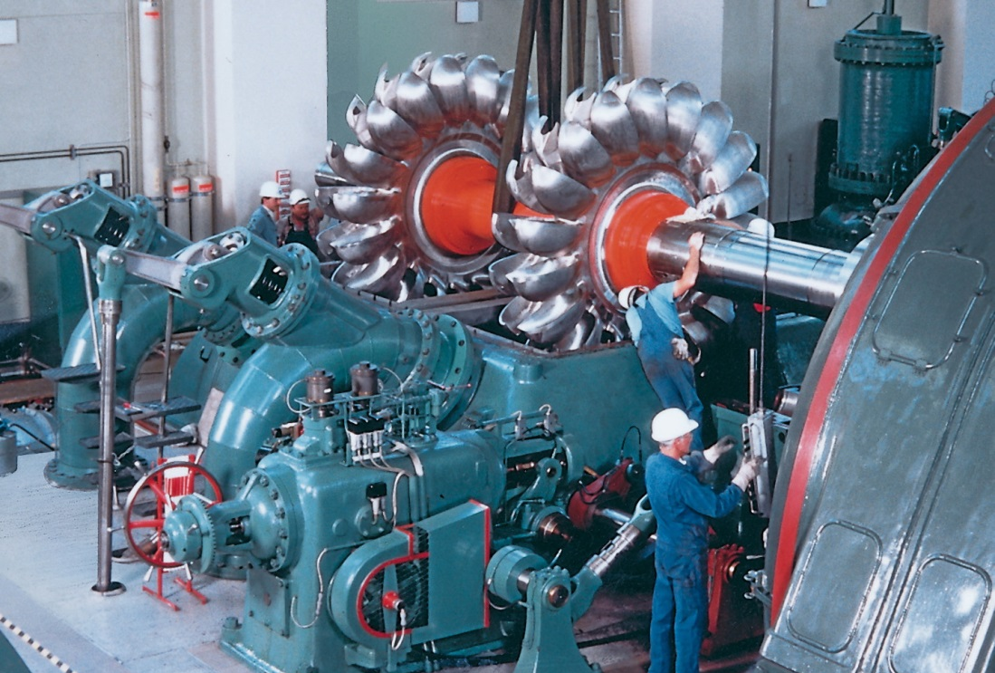
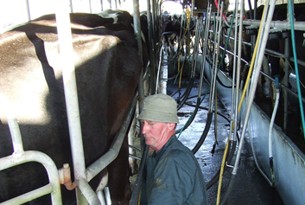
Paddocks are lakes of Grass and Cows are lakes of Energy
Turbine grass into the cow and Turbine the cow to produce milk

Slide 13

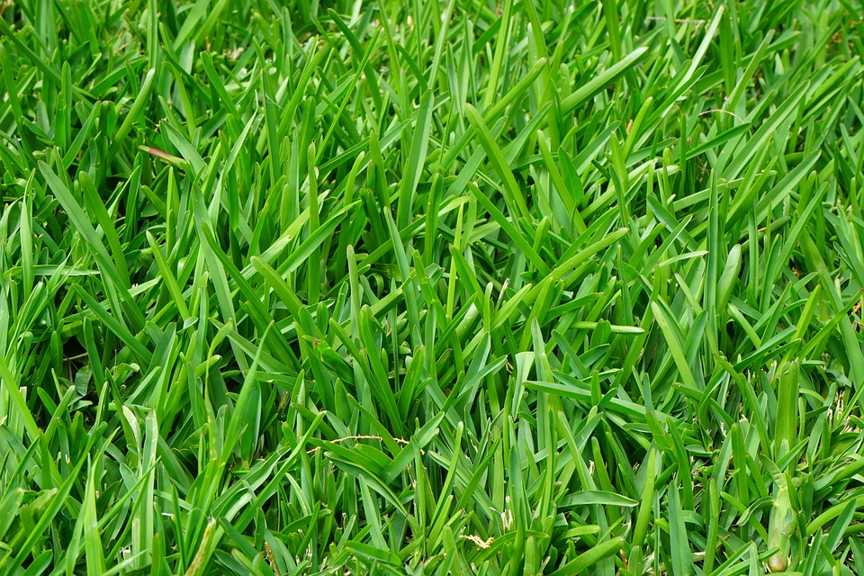
Random grass growth instead of rainfall

Slide 14
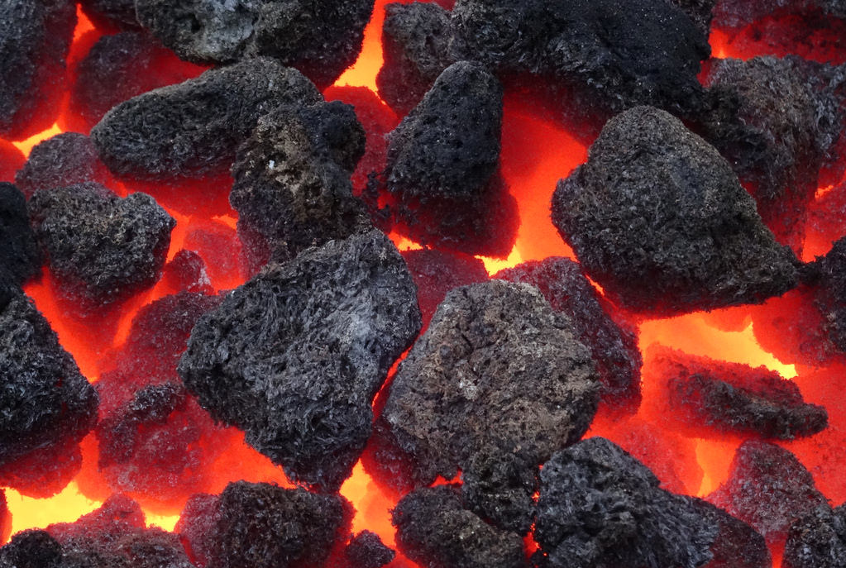
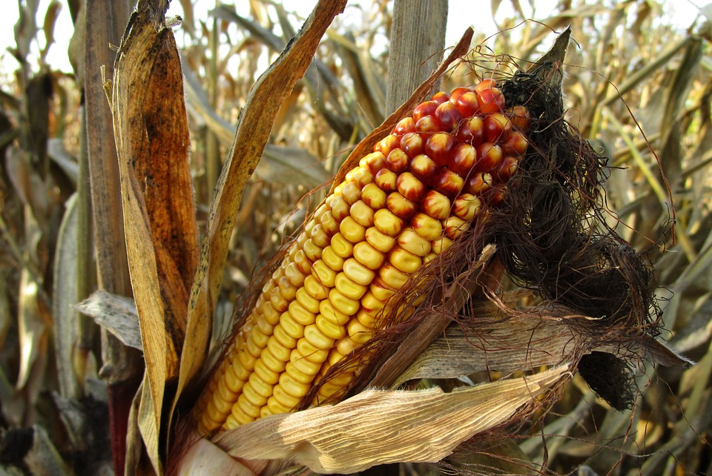
Random grass growth instead of rainfall
maize or palm kernel instead of coal

Slide 15
stochastic Dual Dynamic Programming
A complicated solution technique. The details need not concern us

Slide 16
AMPL
Hydro-thermal
Scheduling
C++
POWDER
Julia

Slide 17
ThAt seems inefficient
Why not make a generic solver?

Slide 18
That’s exactly what people have done over the few years…
FAST (Finally an SDDP Toolbox) https://github.com/leopoldcambier/FAST
SDDP.jl https://github.com/odow/SDDP.jl
StochDynamicProgram.jl https://github.com/JuliaOpt/StochDynamicProgram.jl
StructDualDynProg.jl https://github.com/blegat/StructDualDynProg.jl
PSR (Commercial)

Slide 19
That’s exactly what people have done over the few years…
FAST (Finally an SDDP Toolbox) https://github.com/leopoldcambier/FAST
SDDP.jl https://github.com/odow/SDDP.jl
StochDynamicProgram.jl https://github.com/JuliaOpt/StochDynamicProgram.jl
StructDualDynProg.jl https://github.com/blegat/StructDualDynProg.jl
PSR (Commercial)

Slide 20
AMPL
Hydro-thermal
Scheduling
C++
POWDER
Julia

Slide 21
Hydro-thermal Scheduling
Julia
SDDP.jl
POWDER
JuMP.jl
…

Slide 22
But is it any good?
Benchmarking the NZ Hydro-Thermal Scheduling Problem

Slide 23
Correctness I
 | C++ | SDDP.jl
2005 | $493,125,281 | $493,125,281
2006 | $423,420,729 | $423,420,729
2007 | $575,859,349 | $575,859,349
2008 | $446,507,222 | $446,507,222
2009 | $340,096,459 | $340,096,459

Slide 24
Correctness II
C++
SDDP.jl

Slide 25
Performance
C++
SDDP.jl

Slide 26
Performance
C++
SDDP.jl
+29%

Slide 27
Performance
C++
SDDP.jl
+29%
-16%

Slide 28
Performance
C++
SDDP.jl
+3%

Slide 29
Performance
C++
SDDP.jl

Slide 30
Performance
C++
SDDP.jl

Slide 31
Performance
C++
SDDP.jl
+29%

Slide 32
Performance
C++
SDDP.jl
+29%
+22%

Slide 33
Conclusions
SDDP.jl is
- generic
- open-source
- easy to use
- competitive with hard-coded C++ implementations
- correct

