Slide 1
Fun with Gurobi v6.5.2

Slide 2
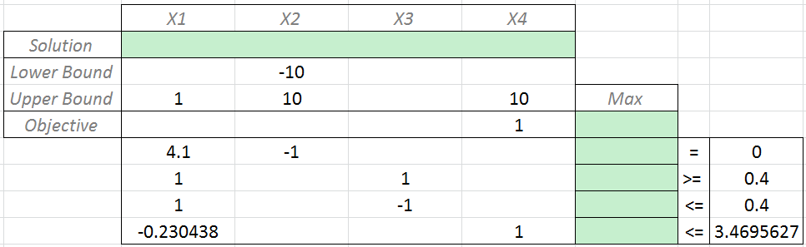
A Simple LP in Excel Solver

Slide 3
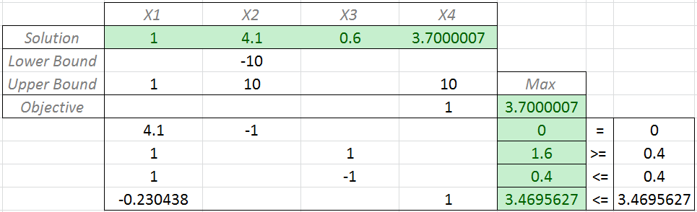
Excel: Solve (1)

Slide 4
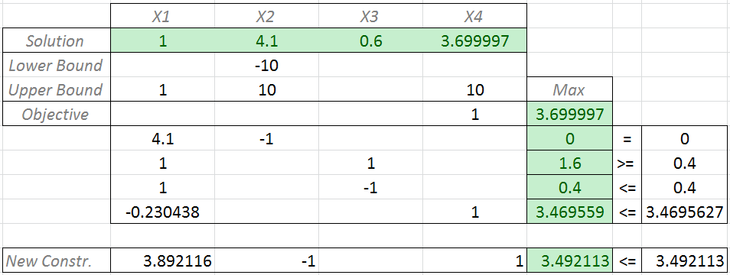
Excel: Solve (2)

Slide 5
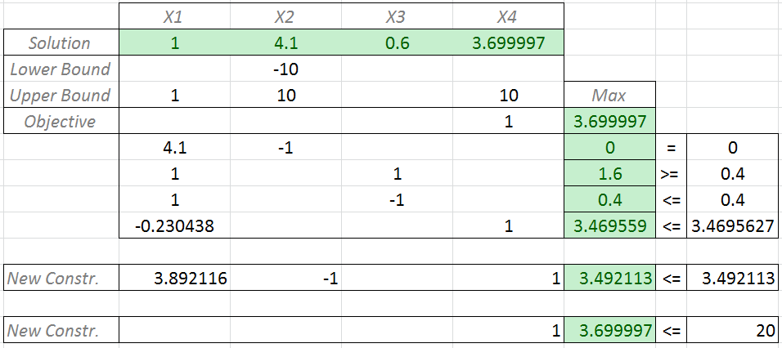
Excel: Solve (3)

Slide 6
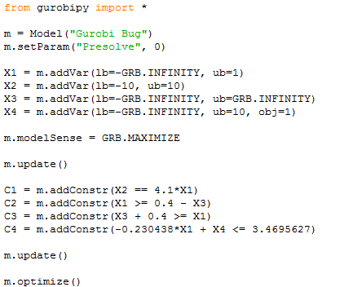
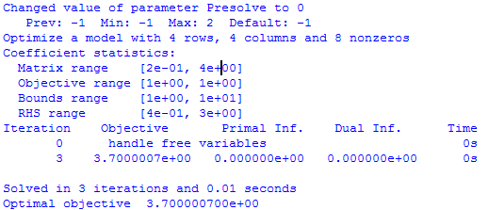
GurobiPy: Solve (1)

Slide 7
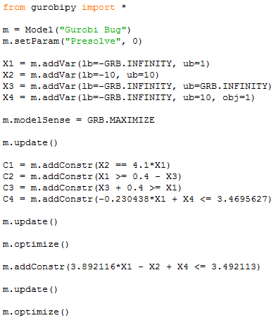
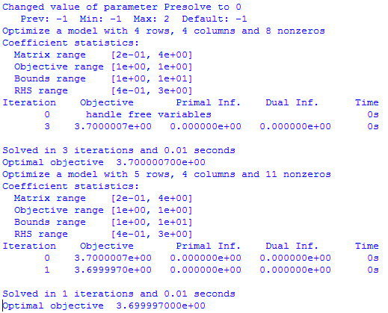
GurobiPy: Solve (2)

Slide 8
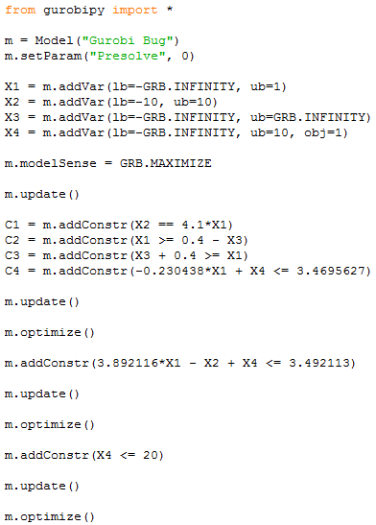
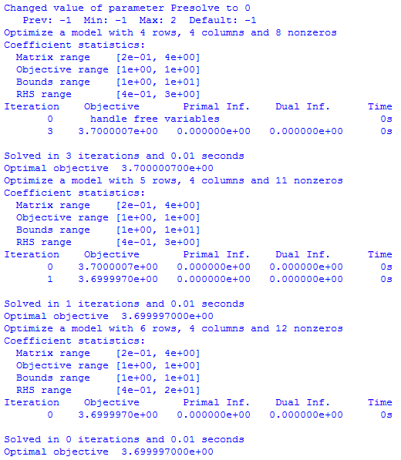

GurobiPy: Solve (3)

Slide 9
Now lets do something redundant
Obj = m.getAttr(“Obj”, m.getVars())
m.setAttr(“Obj”, m.getVars(), obj)

Slide 10
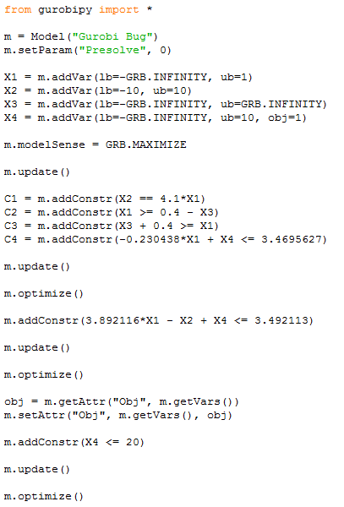
Audience Participation Time
a) Unbounded
b) Infeasible
c) 3.699997
optimal solution
d) 3.7000007
first solution
e) 20
RHS of the last constraint

Slide 11
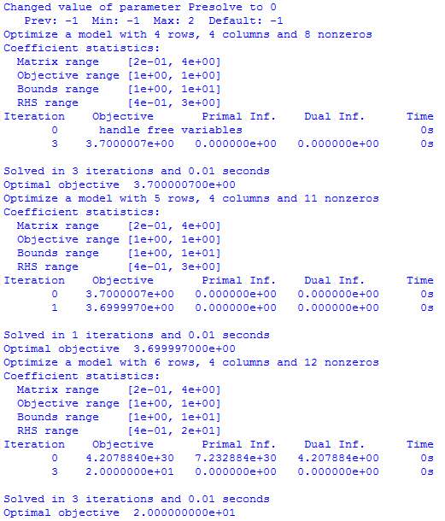

The answer is e) 20!

Slide 13
So what’s going on?
User Land
Gurobi Land
Mathematical
Formulation
Gurobi Model
Internal Gurobi Model
GurobiPy
Reformulation
obj
m.getAttr("Obj", m.getVars())
m.setAttr("Obj", m.getVars(), obj)

Slide 14
So what’s going on?
max X4
s.t.
4.1X1 - X2 == 0
X1 + X3 >= 0.4
X1 - X3 <= 0.4
-0.230438X1 + X4 <= 3.4695627
X1 ϵ (-∞, 1] X2 ϵ [-10, 10]
X3 ϵ (-∞, ∞) X4 ϵ (-∞, 10]
max + X4
s.t.
4.1X1 - X2 == 0
X1 + X3 >= 0.4
X1 - X3 <= 0.4
-0.230438X1 - X4 <= 3.4695627
3.892116X1 - X2 - X4 <= 3.492113
X1 ϵ (-∞, 1] X2 ϵ [-10, 10]
X3 ϵ (-∞, ∞) X4 ϵ [-10, ∞)
max X4
s.t.
4.1X1 - X2 == 0
X1 + X3 >= 0.4
X1 - X3 <= 0.4
-0.230438X1 + X4 <= 3.4695627
3.892116X1 - X2 + X4 <= 3.492113
X1 ϵ (-∞, 1] X2 ϵ [-10, 10]
X3 ϵ (-∞, ∞) X4 ϵ (-∞, 10]
max + X4
s.t.
4.1X1 - X2 == 0
X1 + X3 >= 0.4
X1 - X3 <= 0.4
-0.230438X1 - X4 <= 3.4695627
3.892116X1 - X2 - X4 <= 3.492113
X4 <= 20
X1 ϵ (-∞, 1] X2 ϵ [-10, 10]
X3 ϵ (-∞, ∞) X4 ϵ [-10, ∞)
max - X4
s.t.
4.1X1 - X2 == 0
X1 + X3 >= 0.4
X1 - X3 <= 0.4
-0.230438X1 - X4 <= 3.4695627
3.892116X1 - X2 - X4 <= 3.492113
X1 ϵ (-∞, 1] X2 ϵ [-10, 10]
X3 ϵ (-∞, ∞) X4 ϵ [-10, ∞)

Slide 15
What we know from Gurobi
You need
A variable with a finite upper bound and an infinite lower bound
Value to go variable in SDDP…
A model that Gurobi chooses not to rescale
Hard to control…
To set some coefficients in memory and resolve
Which is what SDDP does…

