Slide 1
ARGOS: Ontology Design Patterns for Governing Dynamic Data Operations in LLM-Powered Applications
Nipun D. Pathirage, Oshani Seneviratne,
and Deborah L. McGuinness
{pathin, senevo, dlm} @rpi.edu
ISWC - WOP 25
Notes:
Introduce yourself: Name, year, program, advisor

Slide 2
The LLM Revolution in the Enterprise
Background
Large Language Models (LLMs) are moving beyond simple chatbots.
They are becoming autonomous "agents" that are being connected to critical enterprise systems.
This includes direct access to internal databases, APIs, and proprietary knowledge sources.
Automate complex tasks and unlock insights from private data.

Slide 3
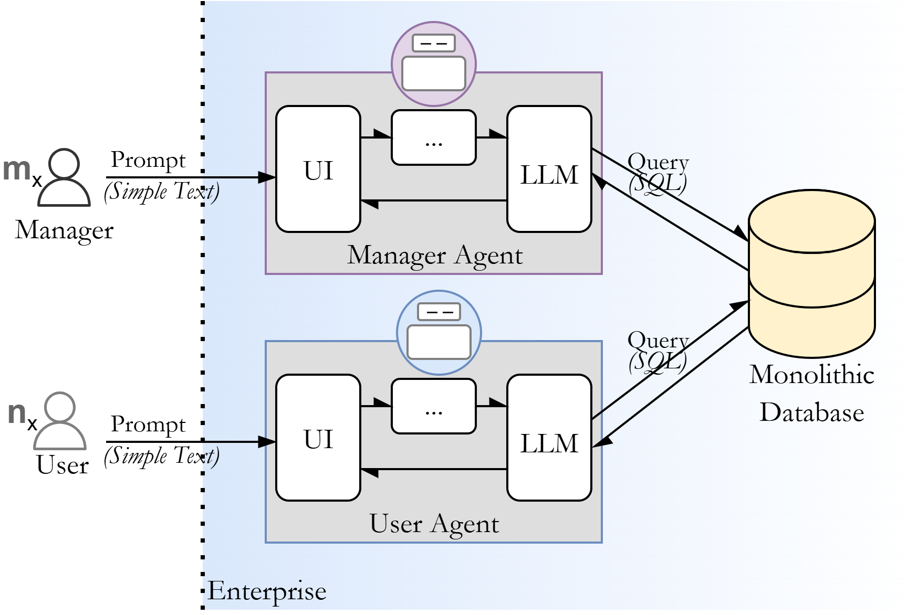
The RAG - Database Interaction
Background
Retrieval-Augmented Generation (RAG) systems give LLMs direct access to enterprise databases.
The LLM generates complex, context-specific queries "on demand" to answer user prompts

Slide 4
The Access Control "Paradigm Clash"
Background
The Old World (Human Users)
  Actor: A human (e.g., 'Alice', a Sales Manager).
  Actions: A predefined, finite list (e.g., View_Report, Edit_Customer_Record).
  Policy Model: Role-Based Access Control (RBAC). "Sales Managers can View_Report."
The New World (AI Agents)
  Actor: An AI Agent (e.g., `Sales_Bot`).
  Actions: Dynamically generated and effectively unbounded (e.g., "Summarize sales for customers in NY" -> `SELECT…`).
  Policy Model: ???

Slide 5
Emerged Challenge …
Potential Solution …
Background
How do we write policies that covers a large control space of queries, generated by LLM?
This is fundamentally a semantic problem, not a syntactic one. We need to understand the meaning and context of a dynamic action.

Slide 6
Why an Ontology Design Pattern (ODP)?
Background
Why an Ontology?
  Provides a formal, machine-interpretable model.
  Allows us to represent the semantics of the data Schema, the Policy, and the Query in one unified framework.
  Enables a reasoner to infer the query's intent and detect violations against the policy.
Why a Pattern (ODP)?
  An ODP provides an adaptable blueprint for governing dynamic queries.
  It's not just for SQL. The abstract pattern can be applied to GraphQL, SPARQL, and other query languages.

Slide 7
Methodology
ARGOS: Action Realignment using Graph-based Ontological Semantics.

Slide 8
What is it?
Methodology
An ODP that semantically unifies the "three worlds" of data governance:
The Schema Component:
What data exists? (e.g., Table, Column) .
The Policy Component:
Who can do what? (e.g., Agent, Action) .
The Query Structure Component:
What is being asked right now? (e.g., SelectStatement, ColumnRef) .

Slide 9
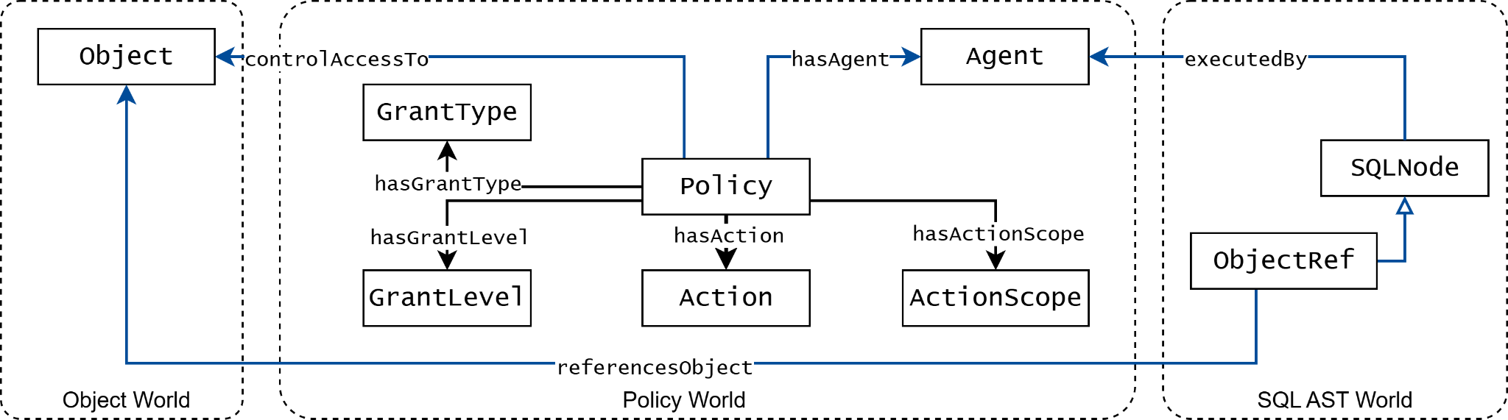
The ARGOS “Triangle of Validation”
Methodology
How to access control for a query, given the database and the query agent:
Map tables and columns operated by the given query
Map query executed agents to related policies
Map filtered policies with once that related to table and column operations done in the query

Slide 10
One Step Forward
Methodology
Existing access control system controls access based on :
Object level (eg: table, column, and row)
Action level (eg: read, update, delete)
However, within a single action there could be multiple data operations included.
Example: `SELECT name, SUM(salary) FROM employees WHERE dept_id > 10;`
Data Operations:
  View `name` and `total salary` for each `employee`
  Who is filtered by `dept_id > 10`
To represent this we introduce ‘Action Scopes’ for access controls

Slide 11
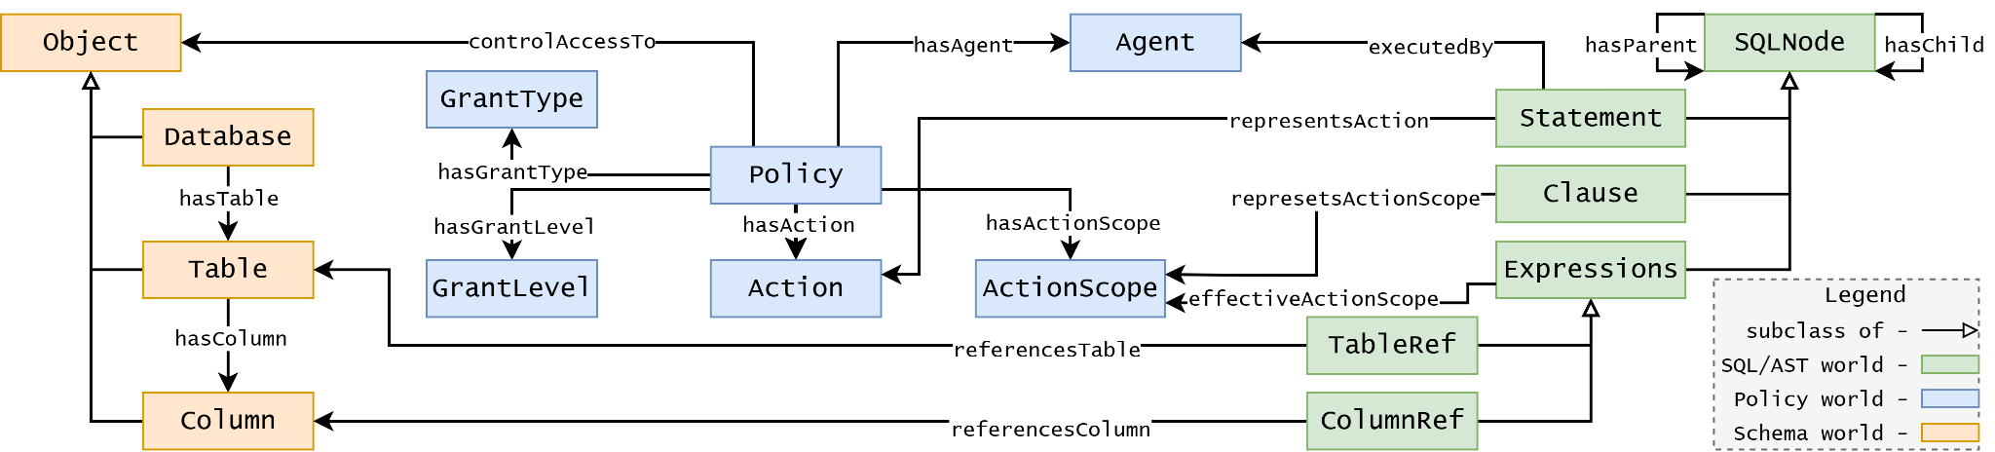
User Case: Securing SQL Databases
User Case
Goal is to enforce access control on dynamic SQL queries from AI agents.

Slide 12
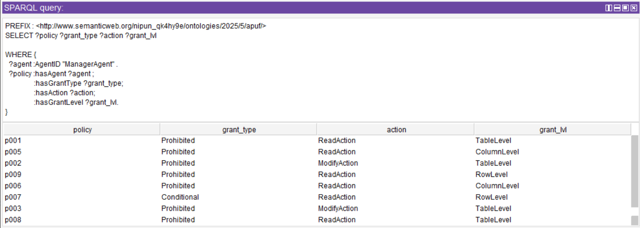
Evaluation: Competency Questions
User Case
Successfully answered all 25 Competency Questions (CQs).
  Inter-world entity based CQs & intra-world entity based CQs

Slide 13
Evaluation: Applicability
User Case
The proposed ARGOS framework successfully applied to a Financial RDB / SQL use case.
And tested again 100 different query patterns could occur, with expected policy activation labels.
Result showing deterministic and complete expected policy activations in all query patterns.

Slide 14
What Makes ARGOS Different? (Contribution)
Conclusion
Explicitly designed for non-human agents with a dynamic, unbounded action space.
Provides a formal mechanism to semantically decompose complex, structured operations (like a query).
Allows policies to bind to the sub-parts of a single action (ActionScope), providing a necessary layer of control that was missing.

Slide 15
Conclusion and Future Work
Conclusion
Conclusion
LLM agents fundamentally break traditional access control models.
ARGOS provides a formal, semantic ODP to govern this new, dynamic action space.
It unifies schema, policy, and query semantics, enabling provable, fine-grained, and explainable enforcement.
Future Work
Map ARGOS to standard Generative AI ontologies (e.g., GENAIO) for wider interoperability.
Design a way for fully automated access control systems, where complex policies could be defined and enforced through simple natural language.
Questions? {pathin, senevo, dlm} @rpi.edu

