Slide 1
Phased Evaluation of Ontologies with Domain and Ontology Experts
Alex Randles and Declan O’Sullivan
ADAPT Centre, Trinity College Dublin, Ireland

Slide 2

Overview
Design methodology to guide ontology development
Phased evaluation with different cohorts of experts
Applied evaluation to proposed ontologies
Refinement of ontologies using evaluation findings

Slide 3
Design Methodology
Steps to produce ontology

Slide 4

Ontology Design Methodology
Identification of Aims, Objectives, Scope: Define the purpose, goals, and boundaries of the ontology to ensure it meets project needs.
Identify and Analyze Relevant Information: Gather and assess domain-specific literature to inform accurate and meaningful ontology design.

Slide 5
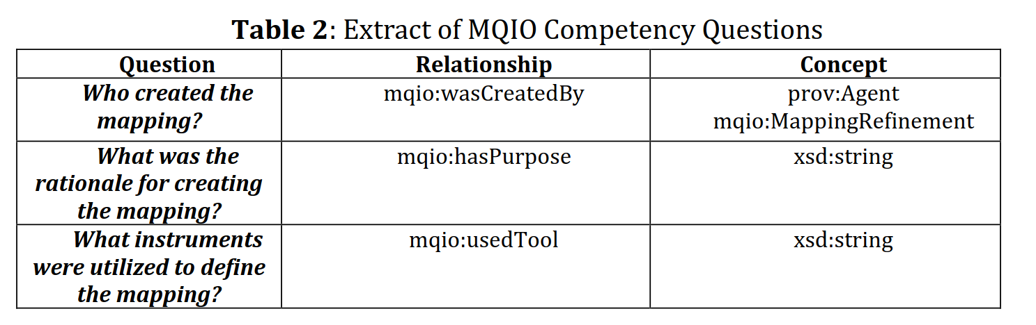
Ontology Design Methodology
Create Use-Cases: Develop practical scenarios illustrating how the ontology will be used to ensure it addresses real-world applications.
Formulate Competency Questions: Define key questions the ontology must answer, guiding its structure and content to meet informational needs.

Slide 6

Ontology Design Methodology
Identify Concepts and Relationships: Determine the key entities and their interconnections to structure the ontology accurately.
Progressive Iterations: Previous steps were repeated until the proposed concepts and relationships met all competency question requirements.

Slide 7

Ontology Design Methodology
Create Ontology: Implement in OWL and RDFS using ontology development tools facilitate creation
Protégé is an open-source ontology editor and knowledge management system used to create, visualize, and manage complex structured data.
Protégé's semantic reasoner plugins, like HermiT, Pellet, and Fact++, support inference, consistency checks, and ontology classification to validate axioms.

Slide 8

Ontology Design Methodology
Evaluation: Assessed ontology for competency question alignment; used Protégé's reasoner and OOPS! Scanner for inconsistencies and design issues, with peer feedback refining documentation.
Publication: Created WIDOCO documentation, added open license, and published online with a persistent W3id identifier.

Slide 9
Proposed Ontologies
Developed two ontologies and applied methods

Slide 10
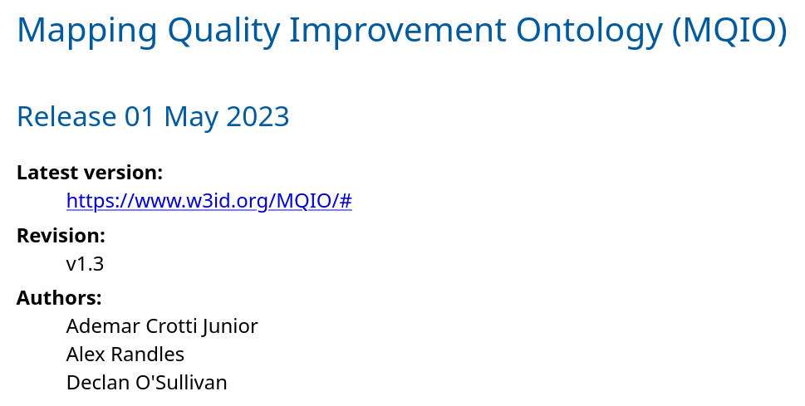
MQIO
The Mapping Quality Improvement Ontology (MQIO) was designed to represent information related to the quality assessment, refinement and validation of uplift mapping used to create RDF datasets
Extends Data Quality Vocabulary (DQV) and PROV Ontology (PROV-O) to represent agents and activities associated with quality improvement of mappings

Slide 11
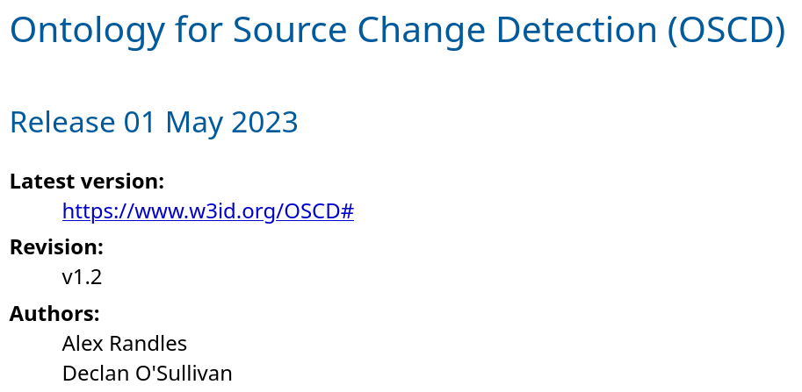
OSCD
The Ontology for Source Change Detection (OSCD) represent changes in source data of mappings
Changes in source data post-execution can affect mapping alignment and data freshness

Slide 12
Evaluation Methods
Validation of ontologies

Slide 13
Summary of Evaluation Methods
Combination of expert feedback and software validation
User Experiment (Domain Expert) | External use-case
User Experiment (Ontology Expert) | Comparison with State of the art
Fulfilment of Competency Questions | Analysis of citations
Semantic Reasoners | Dissemination of work
OOPS! Common Pitfall Detection | Peer reviewed publications
Documentation | Reproducibility
Demonstrate application to use-case

Slide 14
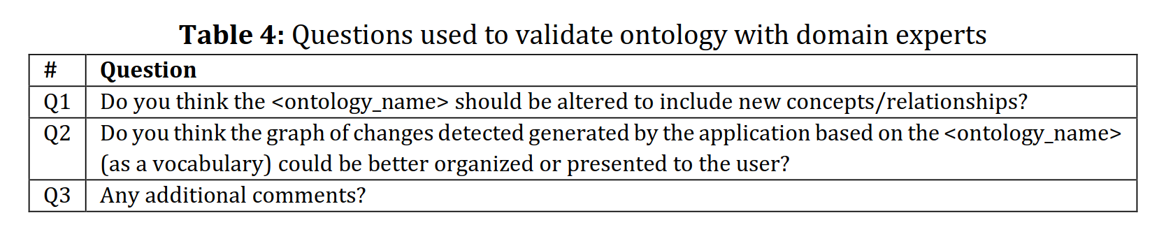
Domain Expert Evaluation
10 subject matter experts in the creation, maintenance and publication of RDF datasets
Targeted questions focused on particular aspects to gather detailed feedback and open comments for additional insights

Slide 15
Domain Expert Evaluation
Summary of Results
Adding New Properties: Introduce additional attributes to refine and expand ontology detail.
Reuse of Ontologies: Incorporate existing ontologies to enhance compatibility and reduce redundancy.
Future Work: Identify areas for ongoing improvements and potential expansions of the ontology.
Affirmation of Design: Validate the ontology structure and functionality, confirming it meets design goals and requirements.

Slide 16
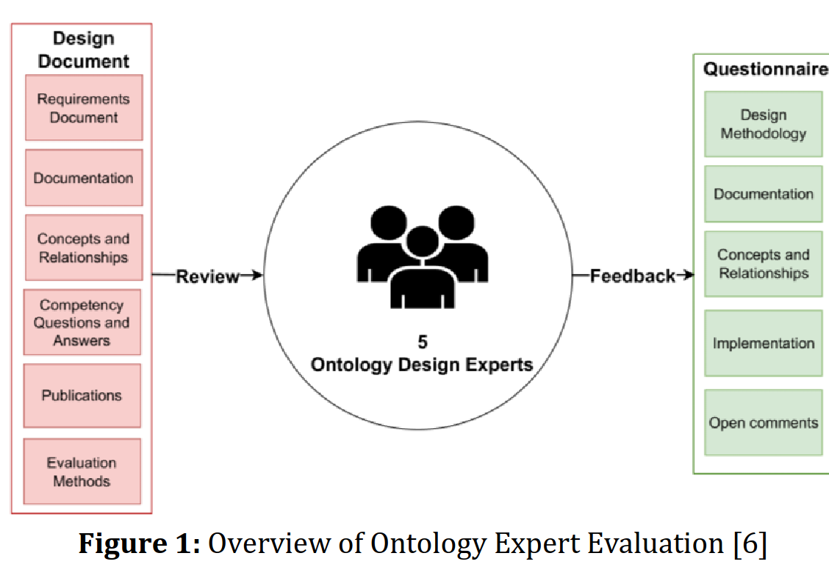
Ontological Design Expert Evaluation
5 experts provided with documentation and asked to complete questionnaire

Slide 17
Ontological Design Expert Evaluation
Requirements Document: Outlines the project goals, scope, and essential specifications for ontology development
Competency questions: Knowledge to fulfill each question
Implementation: Ontology in various formats and sample graphs
Publications: Papers describing the ontologies
Evaluation methods: Results of previous evaluations

Slide 18
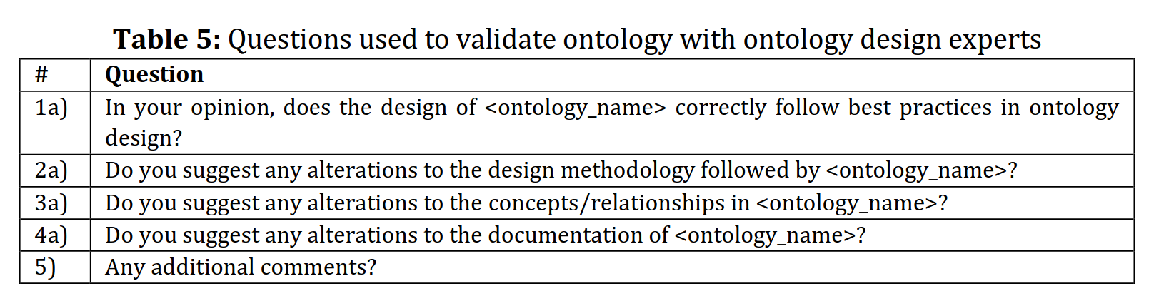
Ontological Design Expert Evaluation
4 specified questions and open comment questions

Slide 19
Evaluation Results
Feedback from experts

Slide 20
Ontological Design Expert Evaluation
Summary of Results
State of the Art: All experts (5/5) stated that both ontologies followed best practices in ontology design practices as recommended in the state of the art.
Design Methodology: 4 out of the 5 experts stated that design methodologies followed by both ontologies were sufficient.
Concepts & Relationships: 2 out of 5 experts did not provide recommendations for this aspect.
Overall: Only 1 expert included an additional recommendation to use different property.

Slide 21
Ontological Design Expert Evaluation
An iterative approach was adopted to assess and address each of the expert’s recommendations.
Modified concepts and relationships in Protégé using semantic reasoners to maintain consistency.
Assessed updated ontology with OOPS! Pitfall Scanner to identify design pitfalls.
Regenerated and updated online documentation using WIDOCO, then republished online.
Final ontologies reflect expert recommendations, indicating sufficient quality.

Slide 22
Conclusion
Iterative approach to ontology development
Software validation followed by expert validation
Applying approach to other ontologies
alex.randles@adaptcentre.ie

