Slide 1
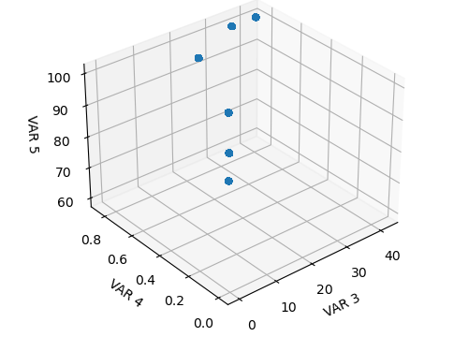
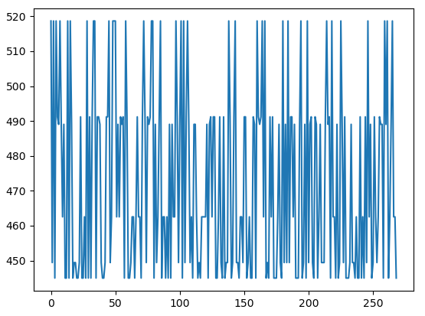

Slide 2
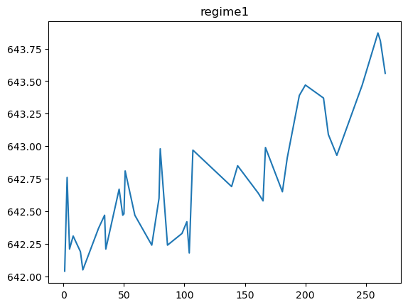
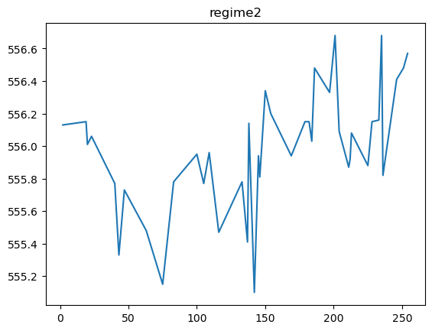
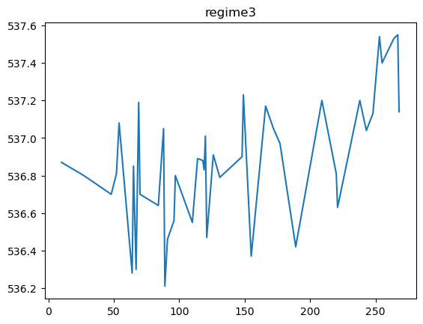
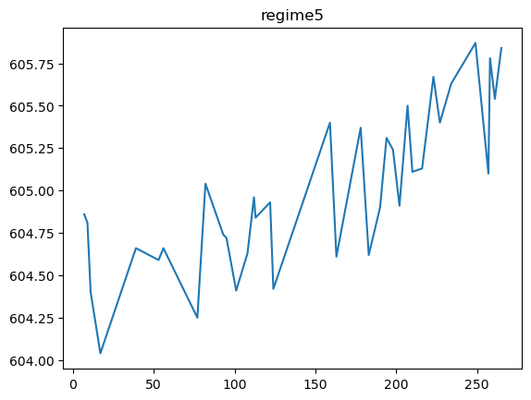
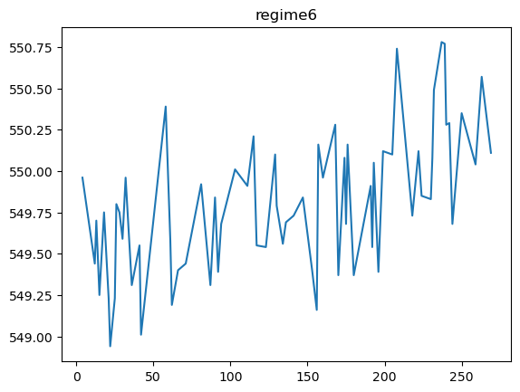
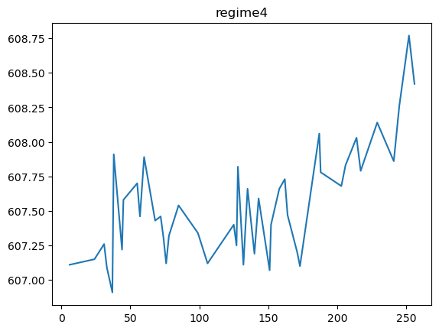

Slide 3
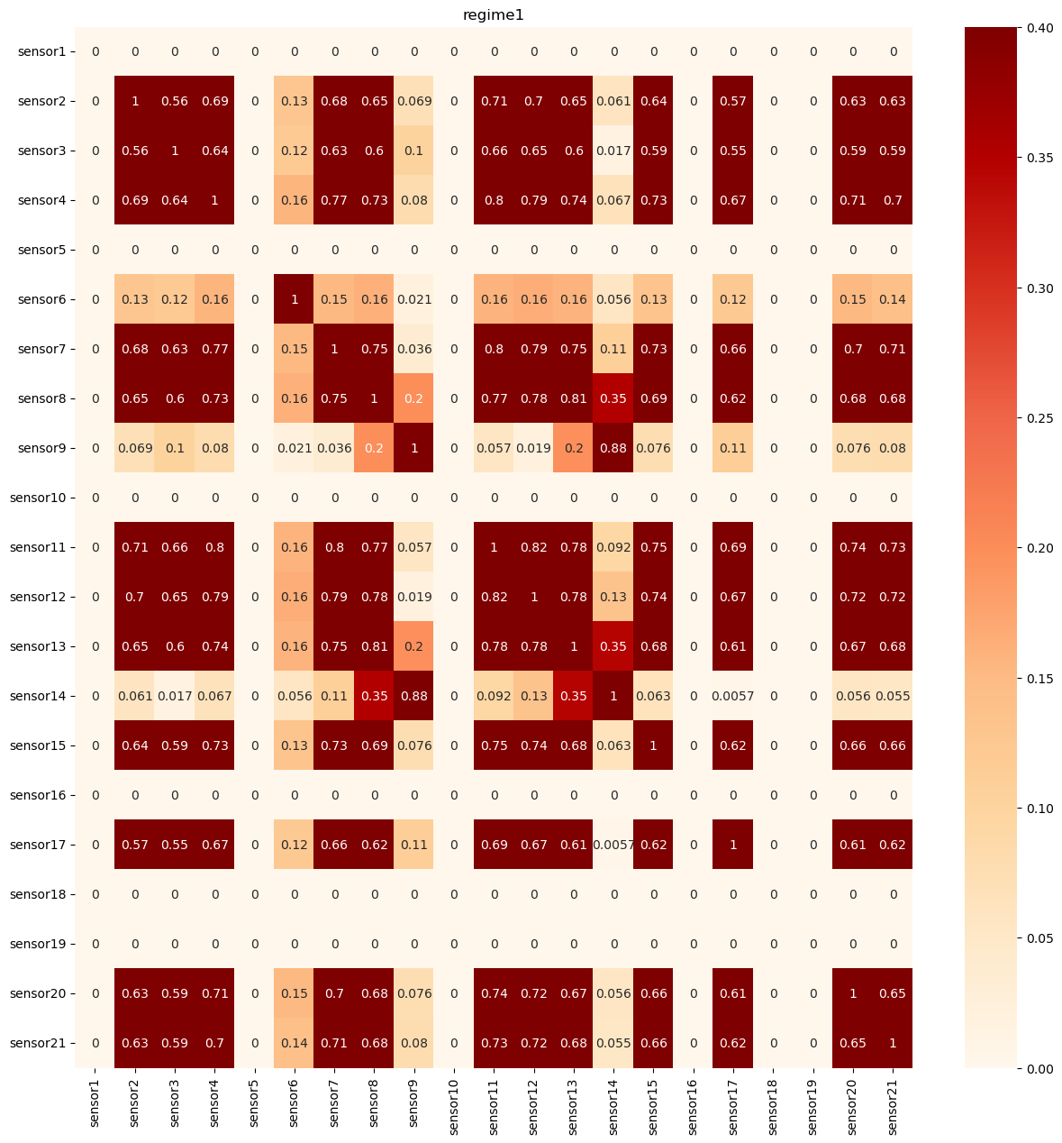
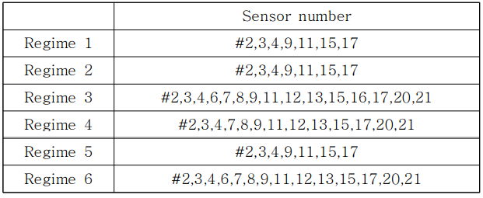
Regime1: 2,3,4,7,8,9,11,12,13,14,15,17,20,21(14개)
14번 추가됨

Slide 4
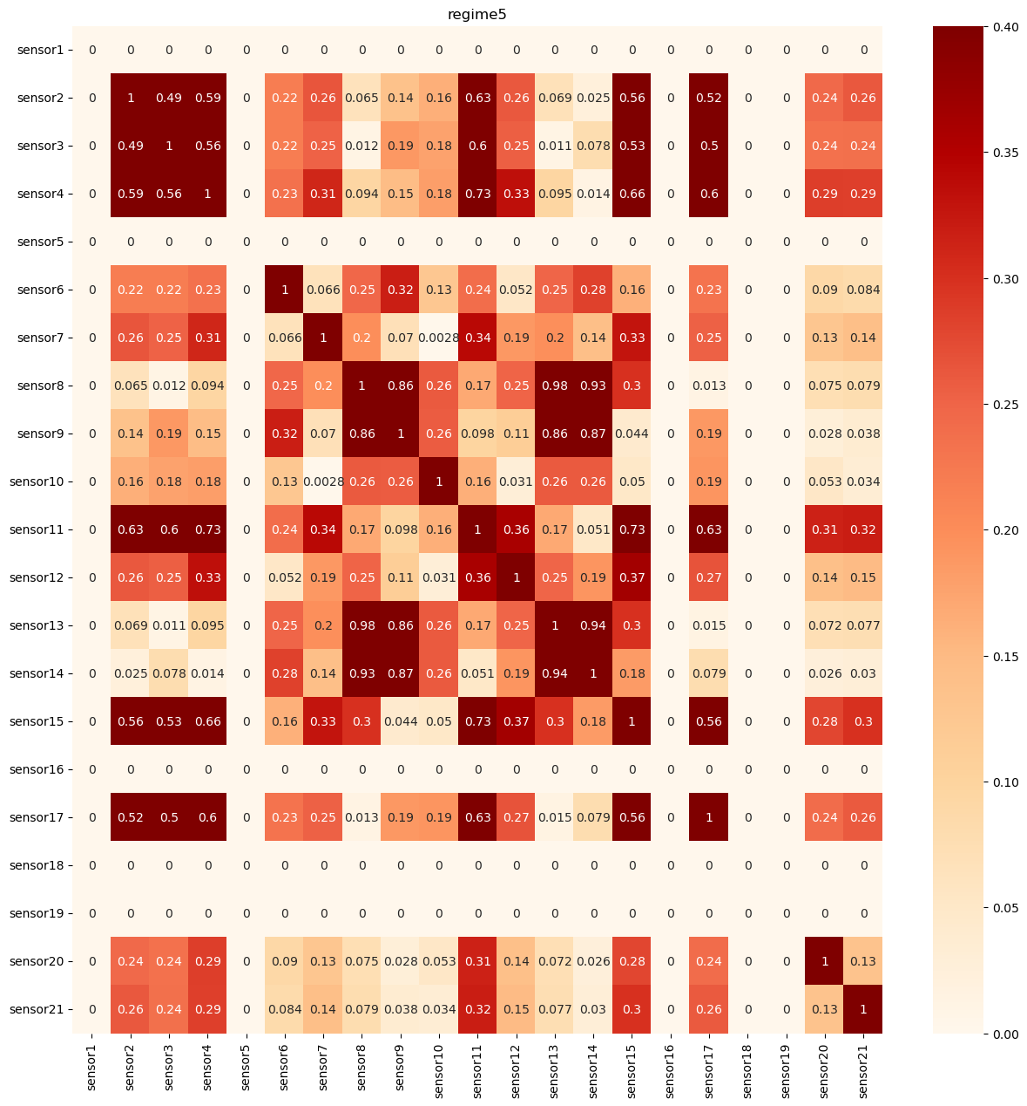
수정후
Regime1: 2,3,4,8,9,11,13,14,15,17
Regime1: 2,3,4,7,8,9,11,12,13,14,15,17,20,21(14개)
14번 추가됨

Slide 5
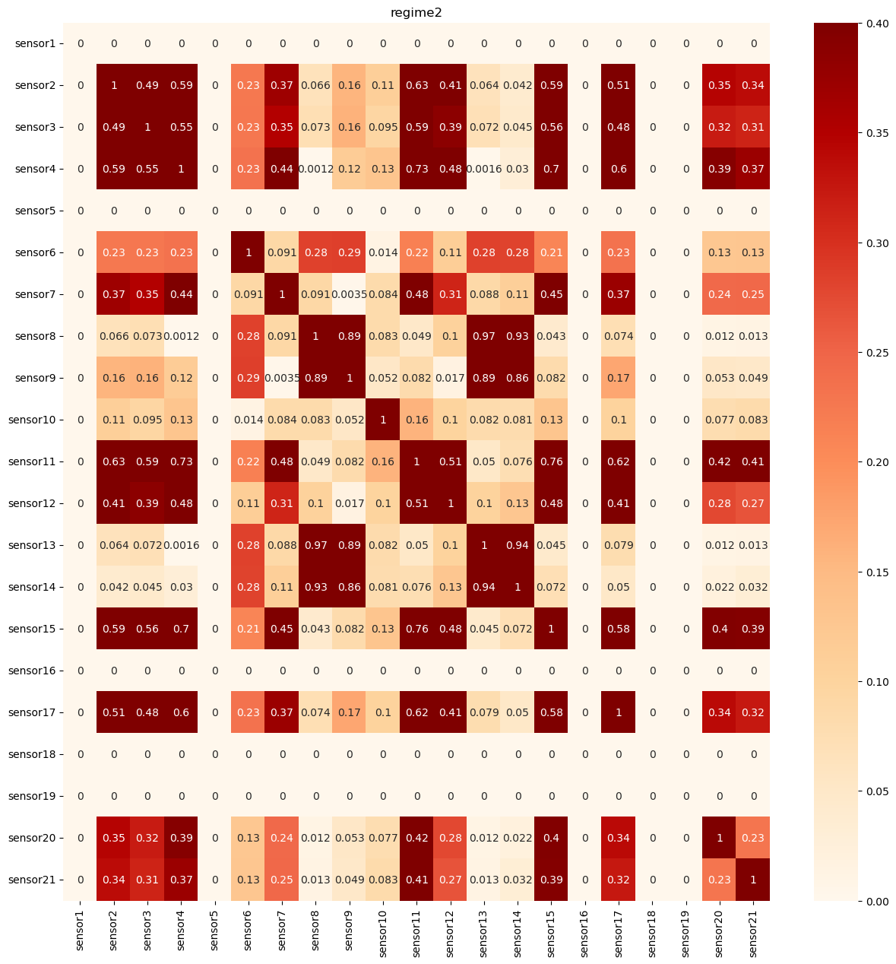
Regime2: 2,3,4,7,8,9,11,12,13,14,15,17,20,21(14개)
:14번은 있음

Slide 6
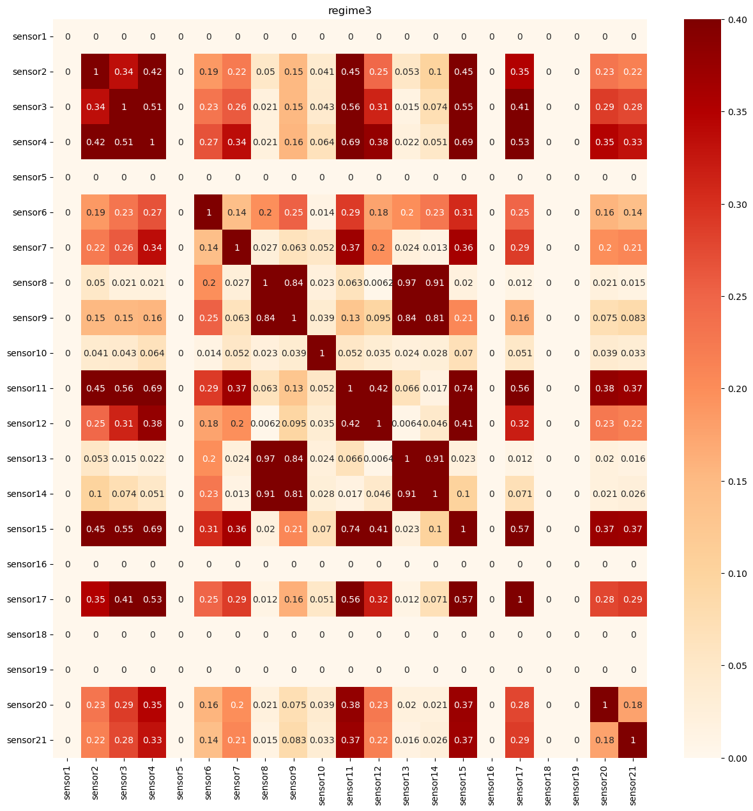
Regime3: 2,3,4,8,9,11,12,13,14,15,17 (11개)
위의 4개 더 있음

Slide 7
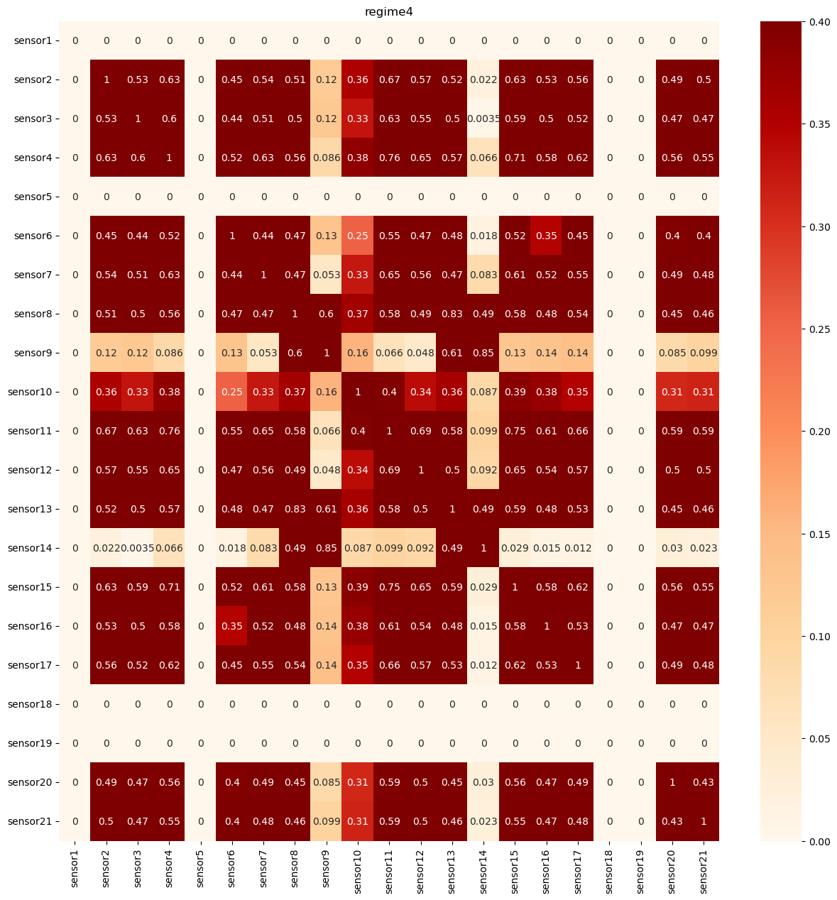
Regime4: 2,3,4,6,7,8,9,10,11,12,13,14,15,16,17,20,21(16개)
10번 추가됨

Slide 8
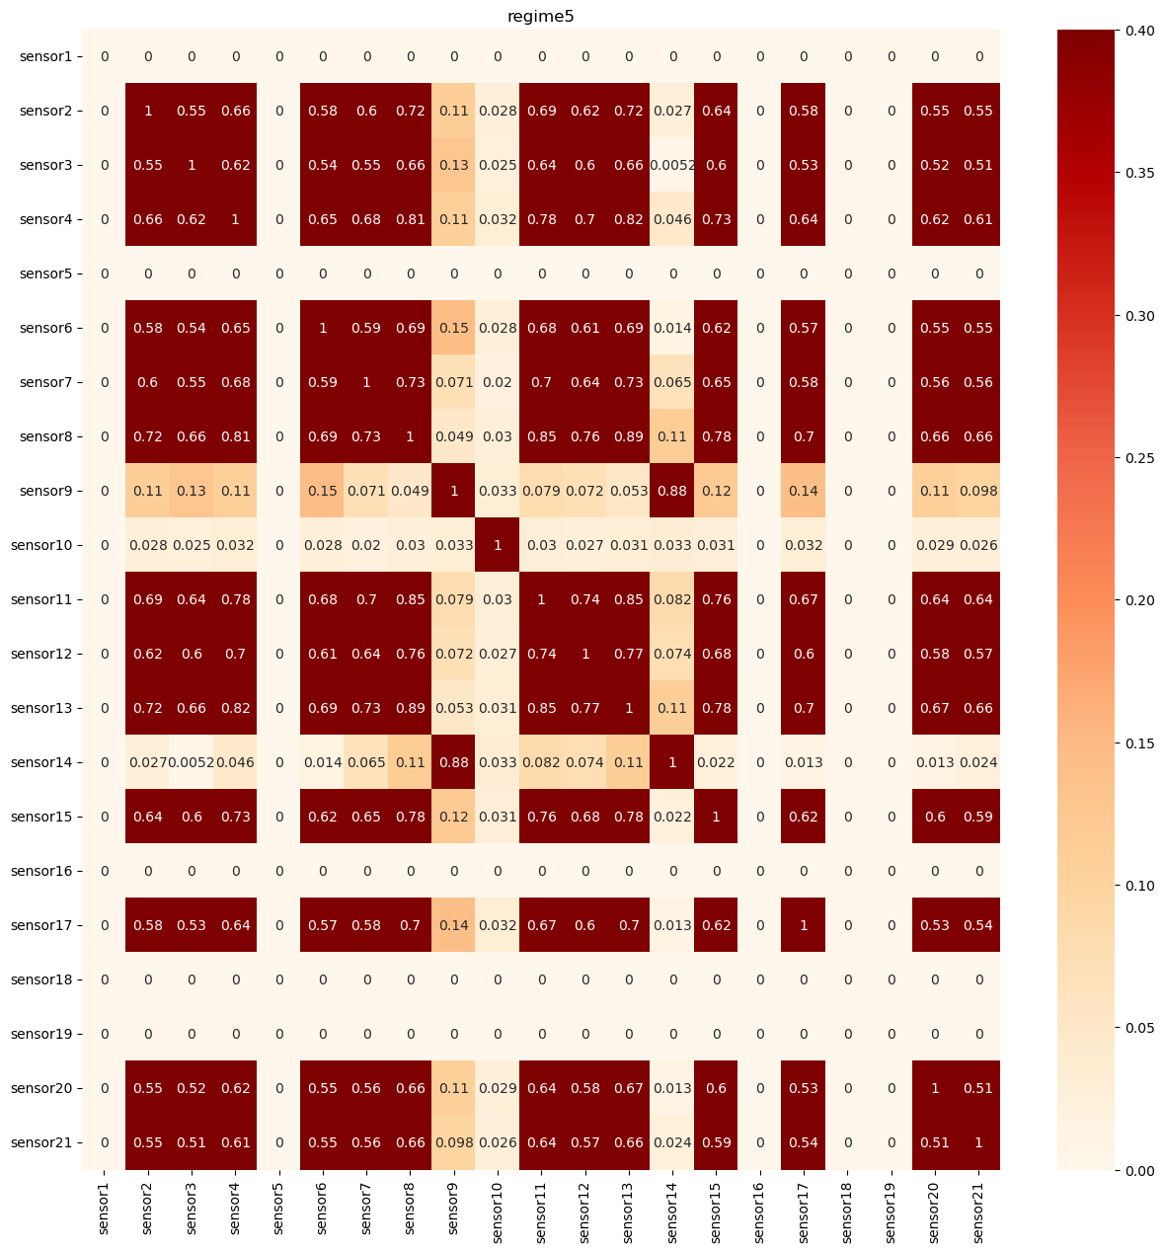
Regime5: 2,3,4,6,7,8,9,11,12,13,14,15,17,20,21(15개)
14번 추가됨

Slide 9

Regime6: 2,3,4,8,9,11,13,14,15,17(10개)
8,13,14번 추가됨

