Slide 1
ENGI 301 Froggy Racer Proposal
10/ 14 /2021
Oscar D. Soto

Slide 2
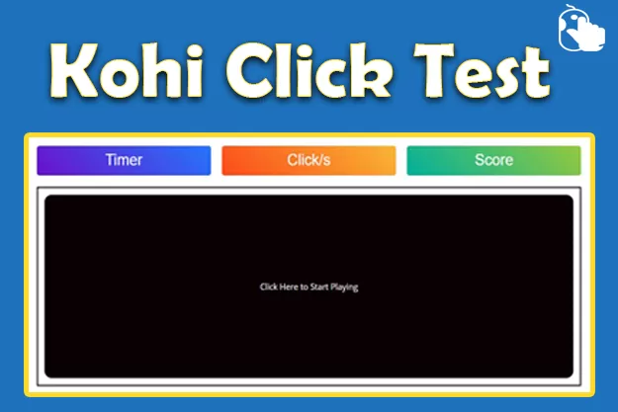


Background Information
Goal: Make a multiplayer clicker game where the objective is to get your frog across the water lily field as fast as possible
Builds off the “Whack-a-Mole” and “PocketBeagle Arcade Machine” projects
https://beagleboard.org/p/beaglefriends-octavosystems/whac-a-mole-game-with-pocketbeagle-738a4c
https://beagleboard.org/p/fdm3/pocketbeagle-arcade-machine-ee661e
Improves on existing projects by introducing:
Multiplayer functionality - play a friendly, competitive game where you race your frogs and test your ability to click fast

Slide 3
System Block Diagram
Rotary Potentiometer
AIN1 (1.8V)
Toggle Switch
PRUO.5
USB1.VIN
USB1.DN
uUSB connector
USB1.DP
USB Speaker
USB1.ID
Arcade Button 2
PRUO.4
PocketBeagle
GND
AINO (1.8V)
Arcade Button 1
LED2 - Red
PRUO.3
LED1 – Green
PRUO.2
GPIO57
Piezo Speaker
Adafruit 7-segment LED Backpack
LCD Screen
SPIO
I2C1.SCL hub
I2C1.SCL
I2C1.SDA hub
I2C1.SDA

Slide 4
Power Block Diagram
Rotary Potentiometer
3.3V
3.3 Volts
Toggle Switch
PocketBeagle
Arcade Button 1
uUSB Host Connector
5 V
1.8 V
1.8 Volts
Arcade Button 2
5 Volts
Adafruit 7-segment LED Backpacks
Vout
USB speaker

Slide 5
Components / Budget
Component | Need to Buy | Cost
2.2" 18-bit color TFT LCD display with microSD card breakout – HX8340BN PRODUCT ID: 797 https://www.adafruit.com/product/797 | 1 | $29.95
Mini External USB Stereo Speaker PRODUCT ID: 3369 https://www.adafruit.com/product/3369 | 1 | $12.50
Arcade Button with LED - 30mm Translucent Red PRODUCT ID: 3489 https://www.adafruit.com/product/3489 | 1 | $2.50
Arcade Button with LED - 30mm Translucent Blue PRODUCT ID: 3490 https://www.adafruit.com/product/3490 | 1 | $2.50

