Slide 1
ENGI 301 Pokey Clicker Game PCB Proposal
11/14/2021
Oscar D. Soto

Slide 2
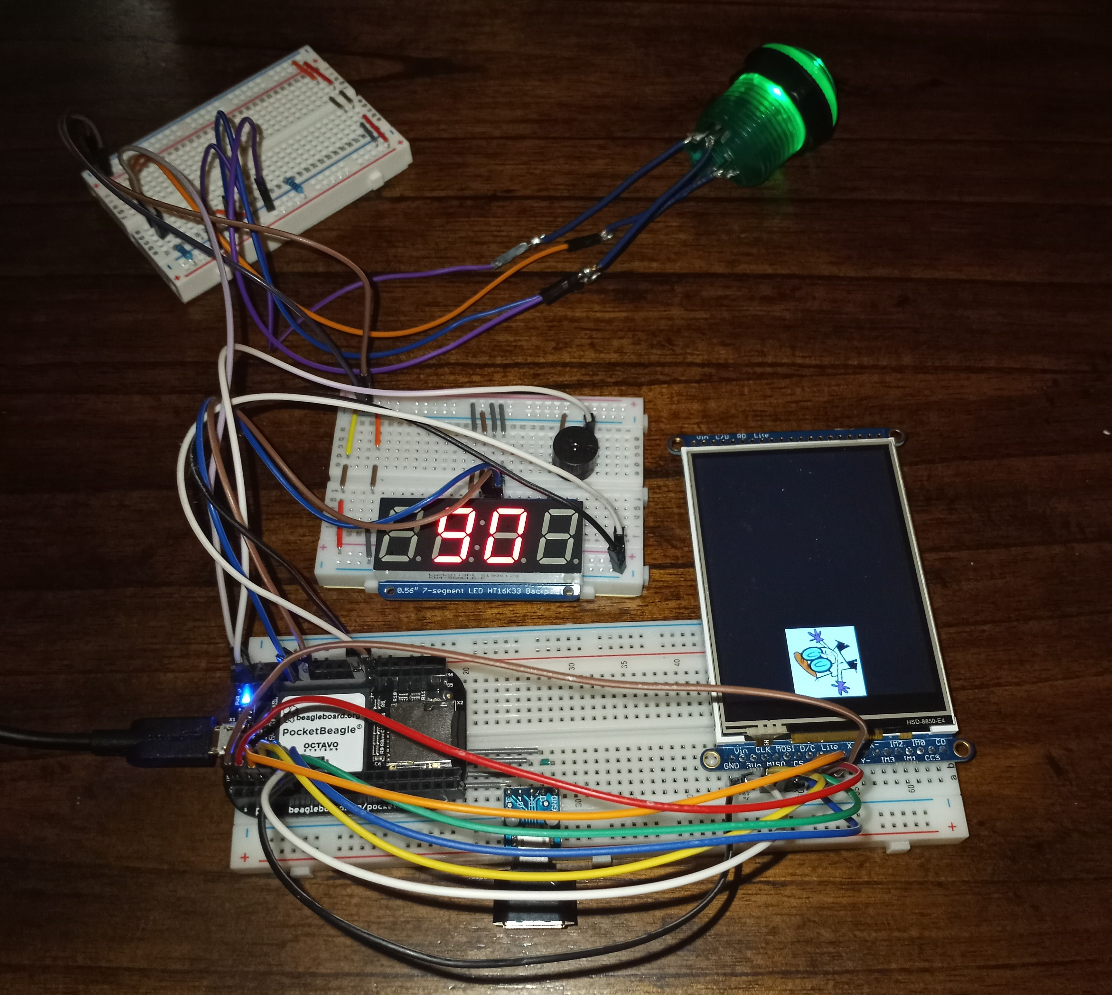
Background Information
What is being proposed?
Hackster page: https://www.hackster.io/oscar-soto/engi-301-pokey-clicker-game-1fbcc4
GitHub page: https://github.com/ods115/ENGI301
As of now, no other additions will be made to the Pokey Clicker Game prototype
Pokey Clicker Game Prototype

Slide 3
System Block Diagram
PocketBeagle
Arcade Button
GPIO57
I2C1.SCL
Adafruit 7-Segment Display w/I2C backpack
LED Green
I2C1.SDA
GPIO58
Adafruit 3.2" Color TFT Touchscreen Breakout v2
SPI0.CS
5V Piezo Buzzer
SPI0.CLK
PWM1A
SPI0.MISO
SPI0.MOSI

Slide 4














Mechanical Block Diagram
R1
R2
$$\frac{1}{3}"$$
2$"$
$$\frac{1}{4}"$$
Hex Display
PocketBeagle
1$\frac{1}{8}"$
1$\frac{1}{4}"$
USB
1$\frac{1}{8}"$
1$\frac{5}{6}"$
1$\frac{1}{2}"$
5V Piezo Buzzer
SPI Screen
7.04”
2$"$
3$\frac{3}{8}"$
1$\frac{11}{16}"$
1$\frac{1}{2}"$
Button
5.61$"$
R3
$$\frac{2}{5}"$$
Front
Back

Slide 5
Components Required
Components needed for the PCB:
Adafruit 3.2" Color TFT Touchscreen Breakout v2
Adafruit 7-Segment Display w/I2C backpack
LED
5V Piezzo Buzzer
1 kOhm Resistors (x3)

