Slide 1

HEART DISEASE REFERRAL APPLICATION
FINAL PROJECT
GROUP PRESENTATION
Terryann Barnett
Osman Dumbuya
Michael Roberts
Data Analytics Boot Camp Program
Columbia University School of Engineering
December 14, 2023

Slide 2
BACKGROUND AND PURPOSE
Heart Disease is among the most prevalent chronic diseases in the United States.
It claims roughly 647,000 lives each year!
Nucare health insurance company is concerned about 2 phenomena which occurred in 2015:
(i) 80% of their cardiovascular specialist referrals were for cases that had low risk
for heart disease.
(ii) The expenditures for Cardiologist specialist care was 40% more than the previous year.
The National Health Insurance Equity Board is looking to lower the number of “No Referral Needed from Primary Care” appointments to make more spots available to patients who need them the most.
Our organization is contracted to develop an application which can be used as a baseline that primary care doctors can use to generate a code to make a referral to a cardiologist.

Slide 3
FEATURES
ETL
RANDOM FOREST BINARY CLASSIFIER
BACKEND DEVELOPMENT
FRONT END DEVELOPMENT

Slide 4
WORKFLOW: ETL/Binary Classifier Model Build
Convert 500mb size dataset of more than 300 columns and 440k rows to 67k columns and 14 rows
Rename columns to make them more readable and drop data rows with null (empty) values
Ensure that columns had binary values (0 or 1) to match expected input data
Separate the dataset into labels (heart disease) and features (13 categories) in preparation to develop training and testing data to use with a Binary Classifier Model

Slide 5
WORKFLOW: Binary Classifier Model Build

Slide 6

WORKFLOW: FLASK SERVER
(need text here)

Slide 7

WORKFLOW: HTML/JavaScript
index.html
Set up head with CSS Link
Set up Navbar with container for button to navigate to external sites
Div for the Form Wizard being careful with setting up the form steps and button functionality and also turning of the auto-complete dropdown to avoid crowding and input errors
Script tag for jQuery for functionality/event handling
JavaScript code to handle the form steps

Slide 8
WORKFLOW: HTML/JavaScript
result.html
Set up head with CSS Link
Set up Navbar with container for button to navigate to external sites
Div for the prediction which includes ‘if’ ‘else’ ‘endif’ and the statements to be printed when a condition is met

Slide 9

WORKFLOW: CSS
index_style.css/result_style.css scripts provide styling for the index.html and result.html
<navbar> with title and buttons
<body>-background picture with ‘no repeat’
<formWizard> size, position, padding, linear gradient color, shadow

Slide 10
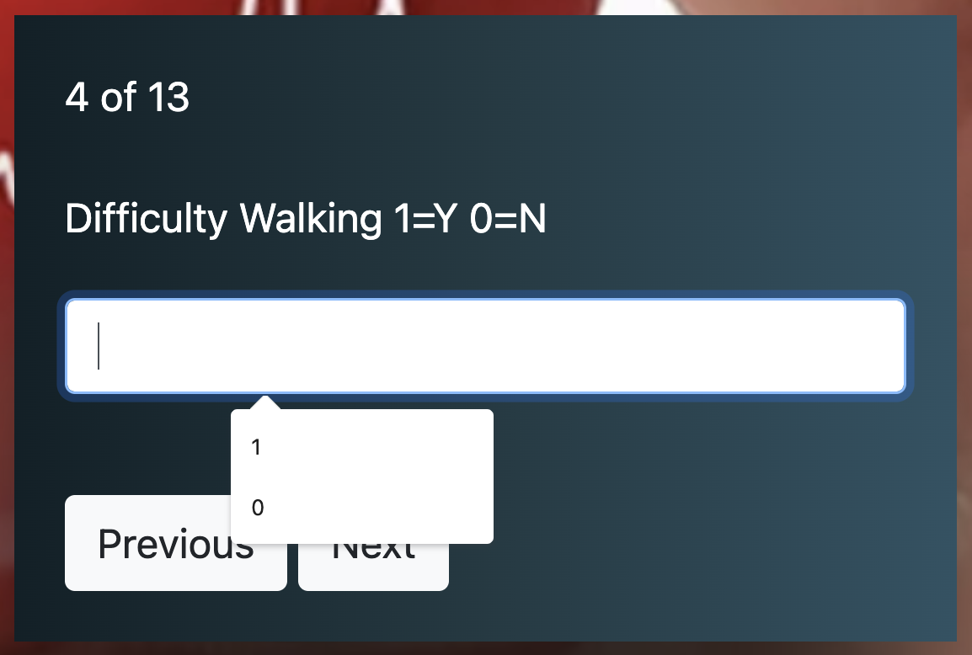
KEY CHALLENGES
DATA ANALYSIS
Large Data Set (440,000 rows by 330 columns
Domain Knowledge - BRFSS Codebook/clinician feedback
Locate and remove nulls/missing values/blanks/extraneous data
DATA SCIENCE
Binary structure (1 & 2)
Categorical coding (0 t0 14)
Logistic Regression Model not converging
Some weakness in model especially High Risk Recall
WEB DEVELOPMENT
Flask (return.html)
Navigation Bar
formWizard
USER EXPERIENCE
Modern
Interactive
Attends to precision
Turn off auto complete
Links

Slide 11
REFERENCES
Kaggle Dataset: Behavioral Risk Factor Surveillance System (2015)
https://www.kaggle.com/datasets/cdc/behavioral-risk-factor-surveillance-system?select=2015.csv
Behavioral Risk Factor Surveillance System 2015 Codebook Report
https://www.cdc.gov/brfss/annual_data/2015/pdf/codebook15_llcp.pdf

Slide 12
LIVE DEMONSTRATION OF THE APPLICATION!
Terryann: Project Structure
Michael: formWizard
Osman: OnClickSubmit

Slide 13
RECOMMENDATIONS FOR IMPROVEMENT
Improve features engineering/improve model performance
Develop for use on mobile devices
Develop for patient use

Slide 14

QUESTIONS/COMMENTS

